Slide 1
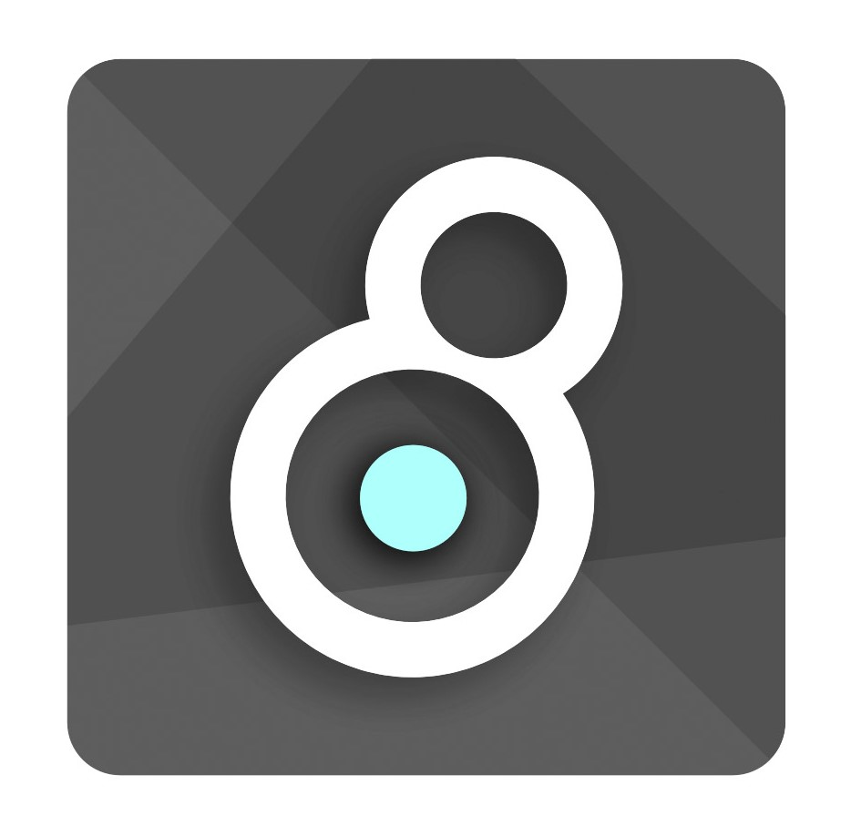
Max MSP
And the MIN-DEVKIT.
Nathan Berwick 15/10/2021

Slide 2
Important links
Min-devkit github: https://github.com/Cycling74/min-devkit
Min-documentation: http://cycling74.github.io/min-devkit/
My github for our examples: https://github.com/nathanberwick/min-devkit
(I just forked the repo and only included our examples in “source”)

Slide 3
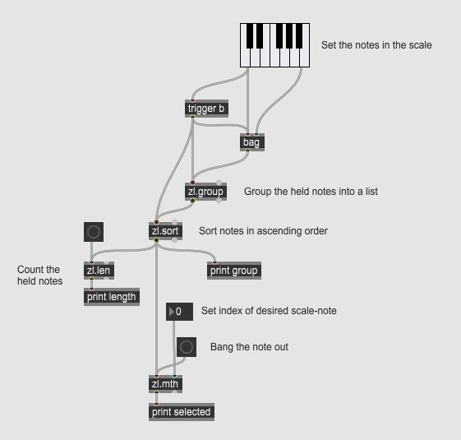
What on earth is max msp?
Total trash (according to all of its users).
Cool for niche audio setups.
Syncs super well with Ableton Live (a sortof DJ Daw?).

Slide 4
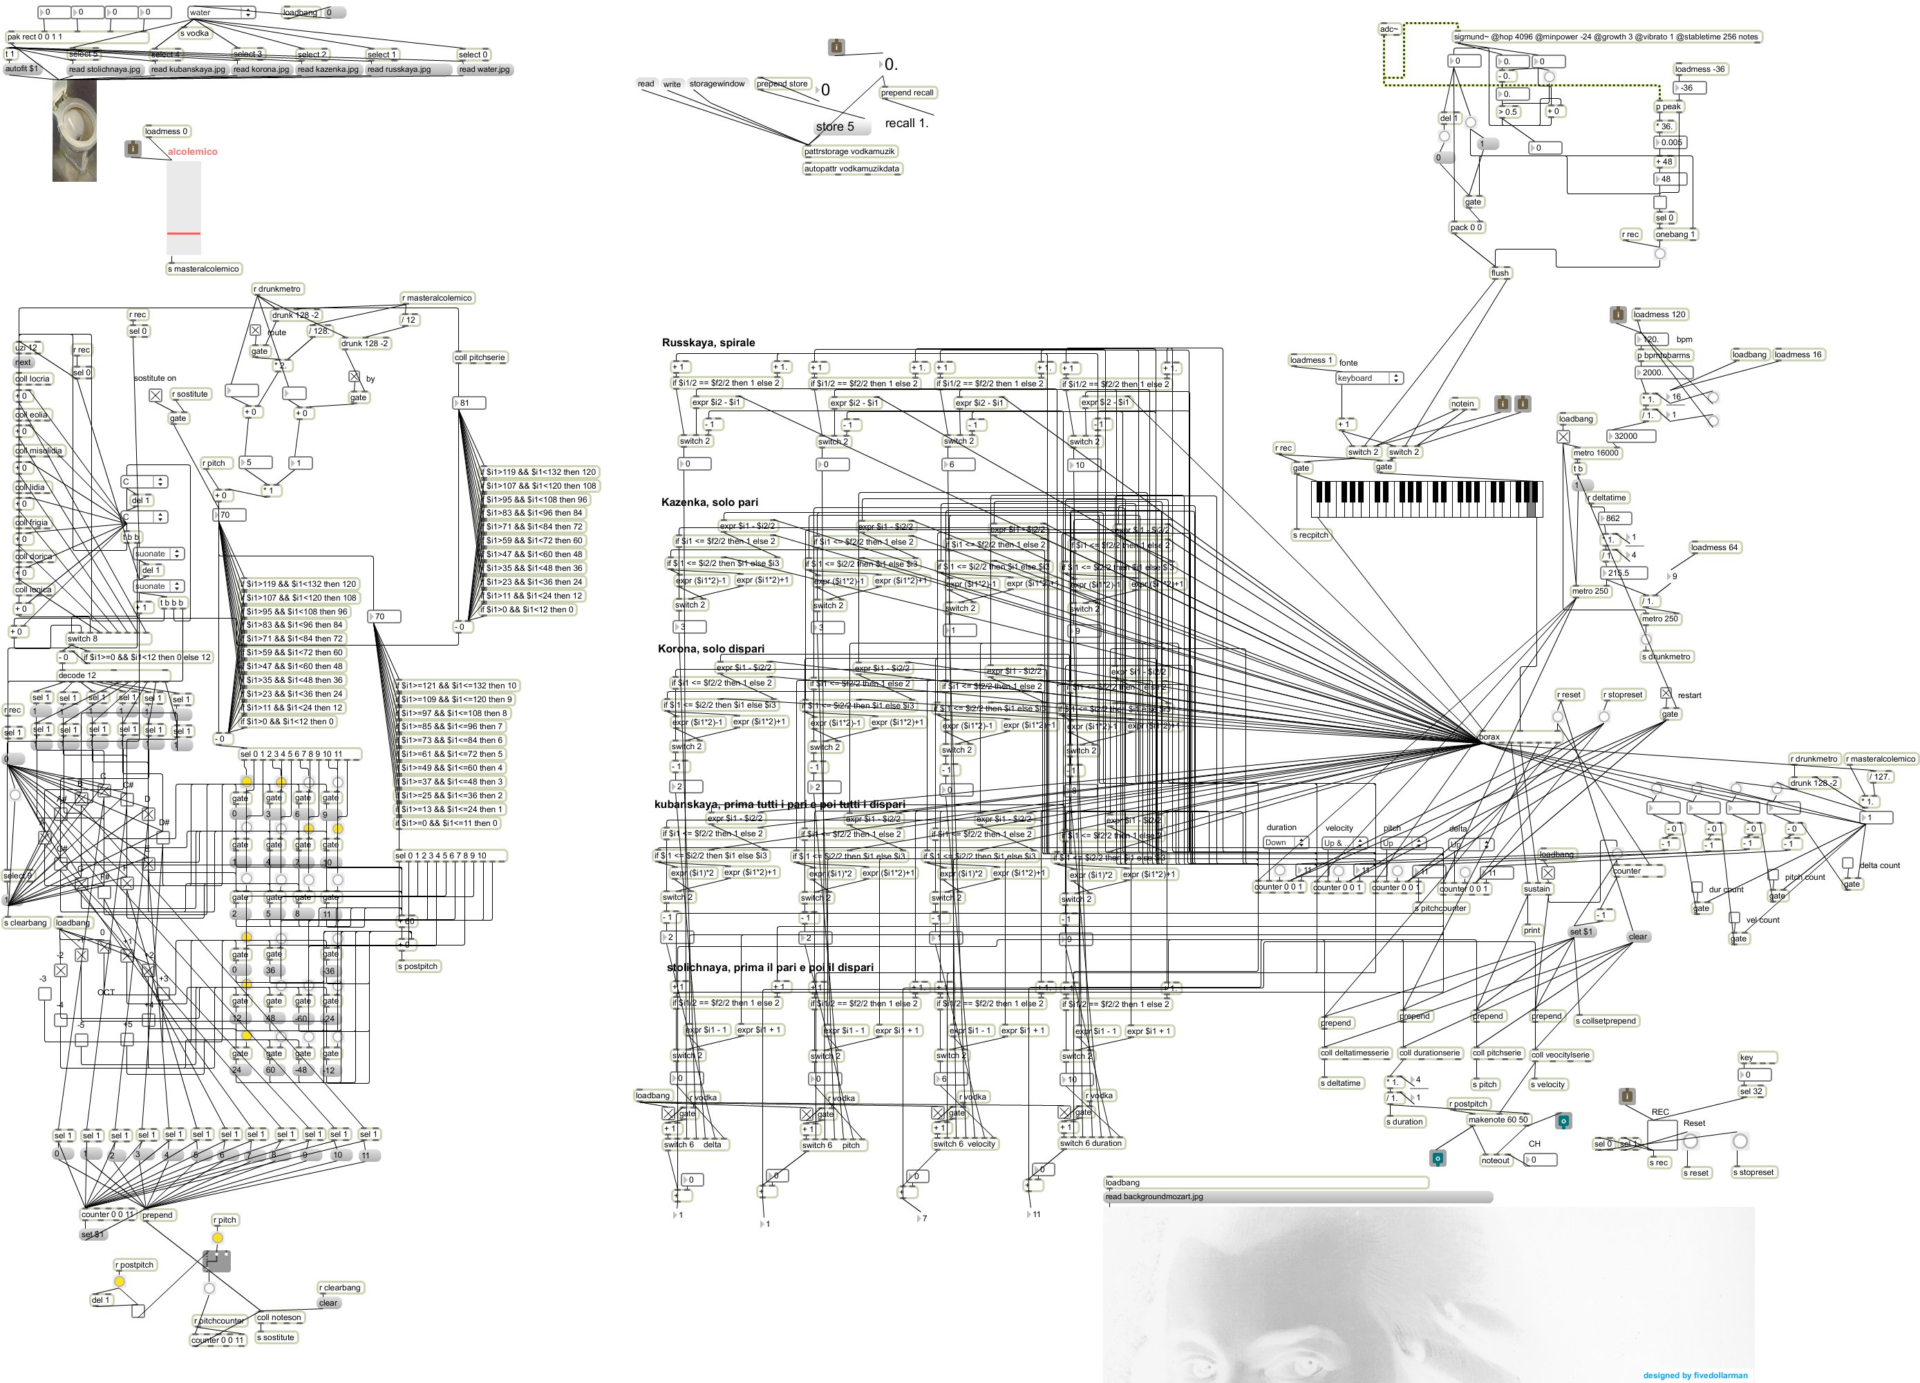
What is it good at?
Flexible routing.
Quick program writing (listening tests anybody?).
Audio applications quickly accessible in other systems (ableton link!).
Lots of other stuff that I don’t know about.

Slide 5
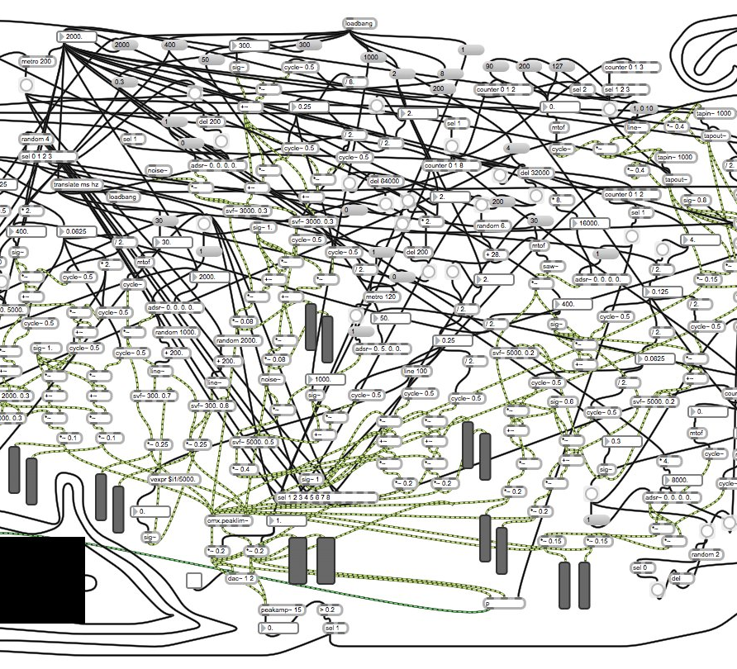
What is it bad at
Running without crashing.
Having native “objects” that just do what you expect.
Having good documentation.
Being sensible.
Doing what you expect.

Slide 6
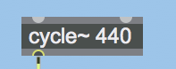
Into an individual object
Runs on a “message” kind of system.
Does something when it gets something (and also audio as a separate thing).
Inlets and outlets.

Slide 7
Inlets and outlets
Can be “signal” type (audio) or: int, float, list, bang, dictionary, matrix.
(full disclosure, I’ve only ever used bang, float, int, or signal).
Bang is like a hit of “do something”.
Dictionary is value pairs.
Priority: right to left.
Definition: left to right (in the min-devkit).
Inlets
outlets

Slide 8
Max devkit and min devkit
Max = C
Min = C++
Max, not so great documentation.
Min, less documentation.
We have more Max content than Min.
Let’s use the min devkit!

Slide 9
Min devkit project setup
Check out the min-devkit into documents/max 8/Packages
source/projects folder.
Make a subdir named “min.nameOfProject” so that the CMakeLists.txt can do its auto magic.
min.nameOfProject_tilde if you want audio processing.
min.nameOfProject.cpp inside.
Copy a CMakeLists.txt from an existing project (easier than DIY)…
Max encourages writing the whole thing in the .cpp.

Slide 10
Side note for clion
cmake -G Xcode
If you don’t use Xcode, for some reason it doesn’t seem to “detect stuff”.

Slide 11
Hello world
Let’s make an object that responds to a bang message

Slide 12
Processing audio
We can do this sample by sample (can I get a hell yeah DSP low latency?)
Or buffers (can I get a “well, that seems more reasonable”)
Debugging issues: (Max 8) with Clion and the DAC, it crashes. with Xcode, crashes on opening. can debug audio in Xcode, but only after opening. can’t debug audio in Clion.

Slide 13
Buffer – let’s make a stutter
When bang “bang flag == true”.
When true. Mute that frame.
Then reset to false.

Slide 14
Something useful.
A gain control.
Add an input parameter.
Constructor argument
Inlet argument

Slide 15
attributes
Example in the “hello world”.
Attrui object in Max or inspector.
Turn “gain” into a float attribute.
Handles the thread safety for you.
Max threading

Slide 16
Max threading
“audio rate” and “data rate”.
Data rate just sort of happens whenever you do something. z.B. bangs or change an inlet int/float.
Audio rate, when the DAC is active will keep circling itself at SampleRate/FrameSize per second.
Can also use “overdrive” to change threading
“Delay 0” object to put things into different thread.
More detail here: https://cycling74.com/tutorials/advanced-max-learning-about-threading

Slide 17
Other stuff!
.maxref.xml (the info displayed)
.maxhelp (a “help” project with an example or two)

Slide 18
Questions?

Slide 19
Important links
Min-devkit github: https://github.com/Cycling74/min-devkit
Min-documentation: http://cycling74.github.io/min-devkit/
My github for our examples: https://github.com/nathanberwick/min-devkit
(I just forked the repo and only included our examples in “source”)
ACE_MAX https://git01.iis.fhg.de/grp-mmc/ace_max

