Slide 1
A DATA ANALYTICS PRESENTATION · FOODPANDA RESTAURANT LISTINGS, 2025
Mapping the Philippine
Restaurant Landscape
Food-Type Diversity, Customer Engagement, and the Distribution of
Restaurant Listings Across Selected Philippine Cities
12,409 restaurant listings · 18 cities · 68 food-type categories

Slide 2
ROADMAP
What We'll Walk Through
01
Project Overview & Objectives
02
Dataset & Data Cleaning
Why this dataset, and what we set out to answer
From raw Foodpanda export to an analysis-ready table
03
Food-Type Diversity
04
Customer Engagement
How varied is each city's restaurant scene?
Ratings and reviewer activity across cities & food types
05
Listing Distribution
06
Relationships & Statistical Check
Where are restaurants concentrated?
Ratings vs. reviewers, and honesty about limits
02

Slide 3
To analyze the Philippine restaurant landscape across selected cities by examining food-type diversity, customer engagement, and the distribution of restaurant listings — using a dataset of Foodpanda restaurant listings collected in 2025.
GENERAL
OBJECTIVE
03

Slide 4
SPECIFIC OBJECTIVES
Six Objectives Guiding the Analysis
1
Assess, clean, and prepare the dataset — missing FoodType values, inconsistent text, repeated identifiers, unrated listings, and reviewer-count outliers — with every decision documented.
2
Quantify and compare food-type diversity across cities via the number of unique FoodType categories and their proportional representation.
3
Assess customer engagement by analyzing reviewer counts and average ratings among rated listings, across cities and food types.
4
Examine the distribution and concentration of listings across cities and food types using counts, proportions, and city-by-food-type summaries.
5
Explore relationships among diversity, distribution, reviewer activity, and ratings using descriptive statistics, group comparisons, correlation, and an inferential check — without claiming causation.
6
Communicate findings through 4–6 clearly labeled, honestly scaled, captioned visualizations with plain-language interpretation and limitations.
04

Slide 5
THE DATASET
Foodpanda Restaurant Listings, 2025
The raw dataset contains one row per restaurant listing as it appears on Foodpanda, with 6 original fields: a store identifier, store name, food-type category, average rating, reviewer count, and city.
Raw Columns
StoreId
Unique code for the store/brand
CompleteStoreName
12,409
6
18
68
Branch-level restaurant name
FoodType
Total listings
Raw columns
Cities covered
Food-type categories
Cuisine / category label
AverageRating
Star rating (0–5)
Reviewers
Number of ratings received
City
Listed city (raw text)
05

Slide 6
OBJECTIVE 1 · CLEANING & PREPARATION
Six Issues Found — and How Each Was Resolved
Missing FoodType
91 listings (0.7%) had no FoodType.
Filled as “Unspecified” — kept, not dropped, so no listing data is lost; excluded from food-type-specific views.
Inconsistent text
“Dim Sum ” had trailing whitespace.
Stripped whitespace from all FoodType values (68 categories confirmed).
Repeated identifiers
67 StoreIds shared by 134 rows (multi-branch/virtual-brand listings).
Flagged with a SharesStoreId column instead of deleting — each row is a real, distinct listing.
Unrated listings
3,037 listings (24.5%) have 0 reviewers / 0 rating.
Flagged via an IsRated column; excluded only from rating-based analysis, kept for listing counts.
City text formatting
18 raw city strings (e.g. “davao city davao del sur”).
Mapped to a clean City name + Province using PH geography knowledge.
Reviewer outliers
1,517 listings (12.2%) exceed the IQR upper fence.
Verified as legitimate major chains (McDonald's, Jollibee) — kept as real values, not errors.
06

Slide 7
OBJECTIVE 2 · FOOD-TYPE DIVERSITY
How Many Distinct Cuisines Does Each City List?
Key Takeaway
Quezon City lists the widest cuisine variety (63 food types), narrowly ahead of Davao City and Manila (62 each).
Valencia has the narrowest range (26), but it also has far fewer total listings overall — so raw category count is partly a function of sample size, not purely a cultural difference.
A Shannon diversity index (which also rewards evenness across categories) tells a similar story — Metro Manila cities lead on both raw count and evenness.
Chart 1. Food-Type Diversity by City (Unspecified excluded).
07

Slide 8
OBJECTIVE 3 · CUSTOMER ENGAGEMENT
Average Rating by City — A Surprisingly Narrow Band
Key Takeaway
The axis here is fixed at the true 0–5 scale, not zoomed in — and even so, average ratings cluster tightly between about 4.87 and 4.96 across every city.
City alone does not meaningfully separate restaurants on rating — the differences between the highest (Marikina City, 4.96) and lowest (Davao City, 4.87) are small in practical terms.
Chart 2. Average Customer Rating by City (unrated listings excluded).
08

Slide 9
OBJECTIVE 3 · CUSTOMER ENGAGEMENT
Which Food Types Rate Highest?
Reading This Chart
Restricted to food types with at least 30 rated listings, so a single 5-star stall with 2 reviews can't masquerade as “the best food type.”
Cakes tops the list at 4.98, followed by Bread and Donut at 4.97 — dessert and bakery categories dominate the top tier.
Just as with cities, the spread from top to bottom of this list is narrow (4.95–4.98) — food type is a weak differentiator of rating, same as city.
Chart 3. Top 10 Food Types by Average Rating (min. 30 rated listings).
09

Slide 10
OBJECTIVE 4 · DISTRIBUTION OF LISTINGS
Where Are Restaurant Listings Concentrated?
Key Takeaway
Quezon City alone accounts for 17.8% of all listings — more than the five smallest cities combined.
The top 5 cities (Quezon City, Manila, Makati, Cebu, Davao) together hold about 56.9% of all listings, while the smallest city, Valencia, accounts for just 0.5%.
This concentration matters for interpreting every other chart: small-city averages rest on far fewer listings and are inherently less stable (see Limitations).
Chart 4. Number of Restaurant Listings by City.
10

Slide 11
OBJECTIVE 4 · DISTRIBUTION OF LISTINGS
Which Food Types Show Up Most Often?
Key Takeaway
Filipino cuisine dominates with 1,657 listings (13.5% of categorized listings) — more than 1.5× the next closest category, Coffee (8.1%).
Milk Tea (6.4%) and Chicken (5.0%) round out the top four, reflecting well-known everyday Filipino food-delivery habits.
The top 15 of 68 categories shown here already cover the large majority of categorized listings — the tail of niche cuisines is long but thin.
Chart 5. Top 15 Food-Type Categories by Listing Count (Unspecified excluded).
11

Slide 12
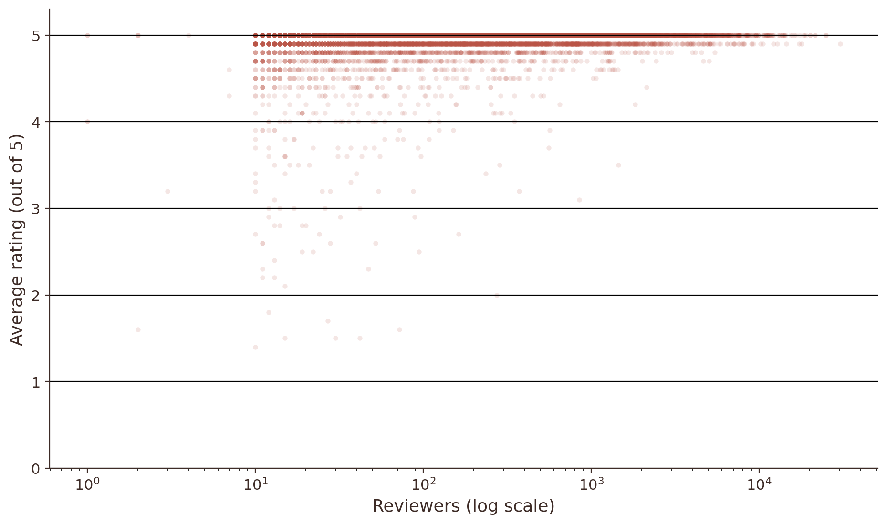
OBJECTIVE 5 · RELATIONSHIPS
Does Reviewer Volume Relate to Rating?
Pearson r
Spearman r
0.101
0.289
p = 1.0×10⁻²²
p = 3.5×10⁻¹⁸⁰
Spearman is the more appropriate measure here since Reviewers is heavily right-skewed and doesn't assume a linear, normally-distributed relationship.
Plain-Language Read
The relationship is small and positive — statistically significant only because the sample is large (n ≈ 9,372), not because it's strong. Reviewer count explains only a small fraction of the variation in rating.
This is a correlation, not a causal claim — it's equally consistent with “popular places get rated well” or “well-rated places attract more reviewers.”
Chart 6. Rating vs. Reviewer Count (rated listings only, n = 9,372).
12

Slide 13
OBJECTIVE 6 · HONEST REPORTING
Statistical Pitfall Check & Limitations
Misleading axes
Rating charts are fixed to the true 0–5 scale rather than zoomed in, which would visually exaggerate small city/food-type differences.
Correlation vs. causation
The rating–reviewer relationship (Objective 5) is explicitly reported as associational only, never causal.
Cherry-picking
Food-type rating comparisons exclude categories under 30 rated listings, so a single lucky 5-star stall can't pass as “best.”
Small-sample overconfidence
A city like Valencia (n=60) has a visibly wider, less trustworthy 95% confidence interval on its average rating than a large city like Quezon City (n=2,211) — not every city average is equally reliable.
Listings ≠ restaurants
134 rows share a StoreId (multi-branch or virtual-brand listings) — city listing counts should be read as menu/brand listings, not a literal restaurant census.
13

Slide 14
SYNTHESIS
Key Findings
1
Diversity varies by city
Metro Manila cities (Quezon City, Davao, Manila) lead in food-type variety, partly — but not entirely — because they simply have more listings.
2
Ratings are compressed
Average ratings sit in a narrow band (~4.87–4.96) across cities and food types alike — rating alone weakly differentiates either.
3
Engagement is right-skewed
A handful of national chains (McDonald's, Jollibee) pull the mean reviewer count far above the median — the median is the fairer “typical” figure.
4
Rating ↔ reviewers: weak link
Spearman r = 0.29 — statistically significant but practically small, and explicitly not causal.
5
Listings are concentrated
The top 5 cities hold roughly 57% of all listings, which also affects how much to trust any single city's average.
14

Slide 15
Thank You
Questions & Discussion
Mapping the Philippine Restaurant Landscape · Foodpanda Restaurant Listings, 2025

