Slide 1
Software Engineering Code of Ethics
John Eveland
John Hoffstatter
CIS 6516_011
Managing Software Projects and Personnel

Slide 2
Overview
Why need for code?
History of development
Initial draft(s) development
8 Fundamental Principles
Ratified code approved
8 Fundamental Principles Revisited
Preamble
Examples
Focus on #5 Management
Missing points

Slide 3
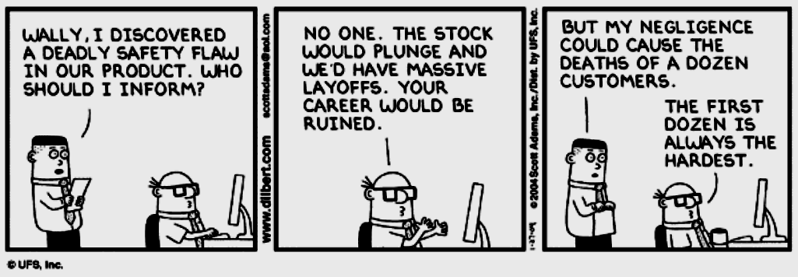
The need...

Slide 4
History
IEEE Board of Governors established steering committee (May, 1993).
ACM Council endorsed Commission on Software Engineering (Late 1993).
Joint steering committee established by both societies (January, 1994).

Slide 5
Joint Commission Steering Committee
4 goals:
  Adopt standard definitions.
  Define required body of knowledge and recommended practices.
  Define ethical standards.
  Define educational curricula for undergraduate, graduate (Masters), and continuing education (for retraining and migration).

Slide 6
Joint Commission Steering Committee
3 initial task forces:
  Software engineering body of knowledge and recommended practices.
  Software engineering ethics and professional practices.
  Software engineering curriculum.

Slide 7
Research
Review of available computing and engineering codes:
  The American Association of Engineering Societies
  Accreditation Board for Engineering Technology
  ACM’s Code of Ethics for Professional Conduct
  The British Computer Society Code of Practice
  Institute for the Certification of Computing Professionals
  Engineer’s Council for Professional Development
  The IEEE Code of Ethics
  National Society of Professional Engineers Code of Ethics
  Project Management Institute Code of Ethics

Slide 8
Brief History Timeline
January 1994 - International Task Force formed the Software Engineering Ethics and Professional Practice (SEEPP).
July 1997 - Initial version shown to professional societies including ACM’s SIGSOFT.
November 1997 - Version 3 published in IEEE-CS and ACM magazines.
Version 4 presented to IEEE review process.
October 1998 - Version 5.2 unanimously adopted by ACM and IEEE.

Slide 9
8 Key Principles:
Product
Public
Judgement
Client and Employer
Management
Profession
Colleagues
Self

Slide 10
The Published Proposal
“Software Engineering Code of Ethics”
by Gotterbarn, Miller, and Rogerson
(November 1997/Vol. 40, No. 11, Communication of the ACM)

Slide 11
Feedback
Numerous commentaries
Consensus discussions
ACM and IEEE surveys
Further review and modification

Slide 12
Code of Ethics Feedback Form
Sent to all software engineers with - concentrated on ACM or IEEE members.
All 8 principle areas surveyed.
Response options range:
Strongly Favor → Favor → Uncertain ← Oppose ← Strongly Oppose

Slide 13
Principle 1: Products
1.01 Ensure adequate software specification
1.02 Understand specifications fully
1.03 Ensure you are suitably qualified
1.04 Ensure all goals are achievable
1.05 Ensure proper methodology use
1.06 Ensure good project management
1.07 Ensure all estimates are realistic
1.08 Ensure adequate documentation
1.09 Ensure adequate testing and debugging
1.10 Promote privacy of individuals
1.11 Use data legitimately
1.12 Delete outdated and flawed data
1.13 Identify and address contentious issues
1.14 Promote maximum quality and minimum cost
1.15 Follow appropriate industry standards

Slide 14
Principle 2: Public
2.01 Disclose any software-related dangers
2.02 Approve only safe, well tested software
2.03 Only sign documents in area of competence
2.04 Cooperate on matters of public concern
2.05 Produce software that respects diversity
2.06 Be fair and truthful in all matters
2.07 Always put the public’s interests first
2.08 Donate professional skills to good causes
2.10 Accept responsibility for your own work

Slide 15
Principle 3: Judgement
3.01 Maintain professional objectivity
3.02 Only sign documents within your responsibility
3.03 Reject bribery
3.04 Do not accept secret payments from the client
3.05 Accept payment from only one source for a job
3.06 Disclose conflicts of interest
3.07 Avoid conflicting financial interests
3.08 Temper technology judgments with ethics

Slide 16
Principle 4: Client and Employer
4.01 Provide services only where competent
4.02 Ensure resources are authentically approved
4.03 Only use property as authorized by the owner
4.04 Do not use illegally obtained software
4.05 Honor confidentiality of information
4.06 Raise matters of social concern
4.07 Inform when a project becomes problematic
4.08 Accept no detrimental outside work
4.09 Represent no interests adverse to your employer

Slide 17
Principle 5: Management
5.01 Assure standards are known by employees
5.02 Assure knowledge of confidentiality protocols
5.03 Assign work according to competence
5.04 Provide due process for code violations
5.05 Develop fair ownership agreements
5.06 Accurately describe conditions of employment
5.07 Offer only fair and just remuneration
5.08 Do not prevent a subordinate’s promotion
5.09 Do not ask a person to breach this code

Slide 18
Principle 6: Profession
6.01 Associate with reputable people
6.02 Promote commitment of this code
6.03 Support followers of this code
6.04 Help develop an ethical environment
6.05 Report suspected violations of this code
6.06 Take responsibility for errors
6.07 Only accept appropriate remuneration
6.08 Be accurate and honest regarding software
6.09 Place professional interests before personal
6.10 Obey all laws governing your work
6.11 Exercise professional responsibility
6.12 Promote public knowledge of the subject
6.13 Share software knowledge with the profession

Slide 19
Principle 7: Colleagues
7.01 Assist colleagues in professional development
7.02 Review other’s work only with their consent
7.03 Credit fully the work of others
7.04 Review others work candidly
7.05 Give fair hearing to colleagues
7.06 Assist colleagues’ awareness of work practices
7.08 Do not hinder a colleague’s career
7.09 Do not pursue a job offered to a colleague
7.10 Seek help with work outside your competence

Slide 20
Principle 8: Self
8.01 Further your own professional knowledge
8.02 Improve your ability to produce quality work
8.03 Improve your ability to document work
8.04 Improve your understanding of work details
8.05 Improve your knowledge of relevant legislation
8.06 Improve your knowledge of this code
8.07 Do not force anyone to violate this code
8.08 Consider code violations inconsistent with
software engineering

Slide 21
The Code Adoption Published
“Software Engineering Code of Ethics is Approved”
by Gotterbarn, Miller, and Rogerson
(October 1999/Vol. 42, No. 10, Communication of the ACM)

Slide 22
Major changes between v3 and v5.2
The 8 principles reordered to show precedence
Short version added
Preamble significantly altered
  Defines software engineers
  Removed reference to 3 levels of obligation
  Stronger focus on standards to help the professional make ethical decisions

Slide 23
Preamble
“Software engineers are those who contribute by direct participation or by teaching, to the analysis, specification, design, development, certification, maintenance, and testing of software systems.”
Prevalence of software in society provide significant opportunities to do good or cause harm.
Ensure that efforts are used to do good.
Not intended to be applied piecemeal.

Slide 24
Preamble - continued
Not to be used to justify errors of omission or commission.
Not a simple algorithm to produce ethical decisions.
Software engineer must use judgment after thoughtful consideration of the 8 fundamental principles.
Always use the public interest as the highest and governing principle.

Slide 25
Short version, 1 of 2
1. PUBLIC - Software engineers shall act consistently with the public interest.
2. CLIENT AND EMPLOYER - Software engineers shall act in a manner that is in the best interests of their client and employer, consistent with the public interest.
3. PRODUCT - Software engineers shall ensure that their products and related modifications meet the highest professional standards possible.
4 . JUDGMENT - Software engineers shall maintain integrity and independence in their professional judgment.

Slide 26
Short version, 2 of 2
5. MANAGEMENT - Software engineering managers and leaders shall subscribe to and promote an ethical approach to the management of software development and maintenance.
6. PROFESSION - Software engineers shall advance the integrity and reputation of the profession consistent with the public interest.
7. COLLEAGUES - Software engineers shall be fair to and supportive of their colleagues.
8. SELF - Software engineers shall participate in lifelong learning regarding the practice of their profession and shall promote an ethical approach to the practice of the profession.

Slide 27
Examples
Brief example of specific points
Not comprehensive

Slide 28
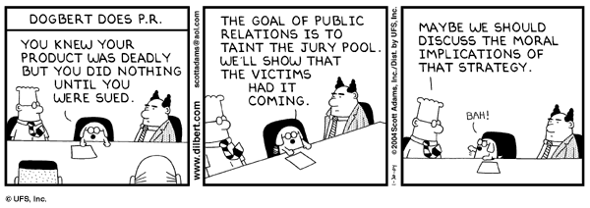
Public
1.04. Disclose to appropriate persons or authorities any actual or potential danger to the user, the public, or the environment, that they reasonably believe to be associated with software or related documents.

Slide 29
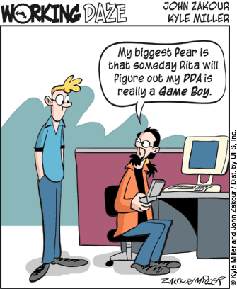
Client & Employer
2.09. Promote no interest adverse to their employer or client, unless a higher ethical concern is being compromised; in that case, inform the employer or another appropriate authority of the ethical concern.

Slide 30
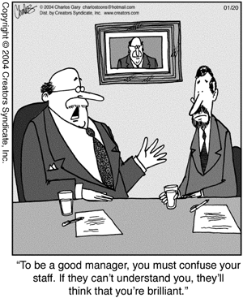
Management
5.01 Ensure good management for any project on which they work, including effective procedures for promotion of quality and reduction of risk.

Slide 31
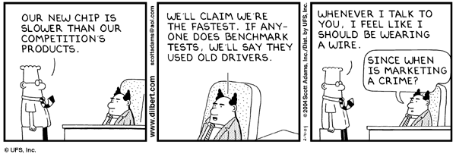
Profession
6.07. Be accurate in stating the characteristics of software on which they work, avoiding not only false claims but also claims that might reasonably be speculative, vacuous, deceptive, misleading, or doubtful.

Slide 32
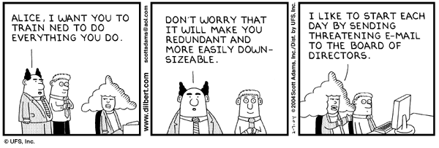
Colleagues
7.02. Assist colleagues in professional development.

Slide 33
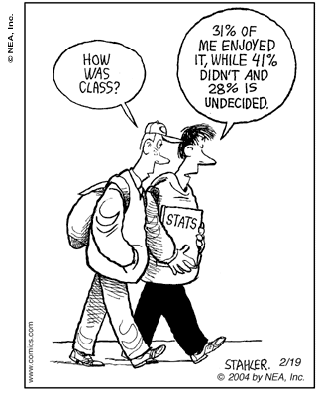
Self
8.01. Further their knowledge of developments in the analysis, specification, design, development, maintenance, and testing of software and related documents, together with the management of the development process.

Slide 34
More on Management
Software engineers need to know the standards which they are held to
Know policy for protecting confidential information
Assign work after considering each individual’s skills
  Principle of team balance*
Provide realistic quantitative estimates
  Function points & SLOC*
  Well defined cost models such as COCOMO*

Slide 35
Even more on management
Fair compensation
Don’t prevent someone’s promotion if he/she is qualified
  Good programmers don’t always make good managers*
  Let the person progress if he shows the aptitude
Don’t punish someone for expressing ethical concerns

Slide 36
Missing from the Code
Where to get help in a dilemma?
Who to report violations to?
Where to get advise and support in a confrontation with employer?
Consequences of violating the code?
Client and Employer – what do you do if their interests conflict?
Provisions for updating the Code

Slide 37
Summary
Why need for code?
History of development
Initial draft(s) development
8 Fundamental Principles
Ratified code approved
8 Fundamental Principles Revisited
Preamble
Examples
Focus on #5 Management
Missing points

Slide 38
Helpful sites:
ACM Professional Code of Conduct
  http://www.acm.org/constitution/code.html
ACM Software Engineering Code of Ethics http:/www.computer.org/tab/seprof/code.htm
ACM Public Policy Statements
  http://www.acm.org/usacm

Slide 39
References
Gotterbarn, D., Miller, K., Rogerson, S., “Software Engineering
Code of Ethics”, Communications of the ACM 40, 11 (Nov. 1997),
pp. 110-118.
Gotterbarn, D., Miller, K., Rogerson, S., “Software Engineering
Code of Ethics is Approved”, Communications of the ACM 42, 11
(Oct. 1999), pp. 102-107.
Gottenbar, D. “A Positive Step Toward a Profession: The Software
Engineering Code of Ethics and Professional Practice”, AMC
SIGSOFT Software Engineering Notes 24, 1 (Jan. 1999), pp. 9-14

