Slide 1


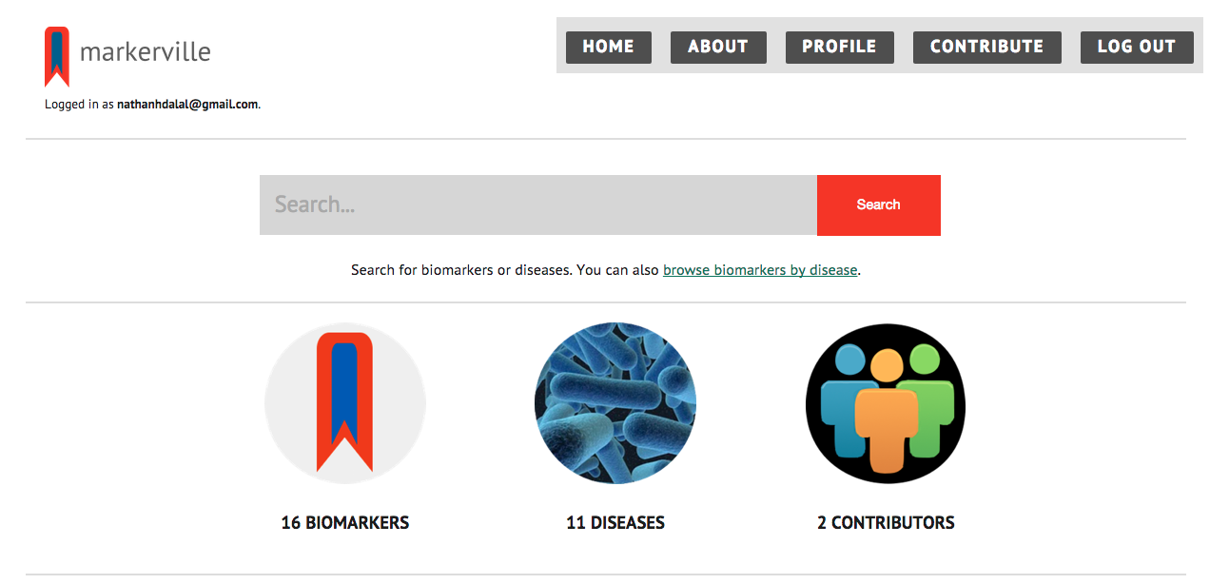
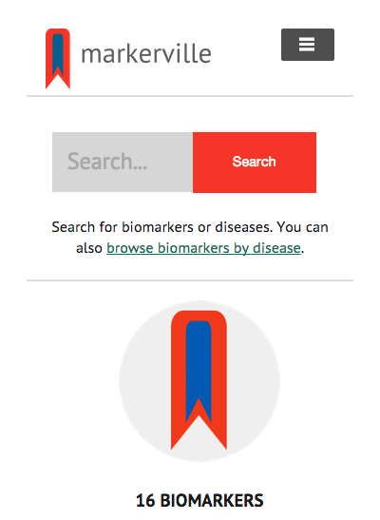
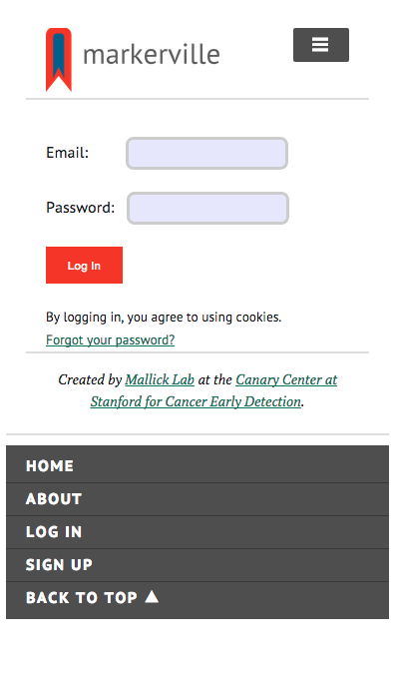
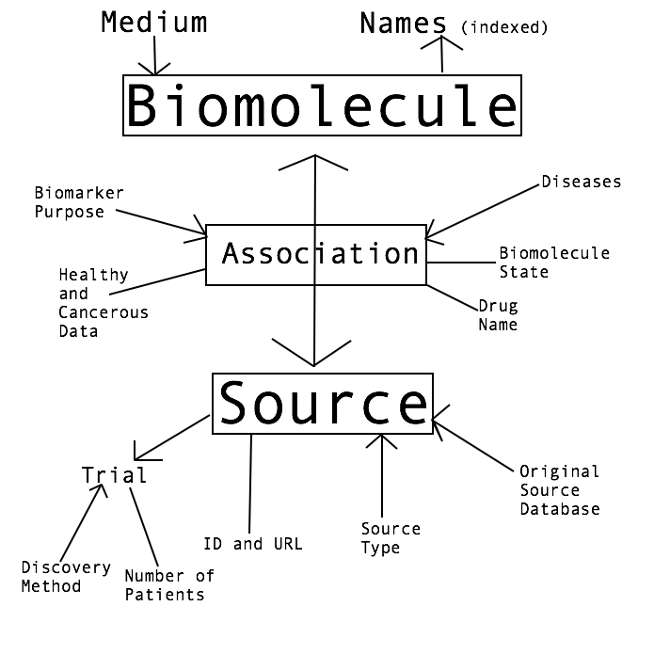
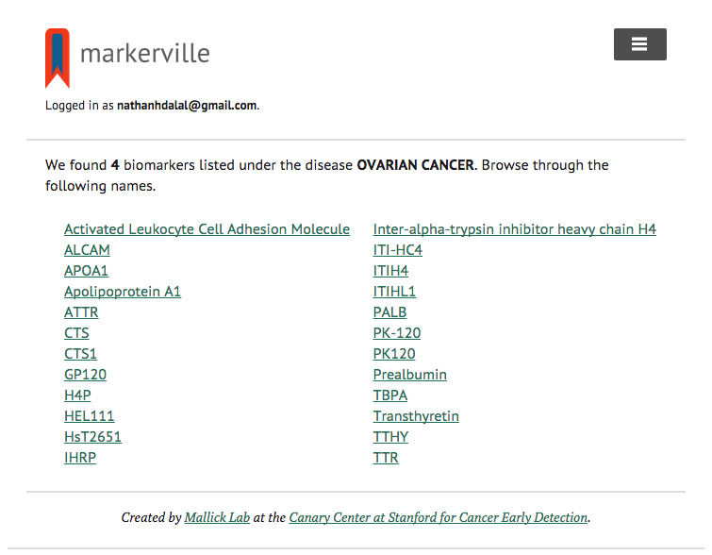
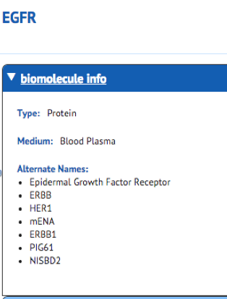
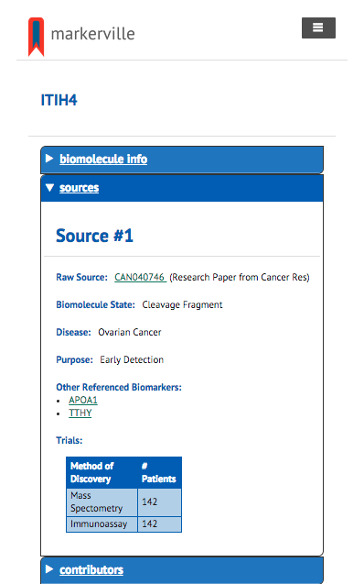


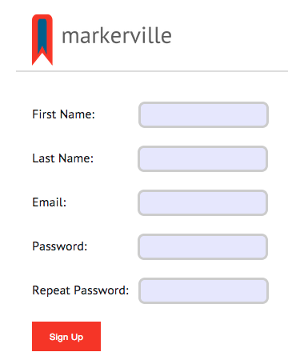
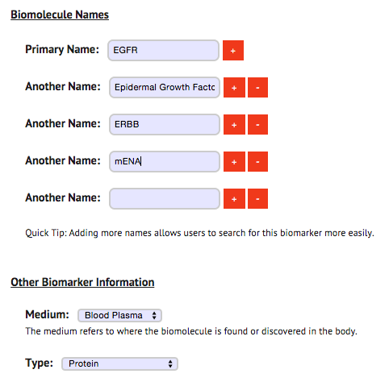
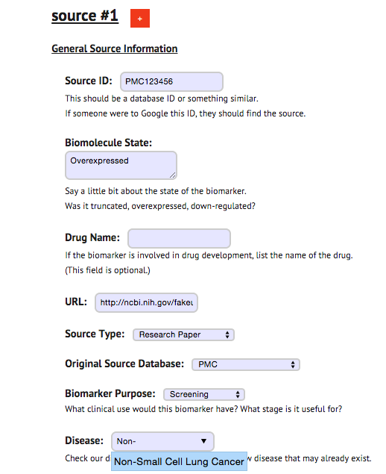




-
Markerville:
Creating a Biomarker Database Website for the Discussion and Verification of Biomarkers
2015 Internship program supported by:
Nathan Dalal (PM), Mythri Ambatipudi, Justin Carden, Dr. Parag Mallick, Ph.D.
Introduction
Implementation
Database Structure
Biomarkers are objective indicators for the progress of biological events or progress[1]. They serve several predictive purposes:
Their presence can reflect drug efficacy or disease prognosis.
They can help explain the results of clinical trials, and they can even show the stage of disease of specific patients.
They serve as artificial indicators or surrogate endpoints to replace clinical endpoints, or a certain biological outcome.
Biomarkers can be proposed through large clinical studies, statistical correlation, or wet-lab work, and verifying the efficacy of biomarkers is a very difficult process, as evidenced by the reluctance of the FDA to approve biomarkers into clinical use. To date, only 18 protein cancer biomarkers have been approved by the FDA [2].
However, biomarkers are almost always not final proof of a particular clinical endpoint.
Objectives
Create Markerville, a biomarker forum for scholars and researchers to discuss the discovery and verification of various biomarkers.
Present comprehensive list of information about various biomarkers, organize biomarker data and make biomarker research more accessible to users.
Create relational database structure for biomarkers based on features of biomarkers (mutations, biochemical properties, body levels, etc.). These proteins will be linked to several diseases and papers.
Create an account system and a user interface for users to enter their own information about various biomarkers, using a Wikipedia-like system and allowing editors to populate the Markerville platform.
Markerville was designed with mobile application usage in mind. We can see the user interface of the home screen changes depending on screen size (left, right). The navigation menu shows up at the bottom for small screens (far left).
Methods and Materials
Information is presented to the user in several formats. Searching for a biomarker yields general information, like its medium and alternate names (right). It also displays information about sources linked to biomarkers (far right). Searching for diseases yields a disambiguation of biomarkers (left).
A line between two entities describes a one-to-one relationship.
An arrow represents a one-to-many relationship, with the arrowhead characterizing many.
A two-sided arrow describes a many to many relationship.
Developer Tools
Built using …
Conclusions and Further Directions
Lessons
Learned how to create a database structure, learning the importance of primary keys, foreign keys, and indexes.
Learned how to create a web server from the ground up using Node.js and Express.
Learned how to manage HTTP request and create dynamic webpages using view engines.
Learned information about various biomarkers, and how to display critical information about biomarkers that researchers need.
Learned how to work in a team, use our strengths together, and create a product.
with the help of …
Editing information in Markerville is paramount to its success. Users can create an account and log in (left). Then they can contribute to the website by entering information about biomarkers that do not yet exist on Markerville (right, far right).
Future Directives
Allow users to edit existing entries and delete obtrusive entries, all while managing edit history.
Allow users to annotate biomarkers and sources to provide more contextual information.
Reform database structure to allow for bulk data entry about hundreds of biomarkers.
Release the site on www.markerville.org, reaching out to users and learning what they need.
Over 8000 lines of code
References
Acknowledgements
Biomarkers Definitions Working Group. Biomarkers and surrogate endpoints: preferred definitions and conceptual framework. Clin Pharmacol Ther 69, 89–95
(2001).
We would like to the thank the Canary Center, as this project would not be possible without them.
Pavlou, M. P., Diamandis, E. P. & Blasutig, I. M. The long journey of cancer biomarkers from the bench to the clinic. Clinical Chemistry 59, 147–157 (2013).
We would like to thank Mallick Lab, especially Justin Carden and Dr. Mallick, for providing advice and help.
Notes:
Copyright Colin Purrington (http://colinpurrington.com/tips/academic/posterdesign).

