Slide 1
Evaluation Project
Nathan D'Angelo
Mississippi Coding Academies- Biloxi
Notes:
Associates, 2013

Slide 2
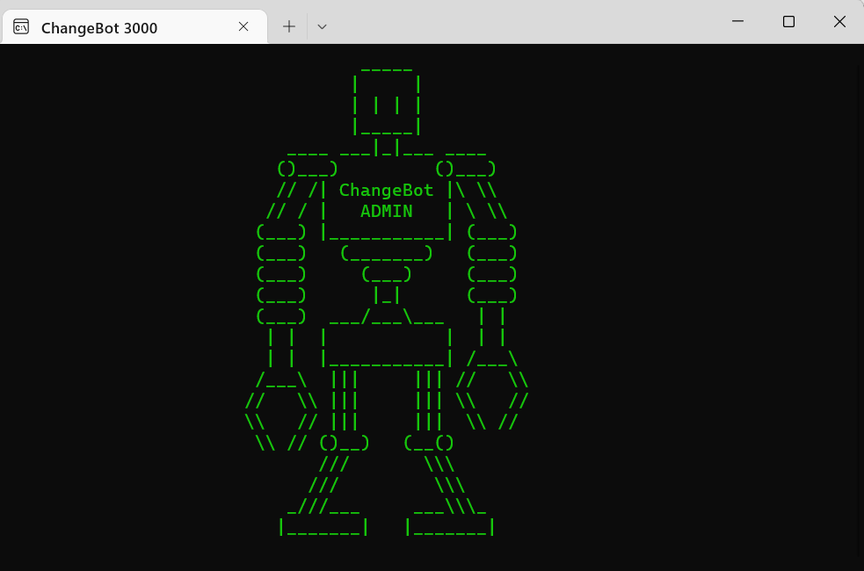




Presenter- Nathan D'Angelo
Senior Cohort
B.A.Sc., Applied Technology, May 22, The University of Southern Mississippi
Computer Network Technology, MGCCC 2013
Cisco NetAcad Graduate

Slide 3
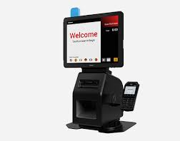
Self-Checkout Kiosk
Tally Items
Manage Cash Drawer
Process Transactions
Accept Payments
Issue Change/Cash Back
Log Transactions

Slide 4
OVERVIEW
The Design
The Details
The Application

Slide 5
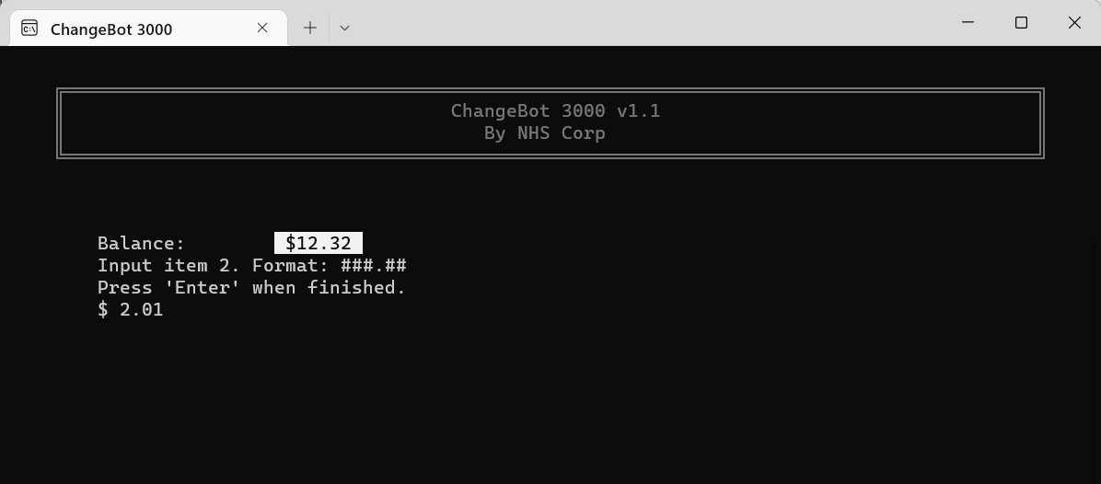
The Design

Slide 6
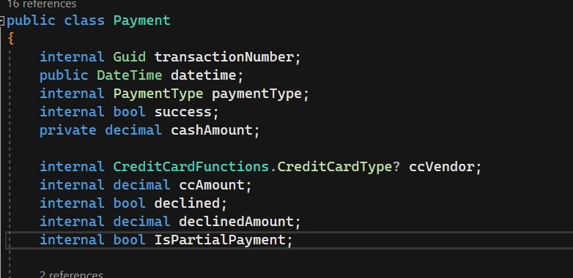
Paradigm: Mix of Functional and Object-Oriented Programming
Classes
Transaction Class
Objects
Transaction No. 0852341
Payment Class
Payment 02- AMEX****
Notes:
Things are broken down into classes and functions
Classes: Blueprints for objects
Objects: Instance of a class

Slide 7
The Flow
Dispense Change/ Cash Back
Enter Items
Make Payments
Add to Transactions List
Logging Program
Add to
Payments List
Transaction Created
Log
On Startup
Admin
Cash Drawer

Slide 8
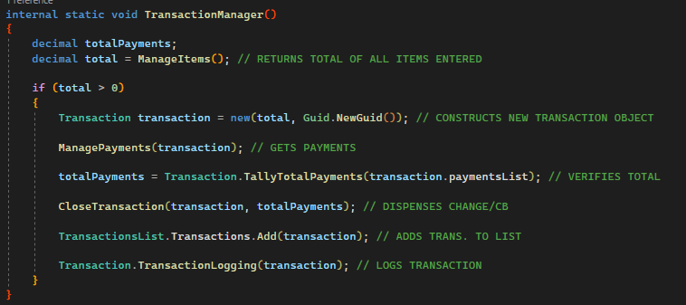
Managing the Flow- TransactionManager()
Notes:
Controls the flow and abstracts away the inner workings

Slide 9
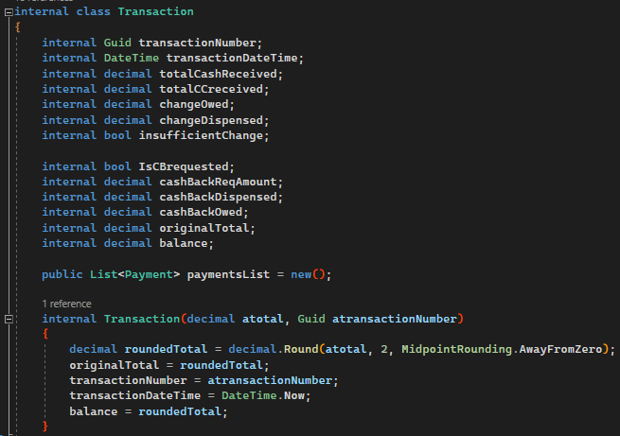
The Transaction Class
Maintains balance, cash received, etc.
Each trans. identified by GUID
Each payment stored in ‘paymentsList’
Constructor to instantiate new transaction objects
Notes:
The transaction class keeps track of each transaction

Slide 10
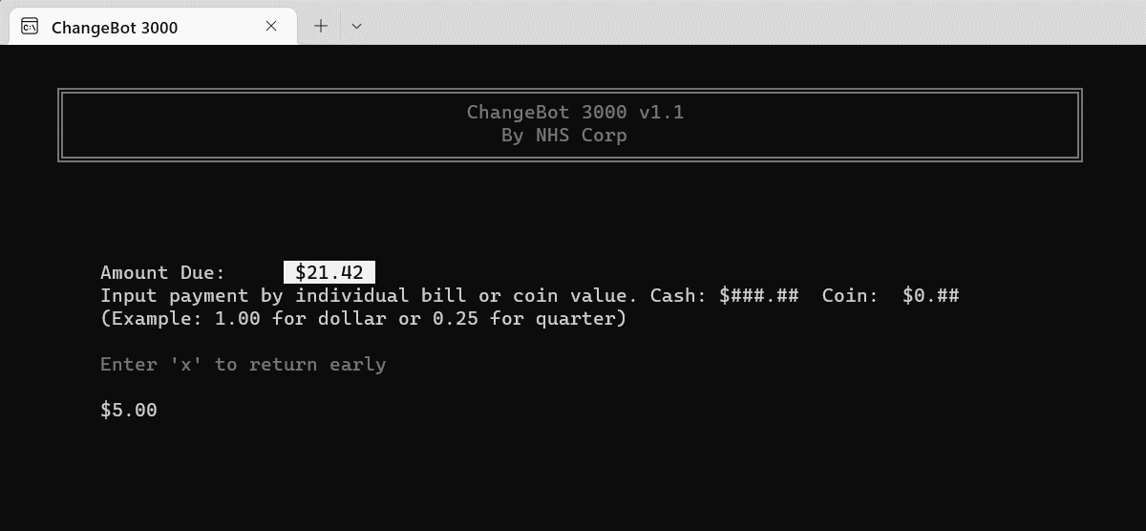
Managing Payments

Slide 11
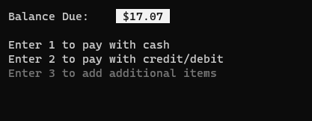
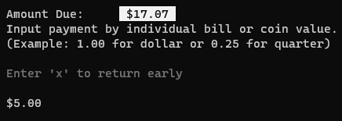
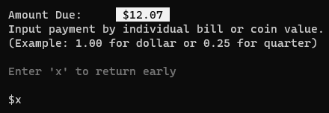
Managing Payments
Cash or Card accepted
User permitted to:
Add items to purchase
Make Partial Cash Payments
Add items after partial payments
User not permitted to:
Pay in cash AFTER Cash Back is requested (Pg.2,req.3)

Slide 12
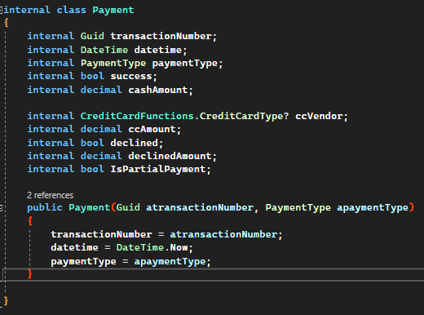
The Payments Class
Transaction number matches parent transaction
Each payment saved to list stored in the parent transaction
Instantiated with constructor
Notes:
To model a payment we have the payments class.

Slide 13
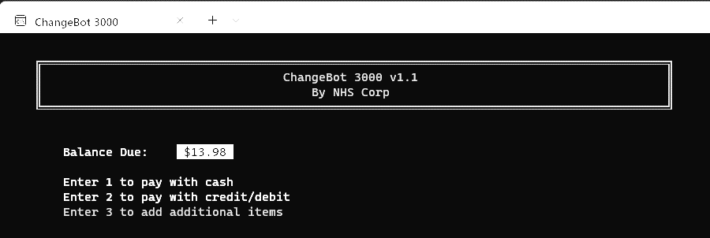
Handling Cash

Slide 14
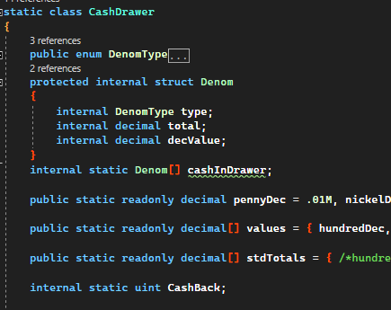
The Cash Drawer Class
Static- i.e., can’t be instantiated
Denom struct- models a currency.
Denom[] ‘cashInDrawer’ represents the state of the cash drawer.
‘CashBack’ uint- holds the cash back increment.
Notes:
To model a cash drawer, I used an array of structs and a parallel array

Slide 15
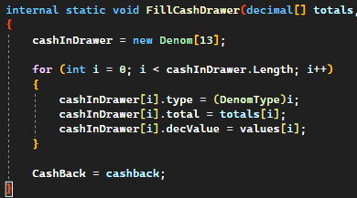
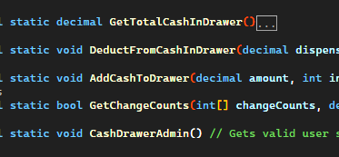
The Cash Drawer- continued…
Pseudo-”Constructor”
Static Methods

Slide 16
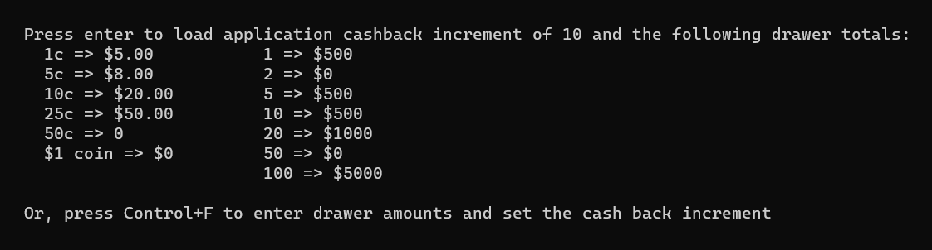
Administration
At Startup,
User can enter cash back increment and cash drawer amounts or accept standard values
Notes:
Drawer totals and Cash Back Increment

Slide 17


Page 1-Req.1: Keep track of each denomination
Notes:
Example of a $5 Cash Payment, Per Requirements

Slide 18
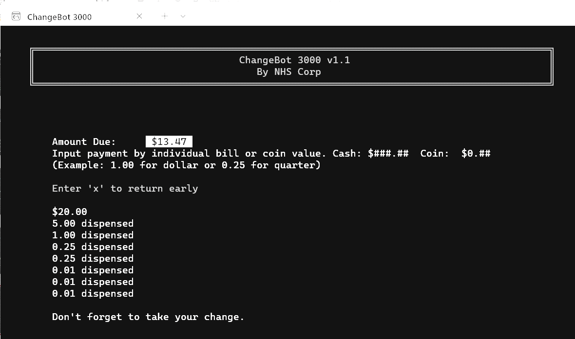
Making Change

Slide 19
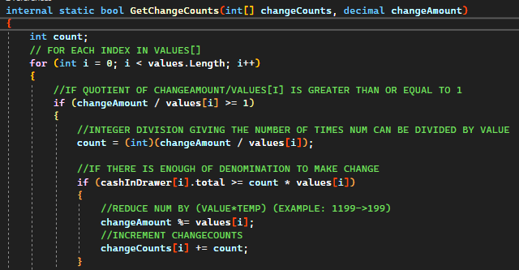
Greedy Algorithm
Notes:
Greedy Algo to get change counts, uses ‘values’ Array which is parallel to the ‘changeCounts’ array.

Slide 20
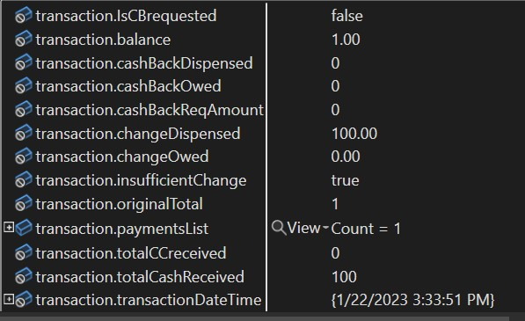
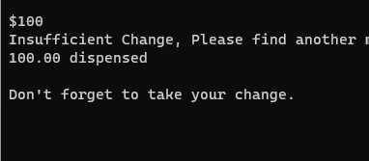
Insufficient Change- Page 1 Req. 4
1. Cash is refunded.
2. CC payment is requested.

Slide 21
Credit Card Transactions

Slide 22
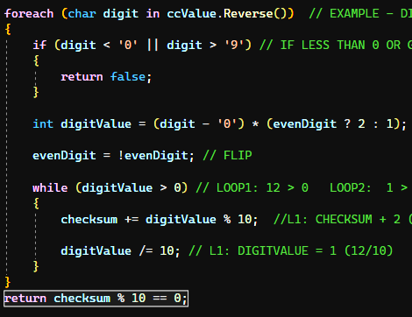
Validating Credit Cards
Luhn Algorithm
AKA ‘Mod 10’ Algorithm
Checksum formula for validation
Used to check for mistyped or incorrect numbers
Source: Wikipedia/luhn_algorithm

Slide 23
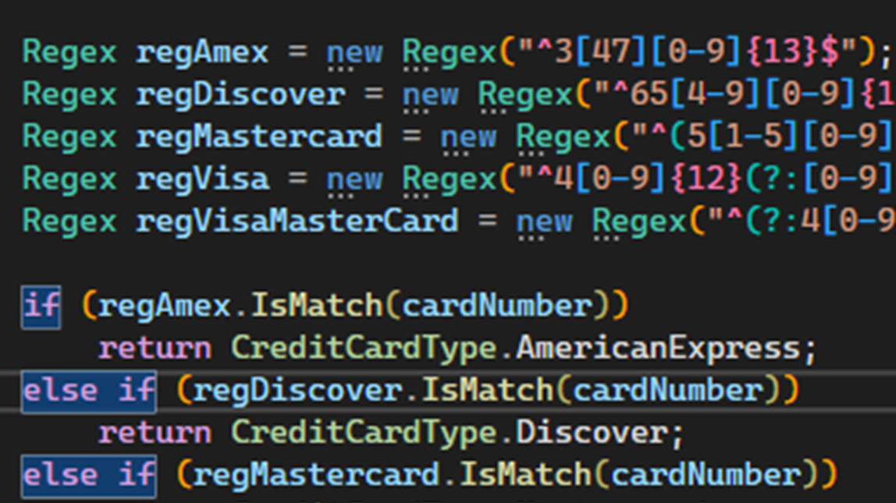
Validating Credit Cards
Regular Expressions
AKA Regex
Sequence of characters that specifies a search pattern in text
Used to get the vendor
Example:
VISA= ^4[0-9]{12}(?:[0-9]{3})?$

Slide 24
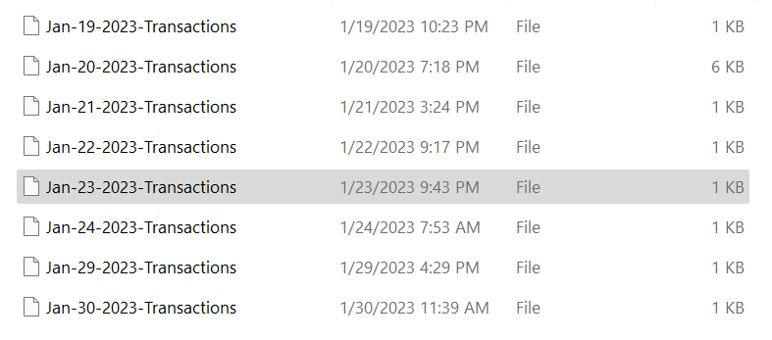
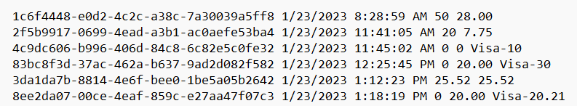
Logging

Slide 25
Lessons Learned
Beware code you don’t fully understand
Git can be confusing
An application is never done
Notes:
Putting together a plan, finding answers when you need them, and debugging are the real challenge.

Slide 26
The Application

Slide 27
“When I wrote this code, only God and I understood what I did. Now only God knows.” - Anonymous

