Slide 1
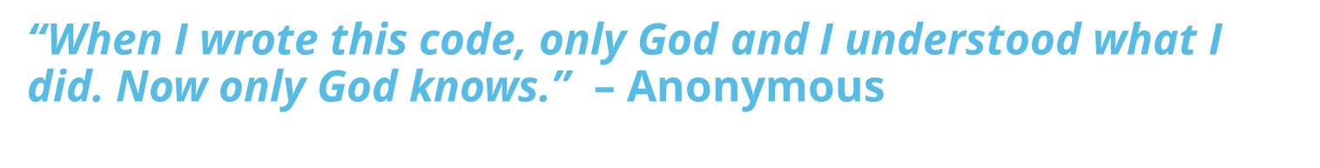
Evaluation Project
Nathan D'Angelo
Mississippi Coding Academies-Biloxi

Slide 2




About Me
Presenter- Nathan D'Angelo
B.A.Sc., Applied Technology, May'22, The University of Southern Mississippi
Computer Network Technology, MGCCC 2013
Cisco NetAcad Graduate

Slide 3
The Project:
Tally Items
Manage Cash Drawer
Process Transactions
Issue Change/Cash Back
Log Transactions
Self-Checkout Kiosk
Notes:
Added Functionality:
Accepts multiple forms of payment
Allows the addition of items to transaction

Slide 4
OVERVIEW
Logic & Code
The Design
The Details
The Application

Slide 5
The Design
“Code is like humor. When you have to explain it, it’s bad.” – Cory House

Slide 6
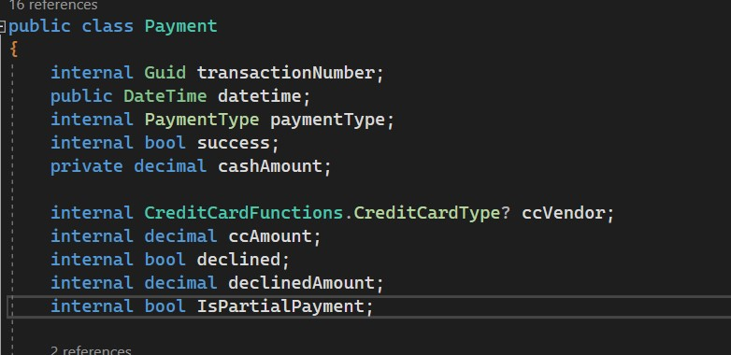
Paradigm: Object-Oriented Programming
Classes
Transaction Class
Objects
Transaction No. 0852341
Payment Class
Payment 02- AMEX****
Notes:
exploring OOP lately,
With OOP, we can model more complex data
Classes: Blueprints for objects, often modeling real-life concepts
Objects: Instance of a class

Slide 7
Design
Admin
Cash Drawer
Transactions List
Logging Program
Log
Transaction
Change/Cash Back
Payments List
Payments
Cash
Card
Notes:
Transaction Class is the functional heart.

Slide 8
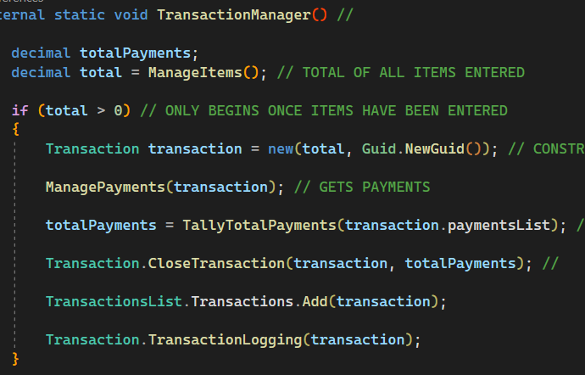
Managing the Flow- Transaction Manager
1.
2.
3.
4.
5.
6.
Notes:
High-level abstraction
Balance equal to total of items
Create Transaction, with Globally Unique Identifier(may be overkill). As seen in the previous slide, each transaction may have multiple payments
4. TallyTotalPayments is a redundant check
Close, dispense change or cashback THEN Log

Slide 9
Handling Cash
“My money don’t giggle, giggle… if FOLDS.” – Louis Theroux

Slide 10
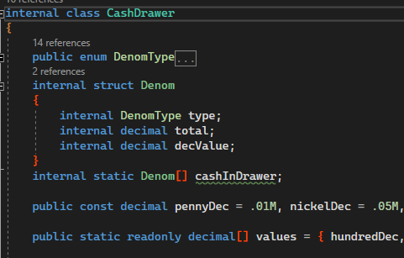
Cash Handling- The Cash Drawer
Notes:
To model a cash drawer, I used an array of structs and decimal values.

Slide 11
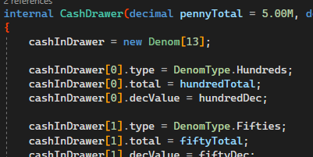
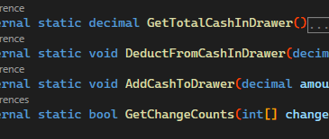
Cash Handling- The Cash Drawer
Parameterized Constructor
Class Methods

Slide 12


Pg.1.Req.1- Keep track of each denomination
Notes:
Example of a Cash Payment, Per Requirements

Slide 13
Making Change
“Code is like humor. When you have to explain it, it’s bad. – Cory House

Slide 14
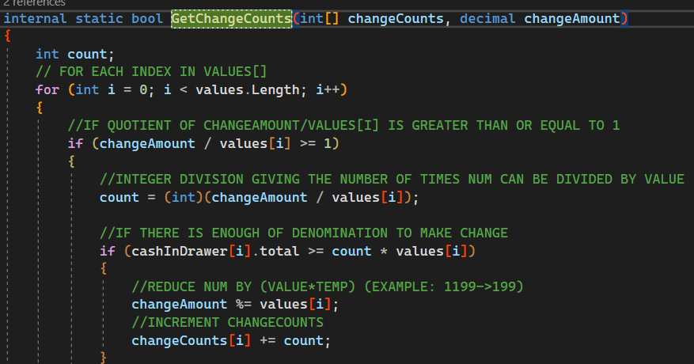
Greedy Algorithm
Notes:
Greedy Algo to get change counts, uses values Array which is parallel to the change counts array.
Indices matchup

Slide 15
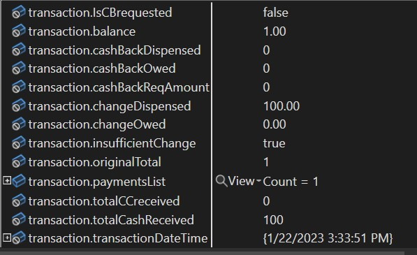
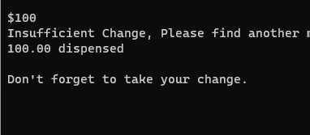
Insufficient Change- Page1 Req4
1. Cash is refunded.
2. CC payment is requested.

Slide 16
Credit Card Transactions
“A lot of fun… until you get the bill.” – Christopher Parker

Slide 17
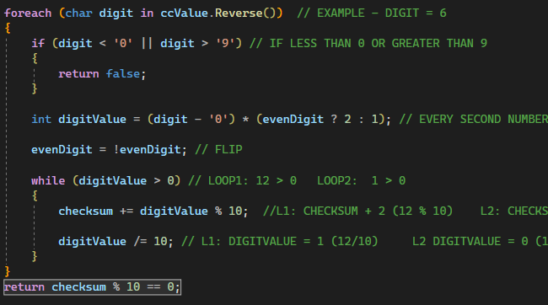
Pg2.Req1- Validating Card Numbers- Luhn Algorithm

Slide 18
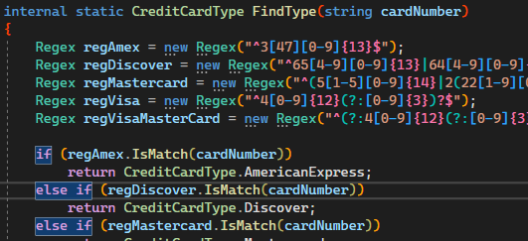
REGEX To Identify Card Vendor
Adapted from: A. Petrov https://stackoverflow.com/a/67286217/20159913

Slide 19


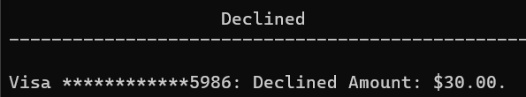
Cash Back & Declined Payments

Slide 20
Time Breakdown

Slide 21
Lessons Learned
Coding is the easy part
Beware code you don’t fully understand
Git can be confusing
A Program is never done
Notes:
Get Revert, Reset, Add, Push, Commit

