Slide 1
RNC

Slide 2
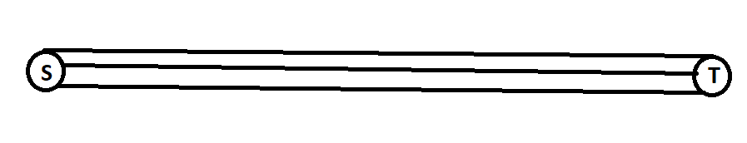
Proposed
A procedure for implementing broadcasting with RNC in wireless ad hoc networks.
Several edge disjoint paths must be established between a source node to every destination node.

Slide 3
Working
Source Node transmits several packets with same sequence number but different coding vectors.
Intermediate nodes relay one coded packet for each sequence number.
With RNC there is a possibility that encoded packets cannot be decoded to the original packets

Slide 4
Wireless Ad hoc with RNC
There are there types of Nodes:
Source – Transmits Original packet
Intermediate - encoded multiple packets together.
Receiver – Retrieves original packets from received packets.

Slide 5
Implementation Issues
What if a coding vector is permanently assigned to each intermediate node?
There exist a possibility that some node always receives packets with invalid coding vectors and they can never decode received packets.

Slide 6
Simplified Network Coding
It was chosen for multicast in wireless networks.
Here the same coding vector is assigned to all nodes.
Each intermediate node encodes received packets with the vector and relays it to all neighbouring nodes.

Slide 7
What if only N packets are decoded?
Then the node relays a packet encoded with a new vector.
Thus when it is used not necessary that all packets can be decoded.

Slide 8
To decode N packets a receiver should know their coding vectors.
This is shared by embedding them in the packet header.

Slide 9
Operation Of Source Node
Ideally the receiver should receive N packets to retrieve the original packets.
Thus, the source divides information into N packets and assigns the same sequence number to every N packets.
Then it encodes the k-th packet in each group with an associated coding vector
The neighbouring node can decode received packets correctly

Slide 10
Operation Of receiver nodes
If a received packet at a receiver has the same sequence number as previously retrieved packets, the node discards it.
If not, it is stored in a buffer.
When N packets are gathered with same sequence number, it tries to decode those packets in order to retrieve the original packet

Slide 11
How Does COPE work?
Network designers use wireless channel as a point-to-point links, and perform forwarding and routing techniques.
Also, COPE exploits the broadcast property of radios instead of hiding it under an artiﬁcial abstraction.
allows the routers to mix the information content in the packets before forwarding them

Slide 12
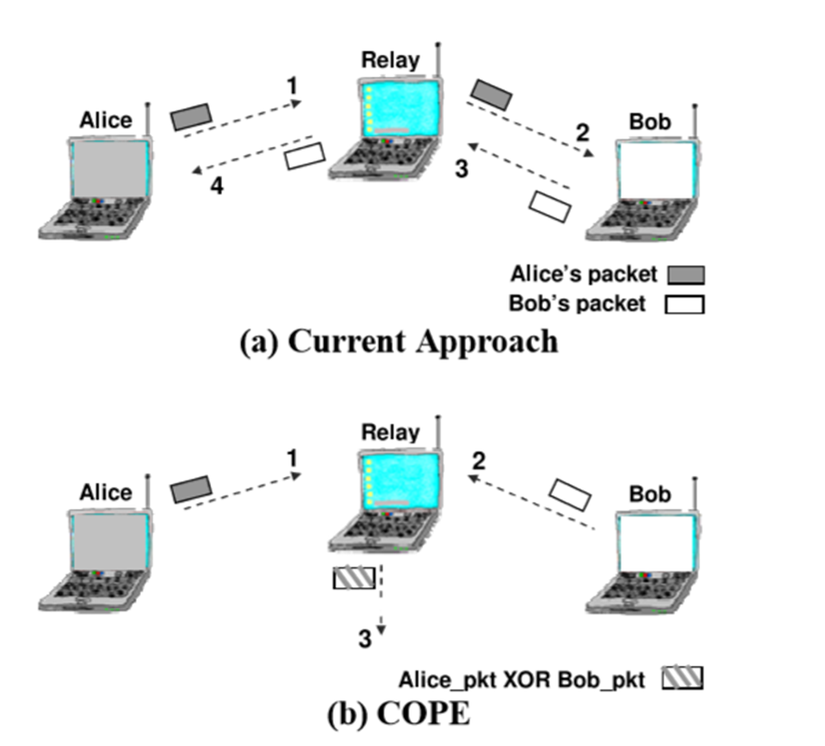

Slide 13
Based on Two principles
COPE disposes of the point-to-point abstraction and embraces the broadcast nature of the wireless channel.
COPE employs network coding.

Slide 14
Cope Advt.
Network coding does have practical beneﬁts, and can substantially improve wireless throughput.
When the wireless medium is congested and the trafﬁc consists of many random UDP ﬂows, COPE increases the throughput by 3-4.
If the trafﬁc does not exercise congestion control , COPE’s throughput improvement may substantially exceed the expected theoretical coding gain.
For a mesh network connected to the Internet via an access point, the throughput improvement observed with COPE varies between 5% to 70%.

Slide 15
Opportunistic Listening
Wireless is a broadcast medium, creating many opportunities for nodes to overhear packets.
COPE sets the nodes in promiscuous mode, makes them snoop on all communications over the wireless medium and store the overheard packets for a limited period T
Each node broadcasts reception reports to tell its neighbors which packets it has stored

Slide 16
Opportunistic Coding
What packets to code together to maximize throughput?
A node may have multiple options
but it should aim to maximize the number of native packets delivered in a single transmission
ensuring that each intended next hop has enough information to decode its native packet.

Slide 17
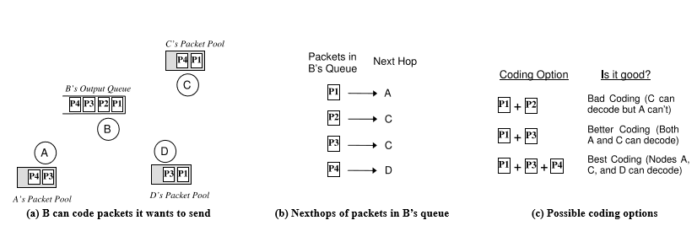

Slide 18
Paths of some packets may diverge at some point and thus need to be decoded.
If not, packets will be forwarded to areas where there is no interest in them thus wasting capacity.
To transmit n packets, p1,...,pn, to N nexthops, r1,...,rn, a node can XOR the n packets together only if each next-hop ri has all n−1 packets pj .
This rule ensures that each nexthop can decode the XOR-ed version to extract its native packet.

Slide 19
Learning Neighbour State
how does a node know what packets its neighbors have?
each node announces to its neighbors the packets it stores in reception reports
at times of severe congestion, reception reports may get lost in collisions
times of light trafﬁc, they may arrive too late, after the node has already made a suboptimal coding decision.

Slide 20
To guess intelligently
Wireless routing protocols compute the delivery probability between every pair of nodes and use it to identify good paths.
assigns each link a weight equal to 1/(delivery probability).
These weights are broadcast to all nodes in the network and used by a link-state routing protocol to compute shortest paths. We leverage these probabilities for guessing.
In the absence of deterministic information, COPE estimates the probability that a particular neighbor has a packet as the delivery probability of the link between the packet’s previous hop and the neighbor.
Occasionally, a node may make an incorrect guess, which causes the coded packet to be undecodable at some next hop.
Thus relevant native packet is retransmitted, potentially encoded with a new set of native packets.

Slide 21
Coding Gain
Coding gain as the ratio of the number of transmissions required by the current non-coding approach, to the minimum number of transmissions used by COPE to deliver the same set of packets.

Slide 22
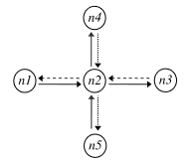

Slide 23
Case1
the wireless channel is available, the node takes the packet at the head of its output queue
checks which other packets in the queue may be encoded with this packet, XORs those packets together, and broadcasts the XOR-ed version
If there are no encoding opportunities, our node does not wait for the arrival of a matching codable packet.
COPE therefore lets the node opportunistically overload each transmission with additional information when possible, but does not wait for additional codable packets to arrive.

Slide 24
Case2
COPE gives preference to XOR-ing packets of similar lengths, because XOR-ing small packets with larger ones reduces bandwidth savings
studies show that the packet-size distribution in the Internet is bimodal with peaks at 40 and 1500 bytes
therefore limit the overhead of searching for packets with the right sizes by distinguishing between small and large packets
We might still have to XOR packets of different sizes. In this case, the shorter packets are padded with zeroes.

Slide 25
Case3
COPE will never code together packets headed to the same nexthop
WHY?
Since the nexthop will not be able to decode them.
we only need to consider packets headed to different nexthops.

Slide 26
Thank You!

