Slide 2
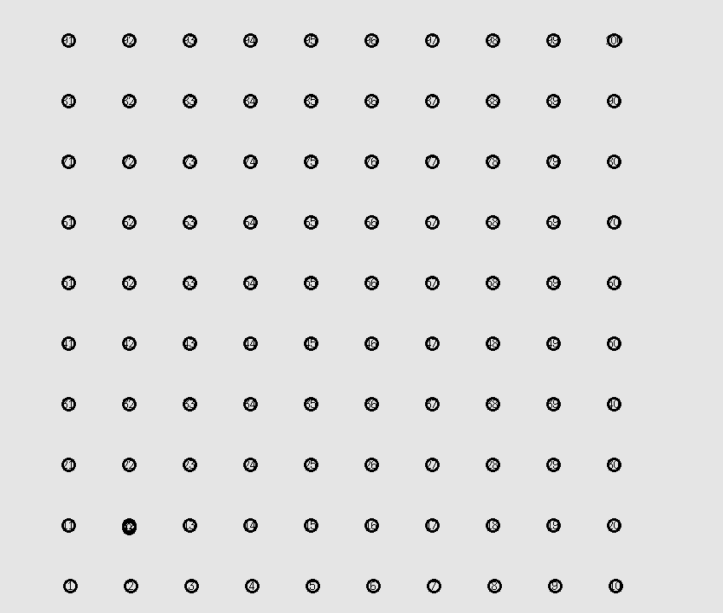

Slide 3
History 1
Threshold | Packets in network | Destination 66 Loss | Destination 100 Loss
0 | 119006 | 12 | 16
0.1 | 119006 | 12 | 16
0.2 | 138036 | 0 | 4
0.3 | 150487 | 0 | 0
0.4 | 150637 | 0 | 0
0.5 | 150708 | 1 | 1
0.6 | 151707 | 0 | 0
0.7 | 151707 | 0 | 0
Packets in the network 119006
Threshold 0-0.1 loss 12 and 66
Distance 50

Slide 4
History 1
Threshold | Packets in network | Destination 66 Loss | Destination 100 Loss
0 | 44757 | 131 | 130
0.1 | 44757 | 131 | 130
0.2 | 44757 | 131 | 130
0.3 | 81477 | 18 | 21
0.4 | 86625 | 0 | 4
0.5 | 87601 | 0 | 3
0.6 | 87837 | 0 | 3
0.7 | 87572 | 1 | 4
Distance 70

Slide 5
Distance 50
Distance 70
Threshold | Packets in network | Destination 66 Loss | Destination 100 Loss
0 | 119006 | 12 | 16
0.1 | 119006 | 12 | 16
0.2 | 138036 | 0 | 4
0.3 | 150487 | 0 | 0
0.4 | 150637 | 0 | 0
0.5 | 150708 | 1 | 1
0.6 | 151707 | 0 | 0
0.7 | 151707 | 0 | 0
Threshold | Packets in network | Destination 66 Loss | Destination 100 Loss
0 | 44757 | 131 | 130
0.1 | 44757 | 131 | 130
0.2 | 44757 | 131 | 130
0.3 | 81477 | 18 | 21
0.4 | 86625 | 0 | 4
0.5 | 87601 | 0 | 3
0.6 | 87837 | 0 | 3
0.7 | 87572 | 1 | 4

Slide 7
Threshold | Packets in network | Destination 10 Loss | Destination 91 Loss | Destination 100 Loss
0 | 52322 | 95 | 100 | 94
0.1 | 56766 | 84 | 87 | 86
0.2 | 57196 | 74 | 74 | 74
0.3 | 50290 | 59 | 59 | 60
0.4 | 16013 | 73 | 82 | 74
0.5 | 60438 | 74 | 76 | 74
0.6 | 60767 | 74 | 76 | 75
0.7 | 60668 | 75 | 76 | 77

Slide 8
Threshold | Packets in network | Destination 10 Loss | Destination 91 Loss | Destination 100 Loss
0 | 52322 | 95 | 100 | 94
0.1 | 56766 | 84 | 87 | 86
0.2 | 57196 | 74 | 74 | 74
0.3 | 50290 | 59 | 59 | 60
0.4 | 16013 | 73 | 82 | 74
0.5 | 60438 | 74 | 76 | 74
0.6 | 60767 | 74 | 76 | 75
0.7 | 60668 | 75 | 76 | 77
History 1
History 2-10
Threshold | Packets in network | Destination 10 Loss | Destination 91 Loss | Destination 100 Loss
0 | 12885 | 0 | 0 | 0
0.1 | 53166 | 92 | 91 | 91
0.2 | 55804 | 71 | 72 | 72
0.3 | 61345 | 70 | 70 | 72
0.4 | 59852 | 74 | 76 | 74
0.5 | 60251 | 74 | 74 | 74
0.6 | 60767 | 74 | 76 | 75
0.7 | 60668 | 75 | 76 | 77

Slide 9
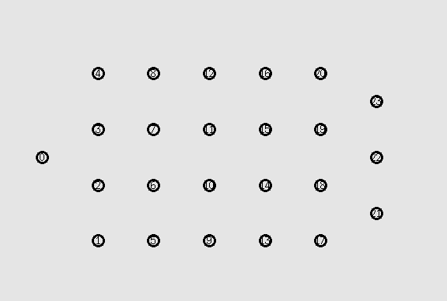

Slide 10
Threshold | Packets in network | Destination 21 Loss | Destination 22 Loss | Destination 23 Loss
0 | 19299 | 28 | 28 | 69
0.1 | 19299 | 28 | 28 | 69
0.2 | 16973 | 76 | 76 | 76
0.3 | 26423 | 11 | 11 | 11
0.4 | 28034 | 4 | 4 | 4
0.5 | 27860 | 10 | 10 | 10
0.6 | 28217 | 4 | 4 | 4
0.7 | 27901 | 10 | 10 | 10

Slide 11
Extra Static Line
No Extra Static Line
Threshold | Packets in network | Destination 21 Loss | Destination 22 Loss | Destination 23 Loss
0 | 19299 | 28 | 28 | 69
0.1 | 19299 | 28 | 28 | 69
0.2 | 16973 | 76 | 76 | 76
0.3 | 26423 | 11 | 11 | 11
0.4 | 28034 | 4 | 4 | 4
0.5 | 27860 | 10 | 10 | 10
0.6 | 28217 | 4 | 4 | 4
0.7 | 27901 | 10 | 10 | 10
Threshold | Packets in network | Destination 17 Loss | Destination 18 Loss | Destination 19 Loss
0 | 13863 | 40 | 75 | 62
0.1 | 13863 | 40 | 75 | 62
0.2 | 11974 | 68 | 90 | 88
0.3 | 21573 | 14 | 14 | 14
0.4 | 22844 | 7 | 7 | 7
0.5 | 23001 | 6 | 6 | 6
0.6 | 23002 | 7 | 7 | 7
0.7 | 22743 | 11 | 11 | 11

Slide 12
History 1
Threshold | Packets in network | Destination 21 Loss | Destination 22 Loss | Destination 23 Loss
0 | 19299 | 28 | 28 | 69
0.1 | 19299 | 28 | 28 | 69
0.2 | 16973 | 76 | 76 | 76
0.3 | 26423 | 11 | 11 | 11
0.4 | 28034 | 4 | 4 | 4
0.5 | 27860 | 10 | 10 | 10
0.6 | 28217 | 4 | 4 | 4
0.7 | 27901 | 10 | 10 | 10
History 4
Threshold | Packets in network | Destination 1 Loss | Destination 2 Loss | Destination 3 Loss
0 | 14259 | 106 | 106 | 106
0.1 | 13020 | 97 | 133 | 119
0.2 | 13120 | 111 | 115 | 117
0.3 | 26402 | 9 | 9 | 9
0.4 | 28101 | 6 | 7 | 7
0.5 | 27202 | 17 | 17 | 17
0.6 | 28217 | 4 | 4 | 4
0.7 | 27901 | 10 | 10 | 10
History 5
Threshold | Packets in network | Destination 1 Loss | Destination 2 Loss | Destination 3 Loss
0 | 7815 | 173 | 173 | 173
0.1 | 7815 | 173 | 173 | 173
0.2 | 7815 | 173 | 173 | 173
0.3 | 26057 | 12 | 12 | 12
0.4 | 27575 | 9 | 9 | 9
0.5 | 28100 | 8 | 8 | 8
0.6 | 28217 | 4 | 4 | 4
0.7 | 27901 | 10 | 10 | 10

