Slide 1
CMPT 225
Data Structures and Programming
February 4, 2021

Slide 2
Big-O notation

Slide 3
Big-O notation
We use Big-O notation to express the amount of resources used by algorithms:
time complexity (running time)
space complexity (used memory).
Denote by f(N) the running time of a program for inputs of size N. Examples:
f(N) = 1.5N2 + 4N+ 3
f(N) = 2N4 + 10N3 + 4N2 + 900 log(N) + 3000
f(N) = 2N – 100 (for N>10)
The big-O notation will be the fastest increasing term for large inputs.
Example: if f(N) = 2N⁴ + 10N³ + 4N² + 900 log(N) + 3 we will say that the time complexity is O(N⁴).

Slide 4
Big-O notation
Q: Why are we ignoring low order terms?
A: Because they become negligible as N grows
Example: f(N) = 4N⁴ + 100N³ + 9000N² + N
 | 4N⁴ | 100N³ | 9000N² | N
N = 100 | 4*10⁸ | 10⁸ | 9*10⁷ | 100
N = 10⁸ | 4*10³² | 10²⁶ | 9*10¹⁹ | 10⁸
N = 10¹² | 4*10⁴⁸ | 10³⁸ | 9*10²⁷ | 10¹²

Slide 5
Big-O notation
Q: Why are we ignoring multiplicative constants?
A: Because if we buy a computer that runs twice as fast or a computer with 4 cores, then the running time decreases accordingly.
But it will not change the order of magnitude
In practice constants do matter!
In theory we ignore them.

Slide 6
Big-O notation – Formal definition
Definition: Let f(N) and g(N) be two functions on positive integers.
Equivalently:
We say that f = O(g) if there exists a large constant C (e.g. C = 1000) such that f(N) < C*g(N) for all sufficiently large N.
f = O(g) if there C>0 (e.g. C = 1000) such that f(N)/g(N) < C for all N large enough.
f = O(g) if lim sup_{N→∞} f(N)/g(N) < ∞

Slide 7
Big-O notation – Formal definition
Definition: Let f(N) and g(N) be two functions on positive integers.
We say that f = O(g) if there exists a large enough constant C (e.g. C = 1000) such that f(N) < C*g(N) for all sufficiently large N.
Example1: f(N) = 5N² + 4N + 3. Want to show f = O(N²)
Let C=12.
Then f(N) = 5N² + 4N + 3
< 5N²+4N²+3N² [for N>2]
= 12N² = CN²
Therefore f = O(N²)

Slide 8
Big-O notation – Formal definition
Definition: Let f(N) and g(N) be two functions on positive integers.
We say that f = O(g) if there exists a large enough constant C (e.g. C = 1000) such that f(N) < C*g(N) for all sufficiently large N.
Example1’: f(N) = 5N² + 4N + 3. Want to show f = O(N³)
Let C=12.
Then f(N) = 5N² + 4N + 3
< 5N³+4N³+3N³ [for N>2]
= 12N³ < CN³
Therefore f = O(N³)

Slide 9
Common orders of magnitude
N² =O(Nª) for all a≥2
log(N) is smaller than any power of N for all large enough N: That is, log(N) = O(N^{0.1}). Equivalently log¹⁰(N) = O(N)
log₂(N) = log₁₀(N) * log₂(10) < 4 log₂(N)
If f = O(g) and g = O(h), then f = O(h)
If f₁ = O(g) and f₂ = O(g), then f₁+f₂ = O(g)
f+g <= 2max(f,g) = O(max(f,g))
That is why we write O(log(N) without specifying the base of log

Slide 10
Big-Θ notation – Formal definition
Definition: Let f(N) and g(N) be two functions on positive integers.
Equivalently:
We say that f = Θ(g) if f=O(g) and g = O(f).
f = Θ(g) if there C,d>0 (e.g. C = 1000, d=0.001) such that d < f(N)/g(N) < C for all N large enough.
f = Θ(g) if lim sup_{N→∞} f(N)/g(N) < ∞
and lim inf_{N→∞} f(N)/g(N) > 0.

Slide 11
Big-Θ notation – Formal definition
Definition: Let f(N) and g(N) be two functions on positive integers.
We say that f = Θ(g) if f=O(g) and g = O(f).
Example: f(N) = 5N² + 4N + 3. Want to show f = Θ(N²)
Let g(N) = N²
We saw before that f=O(g) (*)
Next, let’s show that g=O(f) (**)
Indeed, g(N) = N²< f(N) [for all N>1]
Therefore, by (*) and (**) we conclude that f= Θ(N²)
f(n)
5*g(n)
g(n)
0.5*g(n)

Slide 12
Big-Ω notation – Formal definition
Definition: Let f(N) and g(N) be two functions on positive integers.
Equivalently:
We say that f = Ω(g) if g = O(f).
f = Ω(g) if there d>0 (e.g. d=0.001) such that f(N)/g(N) > d for all N large enough.
f = Ω(g) if lim inf_{N→∞} f(N)/g(N) > 0.

Slide 13
Big-O notation – simple examples
Addition: Design an algorithm that gets two numbers each with n digits, and computes their sum.
Q: What is the running time of the algorithm?
A: O(n) for the standard long addition.
Multiplication: Design an algorithm that gets two numbers each with n digits, and computes their product.
Q: What is the running time of the algorithm?
A: O(n²) for the standard long multiplication.
Fact: can do much faster than n².
If a decimal number has n digits, how large is this number?

Slide 14
Big-O notation – more examples
Factoring: Design an algorithm that gets a number N with n digits, and computes p,q>1 such that p*q = N.
Q: What is the running time of the algorithm?
A1: A naïve algorithm runs will try all p=2,3,4…N-1 and try to divide N by p
This takes ≈N≈10^{n} operations. That is exponential in the input length.
A2: Suffices to go only for p=2,3,4…√N and try to divide N by p.
This takes ≈ √N≈3.162^{n} operations. Still exponential in the input length.
Fact: Can be solved in time 2^{O(∛n)}.

Slide 15
Big-O notation – more examples
Problem 4: Design an algorithm that gets a number N with n digits, and and decides with N is prime.
Q: What is the running time of the algorithm?
Naively looks similar to the factoring problem from the previous slide.
A: Can be done in polynomial time (in the length of the input) i.e., poly(n) = poly log(N)

Slide 16
Big-O notation – more examples
What is the running time of the following function?
int foo (int n) {
int i, j, sum = 0;
for (i=0; i<n; i++)
for (j=0; j<i; j=j+1)
sum += 1;
return sum;
}
What is the running time of this function?
Write an equivalent function that is more efficient.

Slide 17
Big-O notation – more examples
Often when we want to analyze the running time of recursive algorithms, the running time is not given explicitly, but as a recursive formula.
Example: consider the merge sort algorithm:
Given an array A[0…n-1] of length n do
Let mid = n/2
Sort A[0…mid]
Sort A[mid+1…n]
Merge the two halves // can be done in time O(n)
The running time of the algorithm can be written as
T(n) = 2*T(n/2) + O(n), and T(1) = O(1)

Slide 18
Big-O notation – more examples
The running time of merge sort is T(n) = 2*T(n/2) + O(n) and T(1) = O(1).
Claim: T(n) = O(n log(n))
Proof 1: Suppose that T(n) ≤ 2*T(n/2) + Cn and T(1) ≤ C for some constant C.
Let us prove that T(n) ≤ 2Cn*log₂(n) for all n≥2. Proof by induction
Base case: n=2:
T(2) ≤ 2T(1) + C*2 ≤ 4C = 2Cn.
Induction step: suppose the hypothesis holds for 2,3,4…n-1. Let’s prove it for n
T(n) ≤ 2T(n/2) + C*n
≤ 2*(2C*n/2*log₂(n/2)) +Cn [using induction hypothesis]
= 2Cn*(log(n) – log₂(2)) + Cn
= 2Cnlog(n) – 2Cn + Cn < 2C*n*log(n)

Slide 19
Big-O notation – more examples
The running time of merge sort is T(n) = 2*T(n/2) + O(n) and T(1) = O(1).
Claim: T(n) = O(n log(n))
Proof 2: Suppose that T(n) ≤ 2*T(n/2) + Cn and T(1) ≤ C for some constant C.
Let us prove that T(n) ≤ O(n*log₂(n)) by picture
We have log₂(n) levels
Each level contributes ≤Cn to the running time
Cn
C*n/2
C*n/2
Therefore, the total running time is ≤Cnlog₂(n), or just O(n log(n)
C*n/4
C*n/4
C*n/4
C*n/4
… … ….
…
C*1
C*1
C*1
C*1
C*1
C*1
C*1
C*1

Slide 20
Big-O notation – more examples
The running time of merge sort is T(n) = 3*T(n/2) + O(n) and T(1) = O(1).
Claim: T(n) = O(n^{log}2⁽³⁾)
Proof: Suppose that T(n) ≤ 2*T(n/2) + Cn and T(1) ≤ C for some constant C.
Let us prove the claim by picture again
We have log₂(n) levels
Cn
The sum in level 0 is n
Sum in level 1 is 3n/2
Sum in level 2 is 9n/4 = (3/2)²n
C*n/2
C*n/2
C*n/2
The sum in level k is (3/2)^{k} n
C*n/4
C*n/4
C*n/4
C*n/4
C*n/4
C*n/4
C*n/4
C*n/4
C*n/4
… … ….
C*1
C*1
C*1
C*1
C*1
C*1
C*1
C*1
C*1

Slide 21
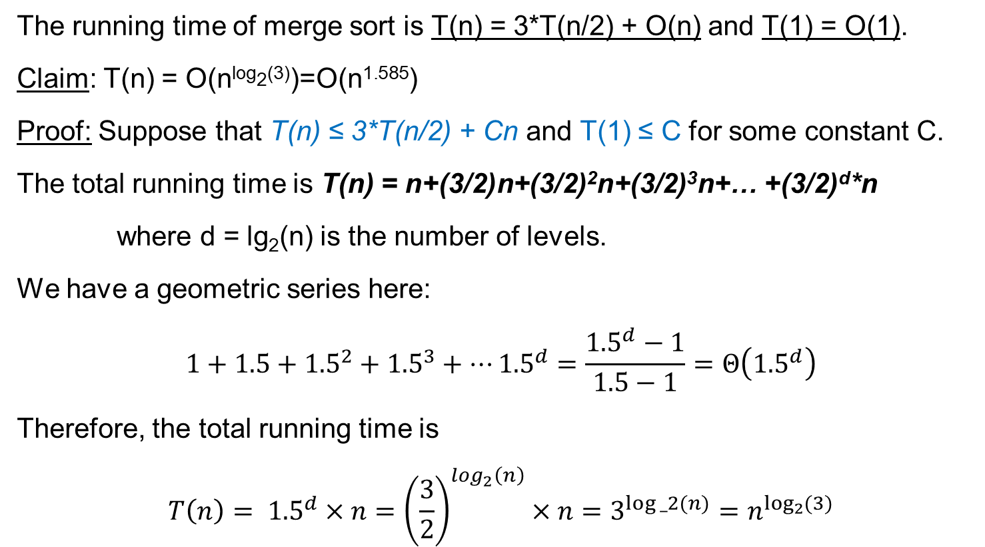
Big-O notation – more examples
The running time of merge sort is T(n) = 3*T(n/2) + O(n) and T(1) = O(1).
Claim: T(n) = O(n^{log}2⁽³⁾)=O(n^{1.585})
Proof: Suppose that T(n) ≤ 3*T(n/2) + Cn and T(1) ≤ C for some constant C.
The total running time is T(n) = n+(3/2)n+(3/2)²n+(3/2)³n+… +(3/2)^{d}*n
where d = lg₂(n) is the number of levels.
We have a geometric series here:
$$1+1.5+{1.5}^{2}+{1.5}^{3}+…{1.5}^{d}=\frac{{1.5}^{d}−1}{1.5−1}=Θ\left({1.5}^{d}\right)$$
Therefore, the total running time is
$$T\left(n\right)= {1.5}^{d}×n={\left(\frac{3}{2}\right)}^{log_{2}\left(n\right)}×n=3^{log⁡_2(n)}=n^{\log_{2}{(3)}}$$

Slide 22
Master Theorem
Master Theorem: Suppose we are given a recurrence relation
T(n) = a*T(n/b) + f(n)
for integers a, b, and some function f.
Let c = log_{b}(a).
Then
If f(n) = O(n^{d}) for some d<c, then T(n) = Θ(n^{c})
If f(n) = Θ(n^{c}), then T(n) = Θ(n^{c} log(n))
If f(n) = Ω(n^{c}), then T(n) = Θ(f)

Slide 23
Master Theorem - examples
T(n) = 2T(n/2) + O(1). Then T(n) = Θ(n log(n))
T(n) = 2T(n/2) + Θ(n) Then T(n) = Θ(n log(n))
T(n) = 2T(n/2) + 3n² Then T(n) = Θ(n²)
T(n) = 4T(n/2) + 4n Then T(n) = Θ(n^{log2(4)}) = Θ(n²)
T(n) = 3T(n/3) + 5n Then T(n) = Θ(n log(n))
T(n) = 4T(n/3) + 5n Then T(n) = Θ(n^{log3(4)}) = Θ(n^{1.26})

Slide 24
Big-O notation – more examples
Consider the following variant of Merge Sort
Given an array A[0…n-1] of length n do
Let k = n/3
Sort A[0…k]
Sort A[k+1…n]
Merge the two halves // can be done in time O(n)
The running time of the algorithm can be written as
T(n) = T(n/3) + T(2N/3) + O(n), and T(1) = O(1)

Slide 25
Slightly more general result
The running time is T(n) = T(n/3) + T(2n/3) + Cn and T(1) = C.
Claim: T(n) = O(n log(n))
Proof:
We have ≤ log_{3/2}(n) levels
Each level contributes ≤Cn to the running time
Cn
C*n/3
C*2n/3
C*n/9
C*2n/9
C*2n/9
C*4n/9
… … ….
Therefore, the total running time is ≤O(nlog(n))
C*1
C*1
C*1
C*1
…
C*1
C*1
C*1
C*1

Slide 26
Questions?
Comments?

