Slide 1
CMPT 225
Data Structures and Programming
February 12, 2021

Slide 2
Binary Trees

Slide 3
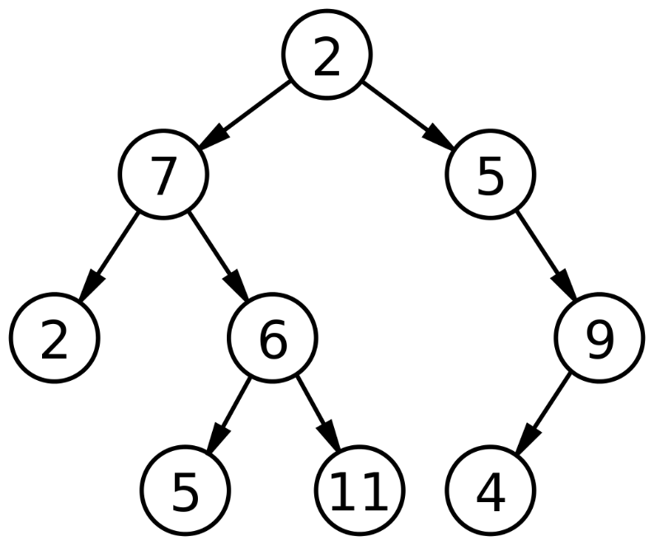
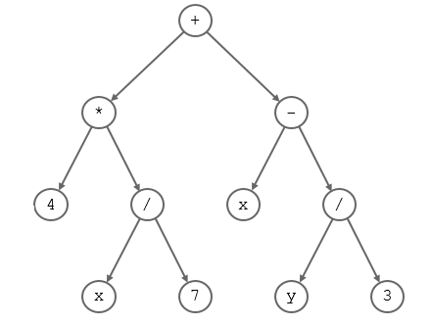
Binary Trees
Trees where each node has at most 2 children.

Slide 4
Binary Trees
public class BTNode<T> {
private T data; private BTNode leftChild; private BTNode rightChild; private BTNode parent; }
public class BinaryTree {
private BTNode root;
}

Slide 5
Traversing Binary Trees

Slide 6
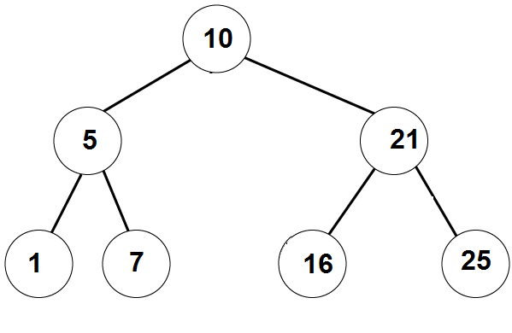
Traversing Binary Trees
InOrder traversal:
First visit the left subtree,
Then the root,
Then the right subtree.
Example:

Slide 7
Traversing Binary Trees
PreOrder traversal:
First visit the root,
Then the left subtree,
Then the right subtree.
Example:

Slide 8
Traversing Binary Trees
PostOrder traversal:
First visit the left subtree,
Then the right subtree,
Then the root.
Example:

Slide 9
Traversing Binary Trees
// prints the tree in PreOrder
PreOrderTraversal (BTnode root):
If root==NULL
1.1 do nothing
Else
2.1 print( root.data )
2.2 PreOrderTraversal (root.left)
2.3 PreOrderTraversal(root.right)
Q:Change the algorithm to get the InOrder/PostOrder traversal

Slide 10
PreOrder Traversal - Iterative
PreOrder(BTnode root):
s = create stack of nodes
s.push(root)
while (s is not empty):
node = s.pop()
printf(node->value)
if (node->right != NULL)
s.push(node->right)
if (node->left != NULL)
s.push(node->left)

Slide 11
PreOrder Traversal - Iterative
PreOrder(BTnode root):
s = create stack of nodes
s.push(root)
while (s is not empty):
node = s.pop()
printf(node->value)
if (node->right != NULL)
s.push(node->right)
if (node->left != NULL)
s.push(node->left)
10
5
21
1
7
21
7
21
21
16
25
25

Slide 12
PreOrder Traversal - Iterative
PreOrder(BTnode root):
s = create stack of nodes
s.push(root)
while (s is not empty):
node = s.pop()
printf(node->value)
if (node->right != NULL)
s.push(node->right)
if (node->left != NULL)
s.push(node->left)
What if we replace the stack with a queue?

Slide 13
Breadth First Search
BFS(BTnode root):
q = create queue of nodes
q.enqueue(root)
while (q is not empty):
node = q.dequeue()
printf(node->value)
if (node->right != NULL)
q.enqueue(node->right)
if (node->left != NULL)
q.enqueue(node->left)
Print 10
Print 5
Print 21
Print 1
Print 7
Print 16
Print 25
10
5 | 21
21 | 1 | 7
1 | 7 | 16 | 25
7 | 16 | 25
16 | 25
25

Slide 14
Iterators for Binary Trees
For each of the four traversals write an Iterator implementing it.

Slide 15
Questions?
Comments?

