Slide 1

CMPT 225
Data Structures and Programming
March 5, 2021

Slide 2
Announcements
Midterm: Friday, March 12 – no class on Friday
4 problems covering all topics covered so far including this week
Take home exam - open books/internet
No talking to each other/asking questions online
I’ll post the paper on March 11 at 10am on the course home page → exams
You will need to submit is before March 12 at midnight
Shouldn’t take you more than 2-3 hours to solve it.

Slide 3
Binary Search Trees

Slide 4
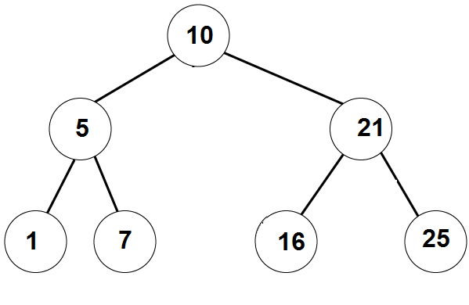
Binary Search Trees
Example 1:
A binary search tree can be balanced

Slide 5
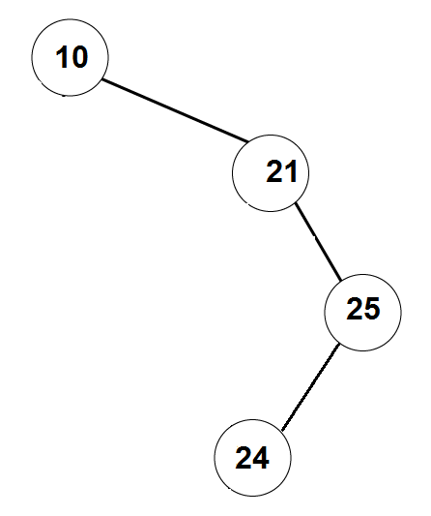
Binary Search Trees
Example 2:
A binary search tree can be
unbalanced

Slide 6
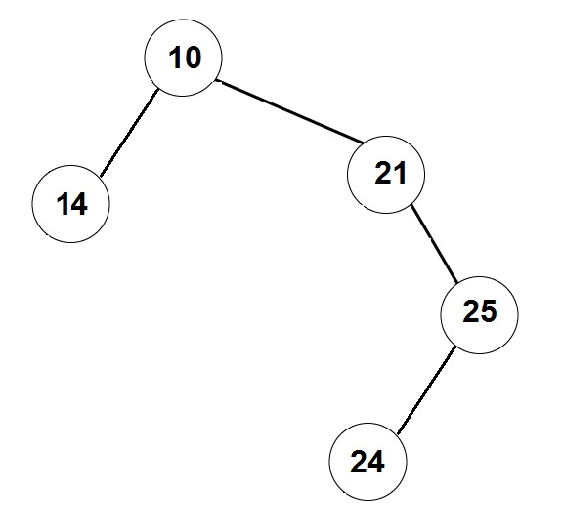
Not a Binary Search Tree

Slide 7
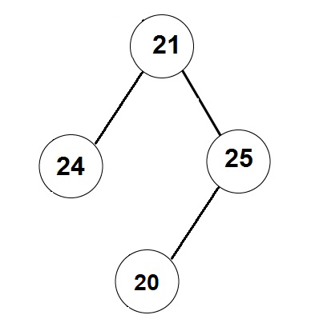
Not a Binary Search Tree

Slide 8
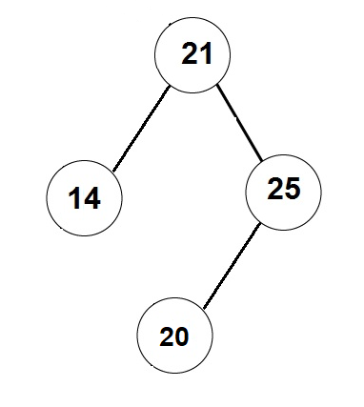
Not a Binary Search Tree

Slide 9
Binary Search Trees
Write a function that finds a given item in a BST (or returns NULL).
BTNode find (BTNode root, T item) {}
find( 7 )
Found

Slide 10
Binary Search Trees
The running time is: O(depth of the tree)
Write a function that finds a given item in a BST (or returns null).
BTNode find (BTNode root, T item) {}
find( 8 )
Not found

Slide 11
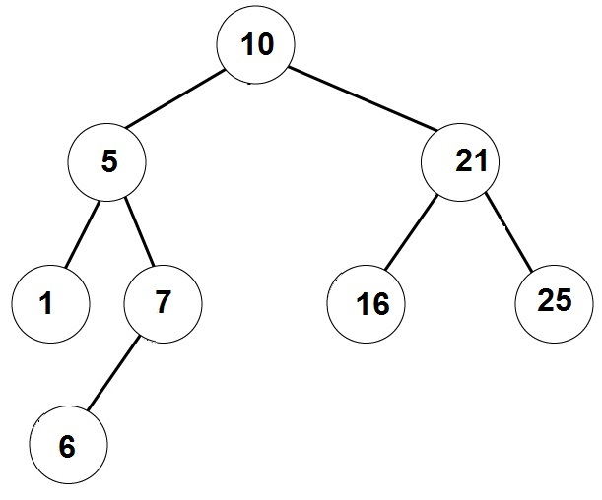
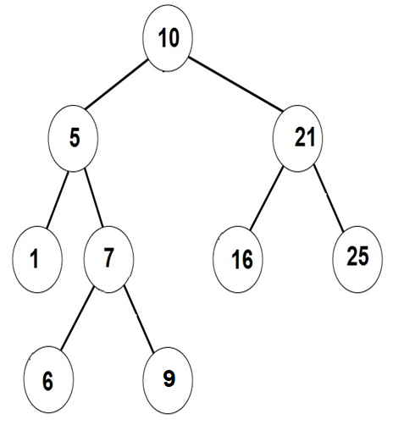
Binary Search Trees
Write a function that adds a given element to a binary search tree
BTNode addItem (BinarySearchTree bst, T item) {}
addItem( 6 )
addItem( 9 )

Slide 12
Removing an element from Binary Search Trees
Write a function that removes a given element from a BST
We will have 3 cases depending on how many child the node has.

Slide 13
Removing an element from Binary Search Trees
Step 1: Get a pointer to the node we want to remove
Removing a node with no children:
Just remove the vertex, and update its parent.
Removing a node with one child:
Update the parent to skip over the removed node, and point to its (unique) child.
Note that if the removed node is the root, then we should update the pointer to the root accordingly.

Slide 14
Remove node with no children
removeNode(BinarySearchTree tree, BTNode node)
if (tree.root == node)
tree.root = null;
else
if (node.parent.getLeftChild() == node)
node.parent.setLeftChild(null)
else // node.parent.getRightChild() == node
node.parent.setRightChild(null)
4
2
6
1
3
5
7
remove( 3 )

Slide 15
Remove node with one child
4
removeNode(BinarySearchTree tree, BTNode node)
child = getChild(node)
if (tree.root == node)
root = child
else
if (node.parent.left == node)
node.parent.setLeftChild(child)
else // node.parent.right == node
node.parent.setRightChild(child)
3
5
6
2
1
7
remove( 3 )
remove( 6 )

Slide 16
Remove node with two children
remove( 4 )
removeNode(BinarySearchTree tree, BTNode node)
next = find successor of node in the tree
// next has ≤1 child
node.data = next.data
removeNode(tree, next)
4
2
6
1
3
5
5
7
Putting the predecessor in the root also works
Successor of 4 is 5

Slide 17
Remove node with two children
removeNode(BinarySearchTree bst, BTNode node)
next = findSuccessor(node)
node.data = next.data
removeNode(bst, next)
// assuming node has right child
findSuccessor(BTNode node) {
findMin(node.right);
}
// assuming node != NULL
findMin(BTNode node) {
BTNode current = node;
while (current.left != null)
current = current.left
return current
}

Slide 18
Running time of the operations
What is the running time of findElement () ?
What is the running time of addElement() ?
What is the running time of removeElement() ?
Answer = O(depth of tree)
Conclusion: we want the tree to be balanced, i.e., have no long strings.
We saw that for a tree with n vertices the depth must be >log(n)-1.
So the best we can hope for in O(log(n)) for each operation.

Slide 19
Balancing a BST

Slide 20
Balancing the tree
How can we make sure that the tree is balanced?
A possible solution: have a method makeBalanced()that balances the tree.
makeBalanced()
create a sorted array with all the values in the tree
can be done using inOrder traversal
create a new tree from the array
WRONG SOLUTION!!!
DON’T LISTEN TO THIS GUY!

Slide 21
Creating a balanced tree from a sorted array
Idea:
1) Set the median to be the root
2) Construct left and right subtrees recursively.
addArrayToTree ( array , first , last )
if (first <= last)
mid = (first+last)/2
addToTree( array[mid] )
addArrayToTree as left subtree ( array , first , mid-1 )
addArrayToTree as right subtree ( array , mid+1 , last )

Slide 22
Creating a balanced tree from a sorted array
Example: Array = [1,2,3,4,5,6,7,8]
Root = 5
Create left subtree from [1,2,3,4]
Root = 3
Create subtree from [1,2]
Create subtree from [4]
Create right subtree from [6,7,8]
Root = 7
Create subtree from [6]
Create subtree from [8]
5
3
7
2
4
6
8
1

Slide 23
Balancing the tree
Disadvantages of the solution using makeBalanced()
Add responsibility to the user to invoke makeBalanced()
The user will need to wait linear time in every invocation of makeBalanced().
A better solution would be to have a self-balancing tree that is makes sure the tree is balanced after each modification (add/remove)
AVL trees
B-trees
RedBlack trees
2-3 trees
We will see AVL trees (definitely) and B-trees(?) next.

Slide 24
Practice Problems

Slide 25
Practice problem 1
Create a Binary Search Tree from the following list of insertions:
List 1: 4, 2, 8, 1, 3 , 6, 5, 9, 10, 7
Remove 5 from the tree
Remove 9 from the tree
Remove 4 from the tree
4
2
8
3
6
1
6
9
5
7
10

Slide 26
Practice problem 2
Write an algorithm that gets a PreOrder traversal of a BST, and returns the tree. Prove that such BST is unique.
Example: Suppose the PreOrder is: [6,4,3,1,5,9,8,7]. What is the BST?
Root=6
Left subtree of 6: [4,3,1,5]
The root is 4. Left = [3 1] Right = [5] Look at [3,1] – 3 is the root, 1 is on the left
Right subtree of 6 is [9,8,7]
9 is the root [8,7] are both on the left
[8,7]: 8 is the root and 7 is on the left
6
4
9
3
5
8
1
7

Slide 27
Practice problem 3
Add to the BST a feature that allows for each node to get the size of the subtree under it in O(1) time.
The running time of the other operations should be
Find – O(depth of the tree)
Insert – O(depth of the tree)
Remove – O(depth of the tree)
getSize – O(1)
A: (1) add a field int size to BTNode
(2) maintain size for all nodes in each operation. Try it!
For example, insert updates the size of all ancestors of the new node.

Slide 28
Questions?
Comments?

