Slide 1
CMPT 225
Data Structures and Programming
February 24, 2021

Slide 2
Evaluating arithmetic expressions

Slide 3
Prefix and Postfix notations

Slide 4
Prefix notation (aka Polish notation)
A notation for writing arithmetic expressions, where the operator comes before the operands.
No parentheses are required!
Examples:
( 5 + 7 ) ➔ + 5 7
( 8 * ( 2 + 4 ) ) ➔ * 8 + 2 4
( (3 + 5) * 4 ) ➔ * + 3 5 4
( ( 16 / ( 8 − ( 2 + 2 ) ) ) * 3 ) ➔ * / 16 − 8 + 2 2 3

Slide 5
Postfix notation (aka Reverse Polish notation)
A notation for writing arithmetic expressions, where the operator after the operands.
No parentheses are required!
Examples:
( 5 + 7 ) ➔ 5 7 +
( 8 * ( 2 + 4 ) ➔ 8 2 4 + *
( ( 3 + 5) * 4 ) ➔ 3 5 + 4 *
( ( 16 / ( 8 − ( 2 + 2 ) ) ) * 3 ) ➔ 16 8 2 2 + - / 3 *

Slide 6
Evaluating prefix notation
Algorithm:
Read right to left.
Push numbers onto the stack.
When reaching an operator:
remove the top two terms from the stack
apply the operator, and push the result onto the stack
Example: / 8 4
4
8
/
4
8
4
2
Return 2

Slide 7
Evaluating prefix notation
Example: ( 15 / ( 7 − ( 2 + 2 ) ) )
Prefix notation: / 15 - 7 + 2 2
2 2
+
7
-
15
/
2
2
4
7
4
3
15
3
5
Return 5

Slide 8
Evaluating postfix notation
Algorithm:
Read left to right.
Push numbers onto the stack.
When reaching an operator:
remove the top two terms from the stack
apply the operator on them, and push the result onto the stack
Example: 8 4 / 3 + // represents ( 8 / 4 ) + 3
8
4
/
3
+
8
4
8
2
3
2
5
Return 5

Slide 9
Evaluating infix in linear time
Algorithm:
1. If we see ‘(‘, push it to the stack
2. If we see an operator or a number, push it to the stack
3. If we see ‘)’
3.1 remove the last four items from the stack
3.2 evaluate, and push the result onto the stack
Example: ( 15 / 5 )
(
15
/
5
)
(
15
(
/
15
(
5
/
15
(
3
Return 3

Slide 10
Evaluating infix in linear time
Example: ( 15 / ( 7 – 2 ) )
( 15 /
(
7 - 2
)
)
/
15
(
(
/
15
(
2
-
7
(
/
15
(
5
/
15
(
3
Return 3

Slide 11
Using trees to represent arithmetic expressions

Slide 12
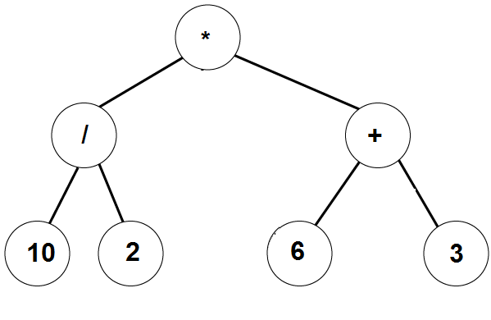
Using binary trees
All inner nodes are operators
All leaves are numbers
(10 / 2) * (6 + 3)
How to evaluate an expression represented by a binary tree?
Algorithm:
Evaluate left subtree
Evaluate right subtree
Apply the operator in the root
What is the stopping condition of the recursion?

Slide 13
Using binary trees
Practice problems:
Write an algorithm that gets a binary tree representing an arithmetic expression and returns:
the expression in infix notation
the expression in prefix notation
the expression in postfix notation
Write an algorithm the converts prefix notation to postfix
Write an algorithm the converts infix notation to prefix
Write an algorithm the converts prefix notation to infix
Try to do all these in linear time

Slide 14
Back to the first two examples we saw last time

Slide 15
Evaluating arithmetic expressions
What is the running time of the algorithm in the worst case?
Q: What is the running time for the expressions below?
(1 + ( 1 + (1 + ( … (1 + 1 )…)))) // n summands
T(n) = T(n-1) + O(1) = O(n)
((( … (1 + 1) … + 1) + 1) + 1 ) // n summands
T(n) = T(n-1) + O(n) = O(n²)
Q:We can tweak

Slide 16
Evaluating arithmetic expressions
Find operand1
term1 = Evaluate(operand1)
Find operand2
term2 = Evaluate(operand2)
Apply the operator on term1 and term2
Q: What is the running time of this algorithm? Write a recursive formula
A: if n is the total length and k is the length of the first term, then the time is
T(n) = O(k) + T(n-k) + T(k)
Note that when k = n-1, we get T(n) = O(n²)

Slide 17
Evaluating arithmetic expressions
Find operand1 by searching from both front and back
term1 = Evaluate(operand1)
Find operand2
term2 = Evaluate(operand2)
Apply the operator on term1 and term2
We can tweak the algorithm, and search from front and back simultaneously.
If n is the total length and k is the length of the shorter term, then the time is
T(n) = O(k) + T(n-k) + T(k), where k ≤ n/2
Q: What is the worst case running time now?

Slide 18
Questions?
Comments?

