Slide 1
CMPT 225
Data Structures and Programming
March 1, 2021

Slide 2
Heap

Slide 3
Min-Heap
Properties:
Heaps are complete binary trees
The vertices in the last row are added left to right
The value in each node is smaller (or equal) than the values of its children
No requirements about other relatives
1
2
5
4
3
9
6
8
10

Slide 4
Get min
getMin():
Return the value at the root
Running time O(1)
1
2
5
4
3
9
6
8
10

Slide 5
Add to heap
Add Item(item):
Add item to the next available position in the tree
Propagate it up to satisfy the min-heap condition
Running time O(log(n))
1
4
7
9
6
9
10
18
10
3

Slide 6
Remove min
Remove min:
min = root.value
Move the last element in the tree be the root
Apply heapify(root) That is, propagate the root down to satisfy the min-heap condition
Return min (from step 1)
Running time O(log(n))
1
4
8
6
5
9
10
8
7

Slide 7
Heaps using array representation
Since the for heaps the tree is always full, it is convenient to represent it using an array:
More specifically, we want to store
The size of the tree
The BFS traversal of the heap
In this example: [1,4,2,9,6,3,10,8,10,7]
1
4
2
How can we find the root in the array?
A: array[0]
9
6
3
10
Where is the left child of array[i]?
A: array[2i+1]
Where is the right child of array[i]?
A: array[2i+2]
8
10
7
Where is the parent of array[j]?
A: array[(j+1)/2-1]

Slide 8
HeapSort
Given an array
buildHeap(array)
Remove nodes one by one from the heap, and insert them into the array in the increasing order.
Step 1 can be done in O(n) time
Step 2 in O(n log(n)) time

Slide 9
BuildHeap in O(n) time
Goal: Given an array, turn it into a heap in O(n) time.
[9,4,2,1,7,8,5,3,10,6]
Algorithm:
Treat the array as a complete binary tree
For each vertex v starting from the bottom
2.1 Apply heapify(v)
Recall: heapify(v) pushes v down until it satisfies the min-heap condition
9
4
2
1
7
8
5
3
10
6

Slide 10
BuildHeap in O(n) time
Goal: Given an array, turn it into a heap in O(n) time.
[9,4,2,1,7,8,5,3,10,6]
Algorithm:
Treat the array as a complete binary tree
For each vertex v starting from the bottom
2.1 Apply heapify(v)
9
4
2
1
7
8
5
heapify(9)
heapify(2)
heapify(4)
heapify(1)
heapify(7)
3
10
6

Slide 11
BuildHeap in O(n) time
Goal: Given an array, turn it into a heap in O(n) time.
[9,4,2,1,7,8,5,3,10,6]
Algorithm:
Treat the array as a complete binary tree
For each vertex v starting from the bottom
2.1 Apply heapify(v)
Correctness: In the end of each iteration the min-heap property is satisfied under the current vertex v
9
4
2
1
7
8
5
heapify(9)
heapify(2)
heapify(4)
heapify(1)
heapify(7)
3
10
6

Slide 12
BuildHeap in O(n) time
The total running time is:
1*(n/2)+ 2*(n/4) + 3*(n/8) +… +log(n)*(n/n)
Algorithm: given a complete binary tree
For each vertex v starting from the bottom
2.1 Apply heapify(v)
Running time:
For n/2 vertices heapify runs for 1 steps
For n/4 vertices heapify runs for 2 step
For n/8 vertices heapify runs for 3 steps
For n/16 vertices heapify runs for 4 steps
…
For 2 vertex heapify runs for log(n)-1 steps
For 1 vertex heapify runs for log(n) steps
9
4
2
1
7
8
5
3
10
6

Slide 13
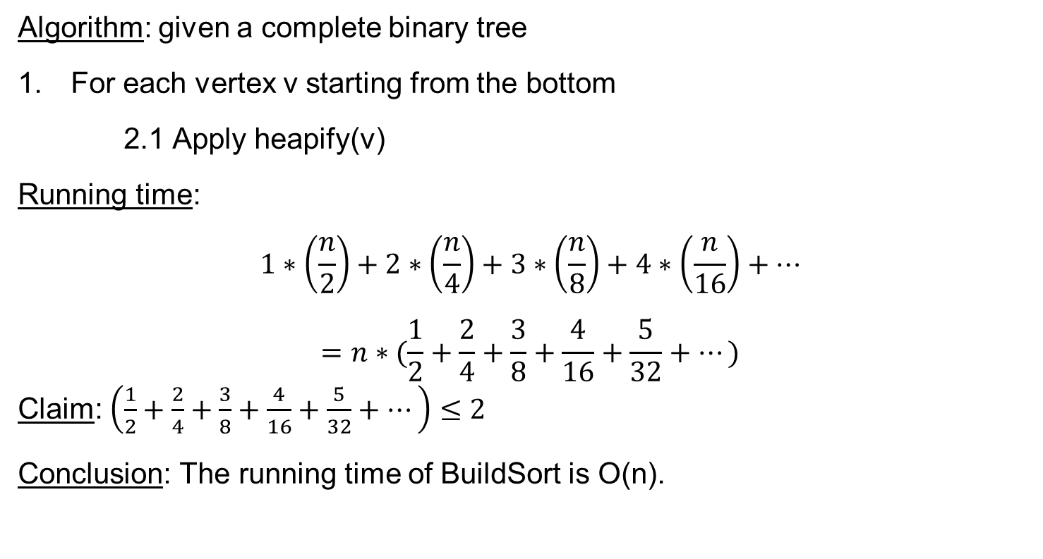
BuildHeap in O(n) time
Algorithm: given a complete binary tree
For each vertex v starting from the bottom
2.1 Apply heapify(v)
Running time:
$$1∗\left(\frac{n}{2}\right)+2∗\left(\frac{n}{4}\right)+3∗\left(\frac{n}{8}\right)+4∗\left(\frac{n}{16}\right)+…$$
$$=n∗(\frac{1}{2}+\frac{2}{4}+\frac{3}{8}+\frac{4}{16}+\frac{5}{32}+…)$$
Claim: $\left(\frac{1}{2}+\frac{2}{4}+\frac{3}{8}+\frac{4}{16}+\frac{5}{32}+…\right)≤2$
Conclusion: The running time of BuildSort is O(n).

Slide 14

BuildHeap in O(n) time
Claim: $\left(\frac{1}{2}+\frac{2}{4}+\frac{3}{8}+\frac{4}{16}+\frac{5}{32}+…\right)≤2$
Proof:
1/2
1/4 | 1/4
1/8 | 1/8 | 1/8
1/16 | 1/16 | 1/16 | 1/16
1/32 | 1/32 | 1/32 | 1/32 | 1/32
1/64 | 1/64 | 1/64 | 1/64 | 1/64 | 1/64
… | … | … | … | … | … | …
≤
1 | 1/2 | 1/4 | 1/8 | 1/16 | 1/32 | 1/64
≤ 2

Slide 15
HeapSort
Given an array
buildHeap(array) – can be done in O(n) time
Remove nodes one by one from the heap, and insert them into the array in the increasing order.
Step 2 in O(n log(n)) time
Therefore, the total running time is O(n log(n))

Slide 16
Heap – Practice problems
Start with the array A=[7,1,4,2,9,3,4,10,5,8]
a. Apply buildHeap(A)
b. Add 6 to the heap
c. Remove min from the heap
d. Remove min from the heap again
Apply buildHeap on the array [n,n-1,n-2,n-3…2,1]
Apply buildHeap on the array [1,2,3,4,…n-1,2]
Modify min-heap of ints so that it also supports getAverage() in O(1) time
Modify min-heap of ints so that it also supports getMax() in O(1) time

Slide 17
Heap – Practice problems
Write a data structure that supports the following operations:
a. addElement(int elt) – in O(log(n)) time
b. getMin() / getMax() -- in O(1) time
c. removeMin() / removeMax() -- in O(log(n)) time
d. getSize() / isEmpty()
Suppose the inOrder traversal of a min-heap is [4,3,5,2,9,1,5,4,7].
Can we recover the min-heap uniquely?
Suppose the preOrder traversal of a min-heap is [1,2,3,4,5].
Can we recover the min-heap uniquely?

Slide 18
Questions?
Comments?

