Slide 1

CMPT 125
Introduction to Computing Science and Programming II
November 18, 2020

Slide 2
Binary Search Trees

Slide 3
Binary Search Trees
A binary search tree (BST) is a binary tree with the following property:
For every node, the value in the node is greater or equal than the values in its left child and all its descendants.
For every node, the value in the node is smaller or equal than the values in its right child and all its descendants.

Slide 4
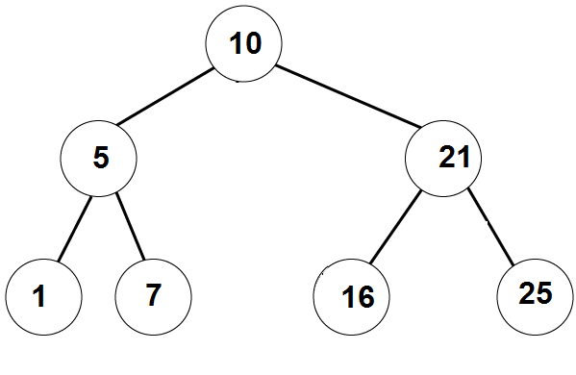
Binary Search Trees
Example 1:
A binary search tree can be balanced

Slide 5
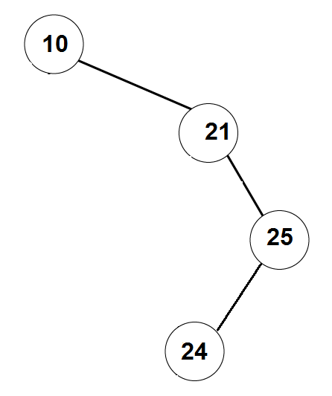
Binary Search Trees
Example 2:
A binary search tree can be
unbalanced

Slide 6
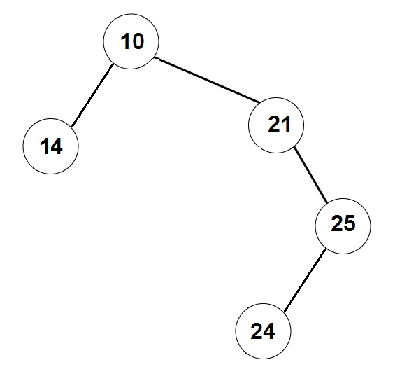
Not a Binary Search Tree

Slide 7
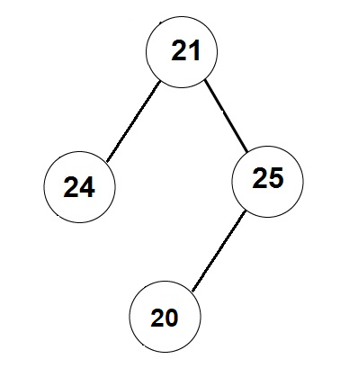
Not a Binary Search Tree

Slide 8
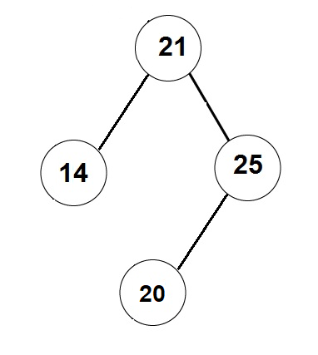
Not a Binary Search Tree

Slide 9
Binary Search Trees
Write a function that prints the values in a BST in the non-decreasing order.
void printSorted (BTNode root) {
if ( root == null)
return;
printSorted(root.leftChild)
print(root.data)
printSorted(root.rightChild)
}

Slide 10
Binary Search Trees
Write a function that finds a given item in a BST (or returns NULL).
BTNode find (BTNode root, T item) {
if ( root == null )
return null;
if (root.data.compareTo(item) == 0)
return root;
if (root.data.compareTo(item) > 0)
return find(root.left, item);
if (root.data.compareTo(item) < 0)
return find(root.right, item);
}
find( 7 )
Found

Slide 11
Binary Search Trees
The running time is: O(depth of the tree)
Write a function that finds a given item in a BST (or returns NULL).
BTNode find (BTNode root, T item) {
if ( root == null )
return null;
if (root.data.compareTo(item) == 0)
return root;
if (root.data.compareTo(item) > 0)
return find(root.left, item);
if (root.data.compareTo(item) < 0)
return find(root.right, item);
}
find( 8 )
Not found

Slide 12
Binary Search Trees
Write an iterative function that finds a given item in a BST (or returns NULL).
BTnode find (BinarySearchTree bst, int item) {
BTnode current = bst.root;
while ( current != null && current.data.compateTo(item) != 0) {
if (current.data.compareTo(item) > 0)
current = current.left.
else // current.data.compareTo(item) < 0
current = current.right;
}
return current;
}
Running time: O(depth of the tree)
find( 16 )
Found

Slide 13
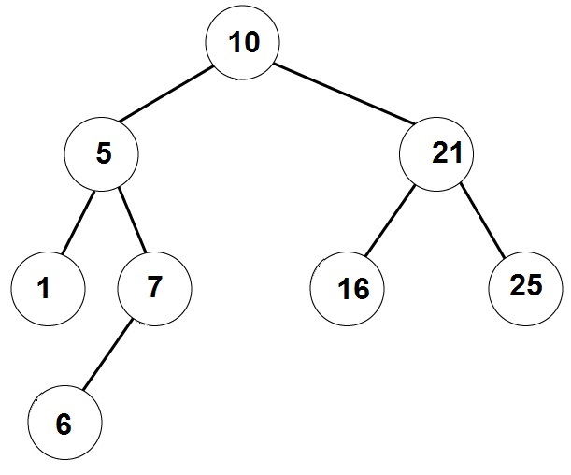
Binary Search Trees
Write a function that adds a given element to a binary search tree
/** returns the added node */
BTNode addItem (BinarySearchTree bst, int item) {
// implement me
}
add_item( 6 )

Slide 14
Binary Search Trees
Create a Binary Search Tree from the following list of insertions:
[4, 6, 2, 3, 1, 5, 8]
Let’s say if item is already in the tree, we add it to the right
4
2
6
1
3
5
8

Slide 15
Binary Search Trees
Create a Binary Search Tree from the following list of insertions:
[4, 2, 6, 1, 3 , 5, 6*]
Let’s say if item is already in the tree, we add it to the right
4
2
6
1
3
5
6*

Slide 16
Binary Search Trees
Create a Binary Search Tree from the following list of insertions:
[1, 2, 3, 4, 5, 6, 7]
1
2
3
4
5
6
7

Slide 17
Binary Search Trees
Create a Binary Search Tree from the following list of insertions:
[1, 2, 3, 7, 6, 5, 4]
1
2
3
7
6
5
4

Slide 18
Binary Search Trees
Create a Binary Search Tree from the following list of insertions:
[4, 3, 2, 1, 5, 6, 7]
4
3
5
2
6
1
7

Slide 19
Binary Search Trees
Create a Binary Search Tree from the following list of insertions:
[4, 1, 2, 3, 5, 6, 7]
4
1
5
2
6
3
7

Slide 20
Removing an element from Binary Search Trees
Write a function that removes a given element from a BST
What if we want to remove an element that is not in the tree?
What if the remove element has no children?
What if the remove element has one child?
What if the remove element has two children?

Slide 21
Removing an element from Binary Search Trees
Step 1: Get a pointer to the node we want to remove
Removing a node with no children:
Just remove the vertex, and update its parent.
Removing a node with one child:
Update the parent to skip over the removed node, and point to its (unique) child.
Note that if the removed node is the root, then we should update the pointer to the root accordingly.

Slide 22
Remove node with no children
removeNode(BinarySearchTree tree, BTNode node)
if (tree.root == node)
tree.root = null;
else
if (node.parent.getLeftChild() == node)
node.parent.setLeftChild(null)
else // node.parent.getRightChild() == node
node.parent.setRightChild(null)
4
2
6
1
3
5
7
remove( 3 )

Slide 23
Remove node with one child
4
removeNode(BinarySearchTree tree, BTNode node)
child = getChild(node)
if (tree.root == node)
root = child
else
if (node.parent.left == node)
node.parent.setLeftChild(child)
else // node.parent.right == node
node.parent.setRightChild(child)
3
5
6
2
1
7
remove( 3 )
remove( 6 )

Slide 24
Remove node with two children
remove( 4 )
removeNode(BinarySearchTree tree, BTNode_t node)
next = find successor of node in the tree
// next has ≤1 child
node.data = next.data
removeNode(tree, next)
4
2
6
1
3
5
5
7
Putting the predecessor in the root also works
Successor of 4 is 5

Slide 25
Remove node with two children
removeNode(BinarySearchTree bst, BTNod node)
next = findSuccessor(node)
node.data = next.data
removeNode(bst, next)
// assuming node has right child
findSuccessor(BTNode node) {
findMin(node.right);
}
// assuming node != NULL
findMin(BTNode node) {
BTNode current = node;
while (current.left != null)
current = current.left
return current
}

Slide 26
Running time of the operations
What is the running time of findElement () ?
What is the running time of addElement() ?
What is the running time of removeElement() ?
Answer = O(depth of tree)
Conclusion: we want the tree to be balanced, i.e., have no long strings.
We saw that for a tree with n vertices the depth must be >log(n)-1.
So the best we can hope for in O(log(n)) for each operation.

Slide 27
Balancing a BST

Slide 28
Balancing the tree
How can we make sure that the tree is balanced?
A possible solution: have a method makeBalanced()
that balances the tree.
makeBalanced()
create a sorted array with all the values in the tree
can be done using inOrder traversal
create a new tree from the array
WRONG SOLUTION!!!
DON’T LISTEN TO THIS GUY!

Slide 29
Creating a balanced tree from a sorted array
Idea:
1) Set the median to be the root
2) Construct left and right subtrees recursively.
addArrayToTree ( array , first , last )
if (first <= last)
mid = (first+last)/2
addToTree( array[mid] )
addArrayToTree as left subtree ( array , first , mid-1 )
addArrayToTree as right subtree ( array , mid+1 , last )

Slide 30
Balancing the tree
Disadvantages of the solution using makeBalanced()
Add responsibility to the user to invoke makeBalanced()
The user will need to wait linear time in every invocation of makeBalanced().
A better solution would be to have a self-balancing tree that is makes sure the tree is balanced after each modification (add/remove)
AVL trees
B-trees
RedBlack trees
2-3 trees
We will see AVL trees (definitely) and B-trees(?) next.

Slide 31
Practice Problems

Slide 32
Practice problem 1
Create a Binary Search Tree from the following list of insertions:
List 1: 4, 2, 8, 1, 3 , 6, 5, 9, 10, 7
Remove 5 from the tree
Remove 9 from the tree
Remove 4 from the tree
4
2
8
3
6
1
6
9
5
7
10

Slide 33
Practice problem 2
Write an algorithm that gets a PreOrder traversal of a BST, and returns the tree. Prove that such BST is unique.
Example: Suppose the PreOrder is: [6,4,3,1,5,9,8,7]. What is the BST?
Root=6
Left subtree of 6: [4,3,1,5]
The root is 4. Left = [3 1] Right = [5] Look at [3,1] – 3 is the root, 1 is on the left
Right subtree of 6 is [9,8,7]
9 is the root [8,7] are both on the left
[8,7]: 8 is the root and 7 is on the left
6
4
9
3
5
8
1
7

Slide 34
Practice problem 3
Add to the BST a feature that allows for each node to get the size of the subtree under it in O(1) time.
The running time of the other operations should be
Find – O(depth of the tree)
Insert – O(depth of the tree)
Remove – O(depth of the tree)
getSize – O(1)
A: (1) add a field int size to BTNode
(2) maintain size for all nodes in each operation. Try it!
For example, insert updates the size of all ancestors of the new node.

Slide 35
Questions?
Comments?

