Slide 1
CMPT 225
Data Structures and Programming
January 29, 2021

Slide 2
Stack

Slide 3
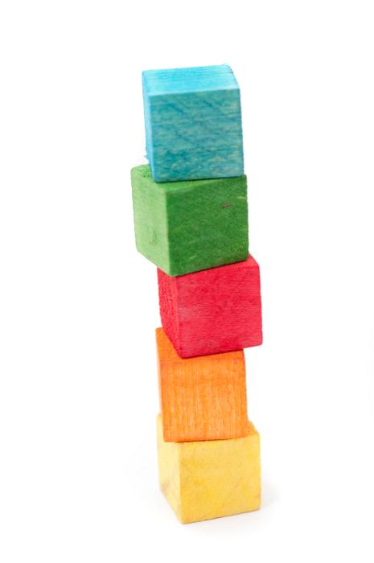
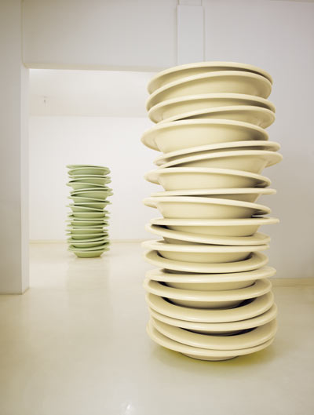

Stack
A stack: an ordered collection of items with the following operations:
push(item): add an item to the stack
pop(): remove an item from the stack, and return its value
isEmpty(): checks if the stack is empty
No bound on the number of elements
Removal follows the last-in-first-out order (LIFO)

Slide 4
Stack
A stack: an ordered collection of items with the following operations:
push(item): add an item to the stack
pop(): remove an item from the stack, and return its value
isEmpty(): checks if the stack is empty
Removal follows a last-in-first-out order (LIFO)
Stack<Integer> s = new Stack<Integer>()
s.push(3)
s.push(5)
s.pop() -- returns 5
s.push(1)
s.push(3)
3
5
3
1
3
3
1
3
3

Slide 5
Stack
Q: How would you implement a stack?
A1: Using ArrayList
push(item) -- add an item to the end of the list
pop() -- remove an item from the end of the list
isEmpty() -- checks if size==0
What is the running time of each operation?
push(item) -- O(1) except sometimes we need to resize. Then runtime is O(size)
pop() -- O(1)
isEmpty() -- O(1)
What would change if we used array[0] as the top of the stack?

Slide 6
Stack
Q: How would you implement a stack?
A2: Using Linked List
push(item) -- add an item to the head of the list
pop() -- remove an item from the head of the list
isEmpty() -- checks if size==0 or head==null
What is the running time of each operation?
push(item) -- O(1)
pop() -- O(1)
isEmpty() -- O(1)
Now all operations run in O(1) time.
Always
Worst case.

Slide 7
Queue

Slide 8
Queue
A queue: an ordered collection of items with the following operations:
enqueue(item): add an item to the queue
dequeue(): remove an item from the queue, and return its value
isEmpty(): checks if the queue is empty
No bound on the number of elements
Removal follows the first-in-first-out order (LIFO)
Example: queue for printer or other resources.
Also, applications in algorithms

Slide 9
Queue
What are the minimal requirements from the linked list?
Doubly linked list?
One-directional list with tail?
Q: How would you implement a queue?
A1: Using Linked List
push(item) -- add an item to the tail of the list
pop() -- remove an item from the head of the list
isEmpty() -- checks if size==0 or head==null
What is the running time of each operation?
push(item) -- O(1)
pop() -- O(1)
isEmpty() -- O(1)
All operations run in O(1) time,
worst case.

Slide 10
Queue
Q: How would you implement a queue?
A2: Using ArrayList
push(item) -- add an item to the tail of the list
pop() -- remove an item from the head of the list
isEmpty() -- checks if size==0 or head==null
What is the running time of each operation?
push(item) -- O(1)
pop() -- O(size)
isEmpty() -- O(1)

Slide 11
Stacks and Queues
Stacks and Queues are the most basic data structure.
They are used everywhere in computer science:
Operating systems
compilers use stack to run our program
Algorithms
We will see an example of a graph exploration algorithms that use stacks/queues.
Recursions be converted into iterations using stack
AI
The above algorithms have applications to AI algorithms (e.g. solving RushHour)
The most basic building blocks. You should all understand them well.

Slide 12
Execution stack and scope of variables

Slide 13
Execution stack
Execution stack / runtime stack / call stack /the stack: is a data structure that stores the information about the functions called during the execution of a program.
For each function the stack stores the following information:
parameters of the function
local variables
return value
return address: When a function completes, it returns control to the function that called it.

Slide 14
Execution stack
int bar (int size) { int i = size+1; return i; } String foo (int n) { String ret = “ABC”; bar(4); bar(8); return ret; } main(String[] args) { foo(5); return 0; }
bar() params: int size = 4 variables: int i =? return value: ? return address: foo line 2
bar() params: int size = 4 variables: int i =5 return value: ? return address: foo line 2
bar() params: int size = 8 variables: int size = 8; int i= ? return value: ? return address: foo line 3
bar() params: int size = 8; variables: int size = 8; int i= 9; return value: ? return address: foo line 3
foo() params: int n = 5 variables: int n= 5; ret = ? return value: return address: main line 1
foo() params: int n = 5; variables: int n= 5; ret = ID28; return value: return address: main line 1
main() params: -- variables:… return value: ? return address: JVM

Slide 15
Execution stack
All local variables of a function are stored in the corresponding stack-frame.
These are primitive types and references to objects
When the function completes, the variables become unavailable.
Objects are stored in "global memory“
They do not die when the function completes.
When we don’t use them anymore, they are released by garbage collector.
Terminology:
Local variables are stored on the stack.
Global variables are stored on the heap.

Slide 16
A comment on recursion

Slide 17
A comment on recursion
How is recursion really implemented inside?
What happens when we make a recursive call?
Wrong answer: my laptop delegates the subtask to other laptops.
Correct answer: the subtask is added on execution stack:
The order in which the functions are called,
Where to return after the function ends
All the local variables of the function
In particular, any recursive function can be implemented non-recursively using stack.
We can do it and we will do it, though not today.

Slide 18
Questions?
Comments?

