Slide 1
CMPT 225
Data Structures and Programming
March 15, 2021

Slide 2
Plan for the rest of the semester
Assignment 4 – for April 02
Final project - for April 16
Final exam – April 19-20 – same format as the midterm

Slide 3
Plan for the rest of the semester
Material left to cover
For the final project you will need
Algorithms for graph exploration – We’ll cover them on Monday, Wednesday.
Hash tables (just a bit) – We’ll get to java.util.HashMap by Friday
For the rest of the semester:
Hash tables - in some depth – March 22-24
Return to self balancing BSTs: AVL trees, B-trees – March 26-29-31
Union-find – April 7-9
Huffman Coding (a very simple compression algorithm)… April 12-14
AI / ML / rocket science… time permitting

Slide 4
Final Project

Slide 5

Final project
For the final project you will write a solver for the Rush Hour game.
You can work on in alone or in pairs
Submit your solutions by April 19.

Slide 6
Final project
For the final project you will write a solver for the Rush Hour game.
Your input will be a file with a rush hour puzzle.
You will need to solve the puzzle,
and write the solution in the output file.
Your solver should be in the class rushhour.Solver.
The class will have a public static method called
public static void solveFromFile(String input String outputPath).
e.g. solveFromFile("c:\\cmpt225project\\A00.txt", "c:\\cmpt225project\\A00.sol")

Slide 7
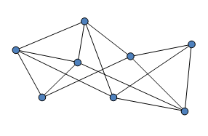
Final project
Key concept we will need is graph traversal.
Given a starting node in a graph, traverse/explore the graph, and find a path to some target node.
Target node
Starting node

Slide 8
Final project
A standard idea to solve this puzzle (or other similar puzzles) is the following:
Consider the graph of all possible states on the game.
We put an edge between two states if we can go from one to the other in one move
Some states represent a solved game (these are the states with red car near the exit)
You are given a starting vertex in a graph
Your goal is to find a path from the starting vertex to a target. Note that there is more than one target vertex.
You don’t need to find the shortest path – any solution is ok
Main problem: the total number of states/vertices is HUGE!
In this example it is probably 10⁶-10⁷ states/vertices

Slide 9
Final project
This week we will discuss graph traversals.
Specifically, we will learn three algorithms:
Breadth First Search
Depth First Search
A*
There are many more traversal algorithms, that consider graphs with lengths on the edges.
We will focus on algorithms where each edge has length 1.

Slide 10
Graphs

Slide 11
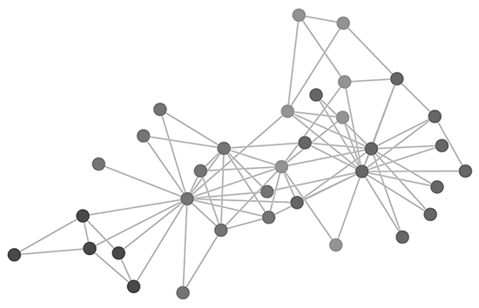
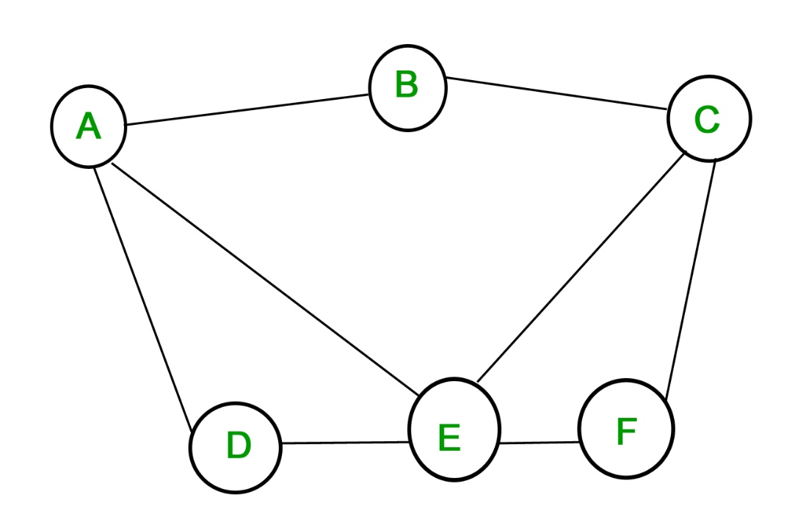
Graphs
Graph: a collection of nodes and a collection of edges, where each edge connects a pair of nodes. Usually denoted G=(V,E).
For us the graphs are always:
undirected (no direction on the edges)
connected:

Slide 12
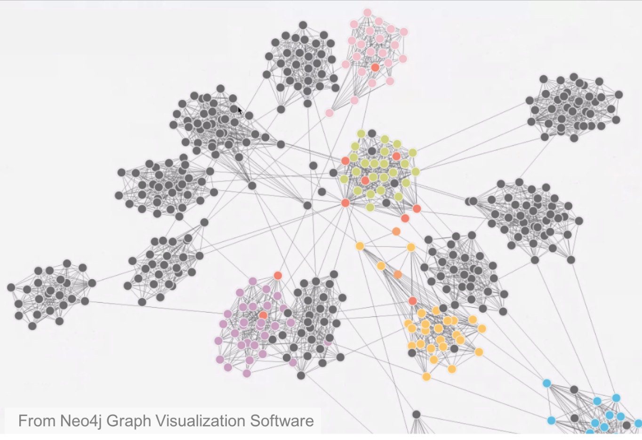
Graphs
Graph: a collection of nodes and edges, where each edge connects a pair of nodes.

Slide 13
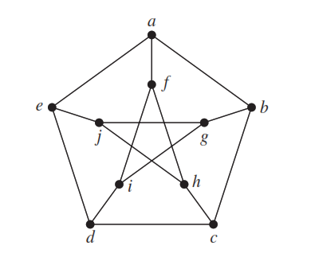
Graphs
Graph: a collection of nodes and edges, where each edge connects a pair of nodes.

Slide 14
Graph representation
There are 2 standard representations:
Matrix representation
Adjacency List representation

Slide 15
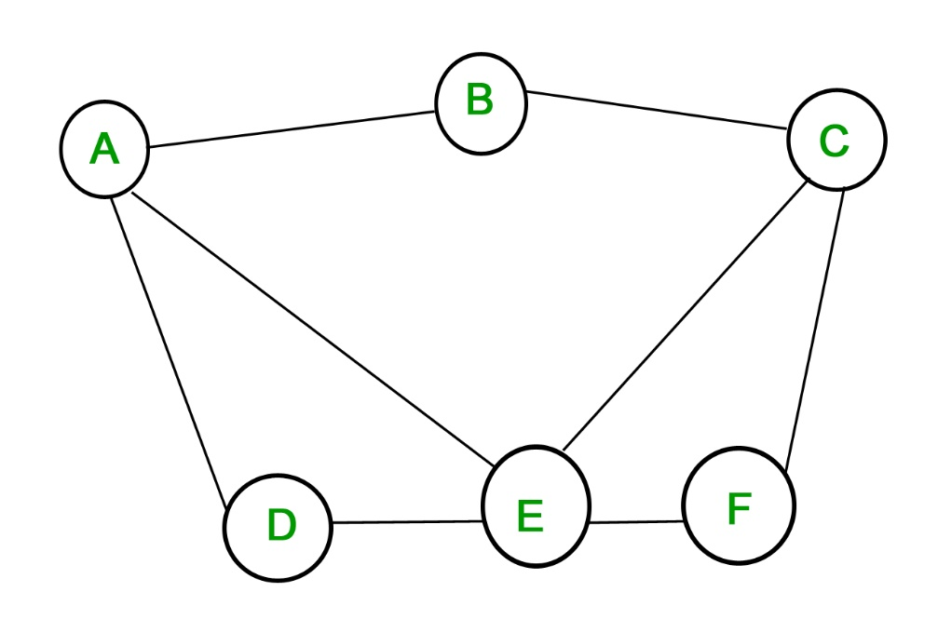
Matrix representation
Given a graph G=(V,E) with |V|=N vertices
A symmetric matrix of size NxN with
M[i,j]=1 if (i,j)∈E
M[i,j]=0 if (i,j)∉E
 | A | B | C | D | E | F
A | 0 | 1 | 0 | 1 | 1 | 0
B | 1 | 0 | 1 | 0 | 1 | 1
C | 0 | 1 | 0 | 0 | 1 | 1
D | 1 | 0 | 0 | 0 | 1 | 0
E | 1 | 1 | 1 | 1 | 0 | 1
F | 0 | 1 | 1 | 0 | 1 | 0

Slide 16
Adjacency list representation
Given a graph G=(V,E) with |V|=N vertices
We have N lists (linked list or array), one for each vertex
The list of a vertex v∈V hold all neighbours of v.
A: | B | D | E
B: | A | C
C: | B | E | F
D: | A | E
E: | A | C | D | F
F: | C | E

Slide 17
Implicit graph representation
It is also possible to without having the graph
For example, because the graph is too large to hold in the memory
We can only store the nodes that we have seen so far.
Similar to exploring a new territory, and creating a map on the fly.
For the project, this is probably the best way.

Slide 18
Breadth First Search

Slide 19
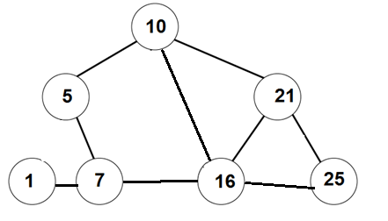
Breadth First Search
Goal: an algorithm that gets a graph G = (V,E), and a starting vertex, and computes the distance from start to all other vertices in G.
BONUS: if for each node v∈V we have the distance from start to v, then we can also compute a shortest path from start to v.
0
1
1
3
2
1
2

Slide 20
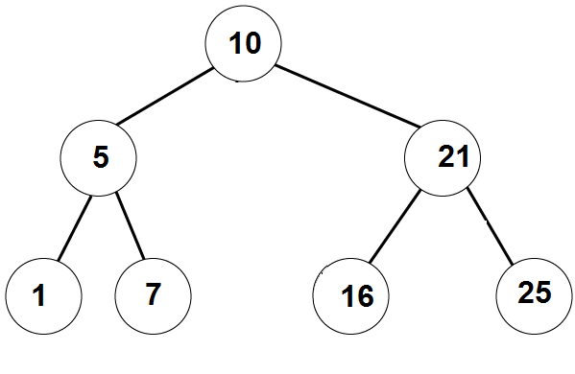
Recall BFS on trees
Breadth Frist Search(Node root):
q = create a queue of nodes
q.enqueue(root)
while (q is not empty):
node = q.dequeue()
print(node.value)
for each child of node
q.enqueue(child)
Print 10
Print 5
Print 21
Print 1
Print 7
Print 16
Print 25
10
5 | 21
21 | 1 | 7
1 | 7 | 16 | 25
7 | 16 | 25
16 | 25
25

Slide 21
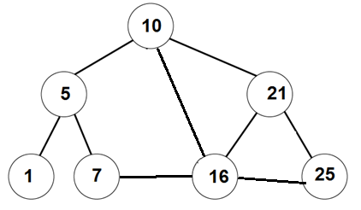
Breadth First Search
Breadth Frist Search(Node start):
q = create a queue of nodes
q.enqueue(start)
while (q is not empty):
v = q.dequeue()
print(v.value)
for each u neighbour of v
q.enqueue(u)
Print 10
Print 5
Print 16
10
5 | 16 | 21
16 | 21 | 1 | 7
21 | 1 | 7 | 7 | 21 | 25
Something is not right here. We return to same nodes more than once.
Solution: mark nodes that have already been visited
Wait, a minute…. When we explored 5, why didn’t we add 10 to the queue?

Slide 22
Breadth First Search
V
V
V
Breadth Frist Search(Node start):
q = create a queue of nodes
Mark all nodes as unvisited
q.enqueue(start)
Mark start as visited
while (q is not empty):
v = q.dequeue()
print(v.value)
for each u neighbour of v
if u is unvisited
q.enqueue(u)
Mark u as visited
V
V
V
V
Print 10
Print 5
Print 16
Print 21
Print 1
Print 7
Print 25
10
5 | 16 | 21
16 | 21 | 1 | 7
21 | 1 | 7 | 25
1 | 7 | 25
7 | 25
25

Slide 23
Breadth First Search
In fact, we can get a bit more out of this algorithm.
Theorem: The vertices of G are added/removed from the queue in the order respecting their distances from the starting node.
That is, all node at distance 1 from start are added to the queue before all nodes at distance 2, etc…
Also, we can get a tree using only nodes of G such that
the distance of each node v from the start is it’s depth in the tree
dist_{G}(start, v) = dist_{Tree}(start, v) = depth_{Tree}(v) for all v∈V

Slide 24
Breadth First Search
V
V
V
Breadth Frist Search(Node start):
q = create a queue of nodes
Mark all nodes as unvisited
q.enqueue(start)
Mark start as visited
while (q is not empty):
v = q.dequeue()
print(v.value)
for each u neighbour of v
if u is unvisited
q.enqueue(u)
Mark u as visited
Set parent(u) = v in the tree
V
V
V
V
Print 10
Print 5
Print 16
Print 21
Print 1
Print 7
Print 25
10
5 | 16 | 21
16 | 21 | 1 | 7
21 | 1 | 7 | 25
1 | 7 | 25
7 | 25
25

Slide 25
Running time
Q: what is the running time of the Breadth First Search algorithm?
A: Observe that we touch every edge exactly twice (once from each side).
This is assuming that G is connected.
Therefore, the total running time is O(|E|) in the adjacency list model.
If the graph is not connected, then the running time is linear in the number of edges in the connected component of start.
*In the matrix representation the running time is O(|V|²)

Slide 26
Depth First Search

Slide 27
Breadth First Search
Almost the same algorithm as BFS,
but we use a stack instead of a queue.

Slide 28
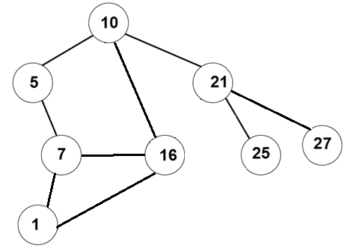
Depth First Search
Depth Frist Search(Node start):
s = create a stack of nodes
Mark all nodes as unvisited
s.push(start)
Mark start as visited
while (s is not empty):
v = s.pop()
print(v.value)
for each u neighbour of v
if u is unvisited
s.push(u)
Mark u as visited
Set parent(u) = v in the tree

Slide 29
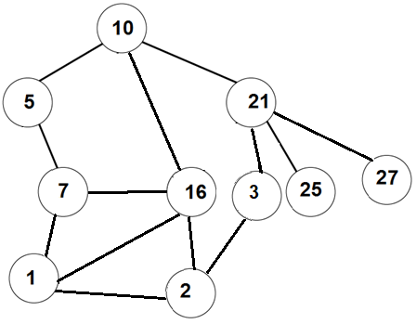
Depth First Search
V
Depth Frist Search(Node start):
s = create a stack of nodes
Mark all nodes as unvisited
s.push(start)
Mark start as visited
while (s is not empty):
v = s.pop()
print(v.value)
for each u neighbour of v
if u is unvisited
s.push(u)
Mark u as visited
Set parent(u) = v in the tree
V
V
V
V
V
V
V
V
V

Slide 30
Depth First Search
V
Depth Frist Search(Node start):
s = create a stack of nodes
Mark all nodes as unvisited
q.enqueue(start)
Mark start as visited
while (q is not empty):
v = q.dequeue()
print(v.value)
for each u neighbour of v
if u is unvisited
q.enqueue(u)
Mark u as visited
Set parent(u) = v
V
V
V
V
V
V
V
V
V
10
5
16
21
7
16
21
1
16
21
2
16
21
3
16
21
16
21
21
25
27
27
27

Slide 31
Running time
Q: what is the running time of the Breadth First Search algorithm?
A: Same as for BFS, we touch every edge exactly twice (once from each side).
This is assuming that G is connected.
Therefore, the total running time is O(|E|) in the adjacency list model.
If the graph is not connected, then the running time is linear in the number of edges in the connected component of start.
*In the matrix representation the running time is O(|V|²)

Slide 32
BFS vs DFS
BFS | DFS
Finds the shortest distance from the starting vertex to all v∈V. | Usually does not give the shortest distance.
Efficient if the target is close to the starting vertex. | Reaches far away vertices quicker.
More structured | More useful for solving puzzles than BFS.
 | Useful for other applications (topological search)
Both create a spanning tree of the connected component.
Both algorithms are uninformed. That is, they don’t have a guess about distance to the target.
Next time: A* - algorithm that uses estimated distance to the target.

Slide 33
Questions?
Comments?

