Slide 1
CMPT 225
Data Structures and Programming
March 17, 2021

Slide 2
Final Project

Slide 3
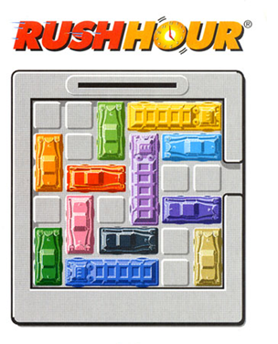
Final project
For the final project you will write a solver for the Rush Hour game.
You can work on it alone or in pairs
Submit your solutions by April 16.

Slide 4
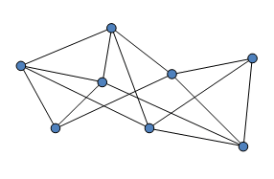
Final project
Key concept we will need is graph traversal.
Given a starting node in a graph, traverse/explore the graph, and find a path to some target node.
Target node
Starting node

Slide 5
Final project
A standard idea to solve this puzzle (or other similar puzzles) is the following:
Consider the graph of all possible states on the game.
We put an edge between two states if we can go from one to the other in one move
Some states represent a solved game (these are the states with red car near the exit)
You are given a starting vertex in a graph
Your goal is to find a path from the starting vertex to a target. Note that there is more than one target vertex.
You don’t need to find the shortest path – any solution is ok
Main problem: the total number of states/vertices is HUGE!
In this example it is probably 10⁶-10⁷ states/vertices

Slide 6
Final project
Last time we talked about:
Breadth First Search
Depth First Search
Today:
A*
Some coding
Some tips and tricks

Slide 7
A* algorithm

Slide 8
A* algorithm
We get a graph G = (V,E), a starting vertex and a target vertex.
Goal: Find a path from start to the target.
More generally: we can have more than one target.
Goal: Find a path from start to any target.
Main difference between A* and BFS/DFS:
A* uses an estimate about the distance from each node to a target.

Slide 9
A* algorithm
BFS and DFS we saw last time perform uninformed search.
That is, they don’t have a guess about distance to the target.
A* - an algorithm that uses estimated distance to the target.
Observation: if for each node v we knew exactly dist(v,target), then we could fine the target easily.
Q: How?
A: If dist(current, target) = 10, then one of the neighbors of current has dist(neighbour, target) = 9.
Move to that neighbour, and now look for a vertex with dist=8.

Slide 10
A* algorithm
A* - an algorithm that uses estimated distance to a target.
Fact: even if we don’t know the distance exactly, A* can find a target faster than BFS/DFS.
Let’s look at the A* algorithm.

Slide 11
A* algorithm
Input:
Graph G = (V,E),
a starting node, a target node,
h(v) – estimated distance from v to target for every node v.h
h stands for heuristic
Goal: find a path from start to target

Slide 12
A*
A* (Node start, Node target):
For each node define:
g(v) - distance travelled from start to v
h(v) – estimated distance from v to target - heuristic
f(v) = g(v) + h(v)
Let OpenQueue be a Priority Queue ordering vertices by f(v), min goes out first
Will be used to hold nodes that are currently processed
Let ClosedSet be a Set
Will be used to hold nodes that have already been processed
Probably implemented using HashSet.
We’ll discuss Sets and HashSets in a bit.
For now, ClosedSet is just a Set, supporting the operations: insert, remove, find

Slide 13
A* (Node start, Node target)
If h(v)=0 for all v, and we use max-PriorityQueue,
we get the DFS algorithm
OpenQueue.add(start)
while (OpenQueue is not empty)
2.1 v = OpenQueue.getMin() -- // min w.r.t f(v) takes O(1) time
2.2 for each u∈v.neighbours() do
2.2.1 if u is a target
Set g(u) = g(v) + 1, set u.parent = v
Return u
2.2.2 Otherwise:
If u is already in OpenQueue with a higher f(u), then update f(u)
Else if u is in the ClosedSet with a higher f(u), then update f(u) and move it to OpenQueue
Otherwise add u to OpenQueue
2.2.3 In all three cases in 2.2.2 set u.parent = v
2.3 Move v to ClosedSet
If h(v)=0 for all v with min-PriorityQueue,
we get the BFS algorithm
If h(v)=dist(v,target) for all v,
we go straight to the target

Slide 14
A* with admissible heuristics
Theorem: if we use min-PriorityQueue and h(v) ≤ dist(v, target) for all v, then A* will *eventually* find the target.
Note that *eventually* depends on:
Computing of h(v) – trade-off between efficiency and precision
Exact implementation of OpenQueue, ClosedSet
How fast .equals() works.
Size of the search space / total number of vertices
Memory used / size of each node
Some luck
(e.g., use randomness to compute h, or prune some branches in the computation)

Slide 15

Some tips for the project
For OpenQueue use Priority Queue ordering vertices by f(v), min goes out first.
For ClosedSet use a HashSet.
Start with the most basic implementation of the games.
Implement hashCode() for your nodes, and use them to quickly check if two vertices are equal.
Consider computing hash in the constructor and just return the value in hashCode().
Some of you will probably see OutOfMemoryError. Try saving the memory in the representation of the board
The board in 6x6, so you can store both x and y of each car in a single byte (8 bits)
Write a method that converts (x,y) to one byte and back.
Good luck!

Slide 16
Questions?
Comments?

