Slide 1
CMPT 225
Data Structures and Programming
March 19, 2021

Slide 2
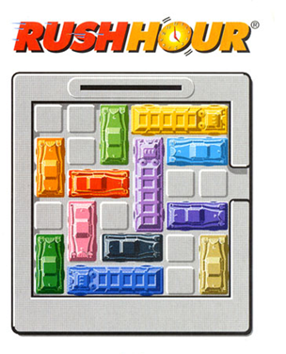
Final project
Last two meeting we talked about:
Breadth First Search
Depth First Search
A*
Today:
Code for BFS/DFS/A*
Some tips and tricks

Slide 3
A* algorithm

Slide 4
A* algorithm
BFS and DFS we saw last time perform uninformed search.
That is, they don’t have a guess about distance to the target.
A* - an algorithm that uses estimated distance to the target.
Observation: if for each node v we knew exactly dist(v,target), then we could fine the target easily.
Q: How?
A: If dist(current, target) = 10, then one of the neighbors of current has dist(neighbour, target) = 9.
Move to that neighbour, and now look for a vertex with dist=8.

Slide 5
A* algorithm
A* - an algorithm that uses estimated distance to a target.
Fact: even if we don’t know the distance exactly, A* can find a target faster than BFS/DFS.
Intuitively we can compare between BFS, DFS and A* as follows:
BFS – uses queue
DFS – uses stack
A* – uses a priority queue
with cost = distance so far + estimated distance to the target

Slide 6
Some tips for the project
For OpenQueue use Priority Queue ordering vertices by f(v), min goes out first.
For ClosedSet use a HashSet.
Start with the most basic implementation of the games.
Some of you will probably see OutOfMemoryError. Try saving the memory in the representation of the board
The board in 6x6, so you can store (x,y,direction) of each car in a single byte (8 bits)
Write a method that converts (x,y, dir) to one byte and back.

Slide 7
Some tips for the project
Try tweaking A* a bit. For example, don’t move nodes from closedSet back to open.
Start with simple (very fast) heuristic functions.
See what happens when you take h(v)=0
Think of more complicated heuristics later
Implement hashCode() for your nodes, and use them to quickly to check if two vertices are equal.
Consider computing hash in the constructor and just return the value in hashCode().
Don’t postpone it. If you haven’t started yet, start working on it today!

Slide 8
Questions?
Comments?

