Slide 1
CMPT 225
Data Structures and Programming
February 5, 2021

Slide 2
Big-O notation

Slide 3
Big-O notation – more examples
What is the running time of the following function?
int foo (int n) {
int i, j, sum = 0;
for (i=0; i<n; i++)
for (j=0; j<i; j=j+1)
sum += 1;
return sum;
}
What is the running time of this function?
Write an equivalent function that is more efficient.

Slide 4
Big-O notation – more examples
What is the running time of the following function?
int bar (int n) {
int i, j, sum = 0;
for (i=0; i<n; i++) {
for (j=1; j<n; j=j*2)
sum += 1; }
return sum;
}
What is the running time of this function?
Write an equivalent function that is more efficient.

Slide 5
Big-O notation – more examples
Often when we want to analyze the running time of recursive algorithms, the running time is not given explicitly, but as a recursive formula.
Example: consider the merge sort algorithm:
Given an array A[0…n-1] of length n do
Let mid = n/2
Sort A[0…mid]
Sort A[mid+1…n]
Merge the two halves // can be done in time O(n)
The running time of the algorithm can be written as
T(n) = 2*T(n/2) + O(n), and T(1) = O(1)

Slide 6
Proof by induction
The running time of merge sort is T(n) = 2*T(n/2) + O(n) and T(1) = O(1).
Claim: T(n) = O(n log(n))
Proof 1: Suppose that T(n) ≤ 2*T(n/2) + Cn and T(1) ≤ C for some constant C.
Let us prove that T(n) ≤ 2Cn*log₂(n) for all n≥2. Proof by induction
Base case: n=2:
T(2) ≤ 2T(1) + C*2 ≤ 4C = 2Cn.
Induction step: suppose the hypothesis holds for 2,3,4…n-1. Let’s prove it for n
T(n) ≤ 2T(n/2) + C*n
≤ 2*(2C*n/2*log₂(n/2)) +Cn [using induction hypothesis]
= 2Cn*(log(n) – log₂(2)) + Cn
= 2Cnlog(n) – 2Cn + Cn < 2C*n*log(n)

Slide 7
Proof using a recursion tree
The running time of merge sort is T(n) = 2*T(n/2) + O(n) and T(1) = O(1).
Claim: T(n) = O(n log(n))
Proof 2: Suppose that T(n) ≤ 2*T(n/2) + Cn and T(1) ≤ C for some constant C.
Let us prove that T(n) ≤ O(n*log₂(n)) by picture
We have log₂(n)+1 levels.
Each level contributes ≤Cn to the running time.
Cn
C*n/2
C*n/2
Therefore, the total running time is ≤Cnlog₂(n), or just O(n log(n)
C*n/4
C*n/4
C*n/4
C*n/4
… … ….
…
C*1
C*1
C*1
C*1
C*1
C*1
C*1
C*1

Slide 8
Big-O notation – more examples
The running time of merge sort is T(n) = 3*T(n/2) + O(n) and T(1) = O(1).
Claim: T(n) = O(n^{log}2⁽³⁾)
Proof: Suppose that T(n) ≤ 2*T(n/2) + Cn and T(1) ≤ C for some constant C.
Let us prove the claim by picture again
We have log₂(n) levels
Cn
The sum in level 0 is n
Sum in level 1 is 3n/2
Sum in level 2 is 9n/4 = (3/2)²n
C*n/2
C*n/2
C*n/2
The sum in level k is (3/2)^{k} n
C*n/4
C*n/4
C*n/4
C*n/4
C*n/4
C*n/4
C*n/4
C*n/4
C*n/4
… … ….
C*1
C*1
C*1
C*1
C*1
C*1
C*1
C*1
C*1

Slide 9
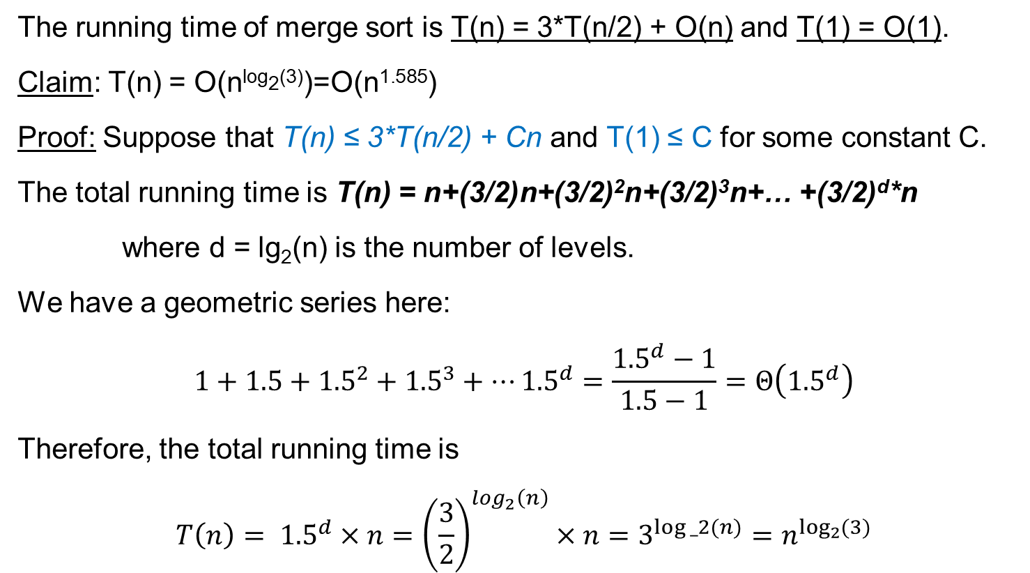
Big-O notation – more examples
The running time of merge sort is T(n) = 3*T(n/2) + O(n) and T(1) = O(1).
Claim: T(n) = O(n^{log}2⁽³⁾)=O(n^{1.585})
Proof: Suppose that T(n) ≤ 3*T(n/2) + Cn and T(1) ≤ C for some constant C.
The total running time is T(n) = n+(3/2)n+(3/2)²n+(3/2)³n+… +(3/2)^{d}*n
where d = lg₂(n) is the number of levels.
We have a geometric series here:
$$1+1.5+{1.5}^{2}+{1.5}^{3}+…{1.5}^{d}=\frac{{1.5}^{d}−1}{1.5−1}=Θ\left({1.5}^{d}\right)$$
Therefore, the total running time is
$$T\left(n\right)= {1.5}^{d}×n={\left(\frac{3}{2}\right)}^{log_{2}\left(n\right)}×n=3^{log⁡_2(n)}=n^{\log_{2}{(3)}}$$

Slide 10
Master Theorem
Master Theorem: Suppose we are given a recurrence relation
T(n) = a*T(n/b) + f(n)
for integers a, b, and some function f.
Let c = log_{b}(a).
Then
If f(n) = O(n^{d}) for some d<c, then T(n) = Θ(n^{c})
If f(n) = Θ(n^{c}), then T(n) = Θ(n^{c} log(n))
If f(n) = Ω(n^{d}) for some d>c, then T(n) = Θ(f)

Slide 11
Master Theorem - examples
T(n) = 2T(n/2) + O(1). Then T(n) = Θ(n log(n))
T(n) = 2T(n/2) + Θ(n) Then T(n) = Θ(n log(n))
T(n) = 2T(n/2) + 3n² Then T(n) = Θ(n²)
T(n) = 4T(n/2) + 4n Then T(n) = Θ(n^{log2(4)}) = Θ(n²)
T(n) = 3T(n/3) + 5n Then T(n) = Θ(n log(n))
T(n) = 4T(n/3) + 5n Then T(n) = Θ(n^{log3(4)}) = Θ(n^{1.26})

Slide 12
Big-O notation – more examples
Consider the following variant of Merge Sort
Given an array A[0…n-1] of length n do
Let k = n/3
Sort A[0…k]
Sort A[k+1…n]
Merge the two halves // can be done in time O(n)
The running time of the algorithm can be written as
T(n) = T(n/3) + T(2N/3) + O(n), and T(1) = O(1)

Slide 13
Slightly more general result
The running time is T(n) = T(n/3) + T(2n/3) + Cn and T(1) = C.
Claim: T(n) = O(n log(n))
Proof:
We have ≤ log_{3/2}(n) levels
Each level contributes ≤Cn to the running time
Cn
C*n/3
C*2n/3
C*n/9
C*2n/9
C*2n/9
C*4n/9
… … ….
Therefore, the total running time is ≤O(nlog(n))
C*1
C*1
C*1
C*1
…
C*1
C*1
C*1
C*1

Slide 14
Recursion

Slide 15
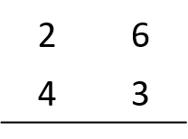






Faster integer multiplication
Input: two positive integers A, B
Output: their product, A*B
Example:
x
+

Slide 16

Faster integer multiplication
Input: two positive integers A, B
Output: their product, A*B
Example of an explicit computation:
26*43 = (20+6) * (40+3)
= (2*4) * 100 + (2*3 + 6*4) *10 + (6*3) *1
= 8*100 + 30*10 + 18*1 = 800 + 300 + 18 = 1118
Crazy method:
26*43 = ?
Units = 3*6 = 18
Hundreds = 2*4 = 8
Tens = (2+6)*(4+3) – Unit – Hundreds = 8*7 –18 – 8 = 30
Answer = 8*100 + 30*10 + 18*1 = 1118

Slide 17
Faster integer multiplication
Goal: Given two positive integers A and B in decimal with n digits each, compute A*B.
Idea: divide and conquer - use recursion.
Let’s write A = a_{n}a_{n-1}a_{n-2}…a₁a₀ and B = b_{n}b_{n-1}b_{n-2}…b₁b₀
represent them as
A = A₁*10^{n/2} + A₀ and B = B₁*10^{n/2} + B₀
Then, we have
A*B = A₁*B₁ * 10^{n} + (A₀*B₁ + A₁*B₀) * 10^{n/2} + A₀*B₀
We can solve each product recursively and then compute the sum?
We make 4 recursive calls. Therefore, the runtime will be
T(n) = 4T(n/2)+O(n) = O(n²).
If we had only 3 recursive calls, then we would get
T(n) = 3T(n/2)+O(n) = O(n^{log2(3)}). = O(n^{1.58})

Slide 18
Integer multiplication in time O(n^{1.58})
Goal: Given two positive integers A and B in decimal with n digits each, compute A*B.
Algorithm: divide and conquer - use a sophisticated recursion.
Let’s write as before
A = A₁*10^{n/2} + A₀ and B = B₁*10^{n/2} + B₀
Define:
U = A₀*B₀
H = A₁*B₁
T = (A₀+A1)*(B₀+B₁) – U – H.
Return H* 10^{n} + T * 10^{n/2} + U
We make only 3 recursive calls (!!!). Therefore, the runtime is
T(n) = 3T(n/2)+O(n) = O(n^{1.58}).
Key observation:
T = (A₀+A1)*(B₀+B₁) – U – H = A₀*B₁ + A₁*B₀

Slide 19
Questions?
Comments?

