Slide 1


Soft_dev_Sensei

Slide 2

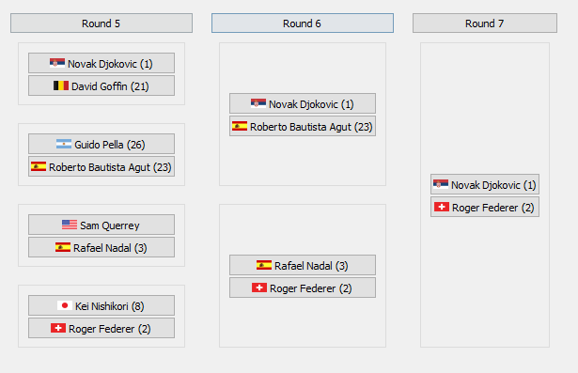
FantasyTennis
nathanesau/FantasyTennis
An interactive draw viewer for tennis
Download brackets from ATP site, and click on players to select winner
View who will play who in future rounds to see bracket luck, etc.

Slide 3
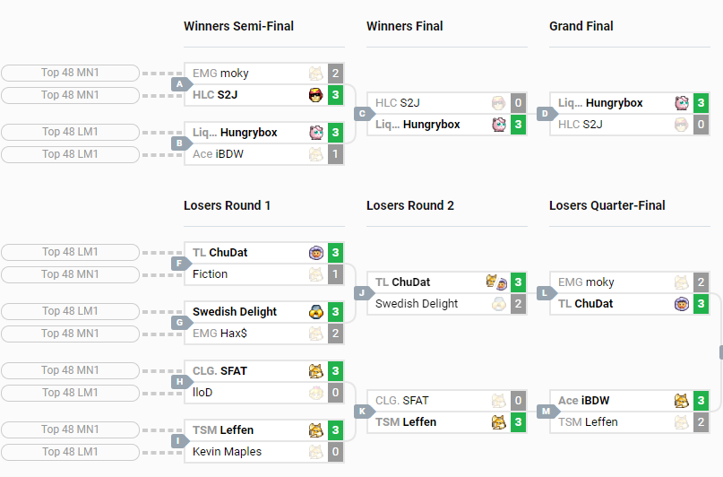
FantasyTennis
nathanesau/FantasyTennis
Inspiration
Always wanted to be able to see who will play who for large events
smash.gg (Shine 2019) – Melee

