Slide 1
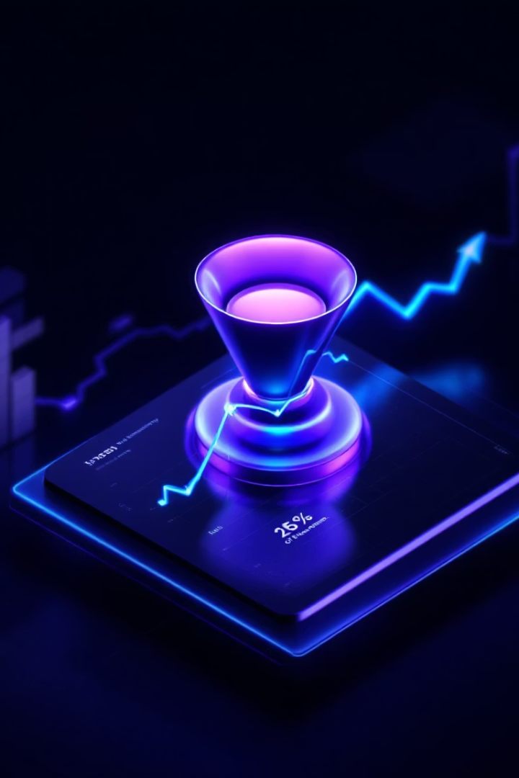
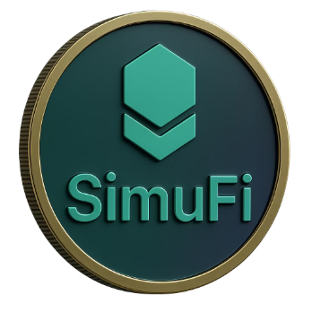


SimuFi: Simulate Your Financial Future
Built for those who want clarity in chaos — no advisors, no spreadsheets, just simulation-backed answers.

Slide 2








Visualise Your Financial Future
Crypto Integration
Investment Modeling
Seamlessly incorporate cryptocurrencies like Bitcoin and Ethereum into your long-term financial planning.
Project your portfolio's performance across different market conditions, from bull runs to bear markets.
Inflation Impact
Real-world Value
See how inflation might erode your purchasing power, and how different assets can help preserve wealth.
Focus on what matters: your actual buying power in the future, not just nominal returns.

Slide 3




Powerful Simulation Engine
Input Your Parameters
Set your starting balance, monthly contributions, and time horizon
Adjust Your Allocations
Customize your mix of traditional and crypto investments
Run Monte Carlo Analysis
See thousands of possible futures based on historical patterns
Gain Actionable Insights
Understand your financial possibilities in plain English

Slide 4
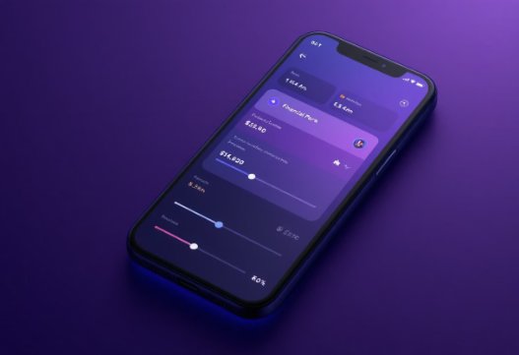
Customize Your Financial Scenario
Key Parameters
Real-Time Updates
Starting balance
Watch your financial projection change instantly as you adjust parameters, helping you understand the impact of different decisions on your future wealth.
Monthly contribution
Investment timeframe
Return expectations
Inflation projections
Crypto allocation percentages
Intuitive Controls
Use simple sliders and dropdowns to adjust your financial inputs without the complexity of spreadsheets or financial jargon.

Slide 5
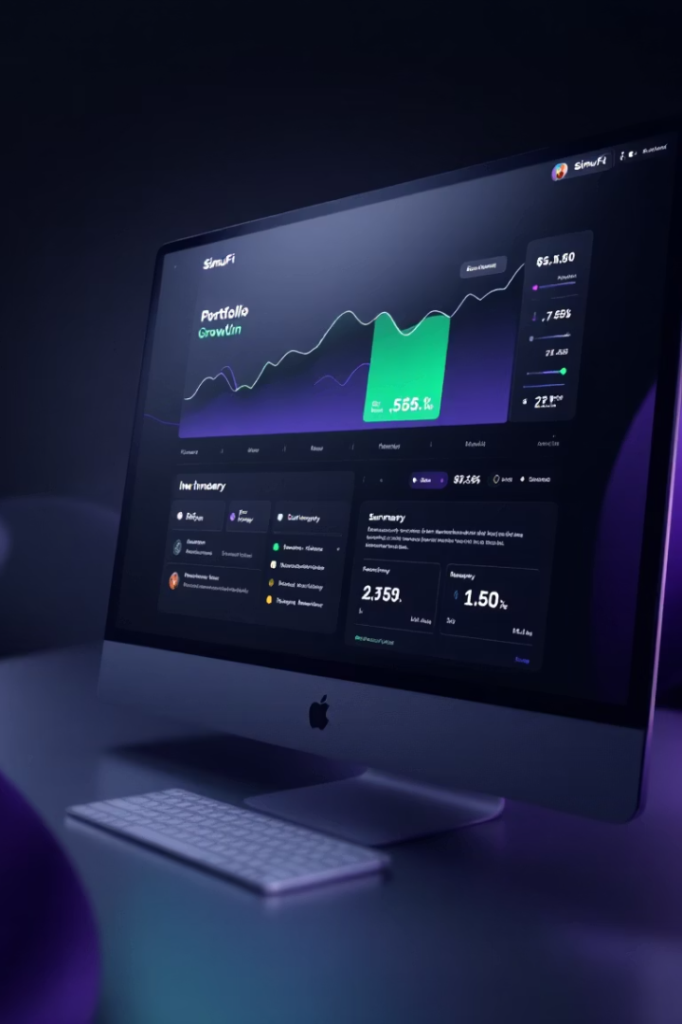




Simulation
SimuFi translates complex financial projections into actionable insights you can understand.
Visual Probability Cones
Real Purchasing Power
See your wealth's likely trajectory with clear confidence intervals showing best and worst scenarios.
All projections show inflation-adjusted purchasing power, not misleading nominal figures.
Visual Growth Trajectory
Results In Plain English
See your wealth's potential path with confidence intervals showing best and worst scenarios
"In 20 years, your real-world buying power could range from $780,000 to $1.25 million, accounting for inflation.

Slide 6

The Future of Investing: Simulation-Powered, AI-Executed
$SIMU Token
Agentic AI Layer
Fully On-Chain
User Simulation Portal
Governance and access in one powerful token.
Advanced AI that executes what it simulates.
Complete transparency in every decision.
Test before you invest.
Try FIRE plans or ETH staking strategies
Share in fund profits via staking
Analyses macro data and on-chain activity
Smart contracts for treasury management
Opt-in for AI-managed allocation
Unlock premium simulations
Runs thousands of simulations daily
All AI decisions publicly visible
Personal insights from collective data
Vote on investment strategies
Executes trades based on expected value
Optional privacy for enterprise users
Simulate before you stake.
Own SimuFi. Guide the future.
GPT meets DeFi strategy
Audit everything. Or fork it.

Slide 7
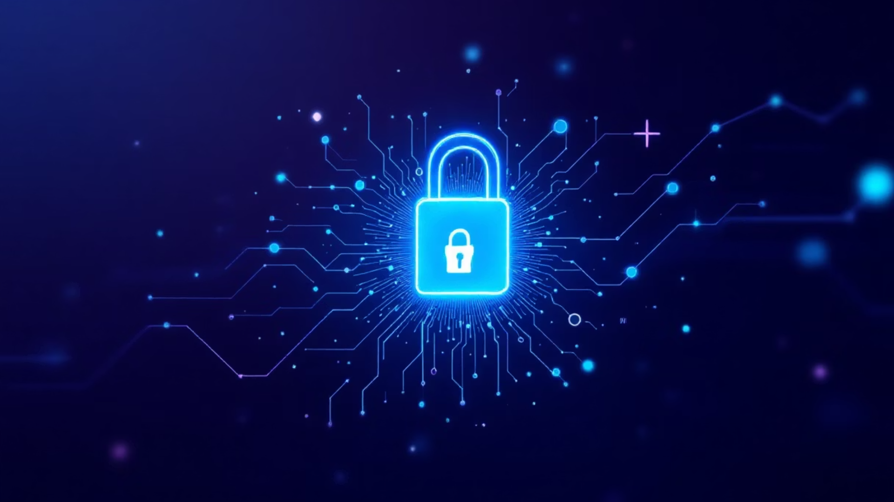




Secure and Privacy-Focused
No Account Required
Local Processing
No Data Collection
Open Source
Run simulations without creating an account or sharing personal information
All calculations happen in your browser—your financial data never leaves your device
We don't track your inputs or store your financial information
Our simulation algorithms are transparent and peer-reviewed for accuracy

Slide 8










How SimuFi Works
SimuFi creates a seamless value loop between users, AI, and token holders.
AI Analysis
User Simulations
Agentic AI processes simulation data to identify optimal investment strategies.
Users run financial simulations to visualise potential wealth trajectories across traditional and crypto assets.
Strategy Execution
Users choose between SaaS guidance or joining the collective DeFi fund.
Value Distribution
Performance Feedback
Fund profits flow back to $SIMU token holders who stake in the ecosystem.
Real-world results feed back to improve future simulations and strategies.
This continuous feedback loop creates a self-improving financial ecosystem that benefits all participants.

Slide 9



What Our Users Are Saying
Financial Clarity
Confidence in Planning
Decision Support
"SimuFi finally helped me understand how my crypto investments fit into my overall financial picture. The visualisations make complex concepts instantly clear." — Joshua H, Crypto Investor
"I've always been intimidated by financial planning. SimuFi's approach removes the jargon and shows me exactly what I need to know." — Rice S, Government Employee
"The ability to quickly test different scenarios has completely changed how I make investment decisions. It's like having a financial advisor in my pocket." — Ben P, Legal Paper Filer

Slide 10
Ready to See Your Financial Future?
10,000+
$2.5B
97%
Simulations Run
Assets Modeled
User Satisfaction
Users gaining clarity about their financial futures daily
From traditional investments to cutting-edge crypto portfolios
Investors report increased confidence in their financial decisions

