Slide 1
Ocular Disease Recognition
Date: 15-01-2024
Nguyễn Anh Thắng - ITCSIU21233
Ngô Thị Thương – ITCSIU21160
Trịnh Quang Anh - ITCSIU21164
Nguyễn Thành Khiêm - ITCSIU21137
International University - HCMIU

Slide 2
Problem Statement
According to the World Health Organization (WHO), there are around 2.2 billion people who are visually impaired worldwide, and at least 1 billion of these cases might have been prevented.
Ocular diseases can be very severe and lead to blindness. Therefore, early identification of the disease can lessen the severity of the condition.
Here, we have solved this problem using some Deep Learning models to predict whether an image belongs to Normal or Cataract category and also made a comparison among them.
*
International University - HCMIU
‹#›

Slide 3
Introduction
Ocular disorders have become more prevalent throughout time, with one of the causes being changes in human behaviour patterns brought on by technology and the creation of technological equipment.
The diagnosis of ocular pathology using fundus images is a significant difficulty in health care.
The aim of our project is to develop a combination of feature extraction methods and Neural Networks to recognize common types of visual disorders using the fundus images.
Fundus photographs are ocular documentation that record the appearance of a patient’s retina.
*
International University - HCMIU
‹#›

Slide 4
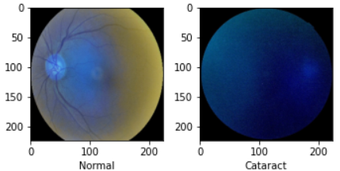
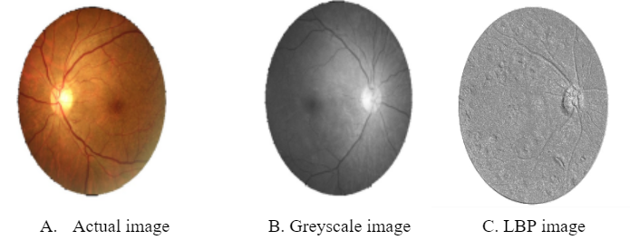
Dataset
This dataset contains 7000 images with 5000 training images and 1000 testing images.
This dataset contains various types of eye images such as Diabetes, Glaucoma, Cataract, Related Macular Degeneration, Myopia, Hypertensive Retinopathy and other ones.
The features of the image are extracted through lbp feature extractor.
*
International Institute of Information Technology, Naya Raipur
‹#›

Slide 5
Models
VGG19 : It is a convolutional neural network trained on a subset of the ImageNet dataset, a collection of over 14 million images belonging to 22,000 categories.It has 138 million parameters with a total of 19 layers including weights.
ResNet50 : It is a convolutional neural network that is 50 layers deep. A 7×7 kernel convolution alongside 64 other kernels with a 2-sized stride. A max pooling layer with a 2-sized stride. 9 more layers—3×3,64 kernel convolution, another with 1×1,64 kernels, and a third with 1×1,256 kernels.
*
International University - HCMIU
‹#›

Slide 6
Models
Vision Transformer : It applies a Transformer-like design to selected areas of the picture. A sequence of vectors is created by dividing a picture into fixed-size patches, linearly embedding each one, adding position embeddings, and then feeding the assembled vectors to a conventional Transformer encoder.
*
International University - HCMIU
‹#›

Slide 7
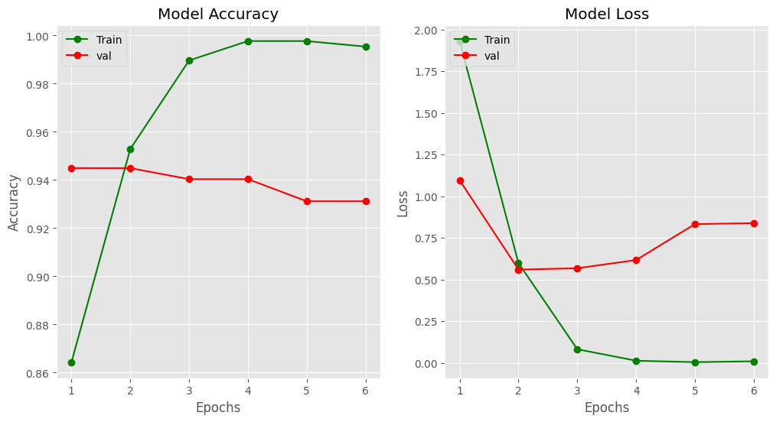
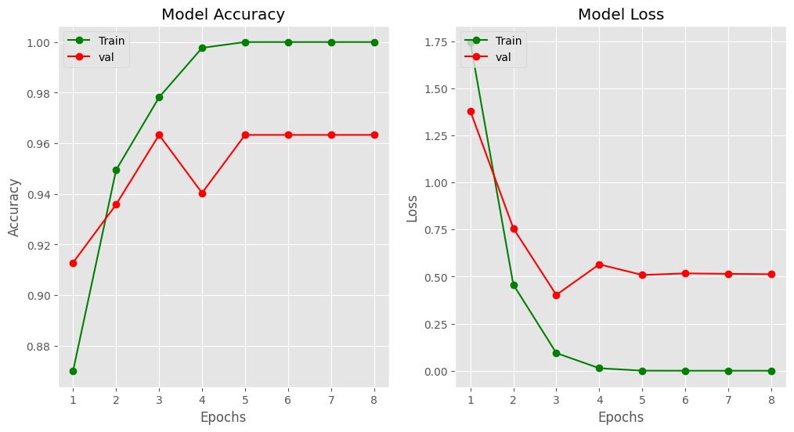
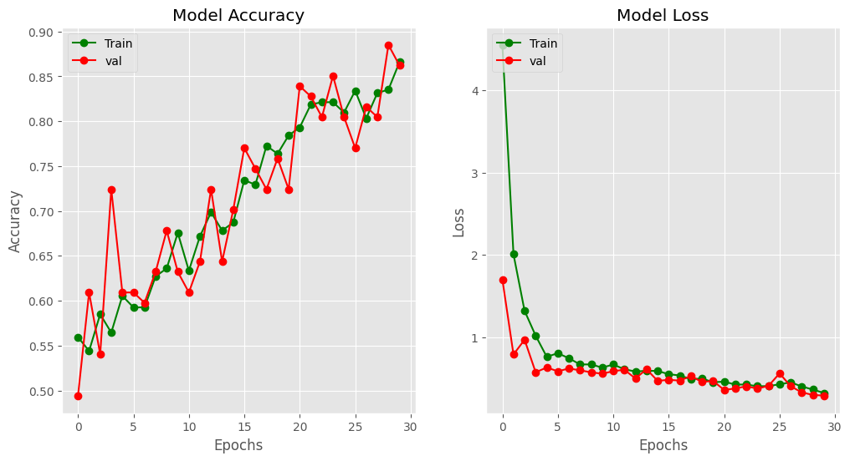
Accuracy vs Epoch
VGG19
ResNet50
Vision Transformation

Slide 8
Loss vs Epoch
VGG19
ResNet50
Vision Transformation

Slide 9
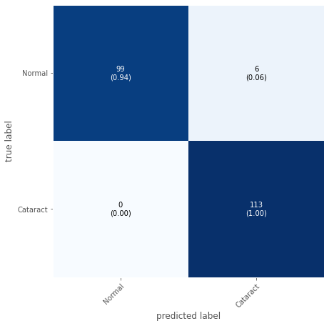

Confusion Matrix
VGG19
ResNet50

Slide 10
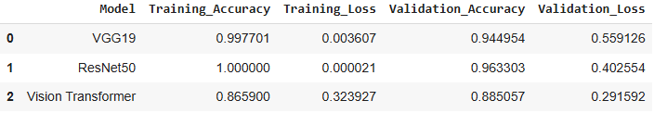
Result Comparison

Slide 11
Novelty
Previous approaches often utilized raw images directly without applying additional feature extraction techniques.
In this project, raw images were used without implementing Local Binary Patterns (LBP).
Instead, the model was designed to learn features directly from the raw images during the training process.

Slide 12
Thank You
..
*
International University - HCMIU
‹#›

