Slide 1
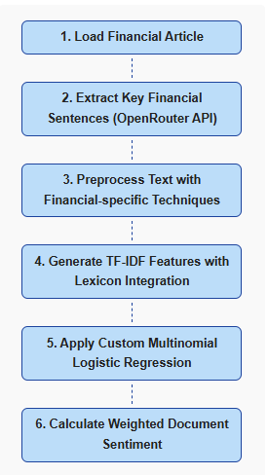
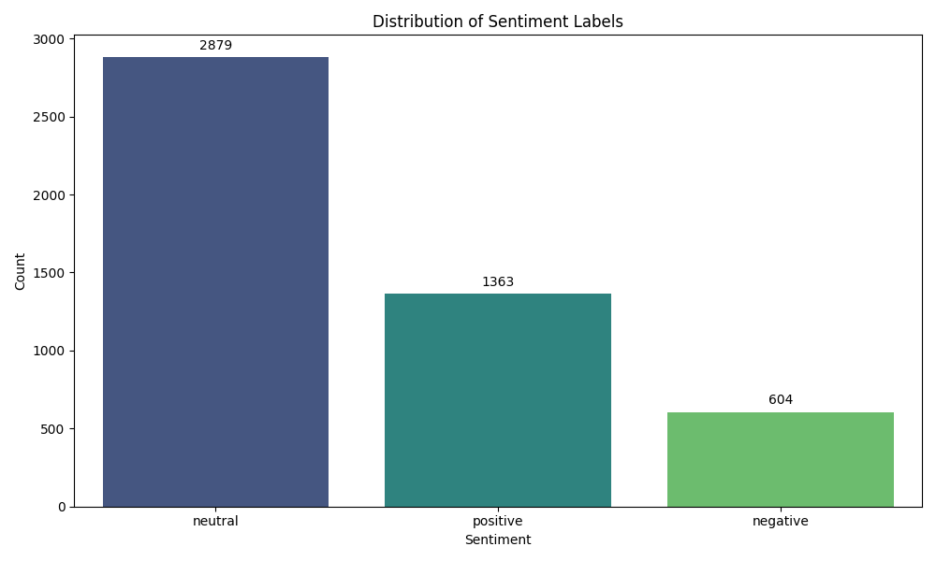
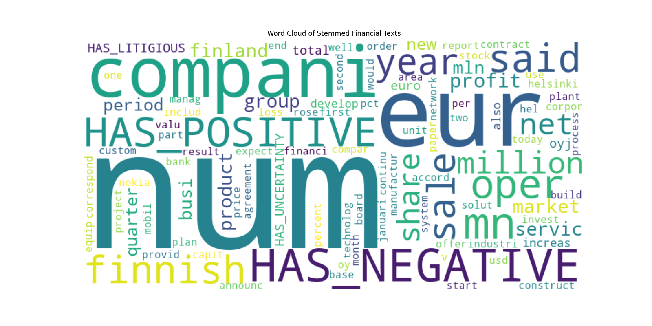
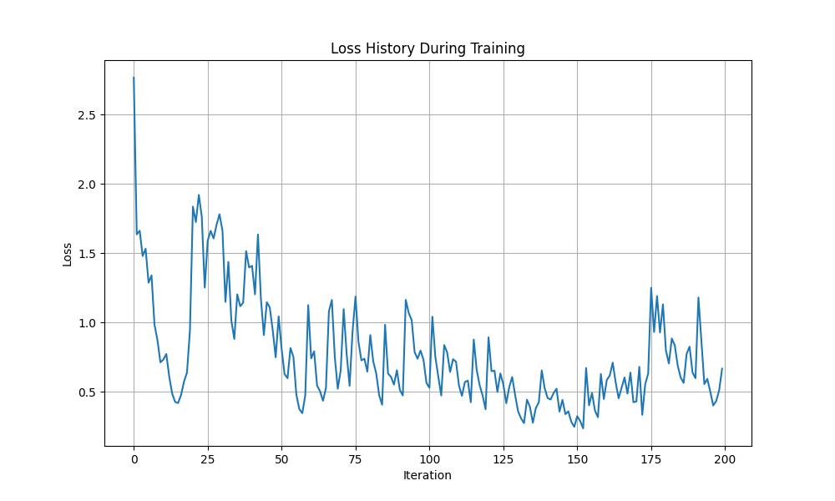
Financial Sentiment Analysis Using Custom Multinomial Logistic Regresssion
A Domain-Specific Approach to Financial Text Classification
Authors: Nathan Nguyen & Camela Phung
Abstract
Dataset and Preprocessing
Results and Performance
Conclusion
This project implements a financial sentiment analysis system using a multinomial logistic regression model.
The system analyzes financial news articles to determine sentiment (positive, negative, or neutral) by leveraging domain-specific financial lexicons and advanced text preprocessing techniques.
Our implementation achieves reasonable accuracy without relying on complex deep learning architectures, demonstrating the effectiveness of well-engineered classical machine learning approaches for specialized text classification.
We used the Financial Phrasebank dataset, containing manually labeled financial news sentences. The dataset exhibits significant class imbalances:
Our custom multinomial logistic regression model achieved an overall accuracy of 65.26% on the test set.
End-to-end sentiment analysis pipeline:
Future directions:
Temporal analysis to track changes.
Semi-supervised learning to leverage unlabeled financial texts
Utilize better performing models for production
Better JSON parser
Class | Precision | Recall | F1-score | Support
Negative | 0.45 | 0.62 | 0.52 | 121
Neutral | 0.76 | 0.74 | 0.75 | 576
Positive | 0.55 | 0.48 | 0.51 | 273
Macro avg | 0.59 | 0.61 | 0.59 | 970
Weighted avg | 0.66 | 0.65 | 0.65 | 970
Preprocessing Pipeline:
Text normalization
Tokenization and Porter Stemming
Loughran-McDonald financial lexicon
Stop word removal with preservation of negation
TF-IDF feature extraction
The model performed best on the neutral class (F1=0.75), reflecting the class imbalance.
Introduction and Motivation
Financial sentiment analysis presents unique challenges compared to general sentiment analysis due to the specialized terminology and nuanced expressions found in financial texts. Words that appear neutral in everyday contexts may carry strong sentiment signals in financial reporting.
Our approach aims to balance accuracy with interpretability and efficiency by implementing a multinomial logistic regression model tailored for financial text.
This project demonstrated the effectiveness of a multinomial logistic regression model for financial sentiment analysis.
By integrating domain-specific knowledge through the Loughran-McDonald lexicon and implementing several model enhancements, we achieved competitive performance while maintaining computational efficiency.
This task remains a challenging but valuable application of NLP, with potential impact on investment decisions, and market analysis.
Key Findings
Domain-specific feature engineering significantly improves performance for financial texts
Financial sentiment classification benefits from less regularization
Gradient clipping is crucial for handling the extreme gradients that occur with sparse financial text features
Class imbalance remains a significant challenge, particularly for negative sentiment detection
Lexicon-based features ("HAS_POSITIVE", "HAS_NEGATIVE") were among the top 10 most influential features
Model Architecture
Multinomial logistic regression model with several enhancements designed specifically for financial text classification:
Mini-batch gradient descent
L2 regularization
Gradient clipping
Loss function: Cross-entropy with L2 regularization
Acknowledgements
LOUGHRAN, TIM, and BILL MCDONALD. “When Is a Liability Not a Liability? Textual Analysis, Dictionaries, and 10‐KS.” The Journal of Finance 66, no. 1 (January 6, 2011): 35–65. https://doi.org/10.1111/j.1540-6261.2010.01625.x.
Malo, P., Sinha, A., Korhonen, P., Wallenius, J., & Takala, P. (2014). Good debt or bad debt: Detecting semantic orientations in economic texts. Journal of the Association for Information Science and Technology, 65(4), 782-796. https://doi.org/10.48550/arXiv.1307.5336
Yang, L., Lin, J., Liang, X., & Zhou, Y. (2020). FinBERT: A Pre-trained Financial Language Representation Model for Financial Text Mining. http://dx.doi.org/10.48550/arXiv.2006.08097

