Slide 1


Revenue Audit, [CLIENT]
[DATE]
TO EDIT

Slide 2


2
Agenda
1
Introduction
TO EDIT
Revenue Audit findings
3
Competency-Gap Analysis per Building Block
4
6-month Roadmap

Slide 3
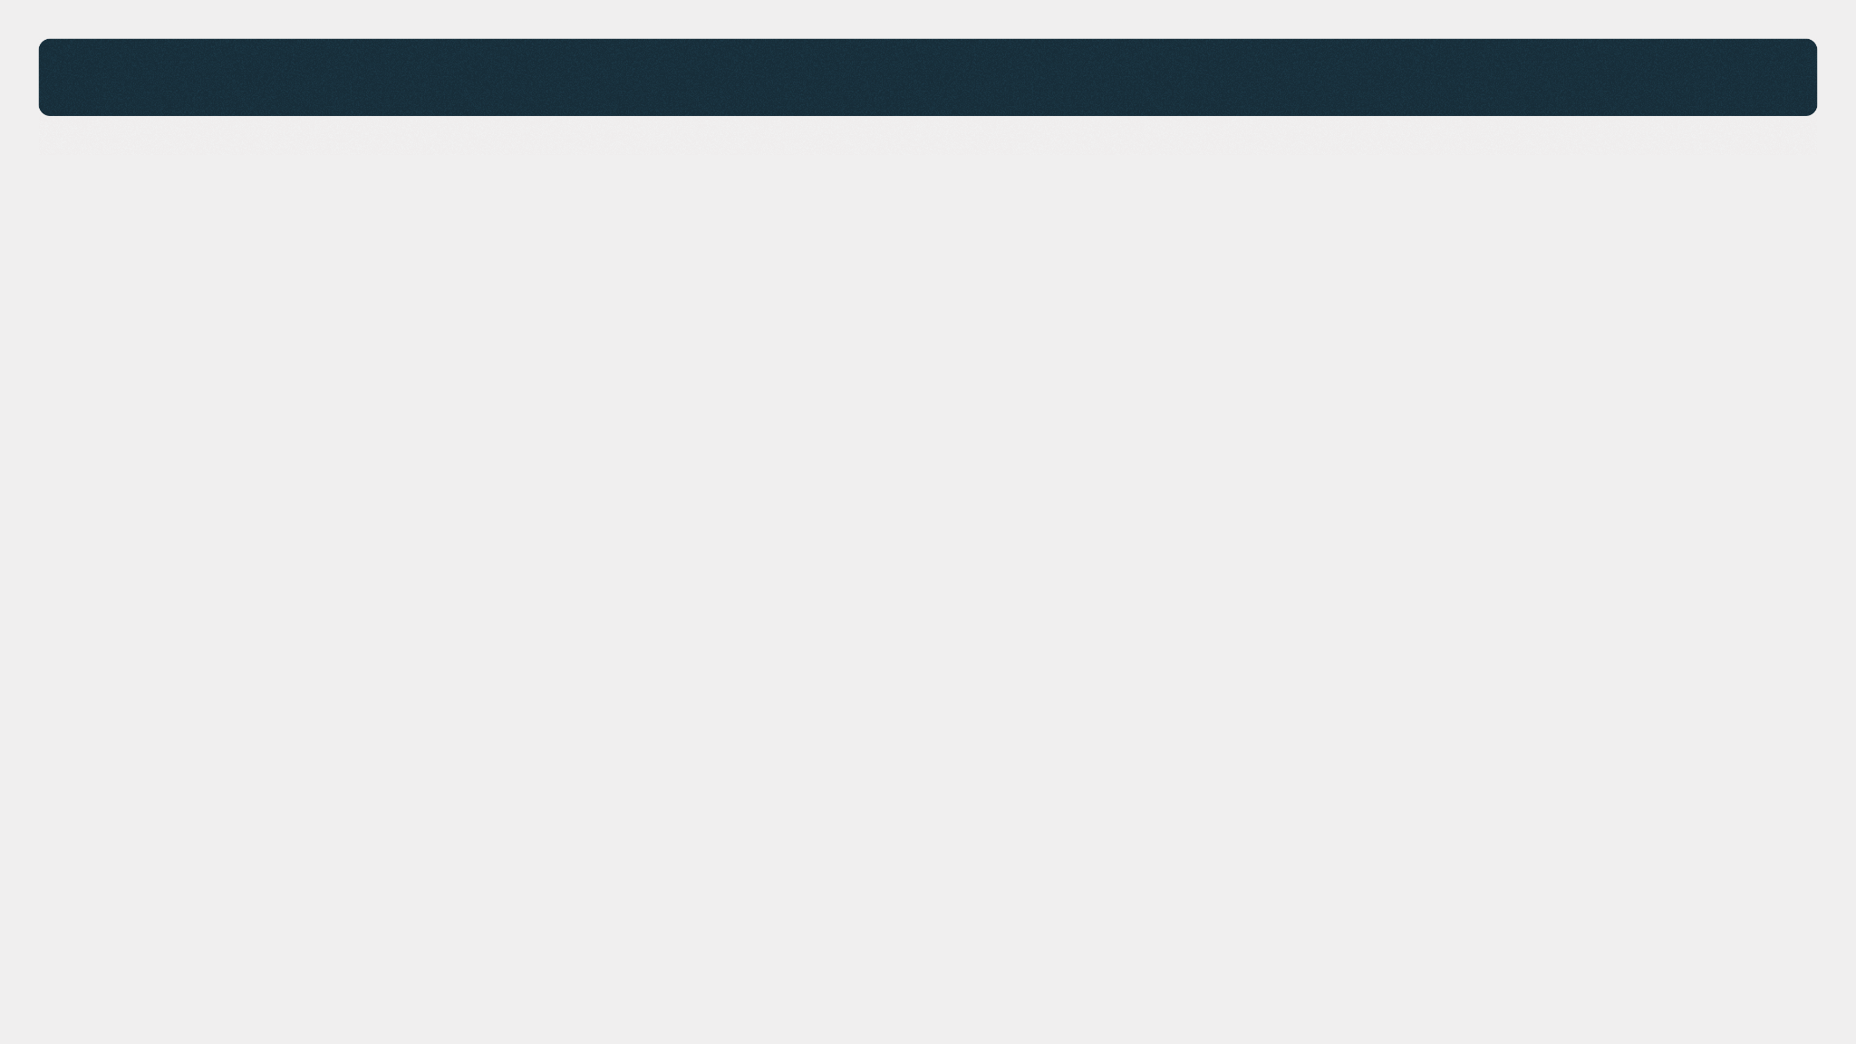
Diagnosis - Executive Summary
[CLIENT] is a success story in the making — a company on its way to €1 billion in revenue, with real product and technology strength, and a global footprint that few European SaaS companies achieve. The ambition is there. The market is there. The question is whether the Enterprise organization is built to match it.
Today, it is not.
Enterprise is a new motion for [CLIENT] — and the gap between what it requires and what currently exists is significant. The performance culture, the Revenue Operations and the Enablement infrastructure: none of these are calibrated for Enterprise. [CLIENT] built a world-class SMB / Lower Mid-Market engine. Upper Mid-Market / Enterprise is a different motion, with specific needs to deliver revenue.
The lack of a clear definition of success and common KPIs to hold responsible parties accountable, and drumbeat the Enterprise organization, is creating smoke on the road. The Enterprise team must level-up in hiring processes, monitoring of ramp-up performance, upper-funnel activities and mastery of Enterprise sales skill set, and should start building granular close-the-gap plans at individual levels.
Enterprise teams require more support headcounts per sales head to operate than SMB teams: Sales Engineers to support complex cycles, Sales Enablement to arm reps with the right tools, Revenue Operations to drive pipeline visibility and forecast accuracy. [CLIENT] Enterprise is currently understaffed in every one of these functions, and the team does not possess yet the hard skills to perform with scarce resources.
Until this changes, quota attainment will remain structurally capped. If [CLIENT] Enterprise wants to compete in the A-League, it must start acting like an A-League franchise.
With these changes and investments, we will then be a position to build a team of A-players.
A 6 to 9-month transformation will be needed to take [CLIENT] Enterprise team to high performance levels.
TO EDIT

Slide 4
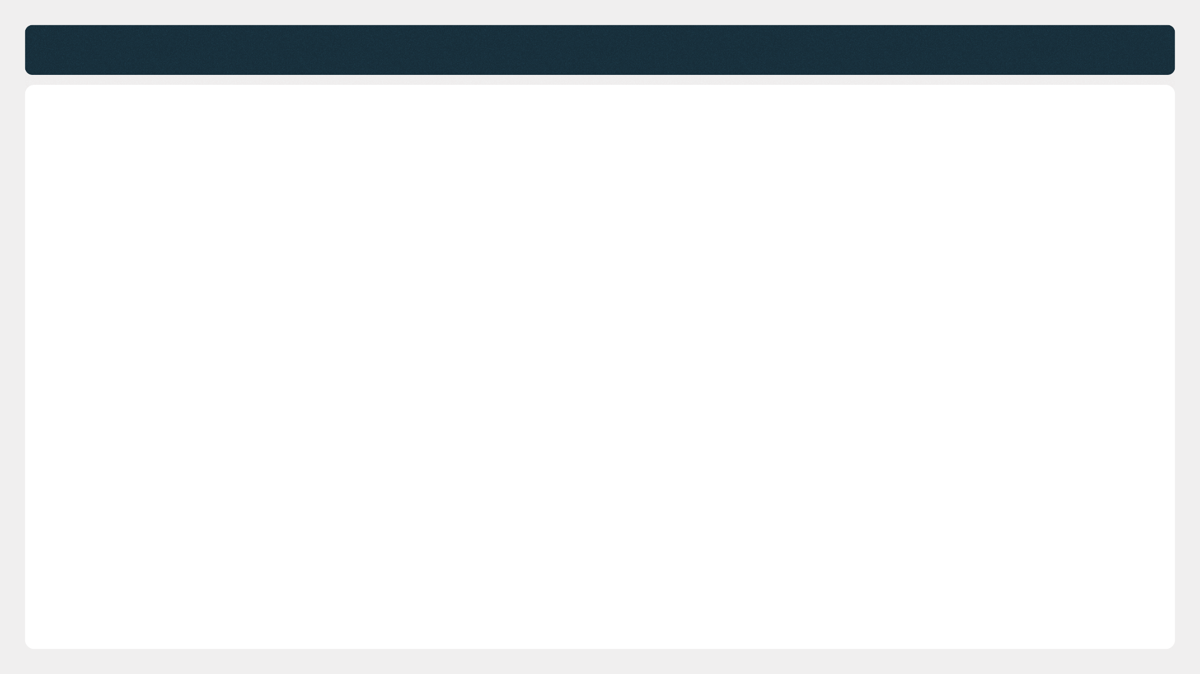




A specific Diagnosis methodology
Diagnosis Restitution
TO EDIT
Data Analysis
Self-assessment
1:1 Interviews
Shadowing
We collected company data and analyze data 20+ documents, at both macro and micro-level.
We sent a 160 questions assessment to a selected group of 3 respondents, all executives.
We performed 25 individual interviews with pre-selected employees working at [CLIENT], from C-Suite members to Sales People.
We’ve observed and shadowed your sales team during team meetings and client conversations.

Slide 5

Strong foundations for success
Diagnosis Restitution
Global Footprint
Untapped opportunity
Product Suite
TO EDIT
[CLIENT]'s international presence and recent acquisitions serves as a step for Enterprise motion to enter new markets.
Partnerships / Indirect Sales channel is barely launched - large companies in this space usually have roughly 50% of their revenue coming from indirect sales motions.
[CLIENT] can address multiple needs, allowing reps to always find a way-in corporates, a critical enabler for land-and-expand strategies, which is the playbook of enterprise sales motions.
Team Engagement & commitment
Senior Management
Reps at [CLIENT] want to perform, they are willing to grow and want to drive change
The new leadership has already initiated the right actions: driving change management, and pushing for accountability.

Slide 6


8 Building Blocks have to be mastered to achieve profitable growth
Diagnosis Restitution
Sales Hiring & Ramp-up
Sales Enablement
Sales Performance
management
Sales Reps Excellence
Talent Management
Demand Generation
Sales Execution
Client relationship
Sales engine
Revenue Operations

Slide 7









Our model captures the quintessence of top-tier performance
Diagnosis Restitution
Sales Hiring & Ramp-up
Sales Enablement
Sales Performance Management
Talent Acquisition
Hiring process
Sales Methodology
Sales Collaterals
Sales Performance Routine
Sales Floor Animation
Sales Reps Excellence
New hire onboarding
New hire ramp-up
Sales Playbook
Sales Training
Under & Top Performance Management
Talent Management
Org Structure
Career Path
Coaching of First Line Sales Managers
Manager Academy
Demand Generation
Sales Execution
Client Relationship
Demand Generation Strategy
Team Structure & Ownership
Prospection
Discovery & Qualification
Client Territory Planning
Outreach Strategy, SLAs & Quotas
Alignment with Sales
Campaign Management
Full funnel data
Demo
Proposal & negotiation
Closing
Portfolio Growth & Churn Prevention
Sales Engine
Revenue Operations
Go-to market & process
Target-Setting, Compensation Plans, Forecasts
Sales Toolstack

Slide 8
2
Agenda
1
Introduction
Revenue Audit findings
3
Competency-Gap Analysis per Building Block
4
6-month Roadmap

Slide 9
Sales Hiring & Ramp-Up :
Diagnosis Synthesis
X.X
X.X
[CLIENT] Grade :
Assessment vs. best in class
1
2
3
4
5
Key takeaways
Initiatives recommended
Talent Acquisition
Process for headcount planning
Pipeline management and use of data in Talent Acquisition
Hiring process
Documentation of feedback
Assessment of candidates
Hiring Process
Case studies
Evaluation of candidate fit with company values
Hiring committee
Acquisition of interviewing skills
Evaluation of candidates competencies
New Hire Onboarding
Sales onboarding program
Accountability and ownership for decreasing ramp-up time
Presence and check-in of direct line manager during first weeks
Peer-to-peer knowledge sharing
Prospect list received day 1
New Hire Ramp Up
Bank of pitches and demos at disposal
Mock calls and demos
Velocity to acquire confidence in pitching our product
Assessment of the product knowledge of new hires
Immediate course-correction of knowledge gaps
Atscale assessment
[CLIENT] self-assessment

Slide 10
Sales Enablement :
Diagnosis Synthesis
2.2
X.X
[CLIENT] Grade :
Assessment vs. best in class
1
2
3
4
5
Key takeaways
Initiatives recommended
Documentation culture
Knowledge Management
Capture and Organize Knowledge
Knowledge Sharing
Training and Onboarding
Continuous Learning
Feedback and Improvement
Importance of sales enablement
Sales Collaterals
Sales enablement platform
Sales enablement materials
Monitoring of results of sales enablement actions
Sales Playbook
Playbooks
Accuracy of Playbook
Leveraging top performers
Ownership
On-boarding including sales training
Training calendar
Sales trainer
Sales Training
Train the trainer
Curriculum
Training quality measurement
Training ROI
Manager's involvement
Budget
Atscale assessment
[CLIENT] self-assessment

Slide 11
Sales Performance Management :
Diagnosis Synthesis
X.X
X.X
[CLIENT] Grade :
Assessment vs. best in class
1
2
3
4
5
Key takeaways
Initiatives recommended
Comprehensive measure of performance
One single source of truth
Sales Performance Routines
Consistency of performance management across teams
Quality of pipeline reviews
Task prioritization
1:1 Structure
Performance based coaching plans
Sales Blitz
Gamification
Sales Floor animation
SPIFF
Sales Floor Routines
Role play simulation between IC
Remote floor animation
Management of underperformance
Performance Expectations
Under & Top Performance Management
Performance Feedback
Performance Improvement Plans
Performance Transparency
Training and Development
Top Performance Management
Atscale assessment
[CLIENT] self-assessment

Slide 12
Talent Management :
Diagnosis Synthesis
X.X
X.X
[CLIENT] Grade :
Assessment vs. best in class
1
2
3
4
5
Key takeaways
Initiatives recommended
Latest organizational update
Org Structure
Easiness of organizational change
Clarity of process of organizational change
Prescriptor for organizational change
Career Path and Competency Framework
Robustness of Career Path
Robustness of Competency framework
Applying Competency Framework to Performance reviews
Perception of Performance Review Process
Homogeneity Performance Review Process
Employee Engagement
Link between Performance Reviews & Compensation
Perform and Develop mindset
360 performance reviews
Individual Development Plans
Measure of Employees' Engagement
Maturity in Future of work
Maturity in Management Trainings
Manager Academy
Onboarding of First-Time Managers
Curriculum Design for Managers
Curriculum per Management Level
Measurement of Impact of Management Trainings
Atscale assessment
[CLIENT] self-assessment

Slide 13
Demand Generation :
Diagnosis Synthesis
X.X
X.X
[CLIENT] Grade :
Assessment vs. best in class
1
2
3
4
5
Key takeaways
Initiatives recommended
Demand Generation Strategy
Market segmentation
Dedicated demand generation budget
Brand awareness
Competitive analysis
Team Structure & Individual Ownership
Demand Generation Manager
Hiring prioritisation
Advanced KPI system
Pods of specialist contributors
Sales Alignment
Alignment with Sales
Sales enablement
Cross-team communication
Improved Lead Forecasting
Campaign Management
Experimentation Framework
Identifying scalable Lead Generation Campaigns
ROI & CAC calculation
Granular campaign reporting
Central performance dashboard
Full Funnel Data
Lead management system
Full funnel definition
Monitoring of all Funnel Stage Indicators
Atscale assessment
[CLIENT] self-assessment

Slide 14
Sales Execution :
Diagnosis Synthesis
2.6
X.X
[CLIENT] Grade :
Assessment vs. best in class
1
2
3
4
5
Key takeaways
Initiatives recommended
Prospecting Methodologies & techniques
Prospection
Tools & Technology
Target Market analysis
Performance monitoring
Discovery & Qualification
Discovery Techniques
Qualification Criterias
Active listening
Questioning skills
Personalization & Customization
Demo
Showcasing demo methodology
Demo technical environment
Post-demo follow-up strategies
Proposal & Negotiation
Proposal customization
Proposal presentation process
Negotiation skills and strategies
Pricing conversations
Sense of Urgency
Closing
Building trust
Existing clients reference checks
Post-closing & relationship building
Atscale assessment
[CLIENT] self-assessment

Slide 15
Client Relationship :
Diagnosis Synthesis
X.X
X.X
[CLIENT] Grade :
Assessment vs. best in class
1
2
3
4
5
Key takeaways
Initiatives recommended
Sizes of book of business
Client Territory Planning
Attribution of new customers in our Account Managers or Customer Success team
Tiering & Customer segmentation
Alignment of customer segmentation with career path
Automation of tasks for the long tail
Outreach Strategy, SLAs & Quotas
Service Level Agreements
Account Managers or Customer Success quotas
Quota achievements
Product adoption and roll-out
Target-driven mindset
Opportunity mapping
Upselling skills
Competition knowledge
Portfolio Growth & Churn Prevention
Product expertise
Seniority of Account Managers or Customer Success reps
Churn prevention
Customer satisfaction
NPS
Business Reviews
Sanity checks
Atscale assessment
[CLIENT] self-assessment

Slide 16
Revenue Operations :
Diagnosis Synthesis
X.X
X.X
[CLIENT] Grade :
Assessment vs. best in class
1
2
3
4
5
Key takeaways
Initiatives recommended
Knowledge of Total Addressable Market
Quality of definition of Persona and ICPs
Go-to-Market & Sales Process
Fit between Go-to-Market and Annual Contract Value
Definition and Optimization of Sales channels
Definition of sales process
Analysis of sales process
Optimization of sales process
Target definition for sales population
Target definition for Account Managers or Customer Success teams
Target-setting, Forecasts & Performance Monitoring
Compensation plans
Sales forecasts
Bottom-up and top-down forecasts for financial planning
Accuracy of forecasts
Sales forecast methodology
Monthly and Quarterly Business Reviews
Accuracy of data in CRM
Sales Toolstack
Data visualization
Sales Automation (Outreach, OctopusCRM, Ringover)
IP phone systems and call listening tools (Aircall, Ringover, Modjo, Gong.io, Unique)
Sales intelligence tools (Apollo, Zoominfo)
Atscale assessment
[CLIENT] self-assessment

Slide 17


8 Building Blocks have to be mastered to achieve profitable growth
Diagnosis Restitution
Sales Hiring & Ramp-up
Sales Enablement
Sales Performance
management
Sales Reps Excellence
Talent Management
Demand Generation
Sales Execution
Client relationship
Sales engine
Revenue Operations

Slide 18
2
Agenda
1
Introduction
Revenue Audit findings
3
Competency-Gap Analysis per Building Block
4
6-month Roadmap

Slide 19
Self Assessment by CLIENT Exec Team
Assessments
Weak
1
2
3
4
5
Best in class
Sales Hiring & Ramp-up
Sales Enablement
Sales Performance Management
Talent Acquisition
Hiring process
Knowledge Management
Sales Collaterals
Sales Performance Routine
Sales Floor Animation
Sales Reps Excellence
New hire onboarding
New hire ramp-up
Sales Playbook
Sales Training
Under & Top Performance Management
Talent Management
Org Structure
Career Path and Competency Framework
Employee Engagement
Manager Academy
Demand Generation
Sales Execution
Client Relationship
Demand Generation Strategy
Team Structure & Ownership
Prospection
Discovery & Qualification
Client Territory Planning
Outreach Strategy, SLAs & Quotas
Alignment with Sales
Campaign Management
Full funnel data
Demo
Proposal & negotiation
Closing
Portfolio Growth & Churn Prevention
Sales Engine
Revenue Operations
Go-to market & process
Target-Setting, Compensation Plans, Forecasts
Sales Toolstack

Slide 20
Atscale Assessment & Recommended Scoping
Assessments
Weak
1
2
3
4
5
Best in class
Sales Hiring & Ramp-up
Sales Enablement
Sales Performance Management
Talent Acquisition
Hiring process
Knowledge Management
Sales Collaterals
Sales Performance Routine
Sales Floor Animation
Sales Reps Excellence
New hire onboarding
New hire ramp-up
Sales Playbook
Sales Training
Under & Top Performance Management
Talent Management
Org Structure
Career Path and Competency Framework
Employee Engagement
Manager Academy
Demand Generation
Sales Execution
Client Relationship
Demand Generation Strategy
Team Structure & Ownership
Prospection
Discovery & Qualification
Client Territory Planning
Outreach Strategy, SLAs & Quotas
Alignment with Sales
Campaign Management
Full funnel data
Demo
Proposal & negotiation
Closing
Portfolio Growth & Churn Prevention
Sales Engine
Revenue Operations
Go-to market & process
Target-Setting, Compensation Plans, Forecasts
Sales Toolstack

Slide 21
2
Agenda
1
Introduction
Revenue Audit findings
3
Competency-Gap Analysis per Building Block
4
6-month Roadmap

Slide 22
Recommendations & Roadmap
Initiatives Prioritization
1
Sales Performance Rituals & Coaching Framework
QUICK WIN
Impact vs Ease of Implementation
2
CRM Hygiene, Activity Tracking & Unified KPI Dashboard
3
Forecast Governance & Stage Definitions
QUICK WIN
4
Outbound Training / Coaching for Enterprise AEs
QUICK WIN
Cycle 1
5
Demand Generation Strategy, BDR Excellence & Lead Quality
1
8
3
7
14
18
17
19
6
Structured Hiring and Ramp-Up Process, Scorecards & TA Operating Model
QUICK WIN
Critical
7
Sales Playbook Relaunch, Discovery & MEDDIC Training
4
10
9
11
13
16
8
Territory Design, Account Allocation & TAM Governance
5
2
9
Career Architecture, Competency Framework & Cross-Region Cadence
10
Sales Compensation, Quota Fairness & Talent Retention
Impact
11
Manager Academy, Leadership Capability & Support Staffing
6
12
15
20
Cycle 2
12
Onboarding Redesign: Role-Based Tracks & Ramp Milestones
Essential
13
Annual Enablement Calendar, Certifications & Operating Model
14
Enterprise Enablement: Coaching, Messaging, Complex Cycles & ROI Content
15
ABM, Events & Partnership Pipeline Governance
16
CS Commercial Enablement & CSM/AE Expansion Motion
17
Customer Health, Churn Prevention & Renewal Program
Cycle 3
18
Value-Based Selling & Negotiation Certification
Important
19
RevOps Operating Model, Funnel Governance & Target Differentiation
20
Enterprise Brand, DG Strategy & Website Repositioning
Low
Medium
High
Complexity
Building Blocks
Sales Hiring & Ramp-Up
Sales Enablement
Sales Perf Mgmt
Talent Management
Demand Gen
Sales Execution
Client Relationship
Rev Ops

Slide 23
Recommendations & Roadmap
Initiatives Prioritization | Gantt view
Recommended programs over time
June
July
August
September
October
November
December
January
February
1. Sales Performance Rituals & Coaching Framework
2. CRM Hygiene, Activity Tracking & Unified KPI Dashboard
3. Forecast Governance & Stage Definitions
4. Outbound Training / Coaching for Enterprise AEs
5. Demand Generation Strategy, BDR Excellence & Lead Quality
6. Structured Hiring Process, Scorecards & TA Operating Model
7. Sales Playbook Relaunch, Discovery & MEDDIC Embedding
8. Territory Design, Account Allocation & TAM Governance
9. Career Architecture, Competency Framework & Cross-Region Cadence
10. Sales Compensation, Quota Fairness & Talent Retention
Programs / decisions to set up
11. Manager Academy, Leadership Capability & Support Staffing
12. Onboarding Redesign: Role-Based Tracks & Ramp Milestones
13. Annual Enablement Calendar, Certifications & Operating Model
14. Enterprise Enablement: Coaching, Messaging, Complex Cycles & ROI Content
15. ABM, Events & Partnership Pipeline Governance
16. CS Commercial Enablement & CSM/AE Expansion Motion
17. Customer Health, Churn Prevention & Renewal Program
18. Value-Based Selling & Negotiation Certification
19. RevOps Operating Model, Funnel Governance & Target Differentiation
20. Enterprise Brand, DG Strategy & Website Repositioning
Cycle 1: Months 1–3 | Fix Foundations
Cycle 2: Months 4–6 | Establish Post-IPO Standards
Cycle 3: Months 7–9 | Scale
Building Blocks
Sales Hiring & Ramp-Up
Sales Enablement
Sales Perf Mgmt
Talent Management
Demand Gen
Sales Execution
Client Relationship
Rev Ops

Slide 24

visit us: at-scale.co

Slide 25

5 needed steps to successfully manage a program from end to end.
Recommendations & Roadmap
Atscale Production
Implementation
> Based on the audit, we submit a proposal, our common starting point
> We come with best practices that are already running in other businesses.
> We share the resources needed to execute.
Program is rolled out.
We make sure teams are informed and receive all support needed to integrate it into their day to day work.
1
2
3
4
5
More in depth audit observation
CLIENT Validation
Regular Check in & KPI Impact
> We assess what the current internal practice is.
> We look at interdependencies with additional projects.
> We list the pros & cons.
> We integrate [CLIENT] specificities.
> The proposal could be improved through iterations.
> We finally validate the program structure.
> Weekly meetings with different stakeholders.
> Monitoring Performance & KPI for each program.

Slide 26

How do we ensure stickiness and transfer of practices to [CLIENT]?
Recommendations & Roadmap
1
2
3
4
5
Embed initiative into your company key processes
Identify key owners to hold the org. accountable for each initiative
Set up rituals and routines to successfully run the initiative
Measure execution with an effective tracking & monitoring. All KPIs have to serve MRR.
How to keep the team engaged on the long run & how to celebrate success?
OKR
Company priorities
Performance Reviews
Identity a “Sponsor” (Sales Leader) who will be the public figure of the initiative: CRO, VP Sales
Weekly: Champion shares updates during team meeting with his peers.
Set up the right KPIs to monitor
Build reports & dashboards to manage performance
Set up goals for each KPIs
Create a monthly/quarterly award for the top performer of this initiative
Set up Spiffs & Blitz days.
Gather testimonials from early adopters
Compensation Plans
Hiring profile specificities
Internal Promotion cycles
The Sponsor will chose a Project Leader to run the initiative on a regular basis: Head of Sales
Weekly: meeting between Project Leader & Champions
Quarterly: Sponsor shares progress, success & major updates
Share performance on a weekly basis during company rituals
Weekly meeting with RevOps to assess performance using the RAG method
Incentivize & recognize Champions & Project Leader for the effort
Offer visibility & acknowledgement to any outstanding achievement
The Project Leader will then build a team of “Ambassadors” that will cascade the initiative at the IC level: Top Performers ICs
Bi-weekly meeting between Sponsor & Project Leader

