Slide 1
How the Modeling Tab Builds a Battery Model
From one cycler test file to every box of the Simscape Battery (Table-Based) block
Battery Builder · battery_data branch
Notes:
Hi everyone, and thanks for taking the time. Over the next hour or so I want to walk you through exactly how the Modeling tab in Battery Builder turns one test file from the cycler into a complete set of parameters for the Simscape Battery Table-Based block. Not just what the numbers are, but where each one comes from in your charge and discharge cycles, why I chose each method, and how much you can trust what comes out. And at the end, I'll spend some real time on the thermal side, the thermal mass and the h A value for the convection block, because I know that's the part that's been the least clear.

Slide 2
What we'll cover
The model the numbers go into, and the one idea behind the whole tab
Your test: 5 charges, 5 discharges, about 70 hours, and the chamber schedule
Phases, FULL and EMPTY: the reference points everything hangs on
Capacity AH and state of charge SOC
Series resistance R₀ from the current steps
The RC pairs from the rests
The multi-rate fit: OCV and R_{dc} over the whole SOC range
Building the tables, and the 25 °C OCV problem
Thermal mass m·c_{p} and convection h·A, and how to wire them in Simulink
Validation, limits, and the whole-test fit for Simulink
Battery Builder · Modeling tab
2 / 66
Notes:
Here's the plan. First, the model itself, because once you see the equations, every method in the tab follows almost naturally. Then your test data: what's in it, and one detail that matters a lot, which is how the chamber temperature moves during the test. Then we go value by value, in the same order the code calculates them. Capacity, state of charge, the series resistance, the R C pairs, and then the most interesting part, the multi-rate fit, which is how we get the open-circuit voltage across the full state of charge range. Along the way I'll explain the problem you saw with the 25 degree files, where the open-circuit voltage never came out, and how that's fixed. Then thermal, and then we'll close with how well all of this holds up against a cell whose answers we actually know.

Slide 3
Where we're headed: the boxes on the Modeling tab
Box | Workspace variable | What it is
Open-circuit voltage V₀(SOC) | batt_V0_vec | voltage with no current, per SOC
Series resistance R₀(SOC) | batt_R0_vec | instant voltage drop per amp
RC pairs R₁, τ₁, R₂, τ₂ | batt_R1_vec, batt_tau1_vec, … | the slow voltage dynamics
Capacity | batt_AH | amp-hours from full to empty
Initial SOC, temperature | batt_SOC0, batt_T0 | where the simulation starts
Thermal mass, convection | batt_thermal_mass, batt_hA | how the cell heats and cools
Voltage range | batt_V_range | lowest / highest measured
Battery Builder · Modeling tab
3 / 66
Notes:
So this is where we're going. Each row is a box on the Modeling tab, and each box becomes a workspace variable that you type into the Battery Table-Based block. The open-circuit voltage and the resistances are tables over state of charge, so they're vectors. The capacity, the initial values and the thermal values are single numbers. When you press Extract, every box the data can support turns green. Anything the data genuinely can't tell us stays empty, and the tool tells you why, rather than quietly filling in a default. That 'no guessing' rule shapes a lot of the decisions you're about to see.

Slide 4
The model
what the block expects, and what a test can show
Notes:
Let's start with the model.

Slide 5
An equivalent circuit, with every element a table over SOC
R₁
R₂
V₀: the open-circuit voltage source
R₀: series resistance, the instant drop
R₁·C₁, R₂·C₂: two RC pairs, time constants τ₁, τ₂
a lumped thermal mass, cooled by convection to the chamber
R₀
+
V₀
C₁ (τ₁)
C₂ (τ₂)
V
−
Battery Builder · Modeling tab
5 / 66
Notes:
The Table-Based block is an equivalent circuit. Think of it as a small electrical stand-in for the chemistry. On the left there's a voltage source, the open-circuit voltage, V zero. That's the voltage the cell would settle to if you took all the current away and waited long enough. Then a series resistance, R zero. That's the part of the voltage drop that appears instantly when current flows. Then two R C pairs: a resistor in parallel with a capacitor. These capture the slower part of the response, the part that builds up over seconds and minutes. The fast pair is mostly charge-transfer at the electrodes, and the slow pair is mostly diffusion. And every one of these elements is a lookup table over state of charge, because a lithium-ion cell behaves differently when it's nearly full versus nearly empty.

Slide 6
The equations behind it
Terminal voltage: V = V₀(SOC) − i·R₀(SOC) − R₁·x₁ − R₂·x₂
RC branch current: dx_{k}/dt = (i − x_{k}) / τ_{k}
State of charge: SOC = SOC₀ − ∫ i dt / (3600·AH)
Temperature: m·c_{p}·dT/dt = i²·R₀ + Σ R_{k}·x_{k}² − h·A·(T − T_{chamber})
i = discharge current (positive); in the app and files, + = charge
Battery Builder · Modeling tab
6 / 66
Notes:
Here are the equations, and it's worth spending a minute on them, because the whole tab is really just reading these equations backwards. The terminal voltage is the open-circuit voltage, minus the current times R zero, minus the voltage across each R C pair. I've written the R C voltage as R k times x k, where x k is the current flowing through that pair's resistor. That branch current doesn't jump. It follows the cell current with a lag, set by the time constant tau k. That's the second line. State of charge is just coulomb counting against the capacity. And the temperature is one lump: heat capacity times the rate of temperature change equals the heat generated in the resistances, minus what convects away to the chamber. One note on signs: in these equations i is the discharge current, but everywhere in the app, and in every saved variable, positive current means charge.

Slide 7
The one idea: measure each quantity where the test shows it
Quantity | Where your test shows it | Why there
AH | full charge → discharge to cut-off | a complete emptying of the cell
SOC | everywhere (coulomb counting) | needs only AH and a reference point
R₀ | where the current steps | only R₀ responds instantly
R_{k}, τ_{k} | where the current stops (rests) | the RC voltages decay on their own
V₀ and R_{dc} | all discharge rates together | extrapolate to zero current
m·c_{p}, h·A | the fast discharge + chamber steps | visible self-heating and cooling
Battery Builder · Modeling tab
7 / 66
Notes:
If you take away one idea from this talk, make it this one. Each quantity can only be measured where the test actually shows it. The series resistance only reveals itself where the current steps, because that's the only moment where the instant part and the slow part separate. The R C pairs only reveal themselves where the current stops, in the rests, because that's when their voltages decay on their own, with nothing else going on. The open-circuit voltage is never visible while current flows, but because you ran the same discharge at several rates, we can extrapolate back to zero current at every state of charge. And the thermal values come from the fast discharge heating the cell, and, as we'll see, from the chamber temperature changes. So the tab never pretends to measure something in a place where the data can't show it. Where it has to fill a gap, it does it in a way that keeps the measured part exact.

Slide 8
Reading the Modeling tab
1. Extract data from test: every box the data supports turns green (✓ From data)
Orange = Required, still empty: the block needs it, the data could not give it
Grey = Optional, empty is fine · Blue = Entered by you, never overwritten
⚠ Check = calculated, but a cross-check failed (e.g. AH vs the Capacity column)
Hover: workspace name, where it goes in the block, and why it is empty
How? on a green box: the method, the equations, your own numbers, the plots
2. Save to workspace: writes every filled box as batt_*, lists what is missing
Battery Builder · Modeling tab
8 / 66
Notes:
Before we get into the methods, a quick tour of how to read the tab itself, because the colors tell you a lot. When you press Extract, every box the data can support turns green and says From data. An orange box is required by the block but still empty, which means the data genuinely couldn't give it, and you'll need a datasheet value or a different test. Grey boxes are optional, so empty is fine. If you type a value yourself, the box turns blue, and Extract will never overwrite it. A warning sign means the value was calculated, but one of its cross-checks failed, so look at it before you trust it. Hovering over any box tells you the workspace variable name, exactly where it goes in the block dialog, and if it's empty, why. And every green box has a How button. That opens a window that walks through the method, the equations, the actual numbers from your file plugged in, and the plots behind it. Honestly, the How windows are this talk in miniature, for your own data. Finally, Save to workspace writes everything as batt variables, and tells you if anything required is still missing.

Slide 9
Your test data
what is in the file, and how the chamber moves
Notes:
Now, the test data.

Slide 10
What the app reads from the CSV
TestTime (s): the time axis · StepTime (s): exact moment a step began
Current (A), Voltage (V): everything · State (C / D / R): sign and rests
Capacity (Ah): the cycler's own count, used as a cross-check
Temp 1: cell temperature · Chamber Temperature (C): the ambient
Sign fixed on load: + = charge, − = discharge (from State, or from dV/dt)
Plot columns added: Test Time (h), Net Ah in, Current +charge, later SOC
Battery Builder · Modeling tab
10 / 66
Notes:
Each file is one cell at one test temperature. The loader matches column names loosely, so small differences in spelling or units in the header don't matter. The important columns are test time, current and voltage, of course. The State column, C, D or R, tells us the sign of the current, because your cycler logs the current as a positive magnitude. StepTime turns out to be surprisingly useful. It tells us exactly when a step began, which matters for the resistance measurement, as you'll see. The cycler's own Capacity column is used only as a cross-check on our capacity. And there are two temperatures: Temp 1, which is the cell surface, and the chamber temperature, which is the air around it. Both matter for the thermal fit, and the chamber temperature turns out to matter for everything.

Slide 11
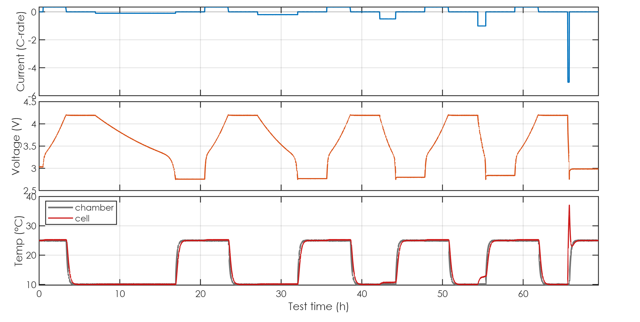
The whole test: 5 charges, 5 discharges, about 70 hours
0.1C
0.2C
0.5C
1C
5C, the fast one
0.34C CC-CV charge
self-heating +27 K
Battery Builder · Modeling tab
11 / 66
Notes:
Here's a complete test. Top is current in C-rate, middle is voltage, bottom is temperature. It's about 69 hours long. For this talk I'm using a synthetic file that I built to follow your profile exactly. The reason is simple: the cell behind it has known parameters, so at the end we can check every extracted number against the right answer. On your real files the app runs exactly the same steps. The test is five cycles. Every cycle starts with a constant-current, constant-voltage charge at 0.34 C. Then a discharge to the cut-off. The first one is slow, 0.1 C, which takes about ten hours. Then 0.2 C, 0.5 C, and 1 C. And the last discharge is fast. In your files it varies somewhere between about 3 and 7 C; here it's 5 C. That fast discharge heats the cell by about 27 kelvin, and that's exactly what we'll use later to measure the thermal mass. So this ladder of rates is really the backbone of the whole analysis. Keep it in mind.

Slide 12
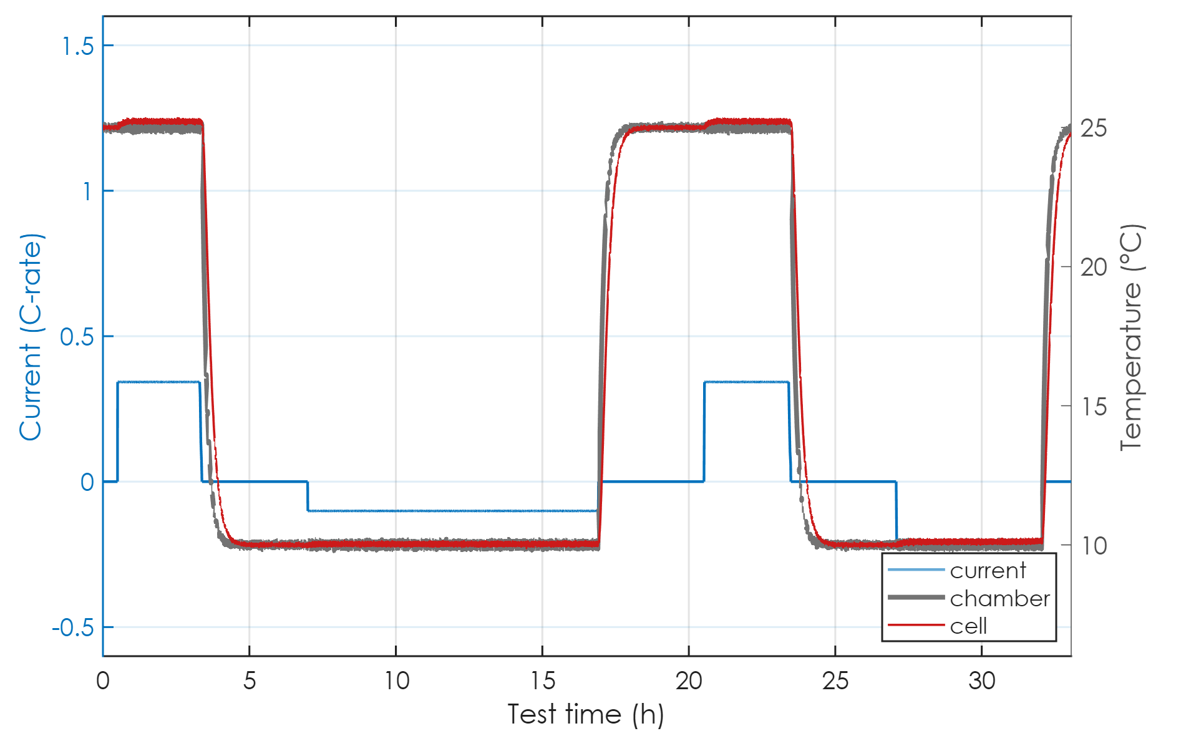
The chamber schedule: charges at 25 °C, discharges at T
Chamber starts at 25 °C; the first charge runs at 25 °C
Right after each charge: chamber → the file's temperature T
T is held through the rest and the discharge
Right after the discharge: back to 25 °C for the rest
So every discharge is at T, every charge is at 25 °C
charge at 25 °C
chamber → 10 °C
back to 25 °C
rest + discharge at 10 °C
Battery Builder · Modeling tab
12 / 66
Notes:
Now, here's a detail you pointed out, and it turns out to matter for nearly every value. The chamber isn't at one temperature the whole time. The chamber always starts at 25 degrees, and the first charge happens at 25. As soon as that charge finishes, the chamber moves to the file's own temperature. In this example that's 10 degrees. It holds that temperature through the rest and through the discharge. And as soon as the discharge is done, it goes back to 25 for the rest, and the next charge starts at 25 again. The red line is the cell. You can see it lag behind the chamber by several minutes each time, which, again, is something we'll actually use later. So the consequence is: in every file, the discharges happen at the file's temperature, and the charges always happen at 25 degrees.

Slide 13
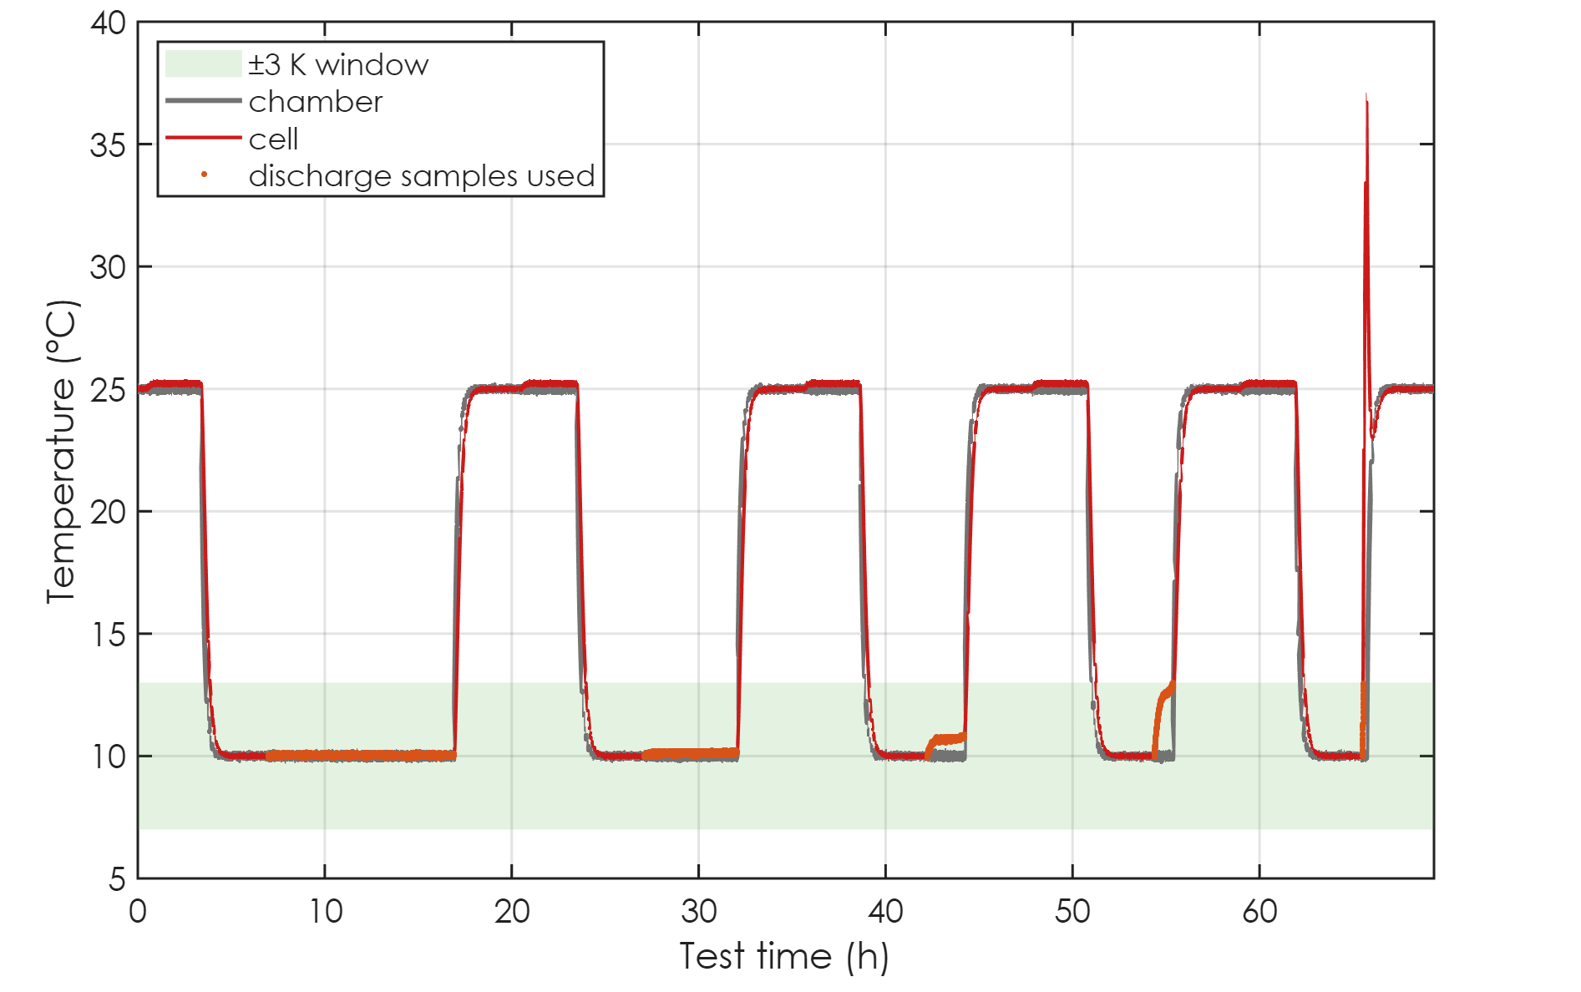
Which samples belong to 10 °C: the ±3 K window
Test temperature = chamber during the discharges = 10 °C
Tables only use samples with the cell within ±3 K of it
Left out: charges, charge-start steps, post-charge rests (25 °C)
Left out: the end of the fast discharge (cell hot)
25 °C file: everything is at 25 °C, so the charges are used too
Here: 6 steps and 6 rests left out
fast discharge: too hot
charges at 25 °C: outside
discharges: inside the window
Battery Builder · Modeling tab
13 / 66
Notes:
So what does that mean for the extraction? Resistances and time constants change with temperature. That's the whole reason the block has temperature-dependent tables. So a table that's meant to describe the cell at 10 degrees should only use samples where the cell really was at 10 degrees. The first thing I fixed here is how the app decides what the test temperature is. It used to take the median chamber temperature over the whole file. But with this schedule, roughly half of the test is spent at 25 degrees, so for a cold test that median could easily land on 25, which would be completely wrong. Now it takes the chamber temperature during the discharges, which is by definition the file's temperature. Then a window of plus or minus 3 kelvin decides which samples are used. The orange dots are discharge samples inside the window. The charges sit outside it, because they run at 25. So do the steps at the start of each charge and the rests right after each charge. And the end of the fast discharge is outside it too, because the cell is hot there. Its resistance is lower, and that point belongs to a different temperature. In the 25 degree file, everything is at 25, so the charges are inside the window and get used as well. That difference between the 25 degree file and the others is going to come back, because it's at the heart of the O C V problem.

Slide 14
Phases, FULL and EMPTY
the reference points everything else hangs on
Notes:
Next: phases, and the two reference points, FULL and EMPTY.

Slide 15
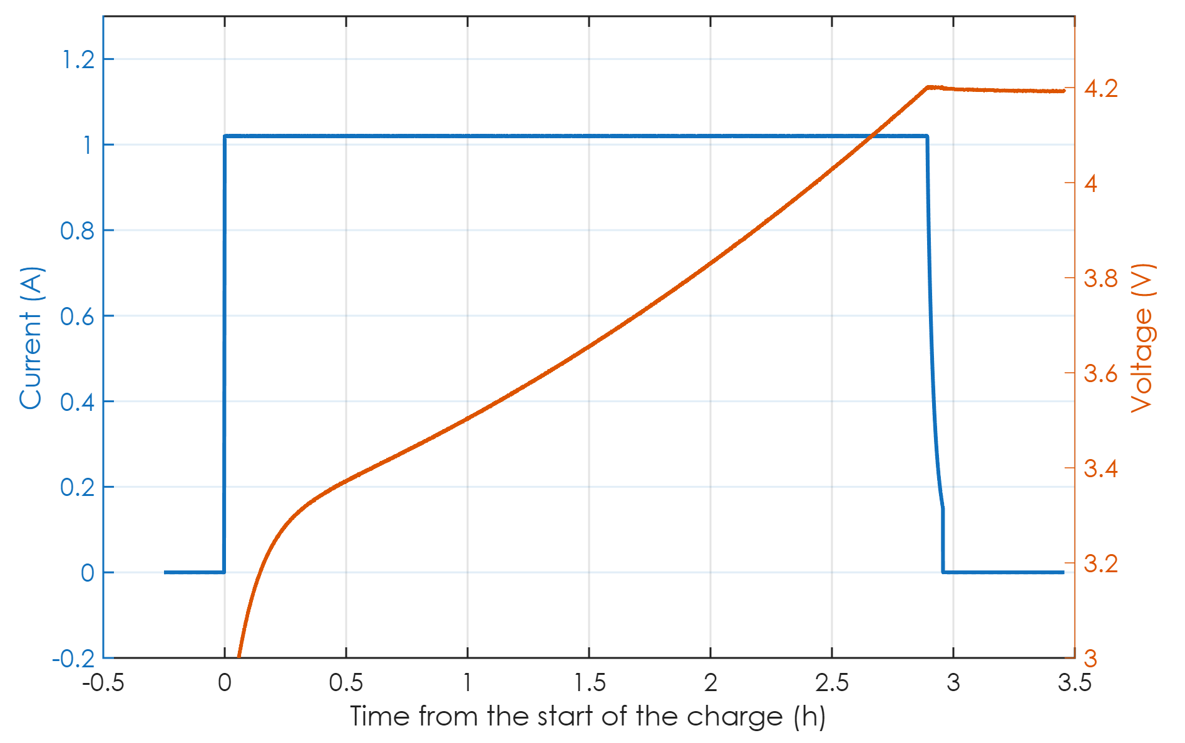
Step 1: split the test into phases, find the CC-CV charges
CV: held at 4.20 V
Phase = run of one current sign: charge, discharge, rest
CC + CV steps merge into one charge phase
CC-CV = current tapered below 35 % of its max, voltage flat within 15 mV
FULL = end of a CC-CV charge at the top voltage (4.20 V)
Here: 5 charges, 5 discharges, 11 rests, 5 CC-CV
CC: constant current
taper ends → FULL
Battery Builder · Modeling tab
15 / 66
Notes:
The very first thing the code does is cut the test into phases, just by the sign of the current: charge, discharge, or rest. Consecutive steps of the same kind are merged, so a constant-current step followed by a constant-voltage step counts as one charge phase. Here's one charge. The current is constant while the voltage climbs. When the voltage reaches 4.20 volts, the cycler holds the voltage and lets the current taper off. The rule for calling this a C C C V charge is: the current tapered below 35 percent of its maximum, while the voltage over that taper stayed flat within 15 millivolts. The end of that taper is what I call FULL. It's the definition of one hundred percent state of charge, the same definition the block and the standards use. In this file the code finds 5 charges, 5 discharges and 11 rests, and all 5 charges are proper C C C V charges.

Slide 16
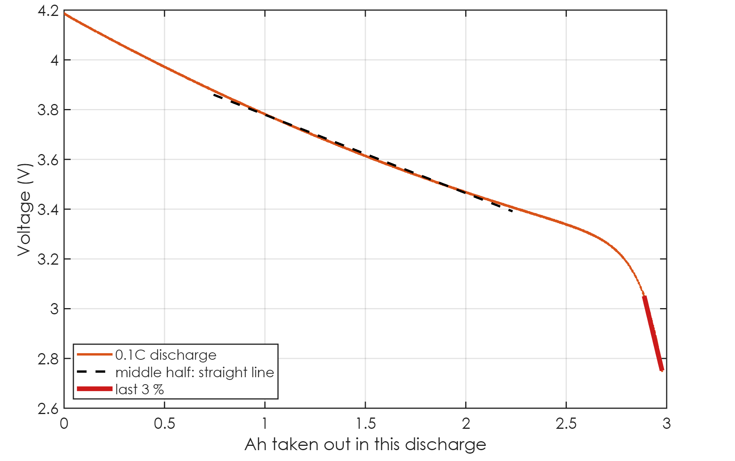
EMPTY needs proof: the end-of-discharge knee
EMPTY = end of a discharge that:
  lasted at least 5 minutes
  ended at the cut-off (lowest end voltage of all long discharges)
  ended on the knee: slope over the last 3 % > 3 × the middle half
Here: 3359 / 315 mV/Ah = 11× → EMPTY
A partial discharge is never mistaken for empty
middle half: 315 mV/Ah
last 3 %: 3359 mV/Ah
Battery Builder · Modeling tab
16 / 66
Notes:
EMPTY is a bit more subtle, because a discharge that simply stops isn't necessarily empty. Think of a single H P P C pulse, or a test that was aborted halfway. So the code needs proof. Three conditions. The discharge lasted at least five minutes. It ended at the cut-off voltage, which I define as the lowest end voltage of all the long discharges, so that a short pulse dipping below the cut-off can't move it. And third, it ended on the knee. Over the middle half of this discharge, the voltage falls about 315 millivolts per amp-hour. Over the last three percent, it falls about 3359. That's 11 times steeper. A lithium-ion cell's voltage drops off a cliff when it's genuinely empty, and that's what we're detecting. The rule asks for at least three times steeper, so this one passes easily.

Slide 17
Capacity and state of charge
AH, SOC and SOC₀
Notes:
With FULL and EMPTY defined, capacity and state of charge are next.

Slide 18
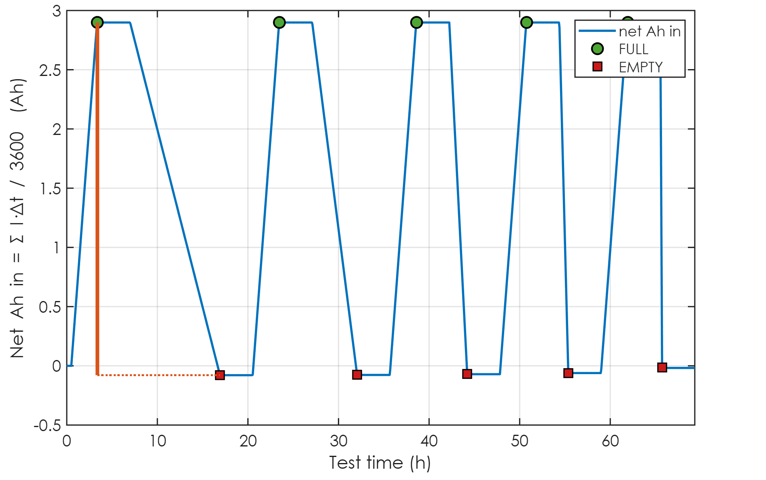
Capacity AH: the amp-hours between FULL and EMPTY
FULL
Net Ah in = Σ I·Δt / 3600 (zero-order hold)
AH = Ah_{in}(FULL) − Ah_{in}(EMPTY)
= 2.8983 − (-0.0789) = 2.9771 Ah
from the slowest discharge (0.3 A)
cycler's Capacity column: 2.9772 Ah (+0.00 %)
known cell: 3 Ah
Δ = 2.9771 Ah
EMPTY
Battery Builder · Modeling tab
18 / 66
Notes:
The blue line is the net amp-hours that have gone into the cell since the start of the file. It's just the current added up over time. It rises during charges and falls during discharges. The green circles are the FULL points, at the end of each C C C V charge. The red squares are the EMPTY points. And the capacity is simply the drop from a FULL point to the next EMPTY point. For the slowest discharge that's 2.9771 amp-hours. As a cross-check, the cycler's own capacity column gives 2.9772, which is a difference of 0.00 percent. If those two ever disagree by more than two percent, the box shows a check warning, because then something is off with the current sign or the time column. The known cell has 3 amp-hours, so we're within one percent, and the small difference is because the true capacity is defined down to a slightly different point.

Slide 19
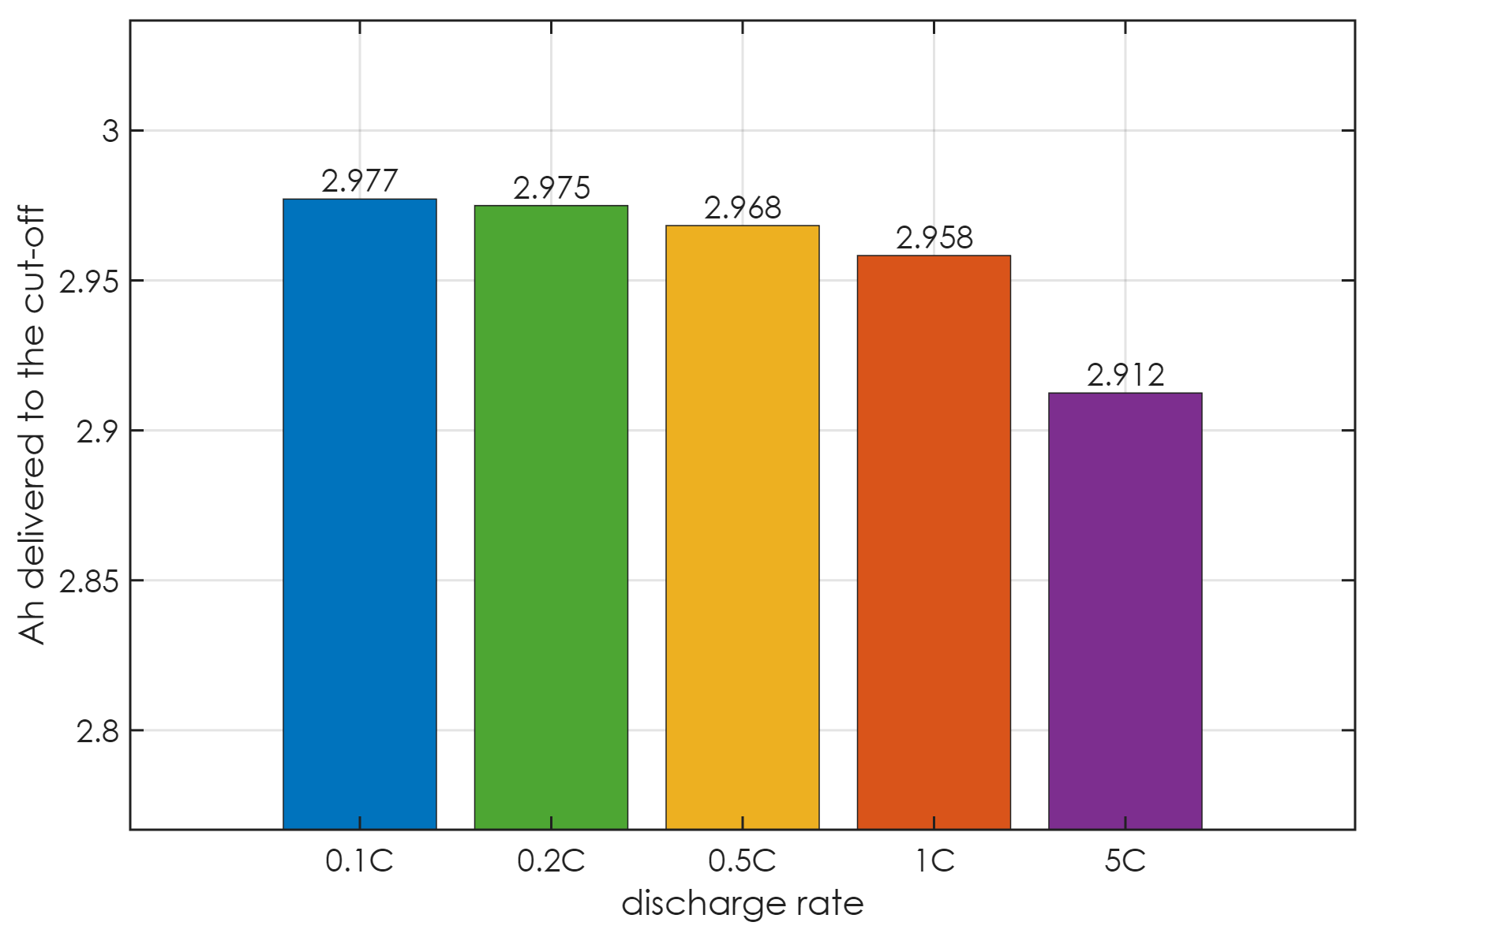
Why the slowest discharge sets AH
Every FULL → EMPTY discharge gives a capacity
Faster → more voltage lost in the resistance → cut-off sooner
2.977 Ah at 0.1C … 2.912 Ah at 5C
The slowest is closest to the charge really stored
SOC keeps using this AH, so a fast discharge ends above SOC 0
used for AH
fewer Ah at the cut-off
Battery Builder · Modeling tab
19 / 66
Notes:
Now, there are 5 full-to-empty discharges in the test, and each one gives a slightly different number. That's not noise. It's physics. When you discharge faster, more voltage is lost across the internal resistance, so the terminal voltage hits the cut-off sooner, while there's still charge left inside. So the slowest discharge, 0.1 C, delivers the most, 2.977 amp-hours, and that's the one that becomes the capacity. The fast one only delivers 2.912. This is the classic rate-capability effect, and the AH How window shows you this same table for your own file. One consequence: because state of charge always uses this one capacity, after a fast discharge the state of charge correctly stops above zero. The cell hit the cut-off, but it wasn't empty.

Slide 20
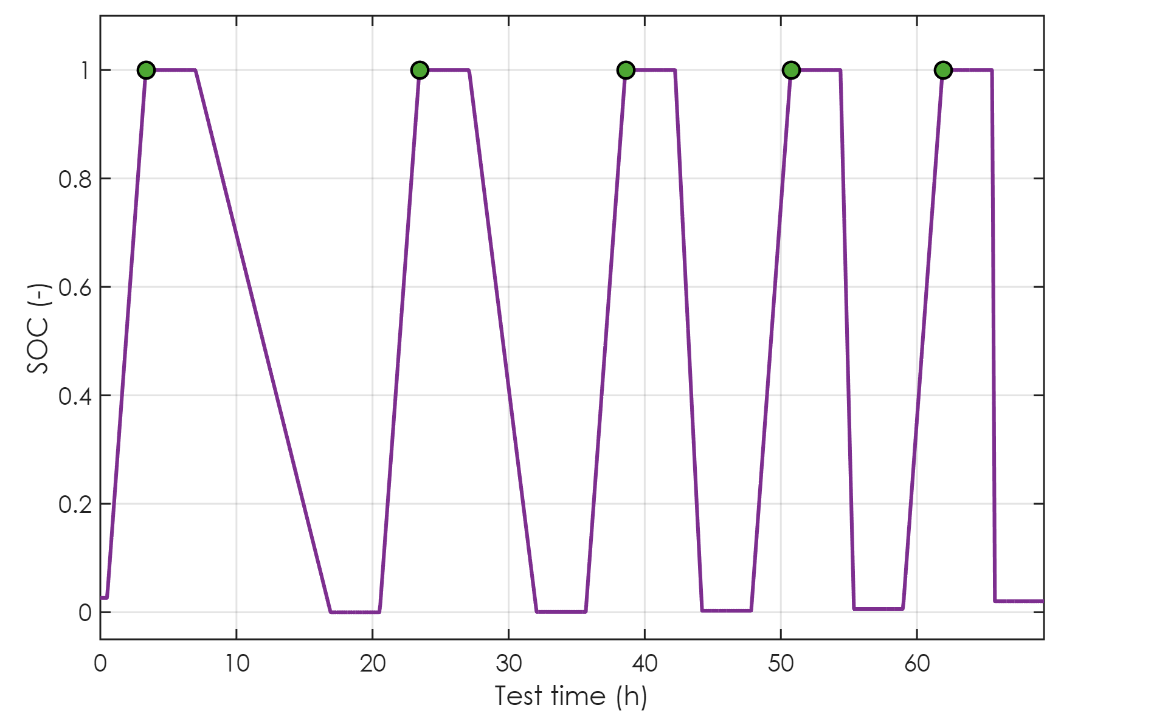
SOC: coulomb counting, reset at every FULL
SOC = 1 + (Ah_{in} − Ah_{in}(FULL)) / AH
Reset to exactly 1 at every FULL point: no drift
Before the first FULL: the same line run backwards
SOC₀ = 1 − 2.8983 / 2.9771 = 0.026
Same SOC definition as the block
SOC = 1 at FULL
after the fast discharge: 0.02
SOC0 = 0.026
Battery Builder · Modeling tab
20 / 66
Notes:
With the capacity known, state of charge is coulomb counting. It's one, plus the amp-hours put in since the last FULL point, divided by the capacity. The key design choice is that it's reset to exactly one at every FULL point. Coulomb counting on its own slowly drifts, because any tiny current offset adds up over seventy hours. Resetting at every full charge means the error can never build up from one cycle to the next. Before the first full charge there's no reset point yet, so the same line is simply run backwards. It took 2.898 amp-hours to fill the cell the first time, so the file must have started at a state of charge of 0.026. Almost empty, which makes sense for a test that starts on a cell that was left at its cut-off. And here at the end of the fast discharge the state of charge stops at 0.02 rather than zero, for the reason we just saw.

Slide 21
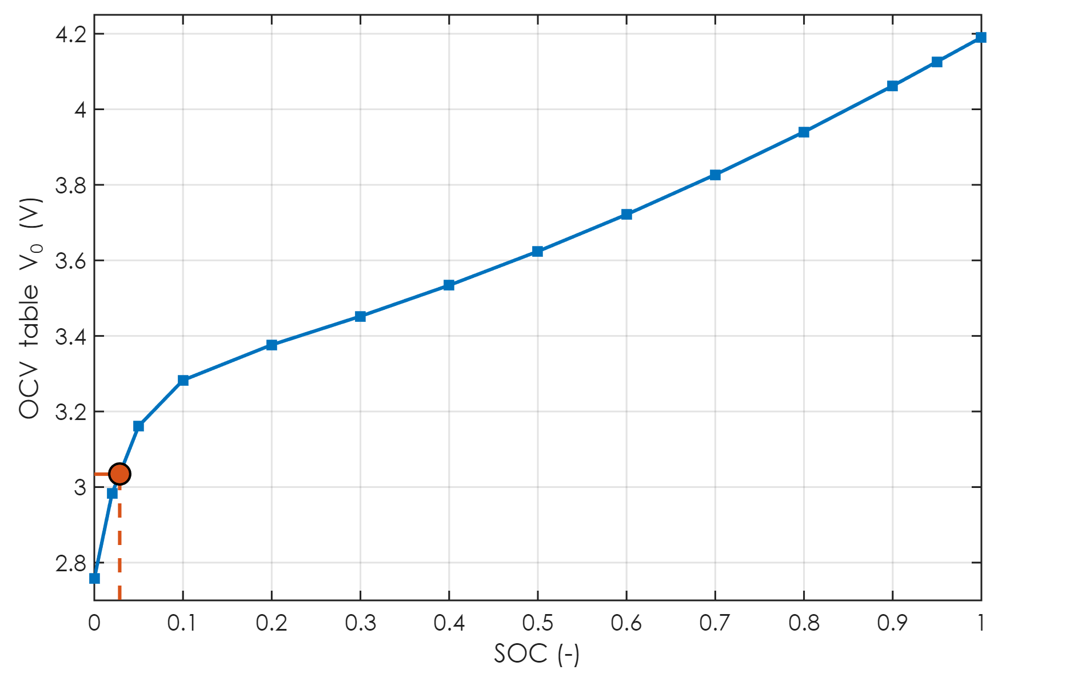
Cross-check: does the voltage agree with SOC₀?
Relaxed voltage of the first rest, read back through the OCV table
rest voltage 3.034 V → OCV table says SOC 0.029
coulomb count says 0.026
Warning if they differ by > 0.08, or by more than the check's own
  uncertainty (5 mV ÷ the local OCV slope: large on flat curves, e.g. LFP)
→ SOC 0.029
first rest: 3.034 V
Battery Builder · Modeling tab
21 / 66
Notes:
There's an independent check on that starting value. The file starts with a rest, and a rested cell sits at its open-circuit voltage. So the code takes the relaxed voltage of that first rest, 3.034 volts, and reads it backwards through the open-circuit voltage table we'll build later. That gives a state of charge of 0.029. Coulomb counting said 0.026. They agree. If they ever disagree by more than 0.08, the box gets a warning. And the tolerance automatically widens on flat parts of the curve, like with L F P cells, where a few millivolts can mean a big change in state of charge.

Slide 22
Series resistance R₀
the instant voltage jump at a current step
Notes:
Now the series resistance, R zero.

Slide 23
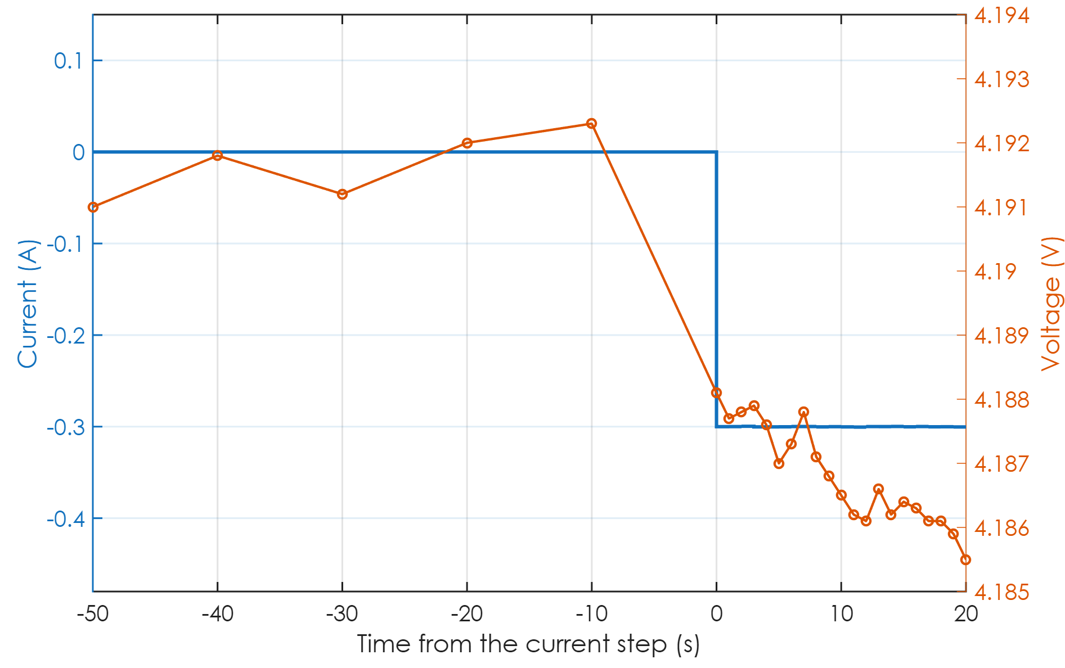
R₀ = ΔV / ΔI across a current step
An RC voltage cannot jump: its capacitor needs time
So the instant jump at a step is R₀ alone
ΔV = 4.1881 − 4.1923 = -4.2 mV
ΔI = -0.300 A
R₀ = 14.00 mΩ at SOC 1.00
Rules: first sample ≤ 5 s after the step, step ≥ 0.08C, cell within ±3 K
last sample before
the current steps
first sample after
Battery Builder · Modeling tab
23 / 66
Notes:
The physics here is lovely and simple. The voltage across an R C pair can't change instantly, because the capacitor has to charge first. So when the current steps, the only part of the voltage that can jump right away is the drop across R zero. Measure the jump, divide by the current step, and you have R zero. Here's the start of a discharge. The current steps from zero to about minus 0.3 amps. The last voltage sample before the step is 4.1923 volts. The first one after the step is 4.1881. That's a change of -4.2 millivolts for 0.300 amps, so R zero is 14.00 milliohms at a state of charge of 1.00. There are three rules. The first sample after the step has to come within five seconds of it, and the StepTime column tells us that exactly. The step has to be at least 0.08 C, so that there's enough voltage change to measure. And the cell has to be inside the temperature window.

Slide 24
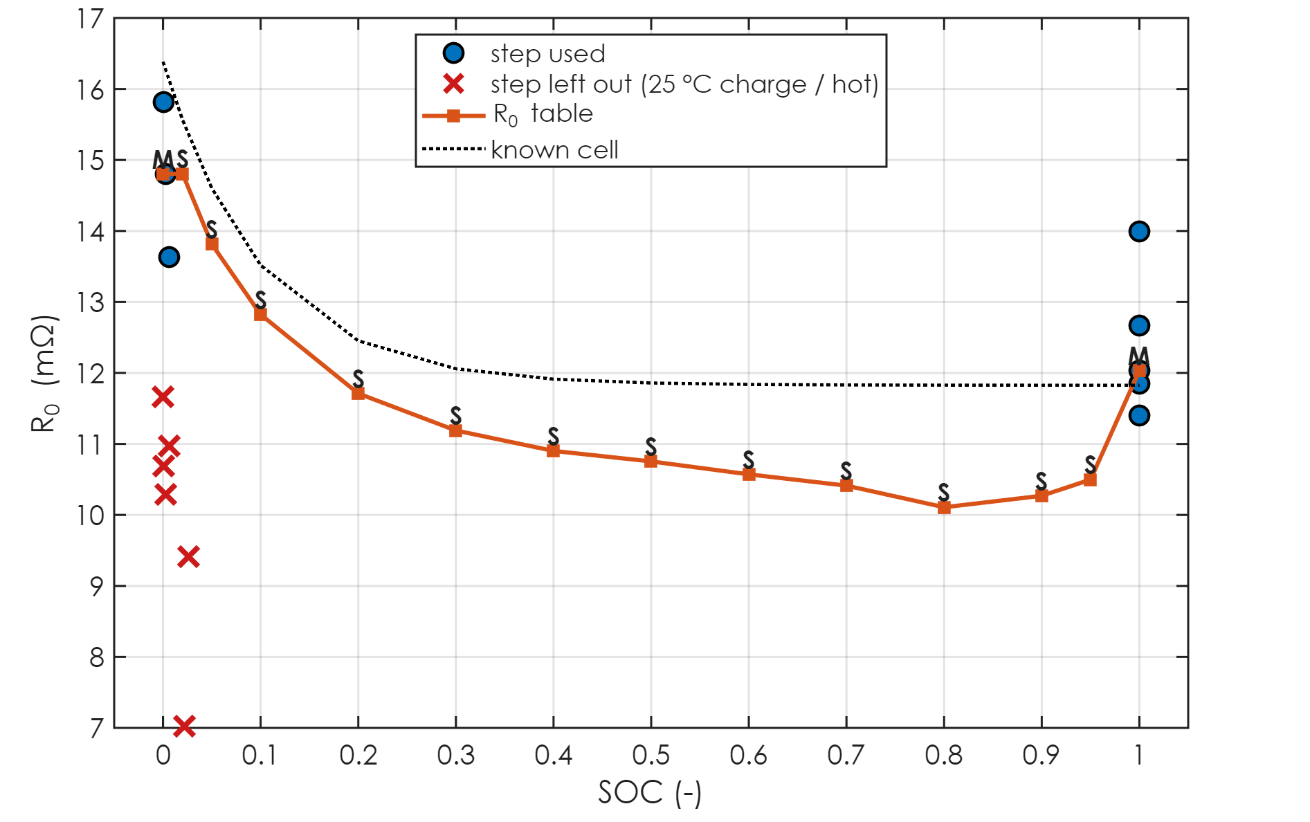
R₀ at every step, and the R₀ table
Steps exist only at the ends of the SOC range:
  start of each discharge (SOC ≈ 1)
  end of each discharge (SOC ≈ 0 … 0.1)
Each breakpoint = median of the nearest steps (M)
In between there are no steps: filled from R_{dc} (S, later)
8 steps used, 6 left out
end of each discharge
start of each discharge
no steps here (S)
left out: 25 °C / hot
Battery Builder · Modeling tab
24 / 66
Notes:
Now let's look at every step in the test at once. The blue circles are the steps that were used, the red crosses are the ones that were left out, the orange line is the final table, and the dotted line is the known cell. Notice where the blue points are. Some sit at a state of charge of one, at the start of each discharge. The rest sit near zero, at the end of each discharge, where the current steps back to zero. The red crosses near zero are the steps at the start of each charge, which happen at 25 degrees, plus the end of the fast discharge where the cell is hot. They're correctly excluded. And in the middle of the range there's nothing. The current simply never steps there in this test. So those middle entries, marked S, come from a different measurement, the multi-rate fit, and I'll show you exactly how in a few minutes. Each measured breakpoint takes the median of the steps nearest to it, which makes it robust to the odd noisy sample.

Slide 25
R₀: what it really includes, and why the details matter
1 s sampling: the 'instant' jump includes ~1 s of the fastest charge-transfer
  → the same R₀ the MathWorks cycler-data workflows get
Here: 14.0 mΩ measured vs 11.8 mΩ for the known cell's pure R₀
StepTime column: how soon after the step the first sample came
  (a rest logged every 10 s is fine: the voltage before a step is steady)
Steps < 0.08C skipped: too little voltage change to read
Hot steps skipped: they belong to another temperature
Battery Builder · Modeling tab
25 / 66
Notes:
A couple of honest details about this number. Your cycler samples about once per second. So the first sample after a step is up to a second late, and in that second the fastest part of the charge-transfer response has already started. So the measured R zero, 14.0 milliohms here, is a bit higher than the known cell's pure series resistance of 11.8. That's expected, it's exactly what the MathWorks workflows get from cycler data too, and it doesn't hurt the model, because as you'll see, the total resistance is pinned down separately and exactly. The other detail is timing. Earlier versions of the code looked at the time gap before the step, and since rests are logged only every ten seconds, they threw away the start of every discharge. Now it looks at how soon after the step the first sample came, which is what actually matters, using the StepTime column.

Slide 26
The RC pairs
R₁, τ₁, R₂, τ₂ from the rests
Notes:
Next, the R C pairs.

Slide 27
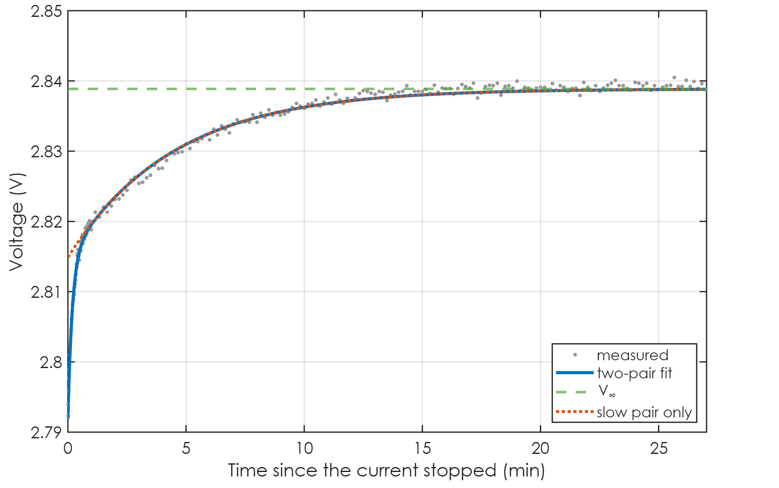
When the current stops, the RC voltages decay on their own
V∞: fully relaxed
V(t) = V∞ + Σ R_{k}·x_{k}(0)·e^{−t/τk}
x_{k}(0) = branch current when the current stopped
Rest at SOC 0.01, after a discharge:
  R₁ = 7.64 mΩ, τ₁ = 11.2 s
  R₂ = 7.99 mΩ, τ₂ = 270 s
  rms error 0.54 mV; V∞ = 2.8389 V is an OCV point
slow pair, τ2 ≈ 270 s
fast pair, τ1 ≈ 11 s
R0 drop gone at once
Battery Builder · Modeling tab
27 / 66
Notes:
This is a rest right after a discharge. When the current stops, a few things happen in sequence, and the equation captures all of it. First, the R zero drop disappears instantly. That's the jump at time zero. Then the fast R C pair decays, with a time constant of about 11 seconds. That's the steep part in the first minute. Then the slow pair, with a time constant of about 270 seconds, which is the long tail. And it all settles to V infinity, the fully relaxed voltage, 2.8389 volts here. That's a free bonus: it's an open-circuit voltage point at this state of charge. The fit gives R one of 7.64 milliohms and R two of 7.99, with an error of only 0.54 millivolts, which is about the noise level of the voltage measurement.

Slide 28
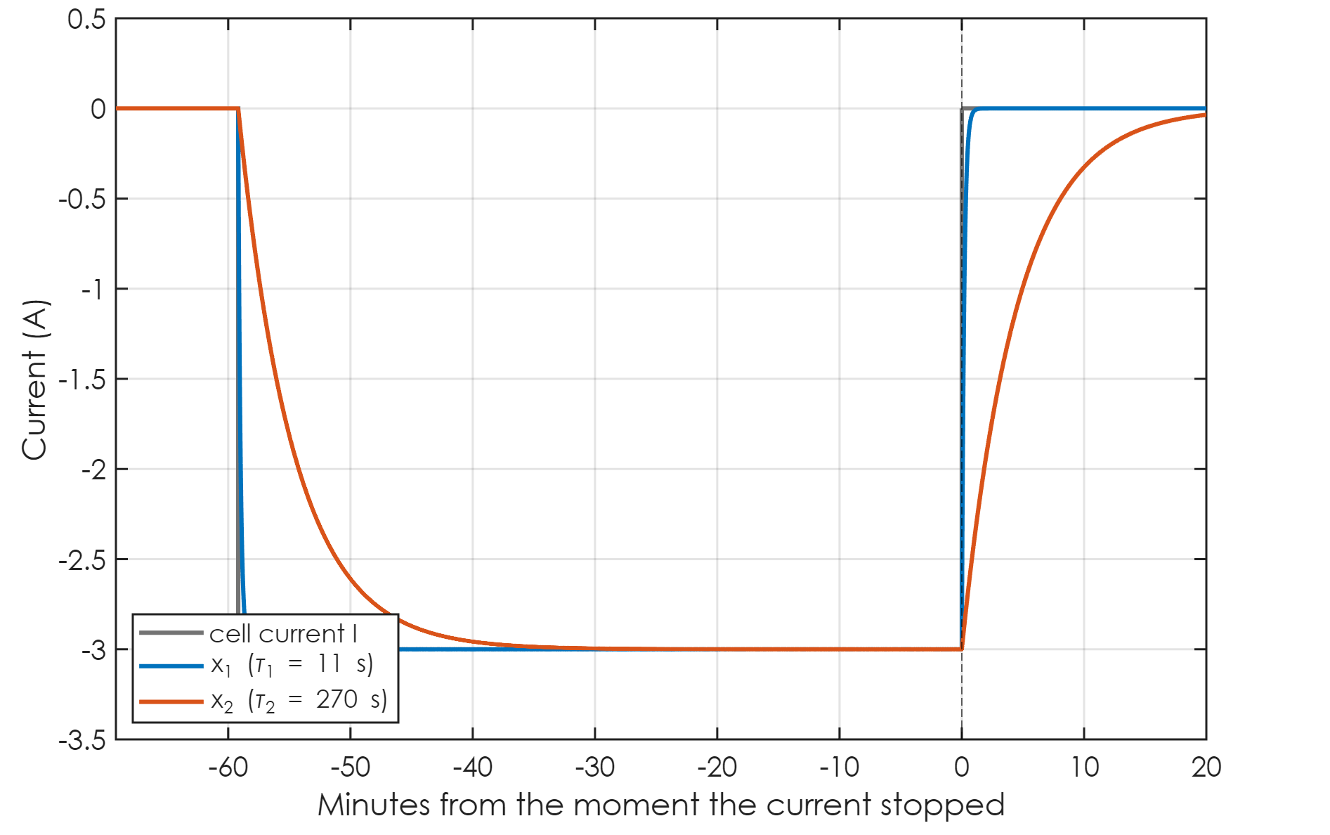
The starting branch currents come from the real history
x_{k}(n) = a·x_{k}(n−1) + (1 − a)·I(n−1), a = e^{−Δt/τk}
Run over the whole current history before the rest
A 10 s pulse and a 10 h discharge are both handled exactly
No assumption that the RC pairs were 'fully charged'
x_{k}(0) multiplies R_{k}: get it wrong and R_{k} is wrong
x2 decays with τ2
x1 = x2 = I: settled
Battery Builder · Modeling tab
28 / 66
Notes:
There's one subtle but important piece in that equation: x k of zero, the current in each R C branch at the moment the current stopped. The voltage we see in the rest is R k times that current, so if we get the current wrong, we get R k wrong by the same factor. A lot of simple methods assume the R C pairs were fully charged, meaning the branch current had caught up with the cell current. That's true after a long discharge, but not after a ten-second pulse. So instead, the code runs the actual current history through each R C branch, step by step, with the exact formula for a piecewise-constant current. For this rest, which follows a one-hour discharge, both branch currents have fully caught up with the cell current by the time it stops, and then they decay, each with its own time constant. That's what the relaxation curve is made of. Because it's computed from the real history, a short pulse and a long discharge are handled exactly the same way.

Slide 29
How the RC fit is solved
For fixed τ₁, τ₂: V∞, R₁, R₂ are linear → least squares with R_{k} ≥ 0
τ search: coarse grid over 1 … 3000 s, then Nelder–Mead (fminsearch)
Pairs sorted so τ₁ < τ₂
Rejected: rms error > 8 mV, rest shorter than 5 min
Rejected: rest starting with the cell > 3 K from T (cooling mixes in)
Here: 4 rests fitted (4 after a discharge)
Battery Builder · Modeling tab
29 / 66
Notes:
How is that fit actually solved? There's a neat trick. If you fix the two time constants, the rest of the problem is linear. V infinity, R one and R two just multiply known curves, so they come out of an ordinary least-squares solve, constrained so the resistances can't go negative. That means the only real search is over the two time constants. The code does a coarse grid search between one and three thousand seconds, picks the best combination, and then refines it with a Nelder-Mead search, which is MATLAB's fminsearch. The pairs are sorted so tau one is always the faster one. Fits worse than eight millivolts are thrown away, and so are rests that start with the cell outside the temperature window, because there the relaxation gets mixed up with the cell cooling down. In this file 4 rests pass, and they all come after discharges, because the post-charge rests are at 25 degrees.

Slide 30
Where the RC values are measured vs interpolated
Rests come after a full charge (SOC 1) and after each discharge (SOC ≈ 0)
So R_{k} and τ_{k} are measured at the two ends of the SOC range
Middle of the range: R_{k} scaled with R₀ to the measured R_{dc} (S)
τ_{k} interpolated: median τ₁ = 11 s, τ₂ = 138 s
known cell: τ₁ = 12 s, τ₂ = 350 s
τ₂ short: the chamber returns to 25 °C during the post-discharge rest
  → the cell warms while the slow tail is being fitted
Tip: hold the chamber at T for 30 min after each discharge
Battery Builder · Modeling tab
30 / 66
Notes:
Same story as R zero: in a rate test, the rests only happen at the two ends of the state of charge range, after a full charge and after each discharge. So that's where R one, R two and the time constants are actually measured. In the middle, the resistances get scaled together with R zero to match the measured total, and the time constants are interpolated, because they only show up where the current stops. The median time constants come out at 11 and 138 seconds, against 12 and 350 for the known cell. The fast one is spot on. The slow one comes out clearly short, and I want to be straight with you about why, because it comes from the chamber schedule. Right after every discharge, the chamber heads back to 25 degrees. So during the very rest we use to fit the slow tail, the cell is warming up by fifteen degrees or so, and that warming mixes into the relaxation. On top of that, a two-pair model is approximating what is really a continuous spread of diffusion time constants. How much does it matter? Less than you'd think. The total resistance is measured independently, so tau two only shapes how quickly the voltage moves after a change in current, not where it settles. But if you want it right, there's an easy fix on the test side: hold the chamber at the test temperature for thirty minutes after each discharge, before switching back to 25. And if you ever want these values measured in the middle of the range too, a few pulses with rests at mid state of charge, an H P P C style test, would do it, and the code picks them up automatically.

Slide 31
One, two or three RC pairs?
The 'Charge dynamics' drop-down: 1, 2 (default) or 3 RC pairs
1 pair: one time constant, misses either the fast or the slow part
2 pairs: seconds (charge transfer) + minutes (diffusion): the usual choice
3 pairs: only if the rests are long and clean enough to separate three
  extra pairs that the rest can't resolve come back empty (NaN), not invented
Lin 2014 compared 1, 2 and 3 pairs and chose 2; Hu 2012 compared 12 models
Whatever you pick: R₀ + Σ R_{k} still equals the measured R_{dc}
Battery Builder · Modeling tab
31 / 66
Notes:
A question that comes up a lot: how many R C pairs should you use? The drop-down on the tab offers one, two or three, and the default is two. With one pair you get a single time constant, so the model has to choose between the fast part of the relaxation and the slow part, and it gets one of them wrong. Two pairs naturally split into a fast one, in the seconds range, which is mostly charge transfer at the electrodes, and a slow one, in the minutes range, which is mostly diffusion. That's why two is the usual choice, and it's what Lin and colleagues settled on after comparing one, two and three pairs. Hu and colleagues compared twelve different model structures and reached a similar conclusion. Three pairs only help if the rests are long and clean enough to separate three distinct time constants. If they aren't, the extra pair simply comes back empty, rather than being made up. And whichever you choose, the scaling we'll see later guarantees that R zero plus all the R C resistances still adds up to the measured total, so the steady-state behaviour doesn't depend on that choice.

Slide 32
The multi-rate fit
OCV and R_{dc} over the whole SOC range
Notes:
And now the part I find the most interesting, the multi-rate fit.

Slide 33
The problem: you never see the OCV while current flows
Under current: V = V₀ − i·R₀ − R₁x₁ − R₂x₂
Rests give V₀ only at the two ends (SOC 0 and 1)
Even a 0.1C discharge sits tens of mV below the OCV
But the same discharge was run at 4 rates ≤ 2C
Once settled, x_{k} = i, so V = V₀(SOC) − i·R_{dc}(SOC)
A straight line in i: intercept = V₀, slope = R_{dc} = R₀ + R₁ + R₂
Battery Builder · Modeling tab
33 / 66
Notes:
Here's the problem. The open-circuit voltage is the most important table in the model, and it's the one you can never see directly while current is flowing. The rests give you exact points, but only at the two ends, full and empty. In between, even the slow 0.1 C discharge sits tens of millivolts below the true open-circuit voltage. But here's the opportunity. You ran the same full-to-empty discharge at several rates. And once the R C pairs have settled, every branch current equals the discharge current, so the block's voltage equation collapses into a straight line in current. The voltage equals the open-circuit voltage, minus the current times the total D C resistance. So at every state of charge, if we plot voltage against current for the different rates, the intercept at zero current is the open-circuit voltage, and the slope is the total resistance. Two tables from one fit, and nothing assumed beyond the block's own equation.

Slide 34
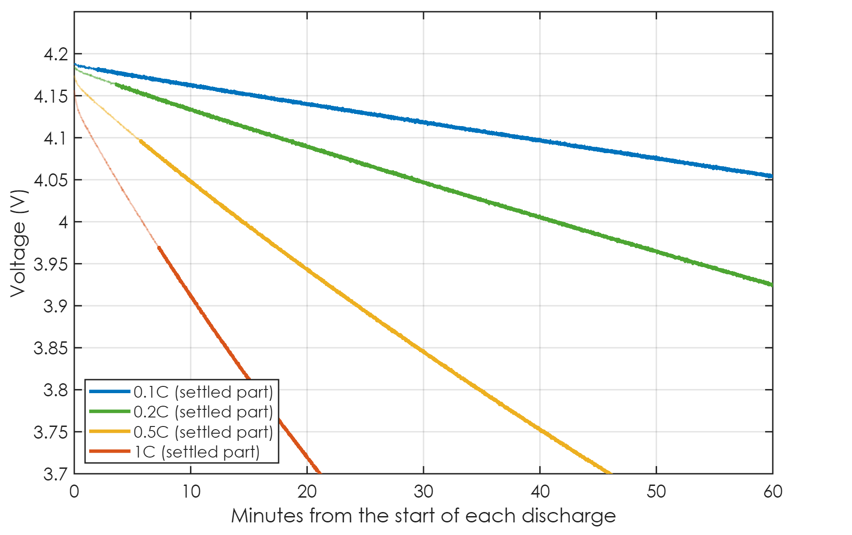
Step 1: wait until the RC pairs have settled
Leftover RC transient: R_{k}·i·e^{−t/τk}
Use a sample once every transient < 1 mV:
  t ≥ max_{k} τ_{k}·ln(R_{k}·i / 1 mV)
R_{k}, τ_{k}: from the rests after a DISCHARGE only
Faint parts of each curve: not settled, not used
0.1C: 2 min
0.5C: 6 min
0.2C: 4 min
1C: 7 min
Battery Builder · Modeling tab
34 / 66
Notes:
But the straight line only holds once the R C pairs have settled. Right after a discharge starts, the R C voltages are still building up, and those samples would bend the line. So the code waits. What's left of each R C transient is R k, times the current, times e to the minus t over tau k. A sample is used once that leftover is below one millivolt for every pair, and that gives a simple formula for the wait. The faint parts of each curve are the samples that aren't used yet. For 0.1 C the wait is about 2 minutes, for 0.2 C about 4, for 0.5 C about 6, and for 1 C about 7 minutes. Faster discharges wait longer, because the transient starts bigger. Now notice the line on the slide: the R and tau values for this wait come from the rests after a discharge only. That one detail is the 25 degree fix, so let me explain it properly.

Slide 35
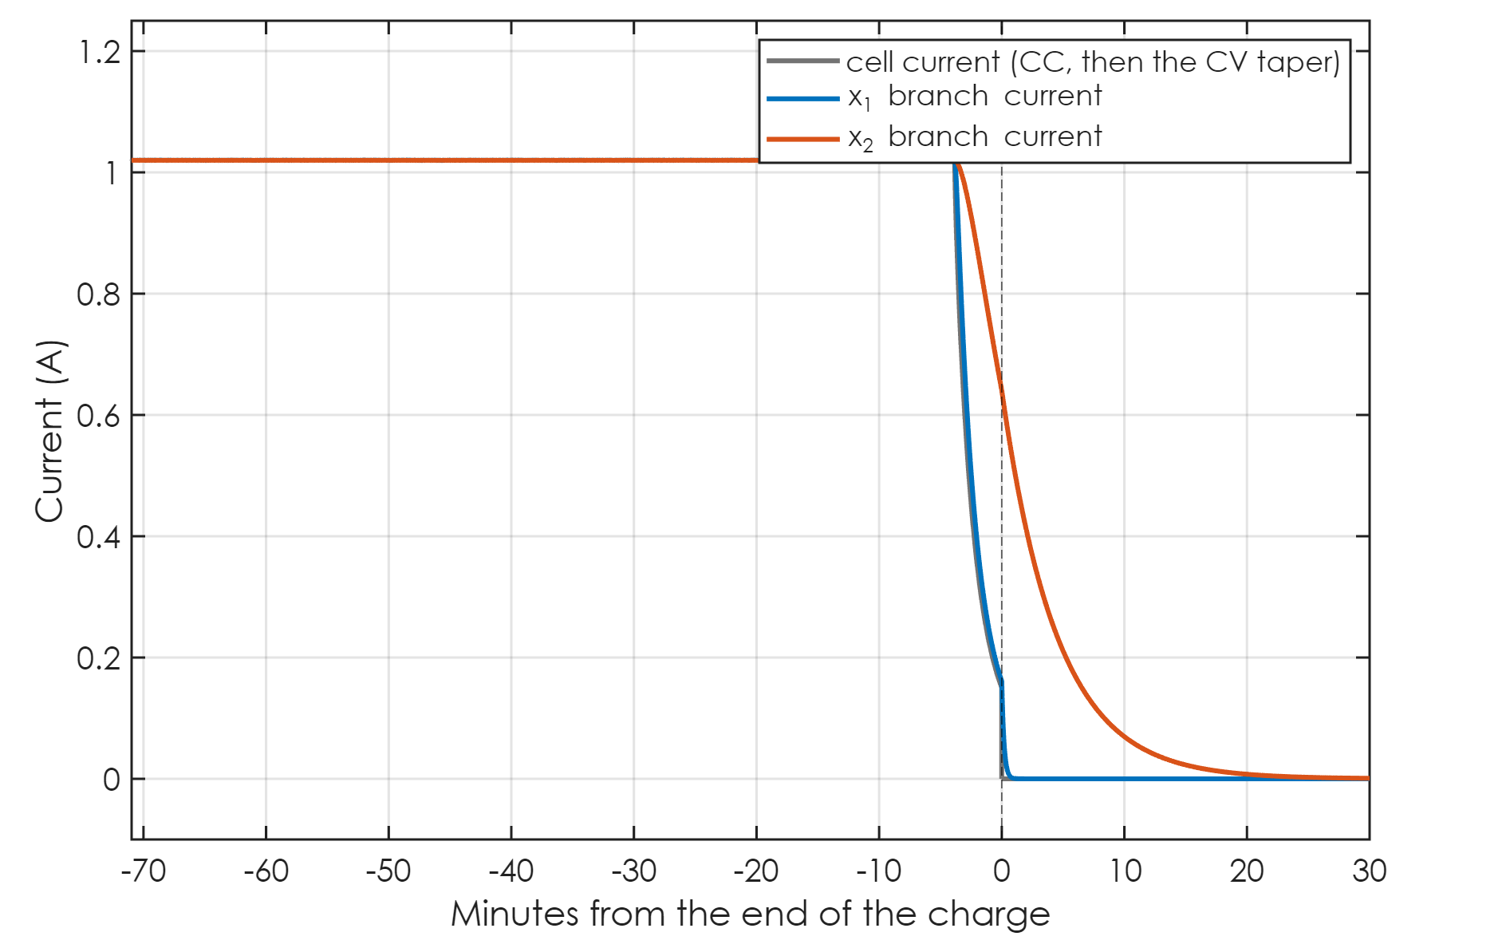
The 25 °C problem: why the OCV came out empty
After CC-CV, the CV taper drains the branch currents
Here: x₂ = 0.64 A at the end of the charge, vs 3.0 A after the 1C
Real cells taper for much longer → x_{k} ≈ 0 → R_{k}, τ_{k} poorly defined
25 °C files: post-charge rests pass the ±3 K window → used for the wait
Wait > the 0.5C and 1C discharges → rates drop → OCV can't cover SOC 0 … 1
Fix: wait uses rests after a discharge only; dropped rates now named in the note
x2 ≈ 0.64 A when it ends
CV taper: current falls
Battery Builder · Modeling tab
35 / 66
Notes:
You noticed that the 25 degree files never produced an open-circuit voltage, while every other temperature did. Here's what I believe was going on. The wait I just described needs R and tau values, and the old code took the median over all the rests in the file. Look at what happens at the end of a C C C V charge. During the constant-voltage step the current tapers away, and the branch currents follow it down. In this synthetic cell, by the end of the charge the slow branch is carrying about 0.64 amps, compared with 3.0 after the 1 C discharge. On a real cell the taper usually goes on much longer, so the branch currents are close to zero when the rest begins. A rest with almost no branch current has almost no R C signal, so the fitted R and tau values are poorly defined, and they can come out with a long time constant and a large resistance. Now here's the key. In every file except 25 degrees, the post-charge rests are at 25 while the test is at some other temperature, so they were already excluded by the temperature window. In the 25 degree file they pass the window, so they went into the median. A long tau and a big R make the wait longer than the 0.5 C and 1 C discharges themselves. Those rates drop out, the fit no longer reaches the top of the state of charge range, and the open-circuit voltage box stays empty. That matches exactly what you saw. The fix is that the wait now uses only rests that follow a discharge, which is where the wait is actually applied. And if a rate still gets dropped for any reason, the O C V note now tells you which rate and how long the wait was, so you're never left guessing. To be transparent: my synthetic cell has a short taper, so it doesn't reproduce your failure exactly. Please run your real 25 degree file and check that the box fills.

Slide 36
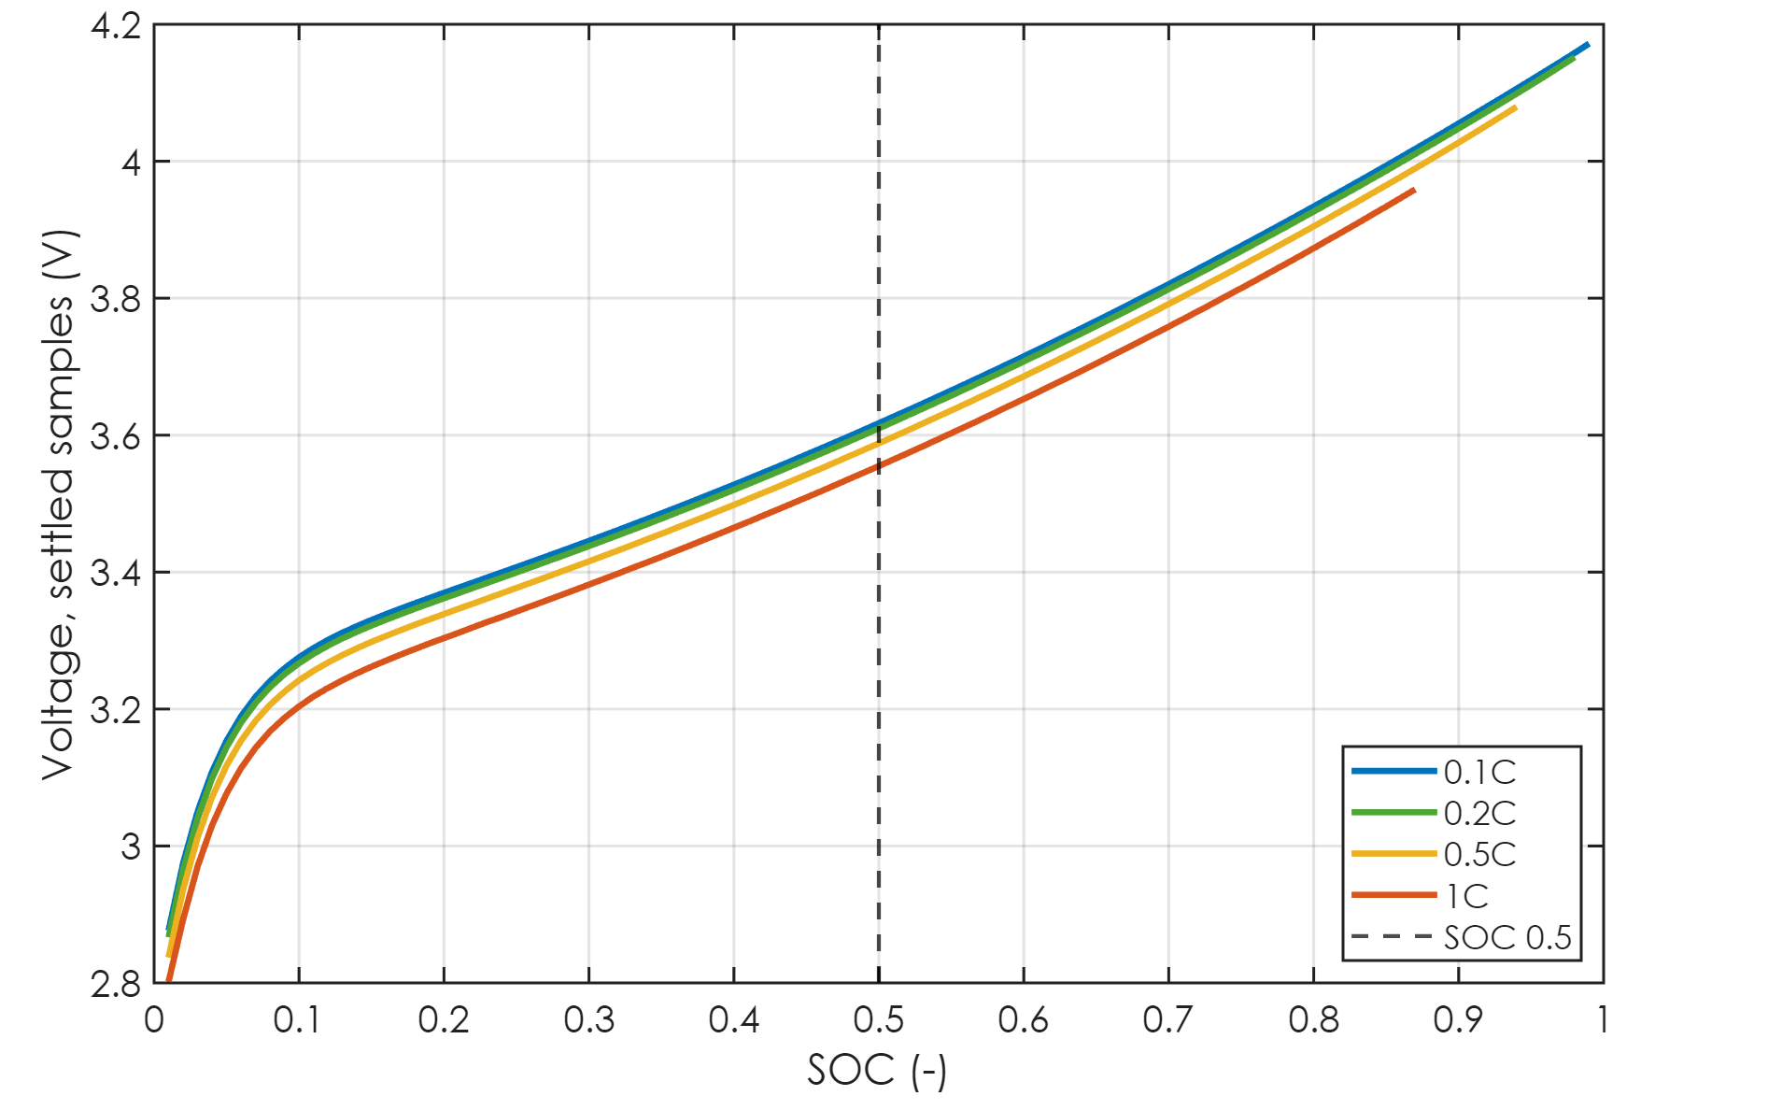
Step 2: every discharge on one SOC axis
Each discharge starts from FULL → its SOC is exact
Settled voltage averaged in 1 % SOC bins
Rates used: ≤ 2C, cell within ±3 K
The fast discharge is left out: too hot, not linear
Slower discharge → higher curve, by i·R_{dc}
1C: lowest
slowest: highest
pick one SOC
Battery Builder · Modeling tab
36 / 66
Notes:
Step two. Every discharge starts from FULL, so its state of charge is known exactly from coulomb counting. That means we can draw all of them on one state of charge axis, using only the settled samples, averaged into one-percent bins. The slowest discharge sits highest, and the 1 C discharge sits lowest. The gap between them is the current times the resistance. The fast discharge isn't here on purpose. It heats the cell by tens of kelvin, so it belongs to a different temperature, and at that current the voltage isn't linear in current any more. Now pick one state of charge, let's say 0.5, and read off the four voltages.

Slide 37
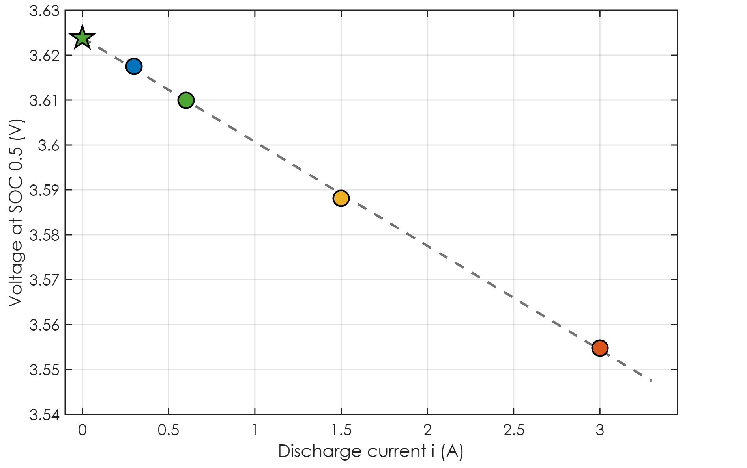
Step 3: at each SOC, a straight line through the rates
0.1C: 0.300 A, 3.6175 V
0.2C: 0.600 A, 3.6100 V
0.5C: 1.500 A, 3.5881 V
1C: 3.000 A, 3.5548 V
Intercept V_{0,dis} = 3.6239 V
Slope R_{dc} = 23.16 mΩ
Scatter 0.61 mV rms → the line holds
known: 3.6249 V, 24.96 mΩ
0.1C
0.2C
intercept: OCV = 3.6239 V
slope: R_dc = 23.2 mΩ
0.5C
1C
Battery Builder · Modeling tab
37 / 66
Notes:
Plot those four voltages against their current. Here's 0.1 C, 0.2 C, 0.5 C, and 1 C. They fall on a straight line. Extend that line back to zero current, and the intercept is the voltage the cell would have with no current at all: the open-circuit voltage, on the discharge side, 3.6239 volts. And the slope is the total D C resistance, 23.16 milliohms. The four points sit only 0.61 millivolts from the line, which is a nice confirmation that the straight-line model really holds. For reference, the known cell has 3.6249 volts and 24.96 milliohms at this point. And this little fit is repeated at every single percent of state of charge.

Slide 38
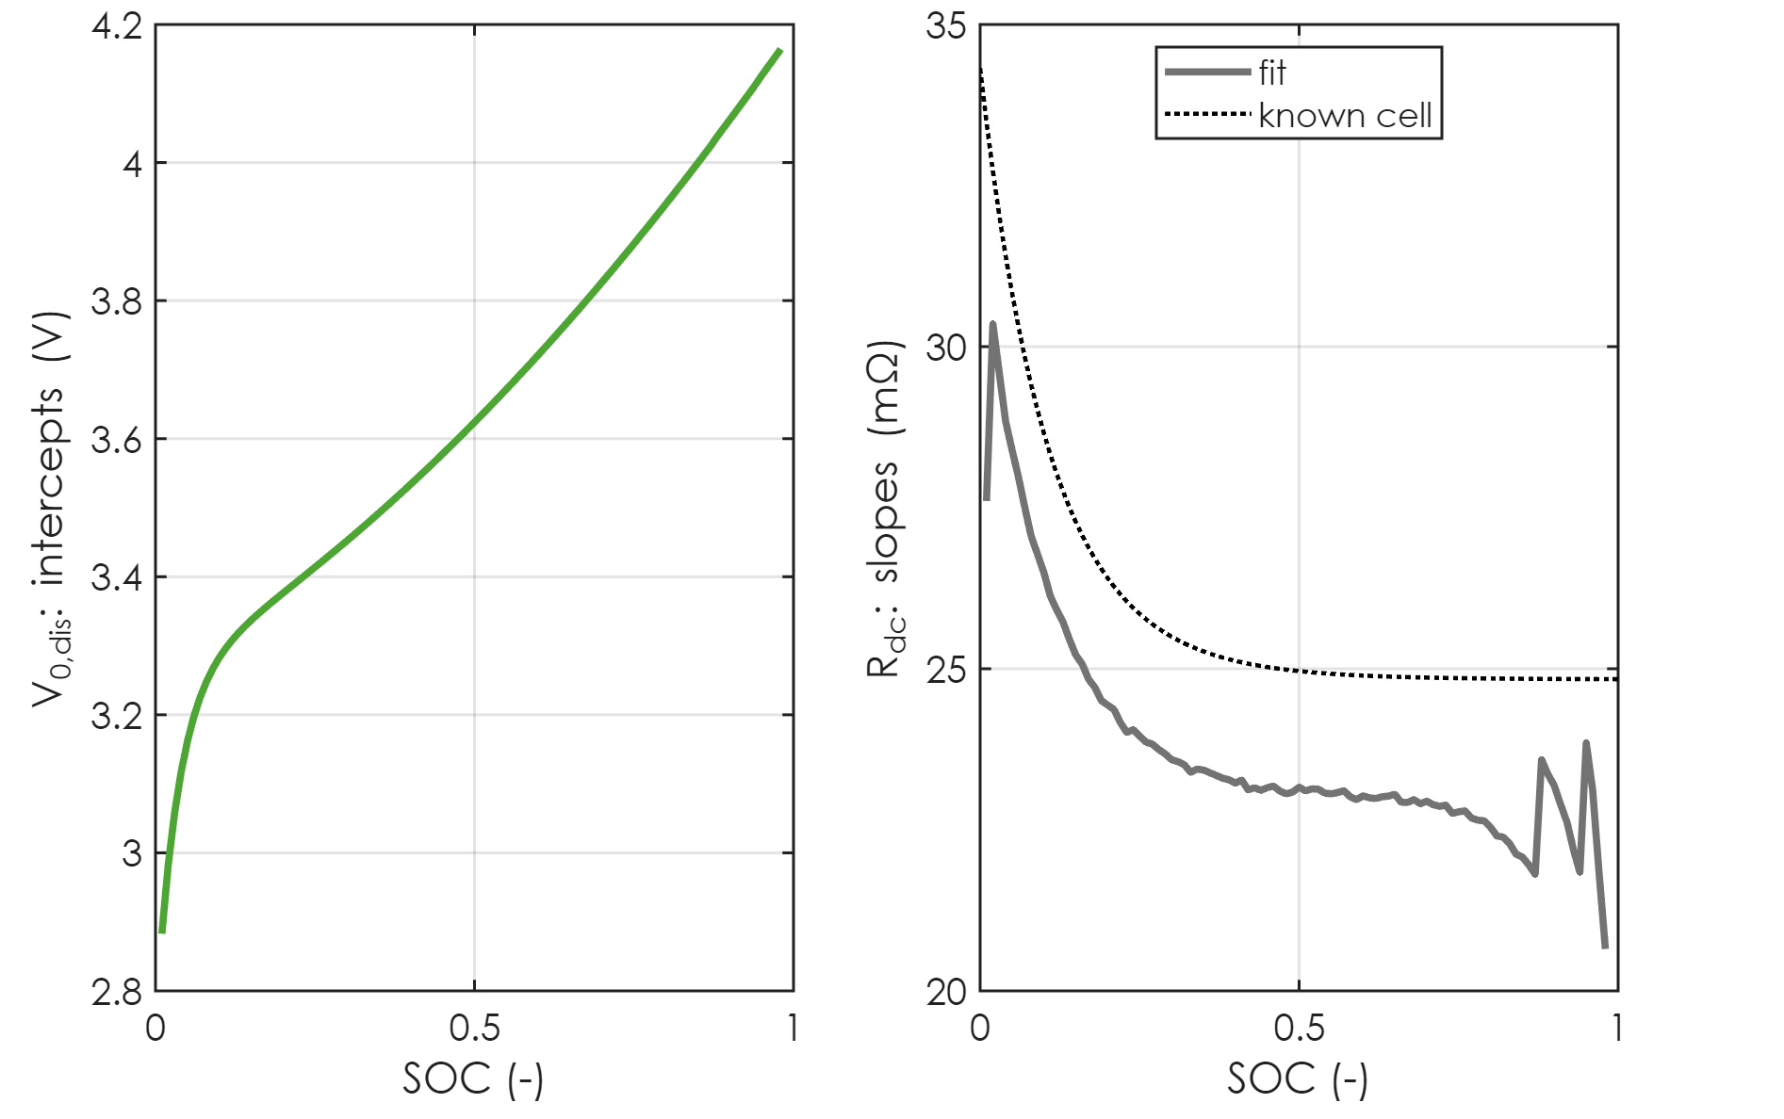
Step 4: one line per 1 % SOC gives two whole curves
top: never settled
Fit covers SOC 0.01 … 0.98
Left: the intercepts → discharge-side OCV
Right: the slopes → R_{dc}(SOC)
R_{dc} mid-range: 23.1 mΩ, 7.5 % from the known cell
No fit at the very top (never settled) or the very bottom (the knee)
rises toward empty
R_dc: the measured total
Battery Builder · Modeling tab
38 / 66
Notes:
Do that at every percent, and you get two complete curves. On the left the intercepts, which is the open-circuit voltage on the discharge side. On the right the slopes, the total resistance against state of charge. The fit covers state of charge 0.01 to 0.98. It can't quite reach the top, because the first minutes of every discharge are never settled, and those minutes are exactly the top of the range. The resistance curve is the measured total, R zero plus R one plus R two, and in the middle of the range it's 23.1 milliohms, within 7.5 percent of the known cell. And it rises toward empty, which is exactly what real cells do. This curve is what pins down the resistance tables in the middle of the range, where we had no steps and no rests.

Slide 39
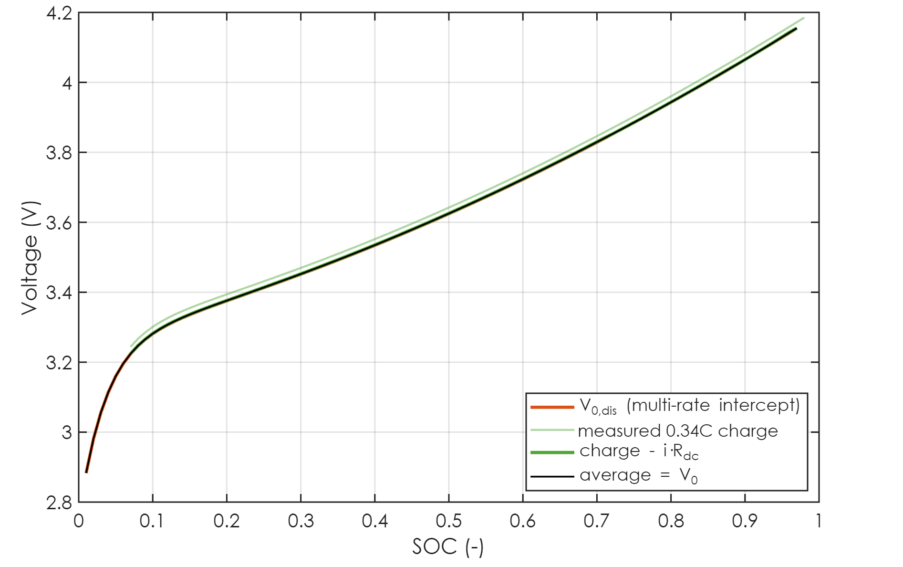
Step 5: the charge side, and hysteresis
A cell rests slightly higher after a charge than after a discharge
Charge side: V_{0,chg} = V_{chg} − i_{chg}·R_{dc}
V₀ = ½ (V_{0,chg} + V_{0,dis}): the standard pseudo-OCV average
25 °C file: half the gap = 0.5 mV (synthetic cell: no hysteresis)
10 °C file: charges at 25 °C → discharge side only
measured 0.34C charge
average = V0
Battery Builder · Modeling tab
39 / 66
Notes:
One more refinement. A real lithium-ion cell has hysteresis: it rests a little higher after a charge than after a discharge. So an open-circuit voltage measured only on the discharge side is slightly low. The standard fix in the literature is to average a charge curve and a discharge curve. This is the 25 degree file. The green curve is the measured 0.34 C charge. Subtract the current times the resistance we just measured, and you get the charge-side open-circuit voltage. The average of the two sides becomes the final curve. In this synthetic cell there's essentially no hysteresis, so half the gap is only 0.5 millivolts, but on your real cells it'll be larger. And here's where the chamber schedule matters again: in the 10 degree file, the charges ran at 25 degrees, so they're outside the temperature window, and the open-circuit voltage is the discharge side alone. The note on the box tells you which case you're in.

Slide 40
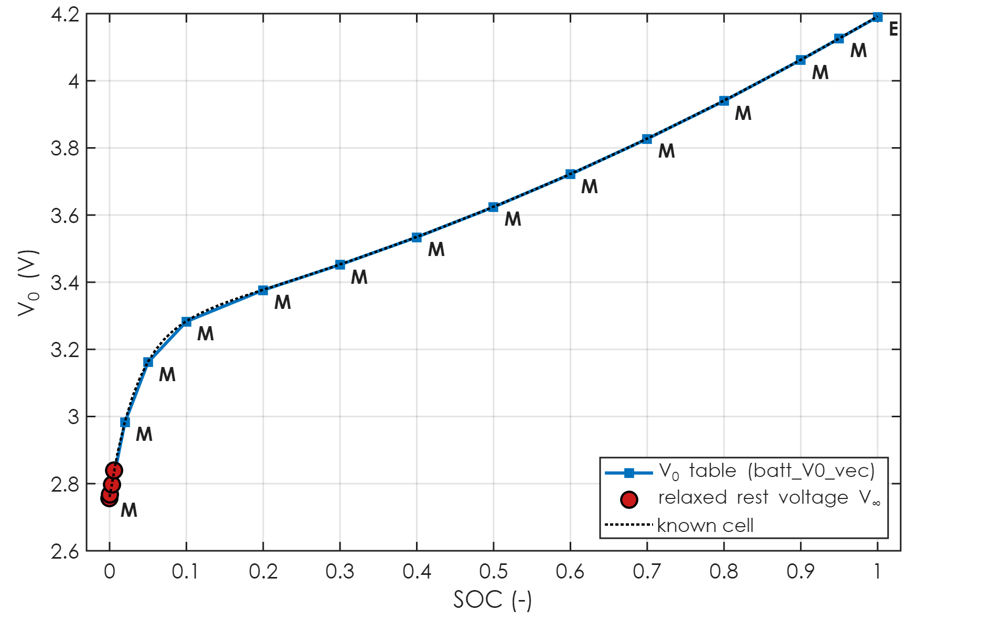
Step 6: the two ends, and the final V₀ table
Ends from relaxed rest voltages V∞:
  after the discharge to cut-off: SOC 0
  after a full charge: SOC 1 (25 °C file)
Smooth (pchip) join to the multi-rate curve; forced to rise with SOC
Max error vs the known cell: 2.8 mV (10 °C), 1.1 mV (25 °C)
M measured · I joined · E short extension
top end
multi-rate fit (M)
rests after cut-off: SOC 0
Battery Builder · Modeling tab
40 / 66
Notes:
The last step for the open-circuit voltage is the two ends, where the multi-rate fit can't reach. At the bottom, the rests after each discharge to cut-off relax to the zero-percent open-circuit voltage. Those are the red circles. In the middle, the multi-rate fit is used as it is, marked M. At the top, the 25 degree file has the rests after the full charges. In the other files those rests are at 25 degrees, so the top is a very short extension from the fit, at most one percent of state of charge. A smooth curve joins the pieces, and the table is forced to rise with state of charge, as an open-circuit voltage must. Against the known cell, the largest error anywhere on the table is 2.8 millivolts in this file, and 1.1 in the 25 degree file.

Slide 41
Why I trust this approach
The straight line is just the block's own equation, once the RC pairs settle
Pseudo-OCV from slow cycling, charge/discharge average: Barai 2019, Lin 2014
Low-current curves still carry overpotential; true OCV is at zero current: Petzl 2013
U = U_{ocv}(SOC) − I·R(SOC) over several rates: Yao 2018
Multi-rate curves extrapolated to zero current: Bussios 2024
Honest note: no single paper does exactly this combination
Battery Builder · Modeling tab
41 / 66
Notes:
A fair question at this point is: is this a standard method, or something I made up? The honest answer is: each piece is standard, the exact combination is mine. The straight line itself isn't an assumption, it's just the block's own equation once the R C pairs have settled. Taking a pseudo open-circuit voltage from slow cycling, and averaging charge and discharge, is the recommended compromise in the Barai review and in Lin's paper. Petzl and Danzer point out that even low-current curves still carry overpotential, and that the true open-circuit voltage is the zero-current value, which is exactly what we extrapolate to. Yao uses the same voltage equation over several discharge rates to get the resistance, and Bussios extrapolates curves at several rates to zero current. All of those references, with links, are in the README and at the bottom of every How window.

Slide 42
Building the tables
putting the measured pieces on the SOC breakpoints
Notes:
Now we have all the measured pieces. Let's assemble the tables.

Slide 43
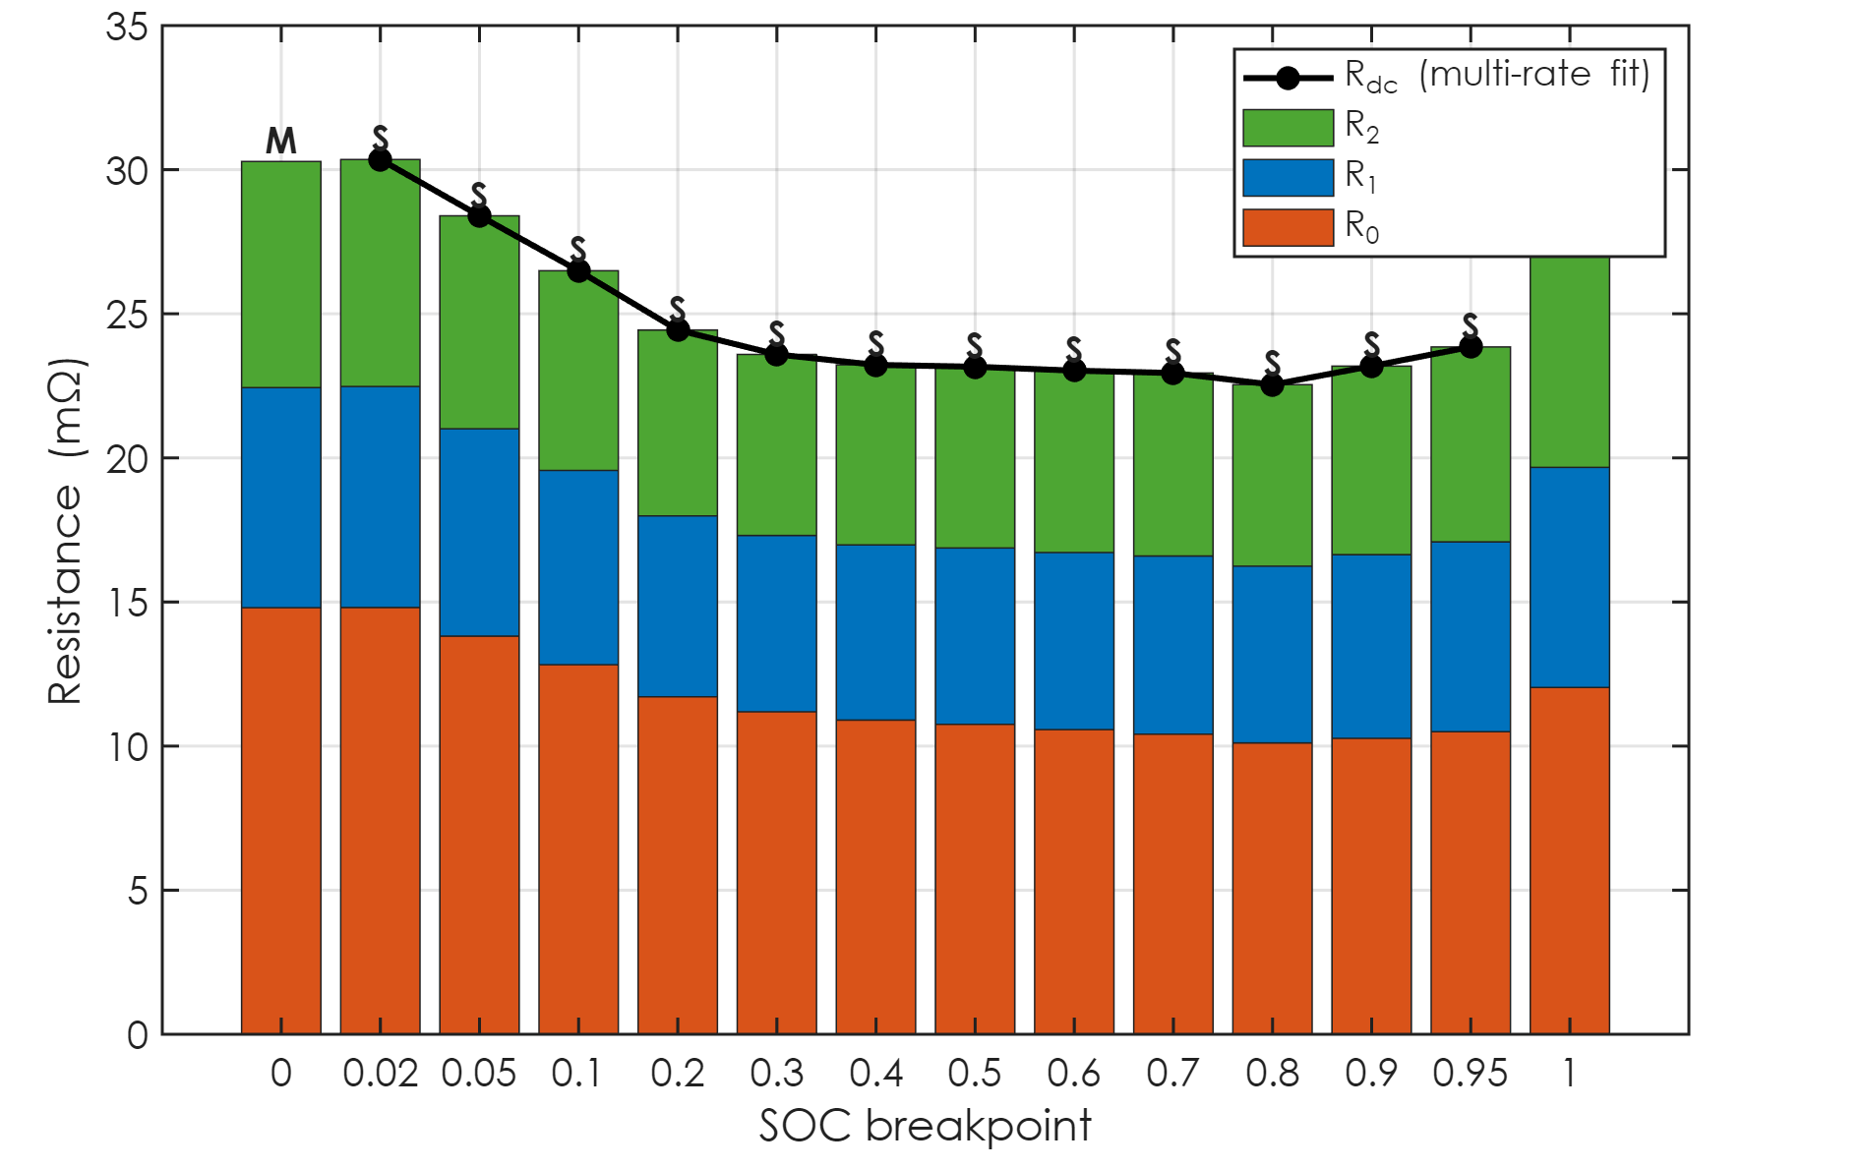
R₀, R₁, R₂: the sum is always measured
measured (M)
M: R₀, R₁, R₂ measured directly (steps / rests)
S: no step or rest there:
  interpolate R₀, R₁, R₂ from the measured ends
  × one common factor so R₀ + R₁ + R₂ = R_{dc}
What a constant current feels is measured everywhere
Only the split between the three is interpolated
measured (M)
scaled to R_dc (S)
Battery Builder · Modeling tab
43 / 66
Notes:
Each bar is one state of charge breakpoint, with R zero in orange, R one in blue and R two in green, stacked. The black line is the total resistance from the multi-rate fit. At the empty end, all three were measured directly, from steps and rests. In the middle, the current never steps or stops, so the three can't be told apart. But their sum can be measured, and it was. So the code interpolates the three from the measured ends, and then multiplies all three by one common factor so that they add up exactly to the measured total. Those are the S entries. And at the full end, they're measured again. The result is that the total resistance a constant current feels is measured at every breakpoint, and only the split between R zero and the R C pairs is interpolated. At measured breakpoints nothing is scaled; the sum and the total are only compared, as a cross-check you can see in the R zero How window.

Slide 44
How scattered points become a table
Breakpoints: batt_SOC_vec = [0 .02 .05 .1 … .9 .95 1] (your choice)
M: median of the measured points nearest the breakpoint
I: linear between measured breakpoints
E: past the last measured point, the end value is held
  (the same as the block's 'Nearest' extrapolation)
S: interpolated, then scaled to the measured R_{dc}
Every entry's flag is shown in its How? window
Battery Builder · Modeling tab
44 / 66
Notes:
Just to make the flags clear, since you'll see them in every How window. M means measured near that breakpoint, taken as the median of the nearby points. I means linearly interpolated between two measured breakpoints. E means it's past the last measured point, so the end value is held, which is the same thing the block's nearest extrapolation would do anyway. And S means interpolated and then scaled to the measured total resistance. The breakpoints themselves are your choice; the default puts extra points near the two ends, where the cell changes fastest.

Slide 45
Thermal mass and convection
m·c_{p}, h·A, and how they go into Simulink
Notes:
Now the thermal side. I know this is the part you were least sure about, so let's take it slowly.

Slide 46
The thermal model: one lump in a chamber
m·c_{p}·dT/dt = Q − h·A·(T − T_{chamber})
m·c_{p}: thermal mass (J/K): energy to warm the cell by 1 K
h·A: convection (W/K): heat lost per kelvin above the chamber
τ_{th} = m·c_{p} / h·A: how fast the cell follows the chamber
Battery block: Thermal mass = batt_thermal_mass
Convective Heat Transfer block: Area = 1 m², coefficient = batt_hA
Battery Builder · Modeling tab
46 / 66
Notes:
The block treats the cell as one lump of material at one temperature. Two numbers describe it. The thermal mass, m c p, in joules per kelvin, is how much energy it takes to warm the whole cell by one degree. It's the cell's mass times its specific heat. And h A, in watts per kelvin, is how much heat leaves the cell for every degree it is above the chamber. It's the convection coefficient times the surface area. Their ratio is a time: the thermal time constant, how quickly the cell follows a change in the chamber temperature. In Simulink, the thermal mass goes directly into the battery block. h A goes into a separate Convective Heat Transfer block, and the simplest way to enter it is an area of one square meter with the coefficient set to batt h A. Then the area times the coefficient is exactly h A, and you never need to know the real area.

Slide 47
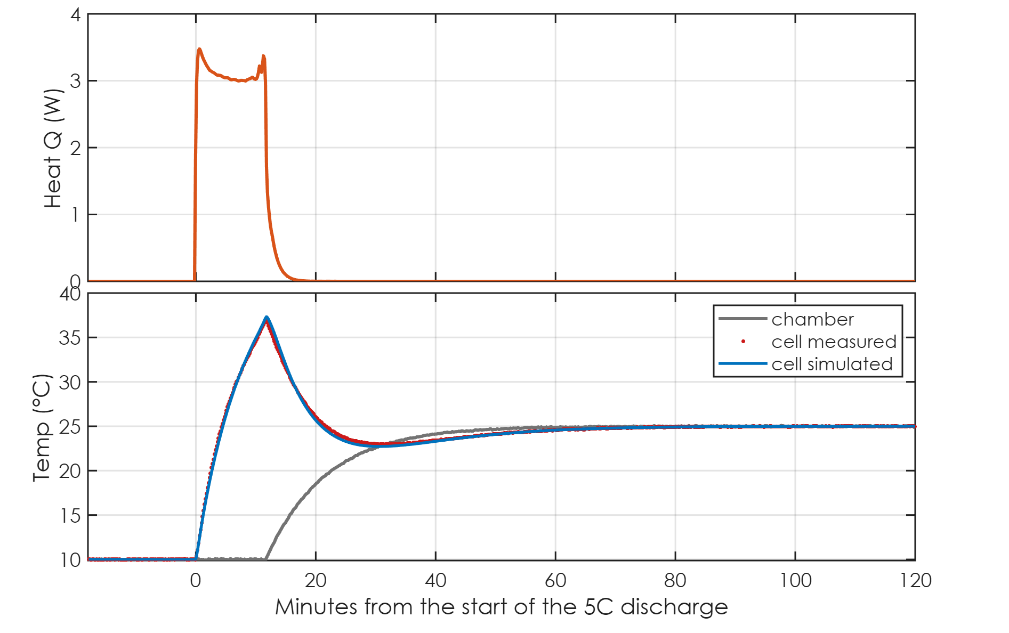
The heat source: electrical loss from the measured voltage
Q = I·(V − V₀(SOC)) − Σ R_{k}·x_{k}·(I − x_{k})
From the MEASURED voltage: right even when the hot cell's R drops
Second term: energy parked in the RC capacitors (heat later)
→ exactly the block's own heat i²R₀ + Σ R_{k}x_{k}²
Fast discharge: ~3.3 W for 12 min
Reversible (entropic) heat left out, as in the block
~3.3 W during the fast discharge
cell peaks at 37 °C
cools back to the chamber
Battery Builder · Modeling tab
47 / 66
Notes:
To fit those two numbers, we need to know how much heat the cell generated at every moment. The heat is the electrical power lost inside the cell: the current, times the gap between the terminal voltage and the open-circuit voltage. I deliberately use the measured voltage here, not the resistance tables. When the fast discharge warms the cell, its real resistance drops, and the measured voltage already knows that. The tables, which are for the test temperature, would over-estimate the heat. The second term removes the energy that's temporarily stored in the R C capacitors, which only turns into heat later, in the rest. With that correction, this is exactly the heat the block itself computes. Here's the fast discharge: about 3.3 watts of heat for about 12 minutes. The cell warms up to about 37 degrees, and then cools back down toward the chamber, which, remember, is also moving back to 25 at the same time.

Slide 48
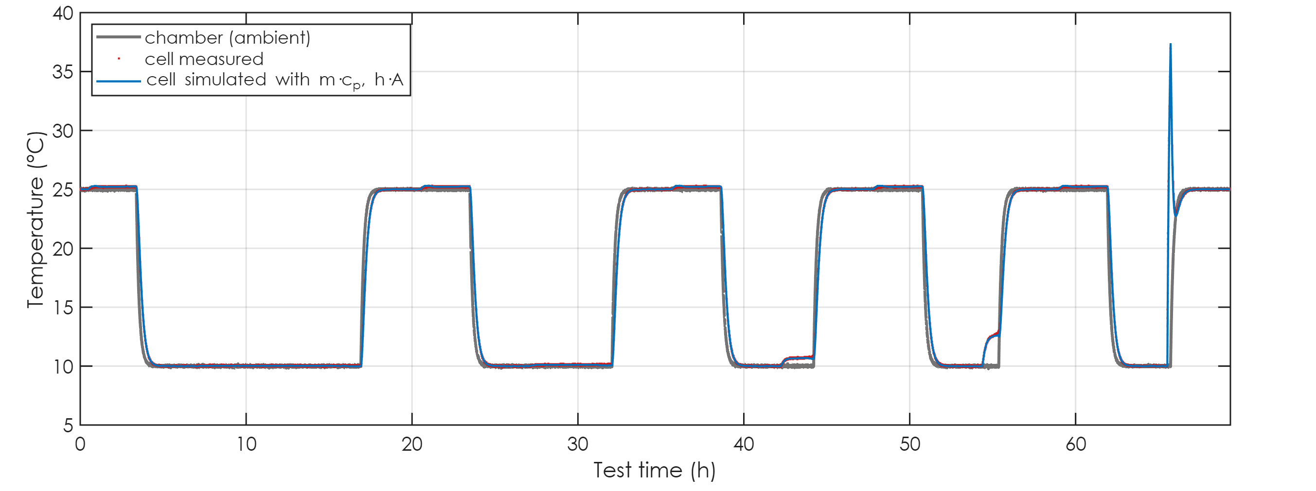
Fitting m·c_{p} and h·A to the measured cell temperature
fast-discharge heating
chamber steps: part of the fit
Least squares on dT/dt (10 s grid) → start: m·c_{p} = 46.9 J/K, h·A = 0.082 W/K
Refined by simulating T(t) and matching it → m·c_{p} = 45.3 J/K, h·A = 0.081 W/K (rms 0.06 K)
Known cell: m·c_{p} = 45 J/K, h·A = 0.08 W/K
Battery Builder · Modeling tab
48 / 66
Notes:
With the heat known, the model equation is linear in the two unknowns, so the code first gets a starting estimate from least squares on the rate of temperature change. Then it refines both numbers so that the simulated temperature, started from the first reading and driven by the real chamber column and the real heat, follows the measured temperature over the whole test. That second step matters, because differentiating a noisy temperature signal biases the first estimate. Notice the chamber steps between 25 degrees and the test temperature are part of the fit, because the ambient is the real chamber column. And the fast-discharge heating is what separates the two numbers. The result: a thermal mass of 45.3 joules per kelvin and h A of 0.081 watts per kelvin. The known cell has 45 and 0.08. The simulated temperature is within 0.06 kelvin of the measured one across all seventy hours.

Slide 49
Check by hand #1: the first minute at 5C → m·c_{p}
At the start, the cell is still at the chamber temperature
→ almost no convection yet: m·c_{p} ≈ Q / (dT/dt)
Q ≈ 3.33 W, dT/dt ≈ 0.0730 K/s (first 90 s)
m·c_{p} ≈ 3.33 / 0.0730 = 45.7 J/K
fit: 45.3 J/K · known: 45 J/K
initial slope 4.4 K/min
Battery Builder · Modeling tab
49 / 66
Notes:
I want to give you two ways to check these numbers by hand, on your own data, with nothing more than a spreadsheet. That way you're not relying on a black box. The first one gives the thermal mass. Look at the first minute or so of the fast discharge. The cell starts at the chamber temperature, so there's almost no convection yet. All the heat goes into warming the cell. So the thermal mass is just the heat, divided by the initial rate of temperature rise. Here that's about 3.33 watts, divided by 0.0730 kelvin per second, which gives 45.7 joules per kelvin. The fit said 45.3, and the known value is 45. So a one-line calculation lands right on it.

Slide 50
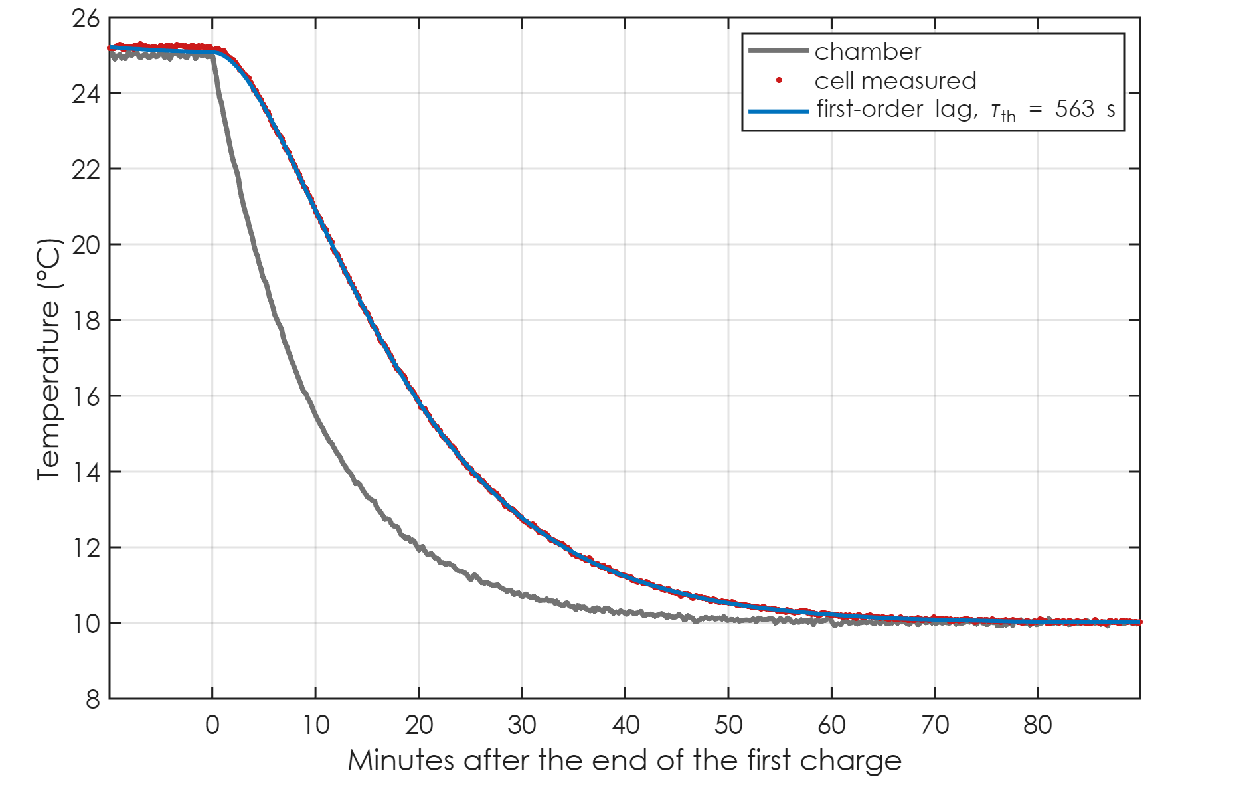
Check by hand #2: chamber steps → h·A
In a rest there is no heat: dT/dt = (T_{chamber} − T) / τ_{th}
Your schedule steps the chamber 10 times: free step tests
Fit over the rests: τ_{th} = 563 s
h·A = m·c_{p} / τ_{th} = 45.7 / 563 = 0.081 W/K
fit: 0.081 W/K · known: 0.08 W/K
cell lags: τ_th ≈ 9 min
chamber steps down
Battery Builder · Modeling tab
50 / 66
Notes:
The second check gives h A, and it uses something your test does for free. Every time the chamber changes temperature during a rest, the cell has no heat source at all, and it simply follows the chamber with a first-order lag. Your schedule does that ten times per test. Here's the chamber stepping down after the first charge. And here's the cell following it, with a time constant of about 9 minutes, 563 seconds. That time constant is the thermal mass divided by h A. So h A is 45.7 divided by 563, which is 0.081 watts per kelvin. Again, the full fit said 0.081 and the known value is 0.08. So between the fast discharge and the chamber steps, your tests contain everything needed for both thermal numbers.

Slide 51
Wiring the thermal side in Simulink
Thermal side
From Workspace
batt_ambient
[t T_chamber] in K
Simulink-PS
Converter
unit: K
Controlled
Temperature
Source
Convective Heat
Transfer
A = 1 m², h = batt_hA
Battery (Table-Based)
Thermal model:
lumped thermal mass
Thermal mass =
batt_thermal_mass
Initial cell temp =
batt_T0
port H ← convection
Thermal
Reference
Electrical side (Load profile tab)
From Workspace
batt_load
[t I], + = charge
Simulink-PS
Converter
unit: A
Controlled
Current Source
+ → battery +
Convective Heat Transfer with Area = 1 m²: the coefficient IS h·A, no real area needed
batt_ambient is the real chamber column (25 °C ↔ T steps included), in kelvin
batt_T0 ≈ 25 °C: the chamber always starts at 25 °C
Battery Builder · Modeling tab
51 / 66
Notes:
Let's wire it up. On the electrical side, the load profile from the second tab drives a controlled current source into the battery. On the thermal side, from left to right: a From Workspace block reads batt ambient, which is the chamber temperature from your file, in kelvin, including all the steps between 25 degrees and the test temperature. A Simulink to physical signal converter turns it into a physical signal, and a Controlled Temperature Source imposes that temperature. Then a Convective Heat Transfer block connects that source to the battery's thermal port, with an area of one square meter and a heat transfer coefficient of batt h A. The other side of the temperature source goes to a thermal reference. Inside the battery block, set the thermal model to lumped thermal mass, the thermal mass to batt thermal mass, and the initial cell temperature to batt T zero, which is the first cell reading, about 25 degrees, because the chamber always starts at 25. With that, the twin sees the same chamber history as the real cell, heats with the same losses, and cools through the same h A.

Slide 52
What m·c_{p} and h·A actually do in your simulation
h·A sets how hot the cell gets in steady state: ΔT_{ss} = Q / h·A
  e.g. 3.3 W / 0.081 W/K = 41 K if that heat lasted forever
m·c_{p} sets how fast it gets there: τ_{th} = m·c_{p} / h·A
  here 558 s ≈ 9 min: a short pulse never reaches ΔT_{ss}
Short, hard pulses: mostly m·c_{p} matters (ΔT ≈ energy / m·c_{p})
Long steady loads: mostly h·A matters
Too-low h·A → twin runs hot; too-low m·c_{p} → twin heats too fast
Battery Builder · Modeling tab
52 / 66
Notes:
Before we talk about what to do when these boxes are empty, it helps to understand what each number actually does in a simulation, because that tells you which one you need to get right for your use case. h A sets how hot the cell gets in steady state. If a heat Q flows for long enough, the cell settles at Q divided by h A above the chamber. For the fast discharge, that would be 3.3 watts divided by 0.081, about 41 kelvin, if that heat lasted forever. The thermal mass sets how quickly it gets there. The time constant is the thermal mass divided by h A, about 9 minutes here. So a short, hard pulse never gets close to the steady-state temperature. For short pulses, it's mostly the thermal mass that decides the temperature rise, roughly the energy divided by m c p. For long, steady loads, it's mostly h A. And the failure modes are intuitive: if h A is too low, your twin runs hot; if the thermal mass is too low, your twin heats up too quickly. So if your real application is long drive cycles, spend your effort on h A. If it's short high-power pulses, spend it on the thermal mass.

Slide 53
If the thermal boxes are empty: what to do
Why they can be empty: no Temp 1 column, < 0.5 K self-heating, or no OCV
  (the OCV is needed for the heat → the old 25 °C OCV bug emptied them too)
m·c_{p} ≈ cell mass × c_{p}, c_{p} ≈ 0.9 … 1.1 J/(g·K)
  18650 (~45 g): ≈ 45 J/K · 21700 (~68 g): ≈ 65 J/K
h·A ≈ h × surface area: 18650 area ≈ 0.0042 m², 21700 ≈ 0.0053 m²
  still air h ≈ 5 … 10, chamber with fan ≈ 15 … 30 W/(m²·K)
  → 18650 in a chamber: h·A ≈ 0.02 … 0.12 W/K
Or measure: the two hand checks above, on your own file
Battery Builder · Modeling tab
53 / 66
Notes:
What if one of your files leaves the thermal boxes empty? There are three possible reasons, and the note on the box tells you which. The file has no cell temperature column. Or the cell barely heats, less than half a kelvin. Or, and this is the subtle one, the open-circuit voltage is missing, because the heat calculation needs the open-circuit voltage. That means the old 25 degree problem also emptied the thermal boxes in those files. With the fix, they should fill. If you ever do need to estimate them, here's how. The thermal mass is the cell mass times its specific heat, and for lithium-ion cells the specific heat is close to one joule per gram per kelvin. So an 18650 cell of about 45 grams is about 45 joules per kelvin, and a 21700 of about 68 grams is about 65. For h A, take the surface area, about 0.004 square meters for an 18650, times a convection coefficient: five to ten in still air, fifteen to thirty in a chamber with a fan. That puts an 18650 in a chamber somewhere between about 0.02 and 0.12 watts per kelvin. But honestly, the better path is the two hand checks I just showed you, because they measure your actual fixture, including the tray, the clamps and the cables.

Slide 54
Sanity-checking the thermal numbers
m·c_{p} / cell mass should be ≈ 1 J/(g·K) (Maleki 1999: 0.96 … 1.04)
h = h·A / surface area should be ≈ 2 … 25 W/(m²·K) for still air
  more is fine: the fixture (clamps, tray, cables) carries heat too
τ_{th} = m·c_{p} / h·A should match how fast the cell follows the chamber
Here: τ_{th} = 558 s from the fit, 563 s by hand
Thermal rms error in the Modeling note: a few tenths of a K or better
Battery Builder · Modeling tab
54 / 66
Notes:
And a few sanity checks you can apply to whatever numbers come out. Divide the thermal mass by the cell's mass in grams; you should get close to one, and Maleki measured 0.96 to 1.04 on an 18650. Divide h A by the surface area; for still air that should land somewhere between two and twenty-five. If it's higher, that's not wrong, it just means the fixture is carrying heat away too, and h A is describing your setup, which is exactly what you want for the twin. And the ratio of the two, the thermal time constant, should match how quickly the cell follows the chamber. Here the fit gives 558 seconds and the hand check gave 563. Finally, the note on the thermal box reports the root-mean-square temperature error of the fit. A few tenths of a kelvin or better means the model is describing the cell well.

Slide 55
Putting it together
results, validation, and limits
Notes:
Let's put it all together.

Slide 56
The remaining boxes, and everything that comes out
Variable | Value (this file) | From
batt_AH | 2.9771 Ah | slowest FULL → EMPTY discharge
batt_SOC0 | 0.026 | Ah to the first FULL point
batt_V0_vec | 2.758 … 4.190 V | multi-rate fit + rest ends
batt_R0_vec | 10.1 … 14.8 mΩ | steps; middle scaled to R_dc
batt_R1_vec, batt_R2_vec | 6.4, 6.5 mΩ (median) | rests; middle scaled to R_dc
batt_tau1_vec, batt_tau2_vec | 11, 138 s | rest relaxation fits
batt_V_range | 2.750 … 4.202 V | lowest / highest measured
batt_thermal_mass, batt_hA | 45.3 J/K, 0.081 W/K | temperature fit
batt_T0 | 298.16 K (25.0 °C) | first cell reading
batt_ambient (Load profile tab) | [t T_chamber (K)] | the real chamber column
Battery Builder · Modeling tab
56 / 66
Notes:
Here's everything that comes out, with its workspace name. Two boxes I haven't mentioned: the voltage range is simply the lowest and highest voltage measured, and the initial temperature is the first cell reading, in kelvin. For this file: a capacity of 2.977 amp-hours, a starting state of charge of 0.026, an open-circuit voltage table from 2.76 to 4.19 volts, R zero between 10.1 and 14.8 milliohms, the two R C pairs, and the thermal values. And the load profile tab adds batt ambient, the real chamber temperature, for the thermal port. The Save button writes all of these to the workspace in one go, and tells you if anything required is still missing.

Slide 57
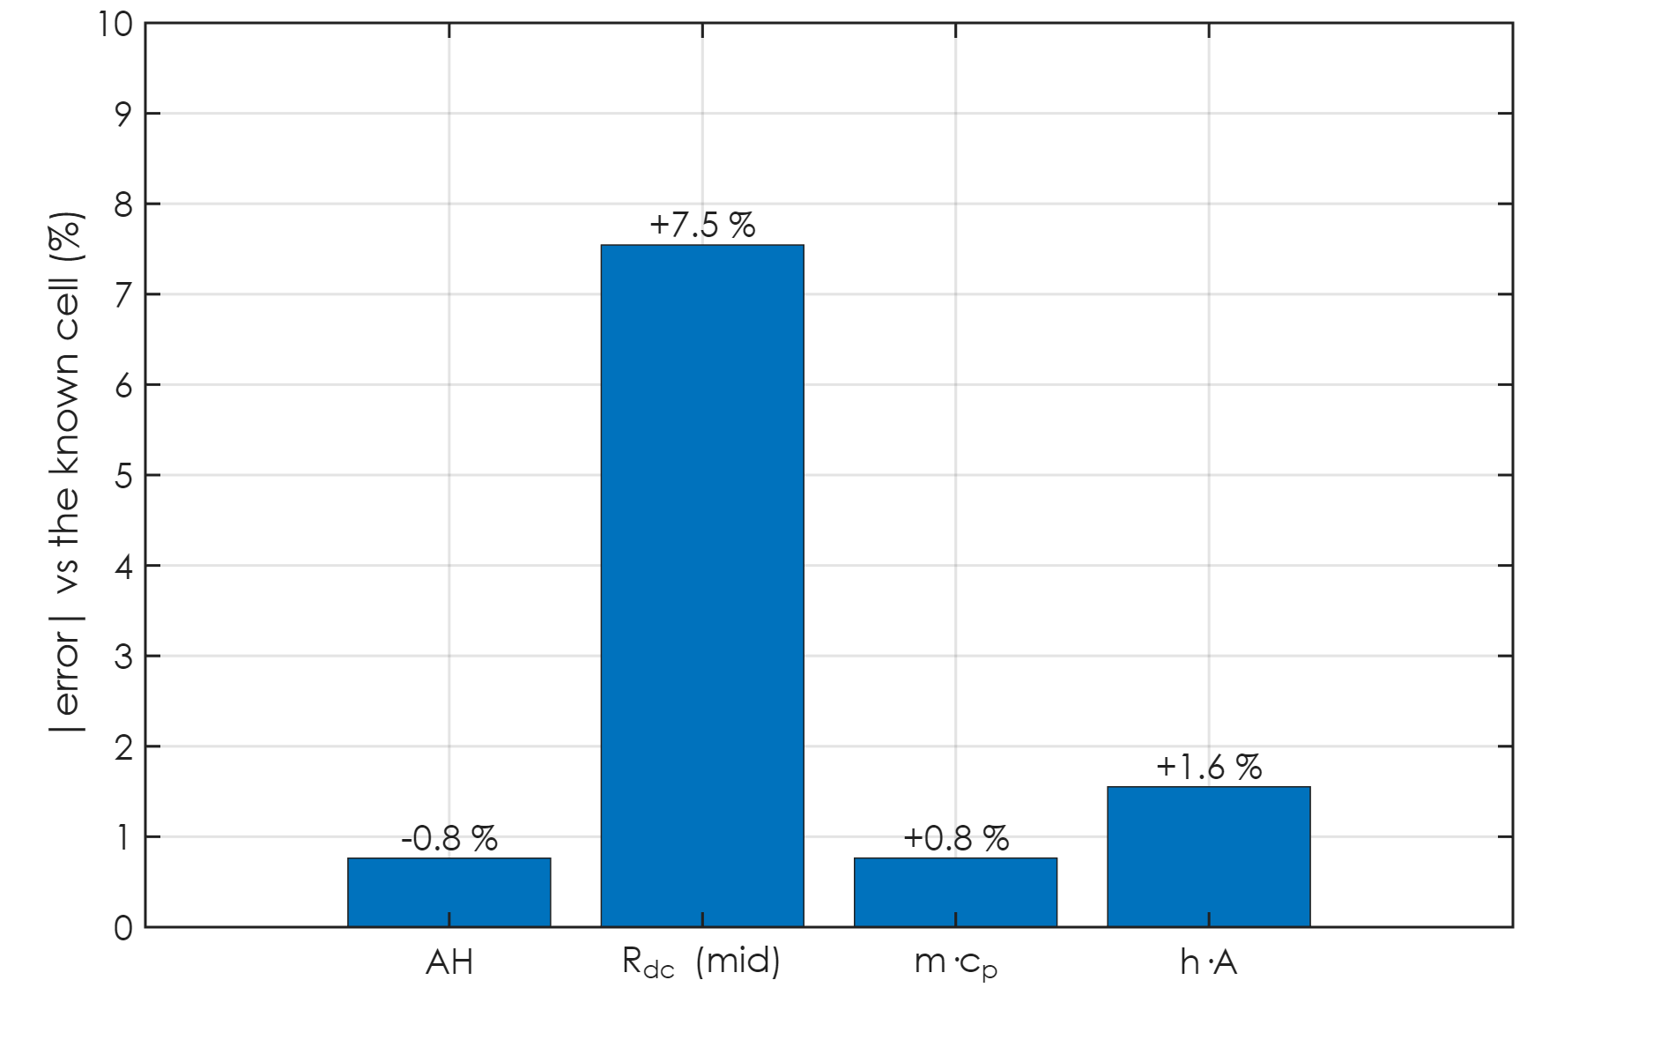
Validation: extracted vs the known cell
AH: -0.8 %
V₀: max 2.8 mV (10 °C), 1.1 mV (25 °C) over all SOC
R_{dc} (mid SOC): 7.5 %
m·c_{p}: +0.8 %, h·A: +1.6 %
Plus: HPPC files at 0 / 25 °C, and a 'nothing may be guessed' test
Synthetic data proves the method; real data adds hysteresis, rate effects
Battery Builder · Modeling tab
57 / 66
Notes:
So how good is all of this? Because the synthetic cell's parameters are known, we can score every result. The capacity is within 0.8 percent. The open-circuit voltage is within 2.8 millivolts everywhere in this file, and 1.1 in the 25 degree file. The total resistance in the middle of the range is within 7.5 percent, and the thermal mass and h A are within about 2 to 2 percent. The validation script also checks H P P C style files, and a cut-down file with no full discharge and no temperature columns, where every box must come back empty, which is the 'no guessing' rule in action. I want to be upfront about the limit of this: synthetic data proves that the method recovers values that are really there. Your real cells will add things the synthetic one doesn't have, like real hysteresis and a resistance that depends a little on the rate. That's why every How window shows its cross-checks, so you can see on your own data how well each piece holds.

Slide 58
What a test needs to contain, for each value
AH, SOC₀: a CC-CV charge followed by a discharge to the cut-off
V₀ + R_{dc} over all SOC: 2+ CC discharges from FULL at different rates ≤ 2C
R₀: current steps, first sample ≤ 5 s after the step
R_{k}, τ_{k}: rests ≥ 5 min after charges / discharges
V₀ ends: rests after the full charge and after the cut-off
m·c_{p}, h·A: Temp 1 + chamber columns, visible self-heating
Mid-SOC pulses + rests would measure R₀/R_{k}/τ_{k} there too
Battery Builder · Modeling tab
58 / 66
Notes:
This slide is a good reference for planning future tests. For each value, here's what the test has to contain. Your rate test already covers all of it, which is great. The one thing it can't give you is R zero and the R C pairs measured in the middle of the state of charge range, because the current never steps or stops there. The tab handles that honestly by scaling to the measured total, but if you ever want those split out properly, adding a handful of short pulses with rests at, say, every twenty percent of state of charge would do it, and the code would pick them up without any changes.

Slide 59
Running your real files: a checklist
Open CSV → check the top bar: current sign note, test temperature
  'chamber changes between …' note: expected with your schedule
Extract → AH: compare with the cycler's Capacity column (≈ 1 %)
SOC₀: the voltage check should agree (no ⚠)
OCV: green on every file, including 25 °C; read the note: which rates, which side
R₀ How?: R₀ + ΣR_{k} vs R_{dc} at the measured points
Thermal: rms error ≲ a few tenths of a K; m·c_{p} / mass ≈ 1 J/(g·K)
Save → Simulink → Plot tab: overlay; "Fit vs data" shows the same check
Battery Builder · Modeling tab
59 / 66
Notes:
Here's a practical checklist for when you run your real files. When you open a CSV, glance at the top bar. It tells you how the current sign was worked out and what test temperature was detected. With your schedule you'll also see a note that the chamber changes between two temperatures. That's expected, and it tells you the discharge temperature is the one being used. After Extract, check that the capacity agrees with the cycler's capacity column to about one percent, and that the starting state of charge has no warning from the voltage check. The open-circuit voltage box should be green on every file now, including 25 degrees. Read its note: it says which discharge rates went into the fit, and whether the charge side was used. In the R zero How window, look at the cross-check where the sum of the resistances is compared with the measured total at the measured points. They should be close. For thermal, the root-mean-square error should be a few tenths of a kelvin or better, and the thermal mass divided by the cell mass should be close to one joule per gram per kelvin. Then save, run your Simulink model, and use the Plot tab to put the twin's voltage and temperature on top of the measured ones. The difference label at the cursor makes it easy to see where the model is good and where it isn't.

Slide 60
Common questions (1/2)
Why not use the datasheet OCV curve?
  it's for a different cell, temperature and protocol; yours is measured
Why the slowest discharge for AH, not the average?
  AH is the charge stored; faster rates just stop earlier
Why ±3 K?
  R changes ~1–2 %/K: 3 K keeps that below the fit's own scatter
Why ignore the 5C discharge in the multi-rate fit?
  it's tens of K hotter and no longer linear in current
Battery Builder · Modeling tab
60 / 66
Notes:
Let me close the technical part with a few questions that tend to come up. First: why not just use the open-circuit voltage curve from the datasheet? Because that curve is for a different cell, often at a different temperature and with a different measurement protocol. The one from your test is for your cell, at your temperature, and it's measured, so it's simply better, and the tool only falls back to asking for a datasheet value when the test can't provide it. Second: why use the slowest discharge for the capacity, rather than averaging them? Because capacity means the charge the cell actually stores. The faster discharges don't store less, they just stop earlier because of the voltage drop, and that effect is already in the model through the resistance. Averaging would count it twice. Third: why plus or minus three kelvin? Lithium-ion resistance changes by roughly one to two percent per kelvin, so three kelvin keeps that effect below the scatter of the fits themselves, while still keeping enough samples. And fourth: why leave the fast discharge out of the multi-rate fit? Because it heats the cell by tens of kelvin, so it isn't at the test temperature any more, and at that current the voltage is no longer a straight line in current.

Slide 61
Common questions (2/2)
Can I trust R₀ in the middle of the SOC range?
  the SUM R₀ + ΣR_{k} is measured there; the split is interpolated
What if a box stays empty on a real file?
  hover: the reason; How?: what was missing; then datasheet or a test tweak
Do the charges at 25 °C go to waste in a 10 °C file?
  they belong to the 25 °C tables: the 25 °C file uses its own charges
What would improve the model most?
  combine all temperatures into R(SOC, T); mid-SOC pulses; 30 min rest at T
Battery Builder · Modeling tab
61 / 66
Notes:
A few more. Can you trust R zero in the middle of the state of charge range? The honest answer: you can trust the total there completely, because it's measured by the multi-rate fit. The split between R zero and the R C pairs is interpolated from the ends. For anything slower than about a second, that split barely matters; for very sharp current steps in the middle of the range, it matters a little. What if a box stays empty on one of your real files? Hover over it first. It tells you the reason. Then open a related How window to see what was missing. Usually the fix is either a datasheet value, or a small change to the test, like a longer rest. Do the charges at 25 degrees go to waste in a 10 degree file? Not at all. They describe the cell at 25 degrees, so they belong in the 25 degree tables, and the 25 degree file uses its own charges for exactly that. And what would improve the model most from here? Three things, in order: combining all your temperatures into tables over state of charge and temperature; a few pulses with rests in the middle of the state of charge range; and holding the chamber at the test temperature for thirty minutes after each discharge, which cleans up the slow time constant.

Slide 62
Limits, and natural next steps
One file = one temperature: tables are R(SOC), not R(SOC, T)
  next: combine the files into R(SOC, T) tables (Tabulate over temperature = Yes)
One resistance for charge and discharge (block: Current directionality = No)
Reversible (entropic) heat left out, as in the block
Self-discharge R_{leak}: needs weeks of storage, so never from this test
Please run the real 25 °C file and confirm the OCV box fills
Battery Builder · Modeling tab
62 / 66
Notes:
A few limits, and where this could go next. Each file describes one temperature. Since you have the same test at several temperatures, the natural next step is to combine them into tables over state of charge and temperature, and switch the block to tabulate over temperature. That's on the list. The model uses one resistance for both charge and discharge, which matches the block setting we're using. The reversible, entropic heat is left out, just as the block leaves it out. And self-discharge needs weeks of storage data, so it will never come from a test like this. And one concrete action item for you: please open the real 25 degree file, press Extract, and confirm that the open-circuit voltage box now fills. If it doesn't, the note will tell us exactly which rate was dropped, and we'll take it from there.

Slide 63
Why Extract now has a second step
Step 1 measures each value where the test shows it (everything so far)
In Simulink, those pieces alone: start −73 mV, 15 A down to ~0.9 V
Start: the OCV near empty came from rests the cell had not finished
After a discharge: the voltage creeps for hours, the RC pairs lasted a minute
Fast discharge: R from low current is far too high at 15 A, hot cell
Step 2 fits the tables so the block's OWN equations give the measured voltage
One least-squares solve; only the 3 time constants are searched
Battery Builder · Modeling tab
63 / 66
Notes:
Everything up to now is step one: each value measured where the test shows it. When you put those values into the Table-Based block in Simulink and run the whole test, three things go wrong. The starting voltage is 73 millivolts low, because the open-circuit voltage near empty came from rests the cell had not finished recovering from. After every discharge the model recovers in a minute while the cell takes hours. And the fast discharge falls to under one volt, because a resistance measured at low current is far too high at fifteen amps, when the cell is also heating up to sixty degrees. So Extract now has a second step: it adjusts every table number so that the block's own equations, driven by the measured current, give the measured voltage over the whole test. Because the voltage is a sum of table values times known signals, that's a single least-squares solve, and only the three time constants are searched.

Slide 64
Step 2: the shapes that keep Simulink stable
V0(SOC): one curve, rising with SOC (same at every T)
R0(SOC,T): only falls as the cell gets hotter, 0 … 60 °C
→ the hot cell's lower R0 is what stops the 15 A discharge at 2.5 V
R1..R3(SOC): grow towards empty; τ = 1 s, 4 min, 3.5 h
m·cp, h·A with the block's own heat, then tables re-solved at that T
Load profile: every logged current held until the next sample
Code: src/fitTableBased.m; check: "Fit vs data" button
Battery Builder · Modeling tab
64 / 66
Notes:
The shapes matter as much as the fit. The open-circuit voltage is one curve over state of charge. When I let it change with temperature, the fit hid overpotential in it, which makes no heat, so the simulated cell never warmed up. R zero gets the temperature axis, from zero to sixty degrees, and it can only fall as the cell gets hotter. That hot, lower resistance is what makes the fifteen amp discharge stop at two and a half volts. The R C pairs are over state of charge only and grow towards empty: that's the knee and the slow recovery, with time constants of a second, four minutes and three and a half hours. Then the thermal mass and h A are fitted with the block's own heat, and the tables are solved again at the temperature the block itself computes. One more fix on the Load profile tab: the current is now held between samples, like the cycler's own amp-hour counter; interpolating through the CV taper drifted the state of charge by 0.14 percent per charge.

Slide 65
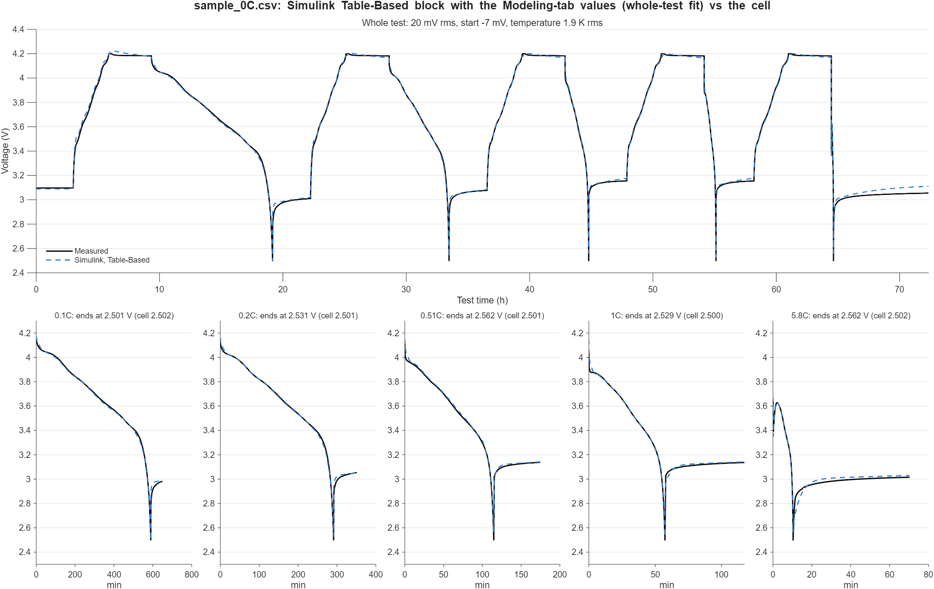
Result in Simulink: Table-Based block vs the cell
Whole test: 241 → 20 mV rms
Start of test: −73 → −7 mV
Discharge ends: 2.50 / 2.53 / 2.56 / 2.53 / 2.56 V (cell 2.50)
15 A: no longer collapses (was ~0.9 V)
Temperature: 23 → 1.9 K rms
Left: a few tens of mV at the fast knees (R also falls with current)
Battery Builder · Modeling tab
65 / 66
Notes:
And here's the result, in Simulink, with the Table-Based block wired exactly as the README describes and every value from the Save button. Over the whole seventy-two hours it's 20 millivolts rms instead of 241. The start is within seven millivolts. Every discharge now ends at two and a half volts, within about sixty millivolts, and the fifteen amp discharge no longer collapses. The temperature follows the cell within two kelvin. What's left is a few tens of millivolts at the end of the faster discharges: the block has one resistance per state of charge and temperature, and a real cell's resistance also falls with current.

Slide 66
Thank you
Every number in this deck came from extractCellParameters on a test that follows your profile.
The How? window on each green box walks through the same steps with your own file.
Notes:
That's everything. To recap the big idea one last time: every quantity is measured where the test shows it. Steps give R zero, rests give the R C pairs and the ends of the open-circuit voltage, the ladder of discharge rates gives the open-circuit voltage and the total resistance everywhere in between, and the fast discharge plus the chamber steps give the thermal mass and h A. Everything you saw today came straight out of the same extraction code that runs when you press Extract, and the How window on every green box walks through exactly the same steps with the numbers from your own file. Thanks for listening.

