Slide 1
Team 5C Project

Slide 2
Overview

Slide 3
personas

Slide 4
Personas continued

Slide 5
Personas continued

Slide 6
specification
User Registration and Profiles: Allow users to create accounts, personalise their profiles, and track their music review history.
Review Posting: Enable users to write and post their reviews for albums or tracks, including rating them on a predefined scale.
Comment System: Allow users to comment on reviews and engage in discussions with other music enthusiasts.
Search Functionality: Enable users to search for artists, albums, or tracks using various filters (e.g., genre, release date, artist popularity).

Slide 7
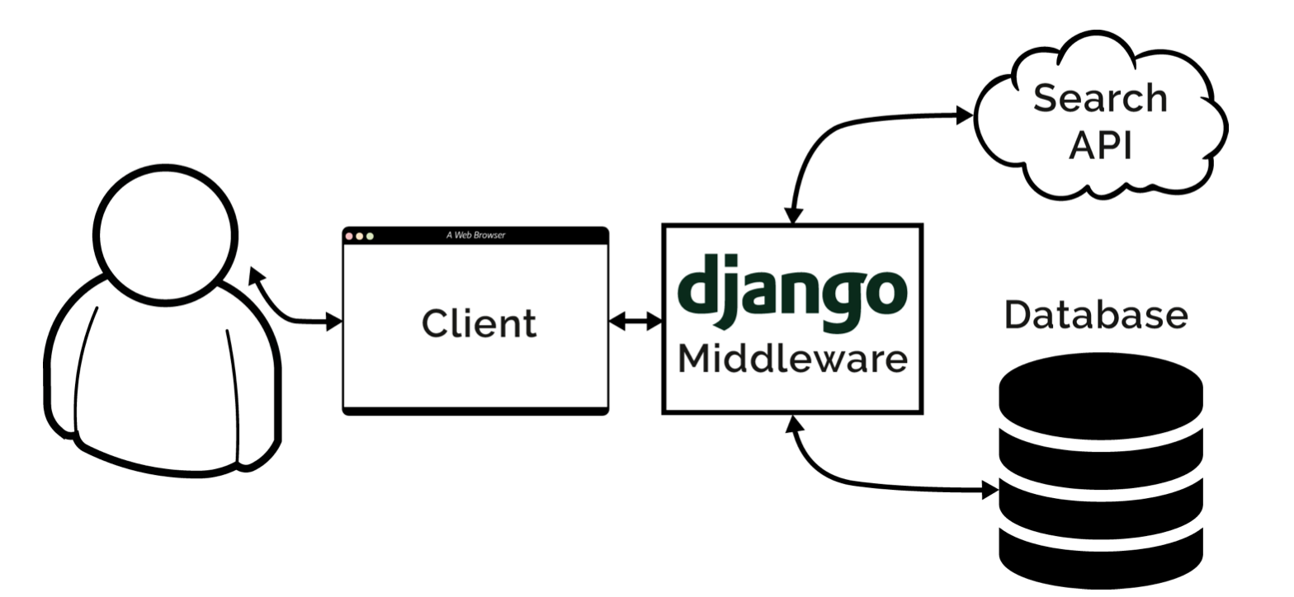
system architecture diagram

Slide 8
ER Diagram

Slide 9
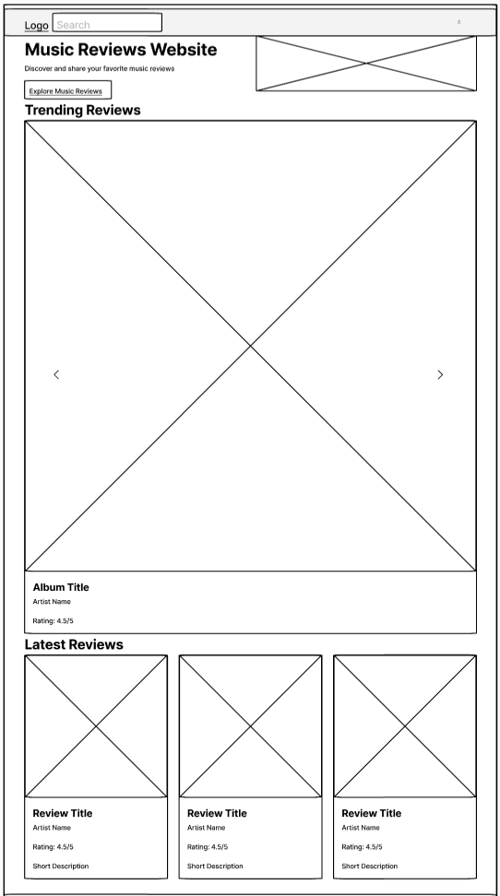
Wireframes - Home
Login

Slide 10
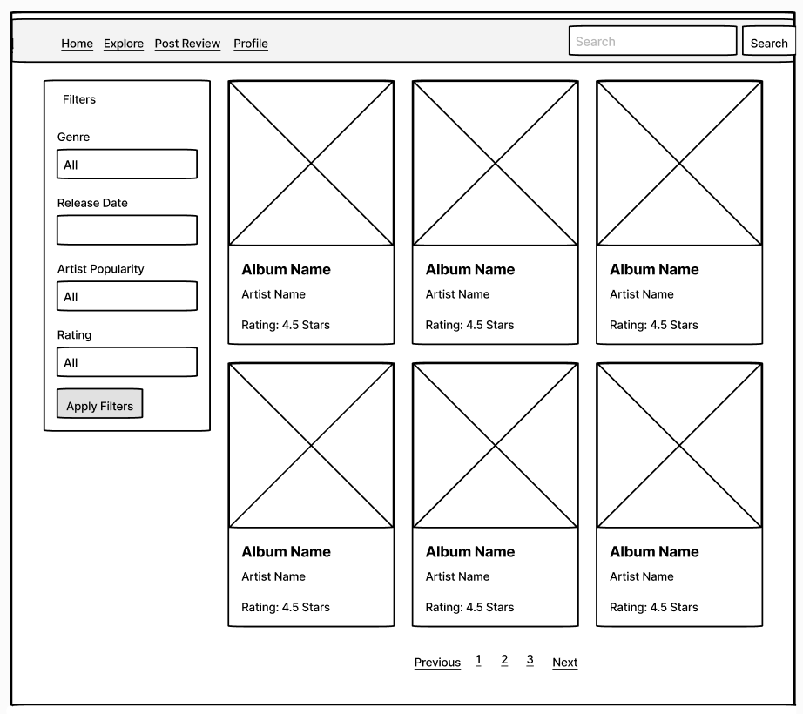
Wireframes - Explore

Slide 11
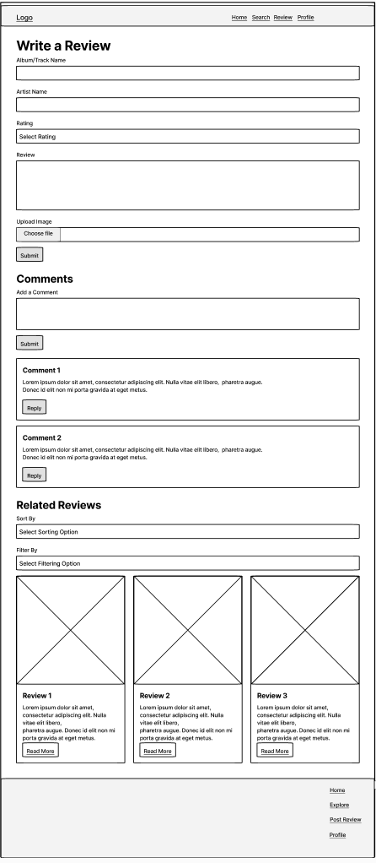
Wireframes – Write review

Slide 12
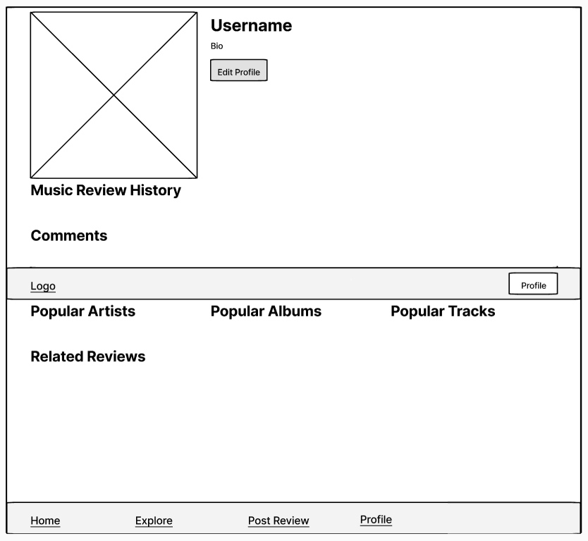
Wireframes – User Profile

Slide 13
walkthrough

Slide 14
walkthrough

