Slide 1
Team 5C Project

Slide 2

Overview
Users can write reviews for music i.e. albums, singles, eps and gigs. The user can choose to review music that is already in the website’s database or add new music to the database.

Slide 3
personas

Slide 4
Personas continued

Slide 5
Personas continued

Slide 6
specification
User Registration and Profiles: Allow users to create accounts, personalise their profiles, and track their music review history.
Review Posting: Enable users to write and post their reviews for albums or tracks, including rating them on a predefined scale.
Comment System: Allow users to comment on reviews and engage in discussions with other music enthusiasts.
Search Functionality: Enable users to search for artists, albums, or tracks using various filters (e.g., genre, release date, artist popularity).

Slide 7
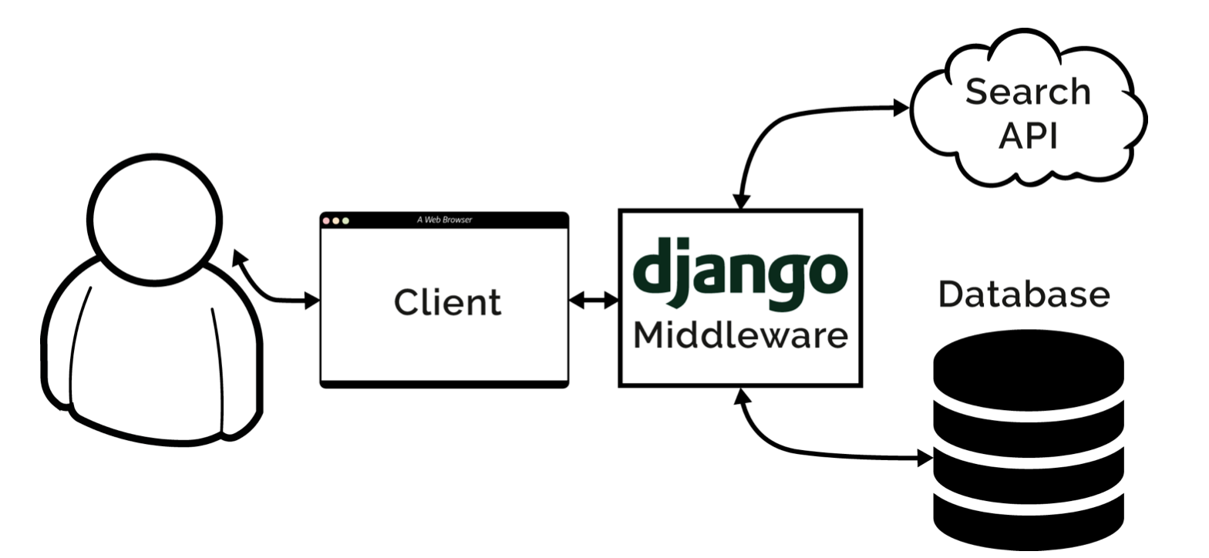
system architecture diagram

Slide 8
ER Diagram

Slide 9
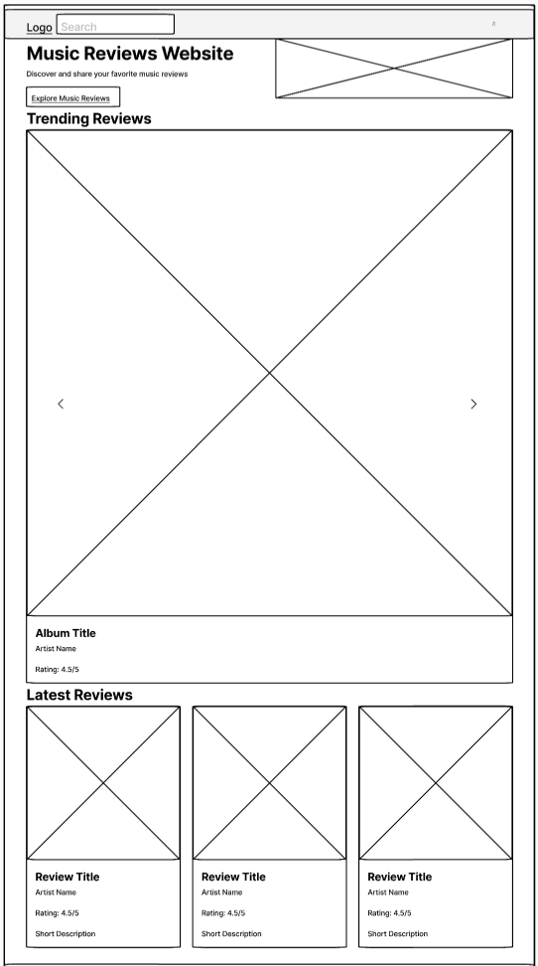
Wireframes - Home
Login

Slide 10
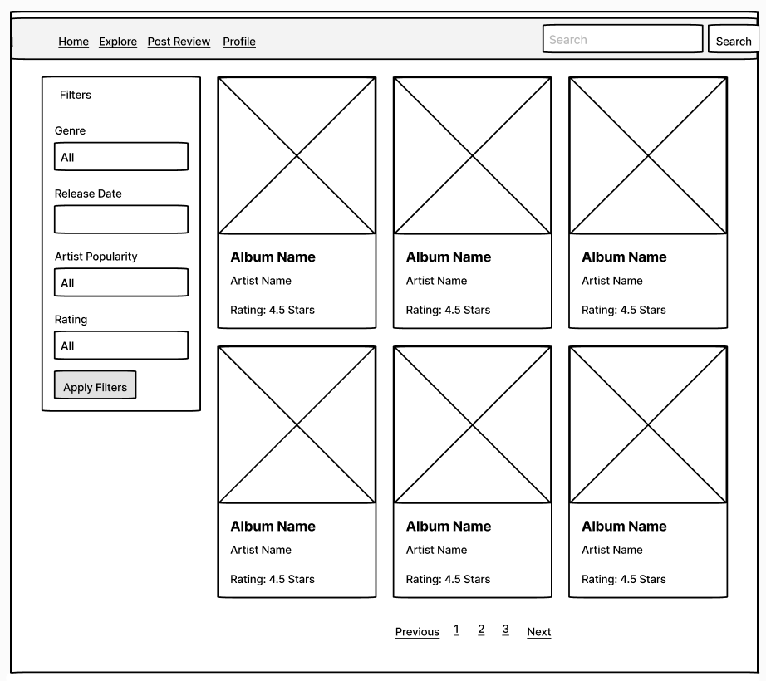
Wireframes - Explore

Slide 11
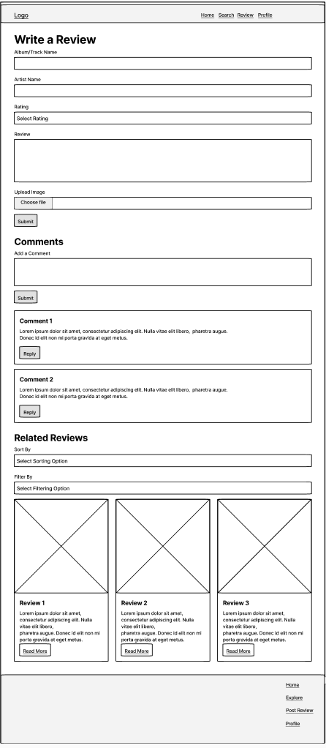
Wireframes – Write review

Slide 12
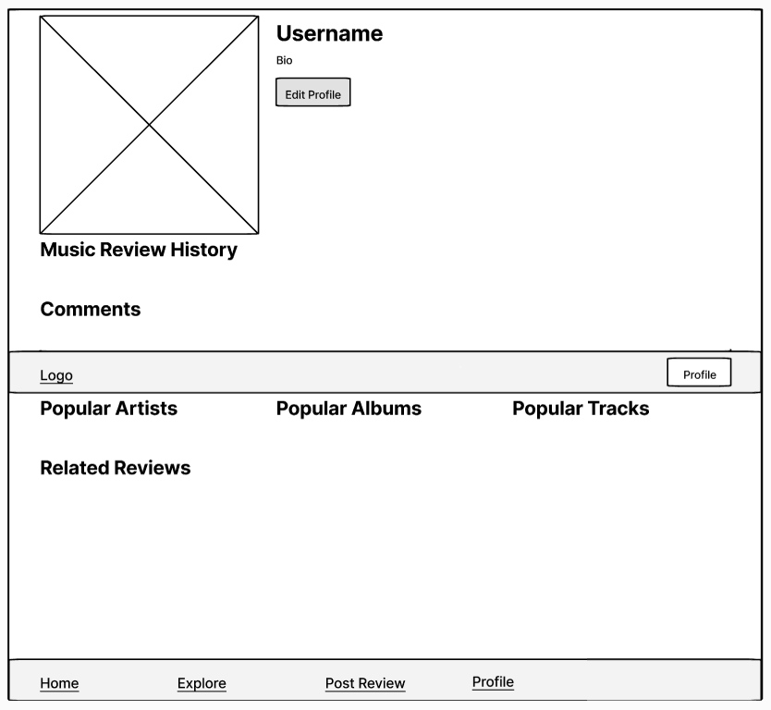
Wireframes – User Profile

Slide 13
walkthrough

Slide 14
walkthrough

