Slide 1
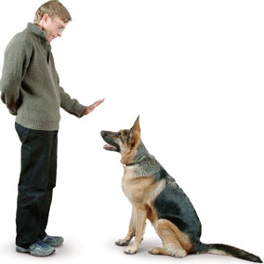
Sit!!!
The Command Pattern

Slide 2
Command
Creational Patterns
factory method
abstract factory
singleton
Behavioral Patterns
strategy
observer
command
Structural Patterns
decorator
Human Computer Interaction Research
University of Nevada, Reno

Slide 3
Problem
“your program has many different actions it can perform, implementing these would lead to huge if-elseif or switch blocks”.
Human Computer Interaction Research
University of Nevada, Reno

Slide 4


Dog Training
Roll
Bark
Sit
Human Computer Interaction Research
University of Nevada, Reno

Slide 5
Naive solution
public static void main(String[] args) {
Dog charles = new Dog("Snoop");
if (args[0].equals("bark")) {
charles.bark(); }
else if (args[0].equals("bite")) {
charles.bite(); }
else if (args[0].equals("roll")) {
charles.rollover();
}
}
Works but gets messy when you add lots of commands (bite, attack, eat homework, barf...)
should this even be in main?
Human Computer Interaction Research
University of Nevada, Reno

Slide 6
Command Pattern
The Command Pattern: encapsulates a request as an object, thereby letting you parameterize other objects with different requests, queue or log requests, and support undoable operations
Human Computer Interaction Research
University of Nevada, Reno

Slide 7
Command Pattern
Move the code for each individual action into it’s own separate class.
Each of these classes implements the same Interface, allowing the code that uses them to interact solely with the Interface and not know or care about the individual classes.
This increases Cohesion because each class is responsible for one discrete set of logic.
This decreases Coupling because the code calling the command only deals with one type, the Interface.
Human Computer Interaction Research
University of Nevada, Reno

Slide 8
Command Interface
public interface DogCommand {
public void execute();
}
You can put any “generic” method in here:
log()
undo()
delete()
load()
Human Computer Interaction Research
University of Nevada, Reno

Slide 9
Specific Commands
public class BarkCommand implements DogCommand {
public void execute() {
System.out.println("Bow wow!!");
}
}
public class BiteCommand implements DogCommand {
public void execute() {
System.out.println("Munch..Munch");
}
}
Human Computer Interaction Research
University of Nevada, Reno

Slide 10
Dog
public class Dog {
String name;
DogCommand commands[] = new DogCommand[2];
public Dog(String name) {
this.name=name;
commands[0] = new SitCommand();
commands[1] = new BarkCommand();
}
}
Human Computer Interaction Research
University of Nevada, Reno

Slide 11
Main class
public class TestDogCommand {
public static void main(String[] args) {
DogCommand cmd;
try {
cmd = (DogCommand) Class.forName(args[0]).newInstance();
cmd.execute();
} catch (InstantiationException e) {
e.printStackTrace();
} catch (IllegalAccessException e) {
e.printStackTrace();
} catch (ClassNotFoundException e) {
e.printStackTrace();
}}}
OK this is ugly, but it scales up a lot better
Eelke-Folmers-MacBook-Pro:bin eelke$ java TestDogCommand BarkCommand
Woof!!
Human Computer Interaction Research
University of Nevada, Reno

Slide 12
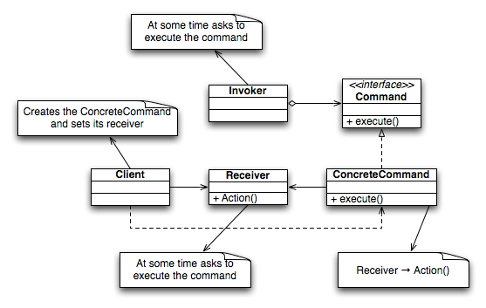
Class Diagram
Human Computer Interaction Research
University of Nevada, Reno

Slide 13

Example
Document Editor
Human Computer Interaction Research
University of Nevada, Reno

Slide 14
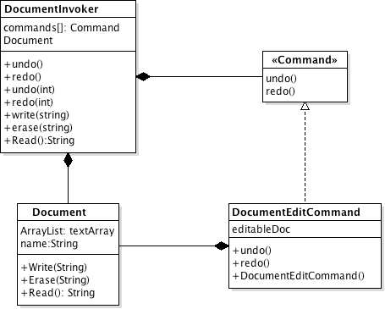
Class diagram
invoker
receiver
Human Computer Interaction Research
University of Nevada, Reno

Slide 15
Command Interface
public interface Command {
public void undo();
public void redo();
}
Human Computer Interaction Research
University of Nevada, Reno

Slide 16
Document write Command
public class DocumentWriteCommand implements Command {
private Document editableDoc;
private String text;
public DocumentWriteCommand(Document doc, String text) {
this.editableDoc = doc;
this.text = text;
editableDoc.Write(text);
}
public void undo() {
editableDoc.Erase(text);
}
public void redo() {
editableDoc.Write(text);
}
public String toString(){
return "Write";
}
}
Human Computer Interaction Research
University of Nevada, Reno

Slide 17
Document Invoker
import java.util.ArrayList;
public class DocumentInvoker {
private ArrayList commands = new ArrayList();
private Document currentdoc;
public DocumentInvoker(String name) {
currentdoc = new Document(name);
}
public void Redo(int level) {
Command tmp;
System.out.println("---- Redo level " + level);
tmp = (Command) commands.get(level);
tmp.redo();
}
public void Undo(int level){
Command tmp;
System.out.println("---- Undo level " + level);
tmp = (Command) commands.get(level);
tmp.undo();
}
Human Computer Interaction Research
University of Nevada, Reno

Slide 18
Document Invoker
public void Write(String text) {
DocumentWriteCommand cmd = new DocumentWriteCommand(currentdoc, text);
commands.add(cmd);
}
public void Bold(int line) {
DocumentBoldCommand cmd = new DocumentBoldCommand(currentdoc, line);
commands.add(cmd);
}
public void RemoveBold(int line) {
DocumentRemoveBoldCommand cmd = new DocumentRemoveBoldCommand(currentdoc, line);
commands.add(cmd);
}
public String Read() {
return currentdoc.Read();
}
public void printCommandBuffer() {
StringBuffer txt = new StringBuffer();
txt.append("---- Commands issued----\n");
for (int i = 0; i < commands.size(); i++) {
txt.append( i +":"+ (Command) commands.get(i) + "\n");
}
System.out.println(txt.toString());
}
}
Human Computer Interaction Research
University of Nevada, Reno

Slide 19
public class TestEditor {
public static void main(String[] args) {
DocumentInvoker myDocument = new DocumentInvoker ("message_to_rudi");
myDocument.Write("Hey I just met you");
myDocument.Write("And this is crazy");
myDocument.Write("But here’s my number”);
myDocument.Write(“so Call me maybe?”);
myDocument.Bold(0);
myDocument.Undo(1);
myDocument.printCommandBuffer();
System.out.println(myDocument.Read());
}
}
Human Computer Interaction Research
University of Nevada, Reno

