Slide 1
Android Location services Security exploration
Presented by
Nathaniel Green

Slide 2
Topics
Types of Location Data
Permissions
Recent Security Events
How to use location services on Android
Ethical Considerations
Demonstration

Slide 3
Fine and Coarse Location
Fine Location
Coarse Location
“Provides an estimate of the device's location that is as accurate as possible, usually within about 160 feet (50 meters) and sometimes as accurate as within 10 feet (a few meters) or better.” Uses GPS to determine location.
“Provides an estimate of the device's location, to within about 1 mile (1.6 km).” Uses a combination of imprecise methods to determine location. Considered more secure but less useful.
Question: how can we abuse Coarse location to get a more precise location? (assume each request generates new data)

Slide 4
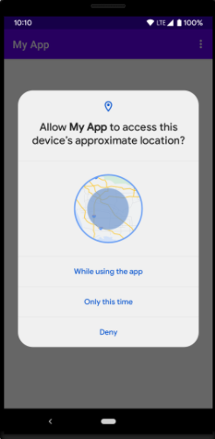
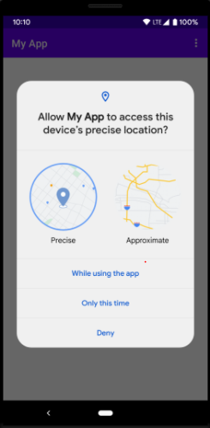
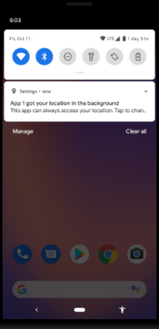
Location Access Permissions on Android
Before accessing location, appropriate permissions must be granted by the user. The developer can request foreground or background permission in combination with fine or coarse location. In newer Android API versions, the user can counter a fine location request with a coarse access permission.
Users should be incredibly cautious with location data!

Slide 5
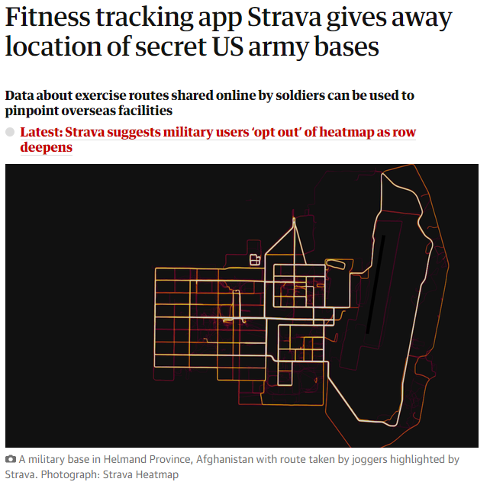
Strava and Military Bases
Even trusted companies can be cavalier with your location privacy!
https://www.theguardian.com/world/2018/jan/28/fitness-tracking-app-gives-away-location-of-secret-us-army-bases

Slide 6
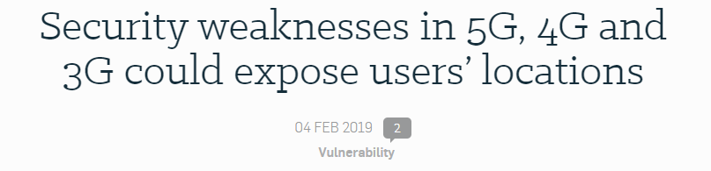
External Location Threats
Despite Android’s protections, certain vulnerabilities can be outside of their control.

Slide 7
How to access location on Android
In current Android applications, location is most often accessed through the Fused Location Provider (FLP) API.
This API works with either coarse or fine location with no code changes.
If background location access is granted, this API can be used to periodically generate location updates in the background.
There are other ways to access location data more often and more cleanly, but this API can be more undetectable due to battery considerations.

Slide 8
Ethical Programming Considerations For Developers
Use coarse location whenever possible
Do not request background data (on newer phones) if it isn’t used
Try to avoid storing location data:
Especially on large servers
Be sensitive of military data
Attempt to filter data to appropriate level
Do not transmit unnecessary location data over networks

Slide 9
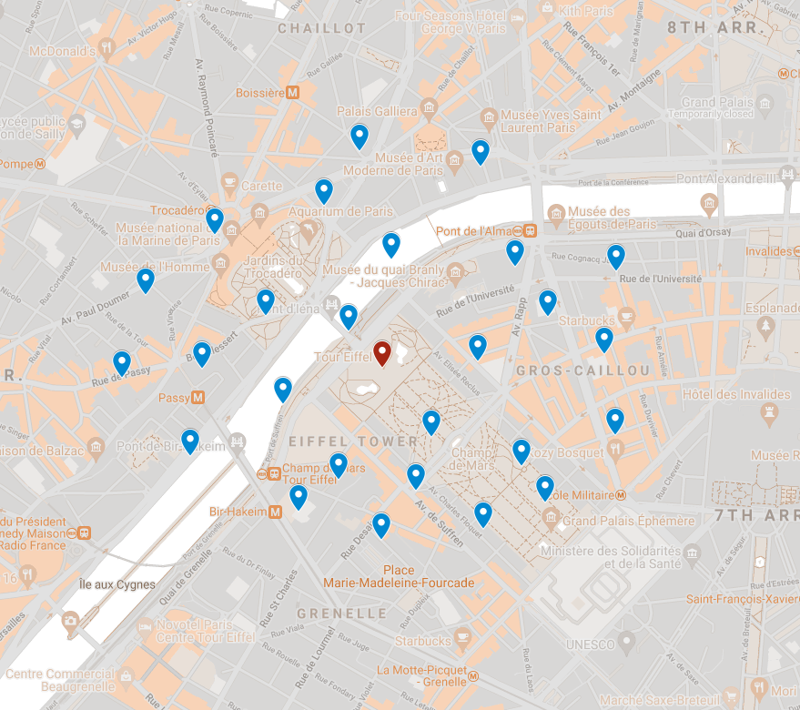
Using coarse location to determine precise location?
One may think that it would be easy to determine a more precise location from coarse location using many requests to obtain an average.

Slide 10
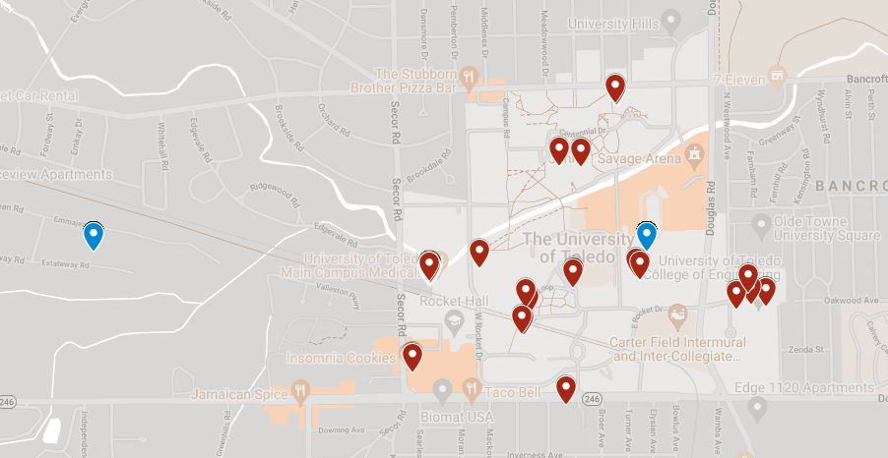
Built-in countermeasures:
Android has built-in protections against this. The exact method is hard to determine, but this exploit is prevented in the Fused Location Provider regardless.

Slide 11
Demo
https://youtu.be/fs63qvDIz9g

Slide 12
Conclusion
Android developers have worked hard to make sure it’s difficult for vigilant users to be tracked by attackers
Developers should take great caution in using location data

