Slide 1
Algorithms Final Project
Mismatch threshold parameter selection for short read sequence alignment

Slide 2
As a naïve approach, what are the possible values of our mismatch threshold T?
RNA-seq
Goal: To find a T that will align the single strand RNA-seq 100-bp reads from wild strain PWK with the reference genome B6.
READ 1
READ 2
Read 3
Read 4
Read 5
mRNA
Not considered a mismatch
READ 1
READ 2
3
3
Read 4
Read 5
EXON 1
INTRON
EXON 2
REF. Genome
0
Window length (100)
Data we have to use:
1. “True” variation in PWK-B6 chromosome 1(.vcf)
2. PWK RNA-seq reads (fastq)
3. B6 Reference Genome (.gcf)
4. B6 fasta file for chromosome 1 (.fa)
Increasing sensitivity
Increasing specificity
Optimal region:
Maximize sens. & spec.

Slide 3
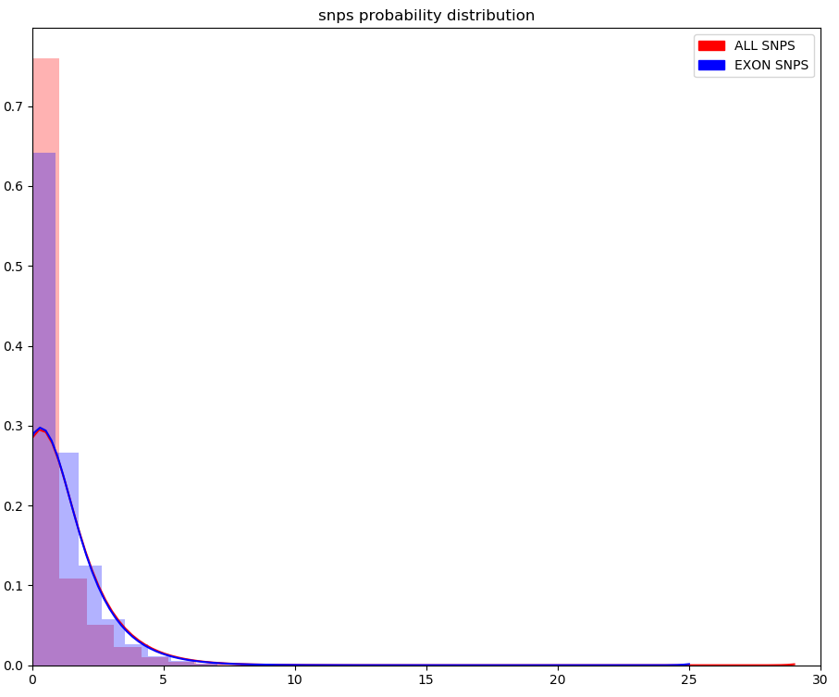
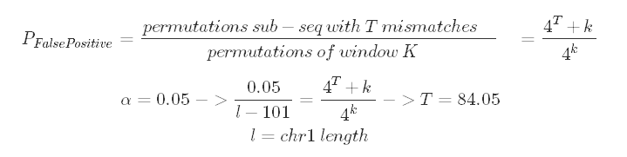
Narrowing the T region
From the Left (T’s lower bound)
Given common variation on B6 chromosome 1, what T will properly accept X% of the variation?
To extrapolate this to PWK alignment assumes:
1. PWK variation is similar to B6
Create a chromosome mask representing SNPs and iterate over each 100-mer in the mask, recording number of SNPs.
BUT, looking at RNA-seq, so exon only, therefore, only include exonic 100-mers.
From the Right (T’s Upper Bound)
Question: Assuming random sequence and subsequence, what is the probability of getting an alignment allowing for T mismatches?
Region | Mean | STD | Max
Exonic
Intronic
Boundary
All | 0.834 | 1.259

Slide 4
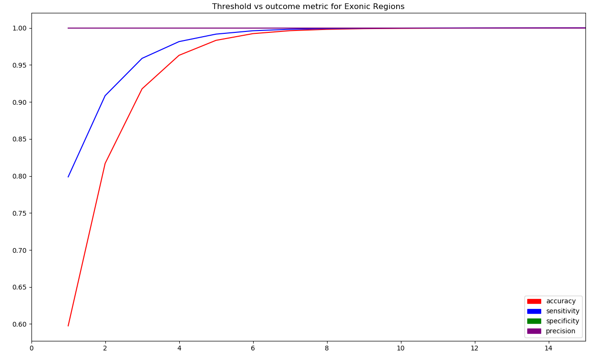

TP and FN :
Found by checking each T over all windows in chr1
0
99.99% specificity
100
12
84

