Slide 1
Algorithms Final Project
Mismatch threshold parameter selection for short read sequence alignment
Nathaniel Evans

Slide 2
As a naïve approach, what are the possible values of our mismatch threshold T?
(using STAR)
RNA-seq
Goal: To find a T that will align the single-stranded RNA-seq 100-bp reads from wild strain PWK with the reference genome B6.
READ 1
READ 2
Read 3
Read 4
Read 5
mRNA
Not considered a mismatch
READ 1
READ 2
3
3
Read 4
Read 5
EXON 1
INTRON
EXON 2
REF. Genome
Mismatch
0
Window length (100)
Data we have to use:
1. variation in B6 chr 1 (.vcf)
2. PWK RNA-seq reads (fastq)
3. B6 Reference Genome (.gcf)
4. B6 fasta file for chr 1 (.fa)
Increasing sensitivity
Fewer improperly
rejected alignments
Fewer multiple Alignments
Optimal region:
Maximize sens. & spec.
(& Min. Comp. resource)
Increasing Comp. Resources

Slide 3
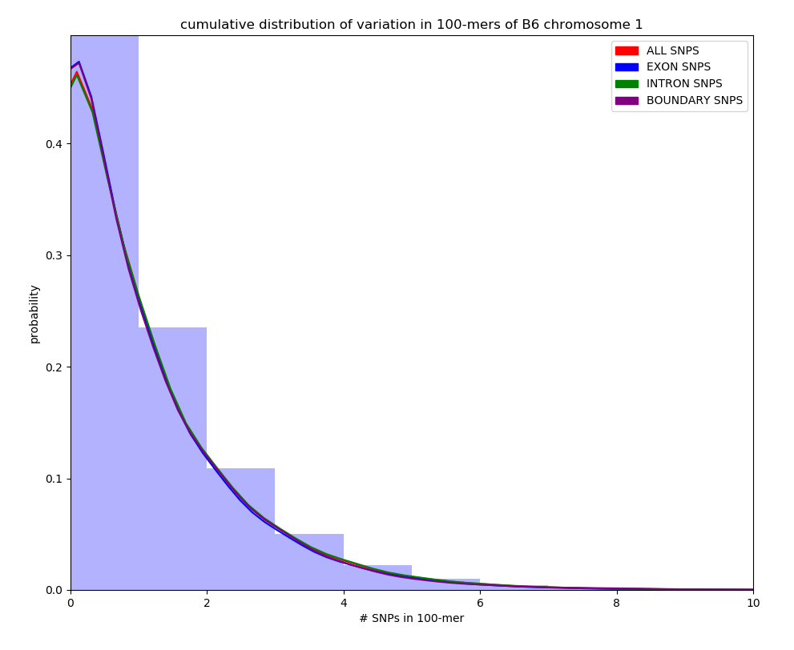
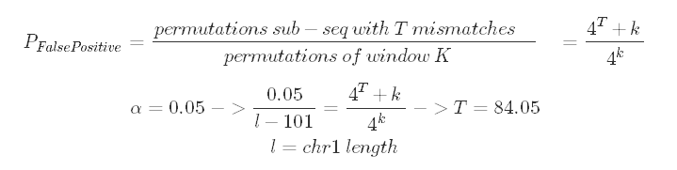
Calculating T
Estimating T’s lower bound
Given common variation on B6 chromosome 1, what T will properly accept 99.9% of the variation?
To use this method assumes:
1. B6 gene-region variation on chr1 is equal to the rest of the genome.
2. PWK gene-region variation is similar to B6
ALGORITHM:
Create a chromosome mask representing SNPs and iterate over each 100-mer in the mask, recording number of SNPs per 100-mer.
Since we’re aligning RNA-seq, only include exonic 100-mers. Use entrez to pull genes to create exon mask.
Calculate T threshold that includes 99.9% data
TODO: Splice out introns by splice sites: GT/AG, GC/AG, AT/AC (STAR)
Estimating T’s Upper Bound
Assuming random sequence and subsequence, what is the probability of getting an alignment allowing for T mismatches?
Region | Mean | STD | Max
Gene Regions (exon & intron!?) | 0.801 | 1.221 | 20
Non -Gene Regions | 0.848 | 1.221 | 26
Boundary | 0.817 | 1.269 | 20
All | 0.834 | 1.259 | 26

Slide 4
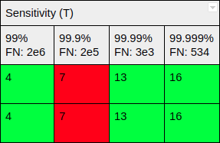
Results and Alignment
Using STAR, and the short_PWK.fastq file
T | Uniquely mapped reads | % reads unmapped: too many mismatches | % reads mapped to multiple loci
1 | 83.13% | 0.0% | 7.29%
3 | 87.10% | 0.0% | 8.37%
7 | 87.6% | 0.0% | 8.63%
13 | 87.76% | 0.0% | 8.65%
75 | 87.78% | 0.0% | 8.65%
EXTENSION/GENERALIZABLE
Calculate variation from RNA-seq data itself by doing global optimal pairwise alignment on a small number of RNA-seq reads, and use this in the Algorithm described here. Unfortunately, this opens up a host of other parameter optimizations (score matrix & gap penalties)
0
99.99% specificity
100
7
84

