Slide 1
HNSCC functional assay pipeline development
Nate Evans

Slide 2
Plate Map
Check ‘Blank490’
Apply ceiling of 1
(Dan’s protocol uses 100 – note for AUC threshold adjustments)
Plate Mapping
Negative Controls Normalization
Floor Normalization
Single agents
Probit Regression & 5th order polynomial regression. For each calculate:
AIC, BIC
Deviance
P value, z-statistic
AUC
Photo spectrometer
Output
Combination-Agents Normalization
The zero value (positive control) of optical density is set by the p.spec software [blank490] but to interpret assay value as cell viability, we need to scale optical density by plate controls:
Cell_viab = opt_dens / avg_plt_control
[This sets PAC control value as cell viability of 1]
No within plate replicates on these panels [rev 001, 002]
Within & Across Plate Inhibitor Averaging
Ceiling Normalization
Regression Fitting
post-processing
Remove runs with:
[probit] AIC > 12
[probit] Deviance > 2
Flag runs where:
[probit] AIC < [poly reg] AIC
Set floor of zero
QC: Negative assay value adjustment ?
Step Description:
Convert from matrix format to long data and merge plate map.
Within-plate replicates are fit with linear regression and drugs with AUC differences > 1 are removed. Remaining are averaged.
Across-plate replicates are fit with linear regression and AUC differences > 0.75 are removed. Remaining are averaged.
Represented combination-agent conc. as Euclidean distance.

Slide 3
Regression Fitting
[Probit_calc.py]
post-processing
[name – not in dev yet]
Panel 1
EDA / Batch Effects Search
Regression Fitting
[Probit_calc.py]
post-processing
[name – not in dev yet]
Panel 2
Regression Fitting
[Probit_calc.py]
post-processing
[name – not in dev yet]
Panel 3
Merge data
Filter Data
Batch Effect Correction
[If necessary]
Panel n
Regression Fitting
[Probit_calc.py]
post-processing
[name – not in dev yet]
Assign Sensitivity Labels

Slide 4
Combination-agent concentration space fit
For combination-agent assays, we have to choose a plane to fit our probit along and we really only have one good choice.
Drug 2 concentration
Cell viab
Cell
viability
Drug 1 concentration
(drg1_conc^2 + drg2_conc^2)^(0.5)

Slide 5
Probit Fitting Convergence
Perfect separation occurs when all [or most] of the cell viability values are identical.
If all are identical I just fit with the max auc value
If not all are identical, I fit with linear regression.

Slide 6
Processing Time & Parrallelization
[20/21] - Total time elapsed: 0:25:10.298157
~75 sec / panel
Processing can parallelize to panel granularity
assuming available_threads > num_panels, parallelization will reduce time complexity to O(c)
Otherwise, O(n)

Slide 7
Overview
Number of HNSCC patients: 11 HNSCC patients [7/20]
Plate map versions
Plates 1-3 (rev 001), Plates 1-6 (rev 002) <- combinatorial
Tyner panels – still need to be re-worked into HNSCC format
+1 assay with 7… require additional work
Excel files with pages: meta, concentration_<num>, inhibitor_<num>
Naming convention
Unique ID for each assay? Or we need to distinguish replicates
Date of assay?
MTS sitting time?
lab_id=XXXXX-norm=XXX-plate_version_id=XXXX

Slide 8
Plate Map Revisions
Drug Names, there are some inconsistencies – need to define clear nomenclature to avoid redundancy.
I can provide a list of all used names, if someone can review and choose the right names.
Alternatively, if there is a list of acceptable drug names, I can do it myself.
I’d like a review of my concentration mapping [request]
Ashley volunteered to review, but a second pair of eyes would be useful as well.

Slide 9
Data output documentation issues
There are a number of assays that are labeled as having been normalized by positive controls (labeled as “blank490”), however, the output file shows discrepancies that indicate it was not.
[lab_id=10308,notes=NA]
[lab_id=10309,notes=matched normal 10308]
*these two assay outputs don’t have a 26th column, which usually says “blank490” in each row.

Slide 10
Standing Questions
Blank 490, how is this normalization done?
Scope of documentation?
Code version control – github repo?
Biocompute object
R/Doxygen
Scope of testing?
Doc-testing / unit-testing
Language Preference? Currently using mix of python, R, bash
Dockerize environment?

Slide 11
Verification
Run beatAML data and compare to values
Unit testing
Doc testing

Slide 12
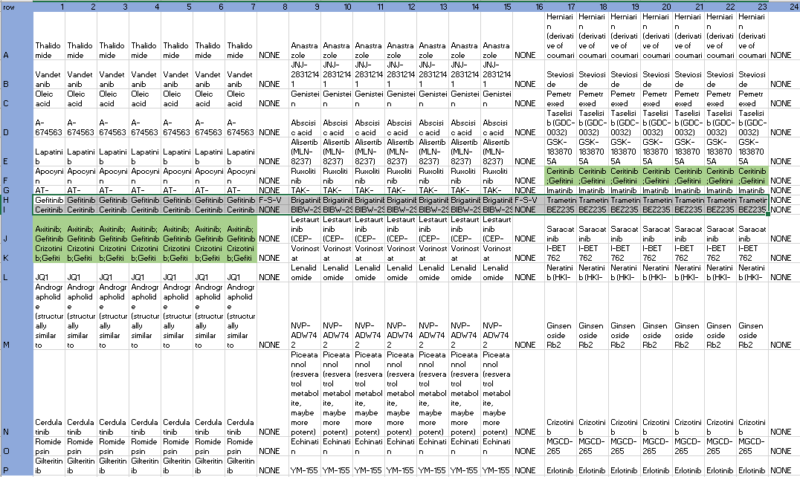
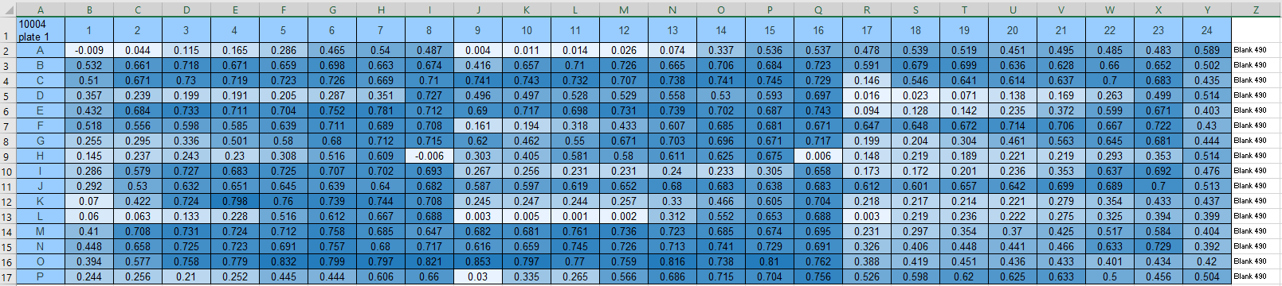
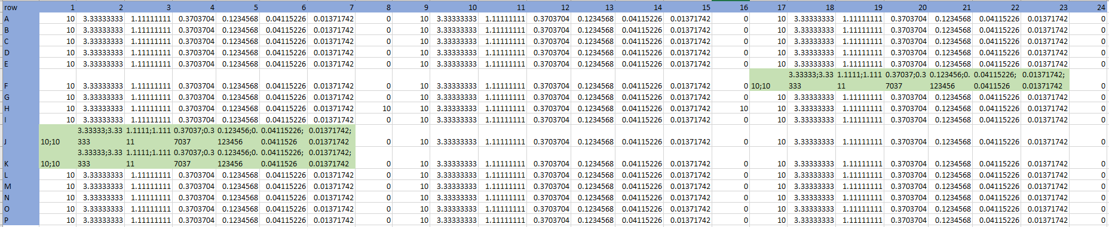
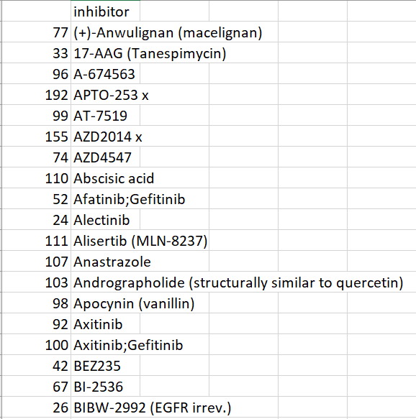
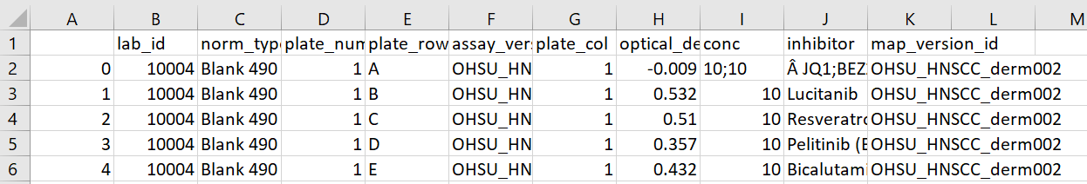
Overview: Map data
$ python ./python/HNSCC_plate_data_mapper.py ./plate_maps ./data
Unique inhibitor names
Functional Data: position, lab_id -> concentration, inhibitor (long format)

Slide 13
Plate Map
output
Curve fitting / AUC calculation
[Traditional]
Dose, inhibitor -Optical Density Mapping
EDA / Batch-Effect Search
Normalization & QC [traditional]
BDR sensitivity designation
[evans]
Inhibitor level EDA
Photo spectrometer
Output
Functional Assay
Atypical classifier
[evans]

