Slide 1
HNSCC functional assay pipeline development
Nate Evans

Slide 2
Overview
Number of HNSCC patients: 11 HNSCC patients, 21 Panels
Plate map versions
Plates 1-3 (rev 001)
Plates 1-6 (rev 002) [combination plates: 3-6]
Tyner panels – still need to be re-worked into HNSCC-format plate map’s.
There is one Panel with 7 plates (10356; Issue #6) which will require a unique plate-map.
Excel files with pages: meta, concentration_<num>, inhibitor_<num>
Plate map REV002 drug names need to be re-done (Issue #8)

Slide 3
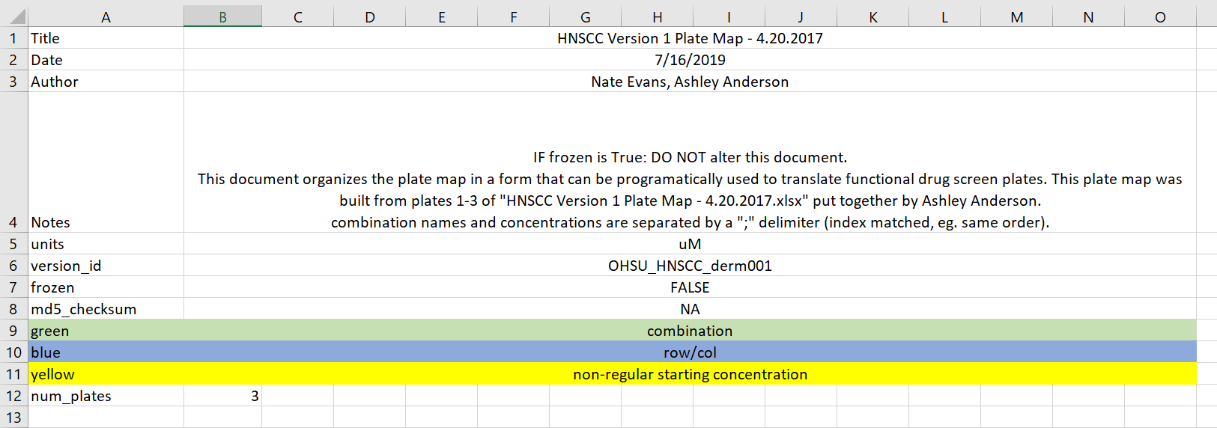
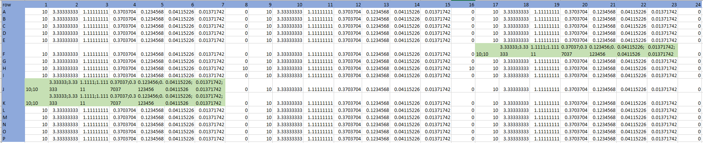
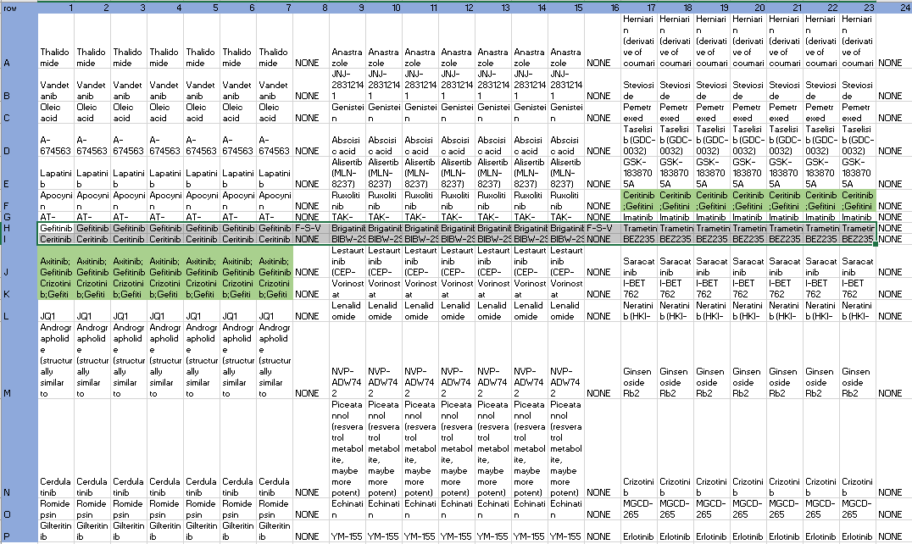
Plate-Map Format

Slide 4
Panel Assay Data Naming Convention
lab_id=10004-norm=Blank490-plate_version_id=OHSU_HNSCC_derm002-note=NA
When each panel assay is processed, a panel_id is assigned to distinguish between across-panel replicates (recorded in .assay_ids)
Currently, renamed data is only stored locally. I’ll add a box folder in the future.
Deviation from the naming convention will result in failed processing.

Slide 5
Plate Map
Check ‘Blank490’
?
Plate Mapping
Negative Controls Normalization
Floor Normalization
Single agents
Photo spectrometer
Output
Combination-Agents Normalization
No within plate replicates on these panels [rev 001, 002]
Within & Across Plate Inhibitor Averaging
Ceiling Normalization
Regression Fitting
post-processing
Each within-plate replicate is fit with linear regression and drugs with AUC differences > 1 are flagged (within_plate_repl_flag); Replicates are then averaged.
Each across-plate replicate is fit with linear regression and drugs with AUC differences > 0.75 are flagged (across_plate_repl_flag); Replicates are then averaged.
Apply ceiling of 1
(Dan’s protocol uses 100 – note for AUC threshold adjustments)
Convert from matrix format to long data and merge plate map.
Set floor of zero; Currently, truncate negative values to zero.
Dan’s protocol uses a Negative assay value adjustment.
Represented combination-agent conc. as Euclidean distance.
The zero value (positive control) of optical density is set by the p.spec software [blank490] but to interpret assay value as cell viability, we need to scale optical density by plate controls:
Cell_viab = opt_dens / avg_plt_control
[This sets PAC control value as cell viability of 1]
Probit Regression & 5th order polynomial regression. For each calculate:
AIC, BIC
Deviance
P value, z-statistic
AUC
Remove runs with:
[probit] AIC > 12
[probit] Deviance > 2
Flag runs where:
[probit] AIC < [poly reg] AIC
Drug 2 conc.
Cell Viability
Cell
viability
Drug 1 conc.
(drg1_conc^2 + drg2_conc^2)^(0.5)

Slide 6

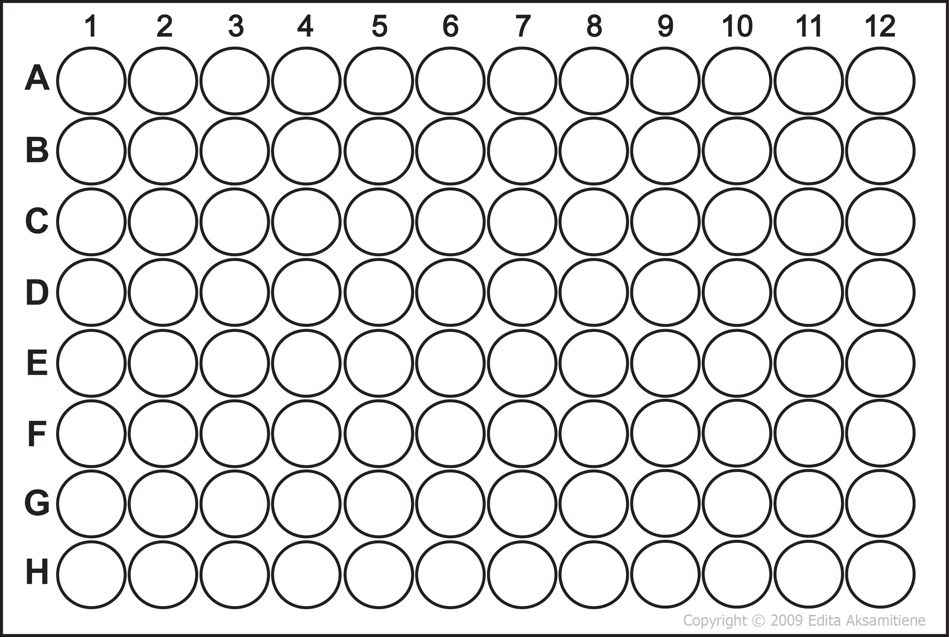

DRUG X
CONTROLS
DOSE
DOSE
DOSE
DOSE
DOSE
DOSE
DOSE
SAMPLE
1.0
0.9
0.7
0.5
0.3
0.1
0.1
0.9
1.1
0.9
1.0
1.1
% viability
AUC
SAMPLE
SAMPLE
Log(dose)
SAMPLE
SAMPLE
SAMPLE
Probability
SAMPLE
SAMPLE
AUC
SENSITIVE
RESISTANT
Notes:
Patient should be BIOPSIES or LAB _ID , separate from clinical study…
Change tail colors to match aucs in next slide!!! And copy
Add numbers in the dose 1-7 wells and plot points on the dose response curve.
Explain AUC: fill in area under the curve

Slide 7
SENSITIVE
RESISTANT
(Resistant)
HIGH AUC
Probability
MID AUC
% viability
LOW AUC
(Sensitive)
AUC
Log(dose)
Notes:
In inhibition model: high auc – greater resistance, low auc – lower resistance
Change position

Slide 8
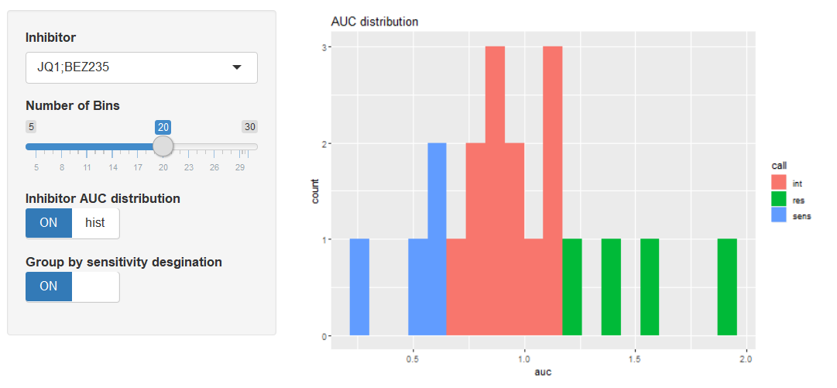
Sensitivity Assignment
Observations are filtered based on QC metrics prior to assignment (Issue #14)
0.2, 0.8 quantile assignment (“Tails” are each 20% of full distribution)

Slide 9
Documentation
All code and documentation is stored in a private github repo. (https://github.com/nathanieljevans/HNSCC_functional_data_pipeline)
Wiki Pages; Wet-lab protocols, DR_ViewerApp_Tutorial, etc.
Issues – Bug tracking, feature requests, etc
Data Dictionary

Slide 10
Pipeline Testing
Doctesting [python]
Unit Testing: Using Data from the BeatAML (Sorafenib, n=851), run the HNSCC pipeline and compare output to BeatAML reported values.
Compare AUC calculation, allow deviance due to minor fitting differences
Compare Sensitivity Assignment, allow no deviance
Travis.CI, commit triggered & cloud hosted build testing.

Slide 11
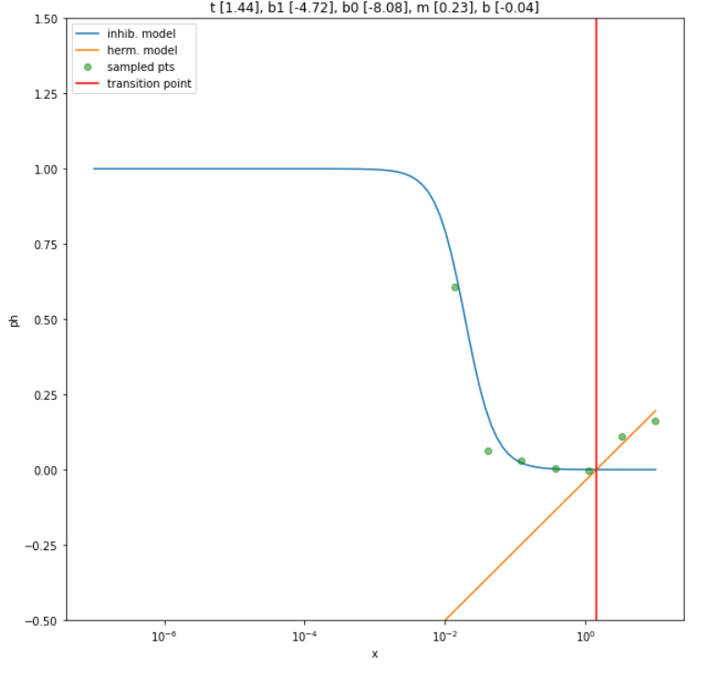
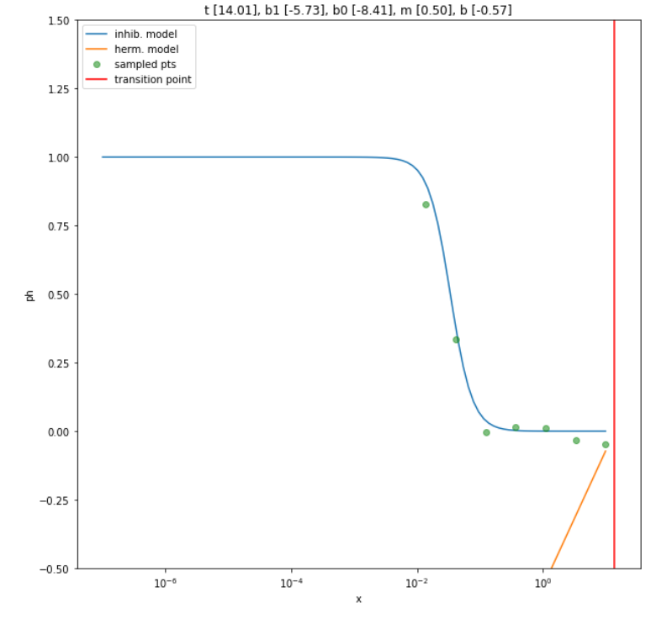
Pipeline Validation (power analysis)
Simulate data using `synthetic_doseresponse_generator` output. (https://github.com/nathanieljevans/synthetic_doseresponse_generator)
Compare HNSCC-pipeline AUC to synthetic AUC and vary noise/replicates

Slide 12
Visualization and Results Interactions
Raw output is saved as: ./output/HNSCC_all_functional_data.csv
Future filtering script will save filtered final data to separate file (Issue #16)
DR_ViewerApp
Feedback welcome!
Host via R cloud? Data-accessibility issues.

Slide 13
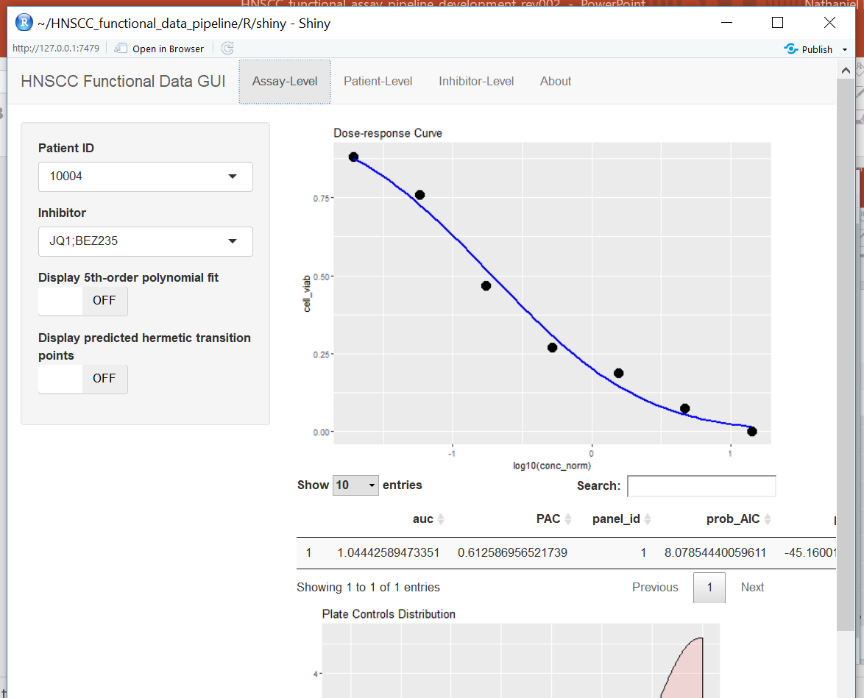
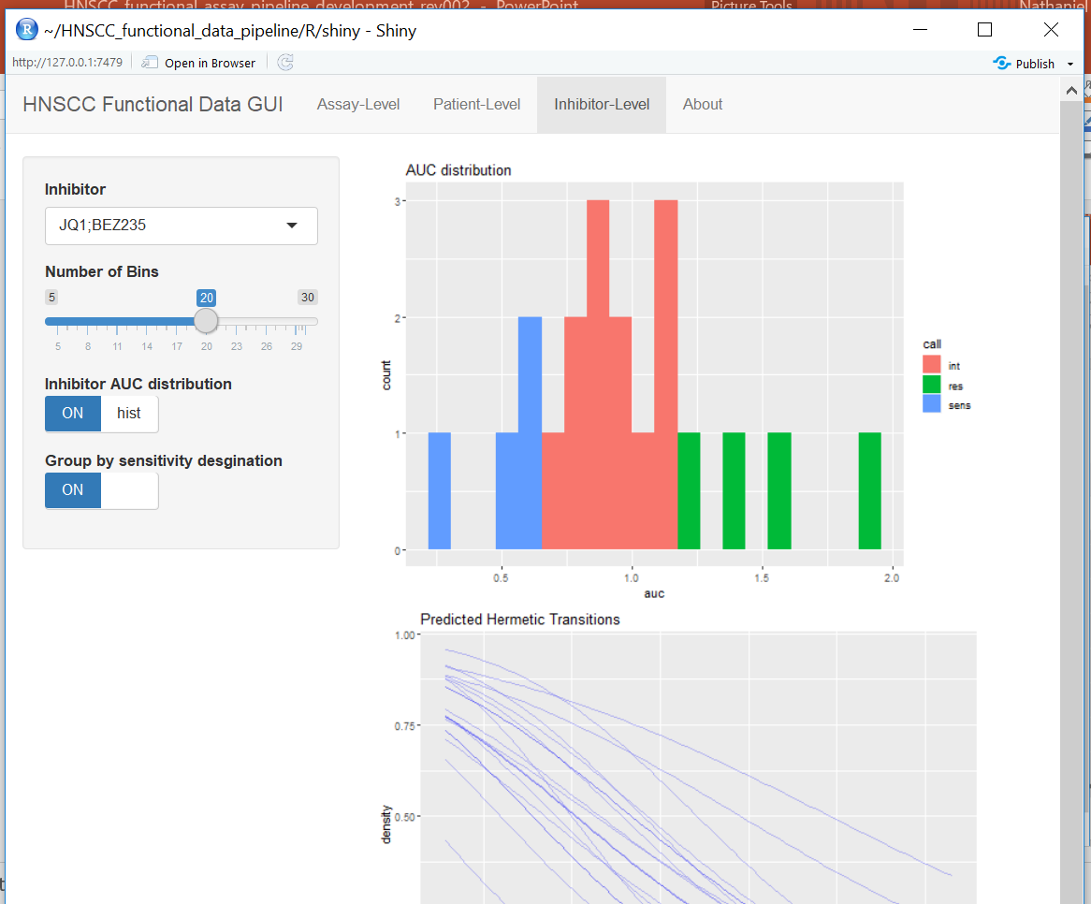
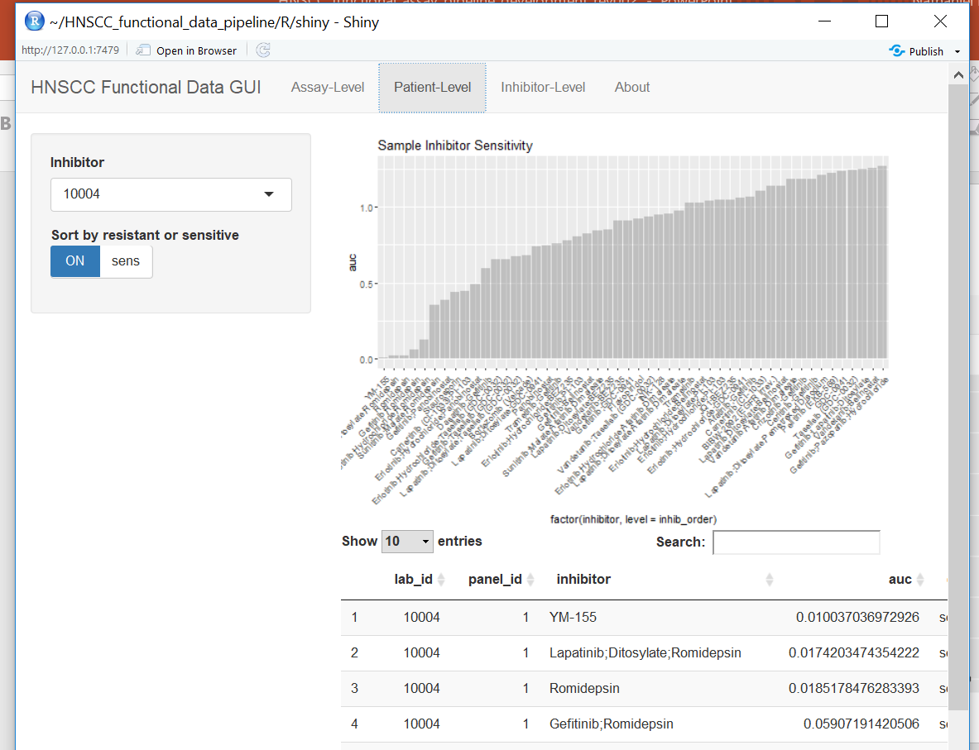
DR_ViewerApp

Slide 14
Processing Time & Parallelization
[20/21] - Total time elapsed: 0:25:10.298157
~75 sec / panel
Processing can be parallelize to the panel-level
If our available nodes are greater than the number of panels to process: parallelization will reduce time complexity to O(c) ~ 75s
Otherwise, O(n)

Slide 15
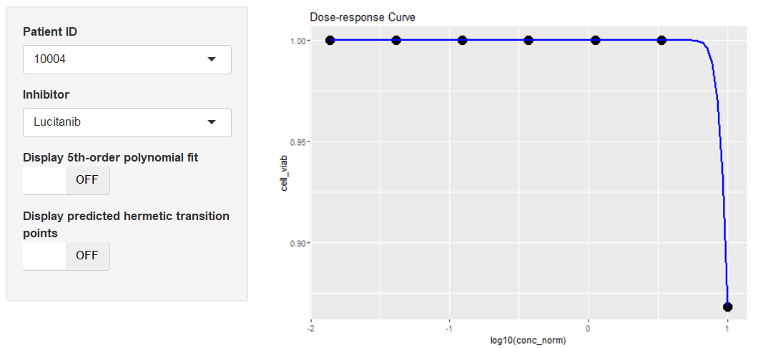
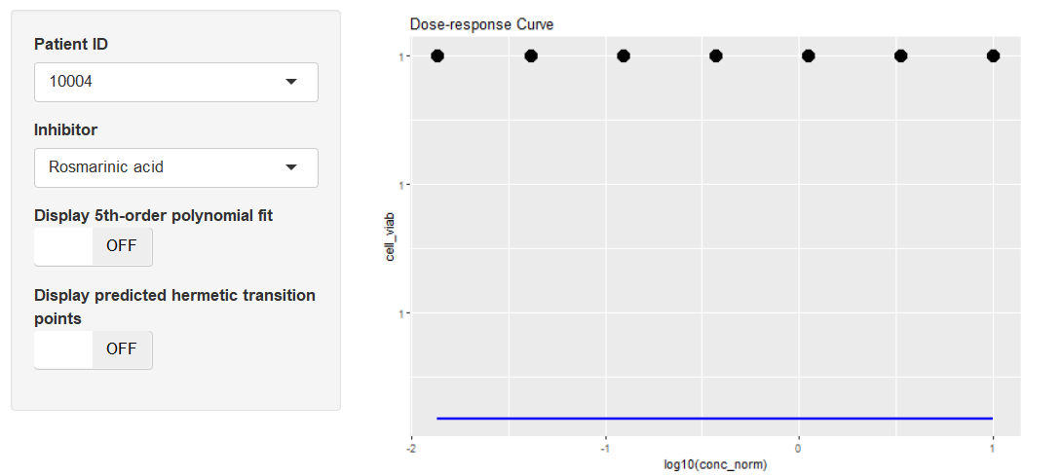
Probit Fitting Convergence
Perfect separation occurs when all [or most; Issue #15] of the cell viability values are identical.
If all are identical I fit with the max auc value, 1*log_conc_range
If not all are identical [issue #15], I fit with linear regression – logistic or rectangle integration might be more intelligent here.

Slide 16
TODO
Testing / Validation dev.
Drug synergies
Tyner plate-maps
Etc

