Slide 1
HNSCC functional assay pipeline development
Nate Evans

Slide 2
Plate Map
output
Curve fitting / AUC calculation
[Traditional]
Dose, inhibitor -Optical Density Mapping
EDA / Batch-Effect Search
Normalization & QC [traditional]
BDR sensitivity designation
[evans]
Inhibitor level EDA
Photo spectrometer
Output
Functional Assay
Atypical classifier
[evans]

Slide 3
Plate Map
Plate Mapping
[HNSCC_plate_data_mapper.py]
Normalization (1)
[name – not in dev yet]
Normalization
(2)
[name – not in dev yet]
Normalization
(3)
[name – not in dev yet]
Photo spectrometer
Output
Convert from matrix format to long data and merge plate map. Critical output features:
[conc, optical_density, lab_id, inhibitor]
The zero value (positive control) of optical density is set by the p.spec software [blank490] but to interpret this value as cell viability, we need to scale optical density by plate controls….eg
Cell_viab = opt_dens / avg_plt_control
A ceiling and floor must be set to constrain cell viability within [0,1].
If we have replicates, then they are averaged.
Quality Control
[name – not in dev yet]
Single-agent / Combination Split
[name – not in dev yet]
Probit Fit & Overfitting QC
[name – not in dev yet]
Single agent
Combination-Agents Normalization
[name – not in dev yet]
??? Check Dan Bottomly’s documentation ??? I believe this step drops data when replicate_auc – avg_replacate_auc > some_value
Concentrations have to be represented as euclidean distances in concentration space to provide accurate plate to fit along.

Slide 4
Overview
Number of HNSCC patients: 11 HNSCC patients [7/20]
Plate map versions
Plates 1-3 (rev 001), Plates 1-6 (rev 002) <- combinatorial
Tyner panels – still need to be re-worked into HNSCC format
+1 assay with 7… require additional work
Excel files with pages: meta, concentration_<num>, inhibitor_<num>
Naming convention
Unique ID for each assay? Or we need to distinguish replicates
Date of assay?
MTS sitting time?
lab_id=XXXXX-norm=XXX-plate_version_id=XXXX

Slide 5
Plate Map Revisions
Drug Names, there are some inconsistencies – need to define clear nomenclature to avoid redundancy.
I can provide a list of all used names, if someone can review and choose the right names.
Alternatively, if there is a list of acceptable drug names, I can do it myself.
I’d like a review of my concentration mapping [request]
Ashley volunteered to review, but a second pair of eyes would be useful as well.

Slide 6
Data output documentation issues
There are a number of assays that are labeled as having been normalized by positive controls (labeled as “blank490”), however, the output file shows discrepancies that indicate it was not.
[lab_id=10308,notes=NA]
[lab_id=10309,notes=matched normal 10308]
*these two assay outputs don’t have a 26th column, which usually says “blank490” in each row.

Slide 7
Standing Questions
Blank 490, how is this normalization done?
Scope of documentation?
Code version control – github repo?
Biocompute object
R/Doxygen
Scope of testing?
Doc-testing / unit-testing
Language Preference? Currently using mix of python, R, bash
Dockerize environment?

Slide 8
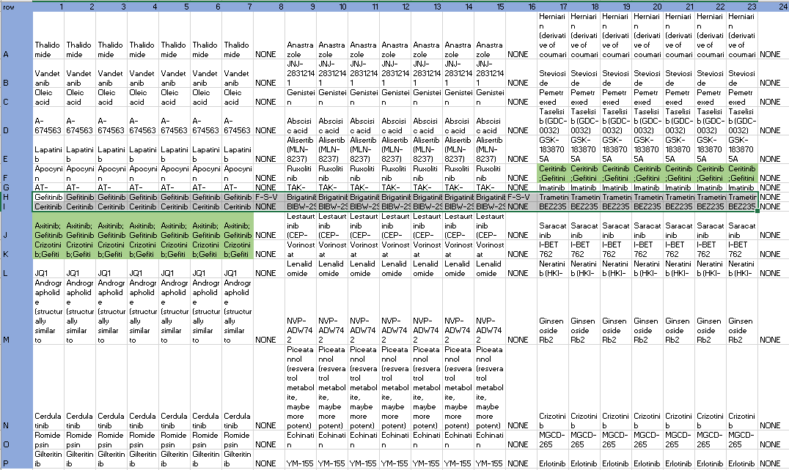
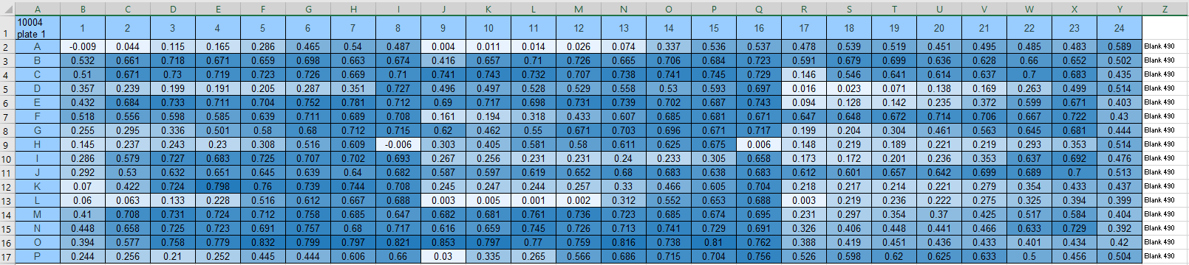
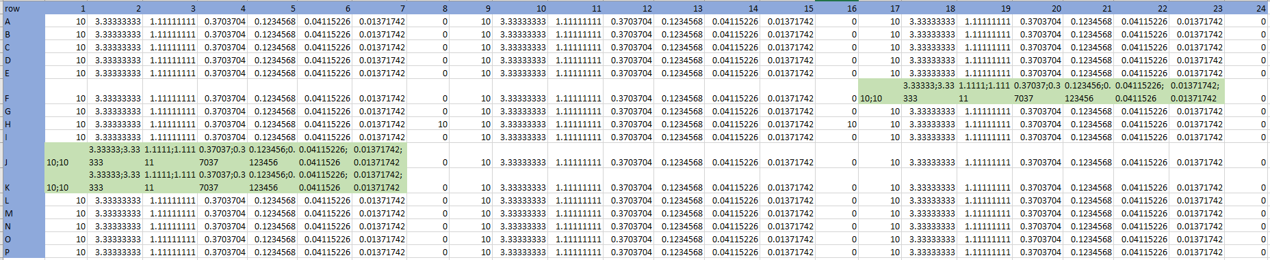
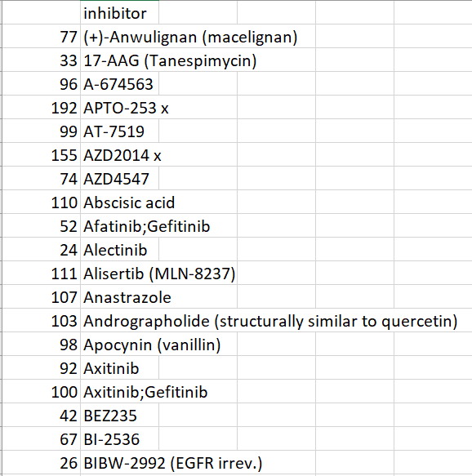
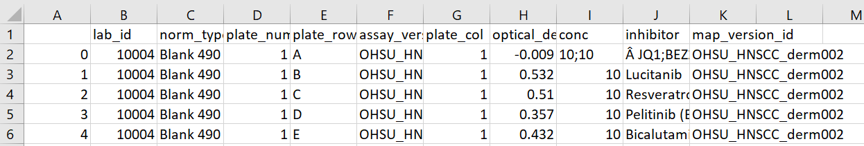
Overview: Map data
$ python ./python/HNSCC_plate_data_mapper.py ./plate_maps ./data
Unique inhibitor names
Functional Data: position, lab_id -> concentration, inhibitor (long format)

