Slide 1
HNSCC inhibitor heatmaps

Slide 2
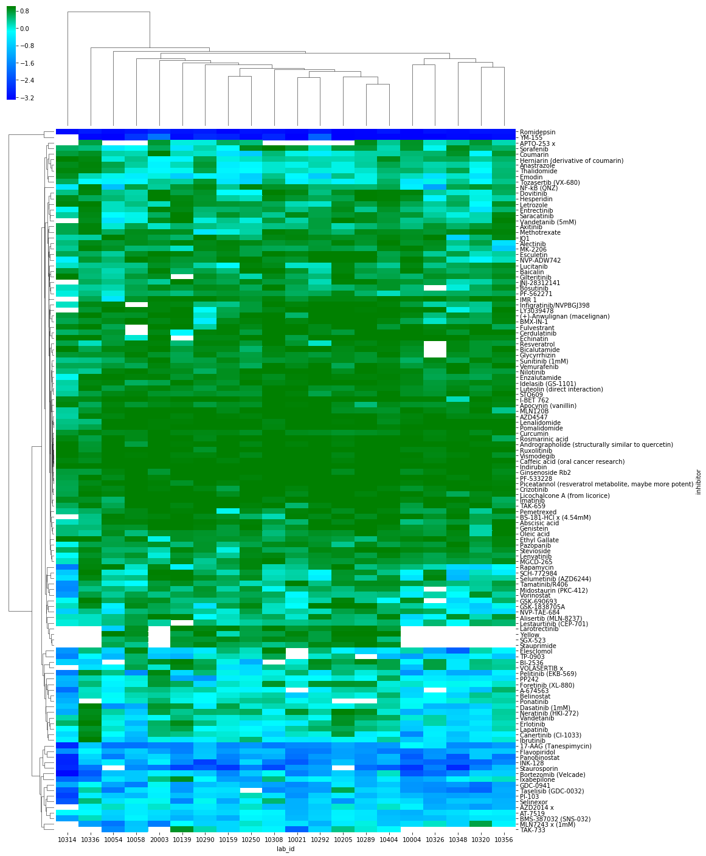
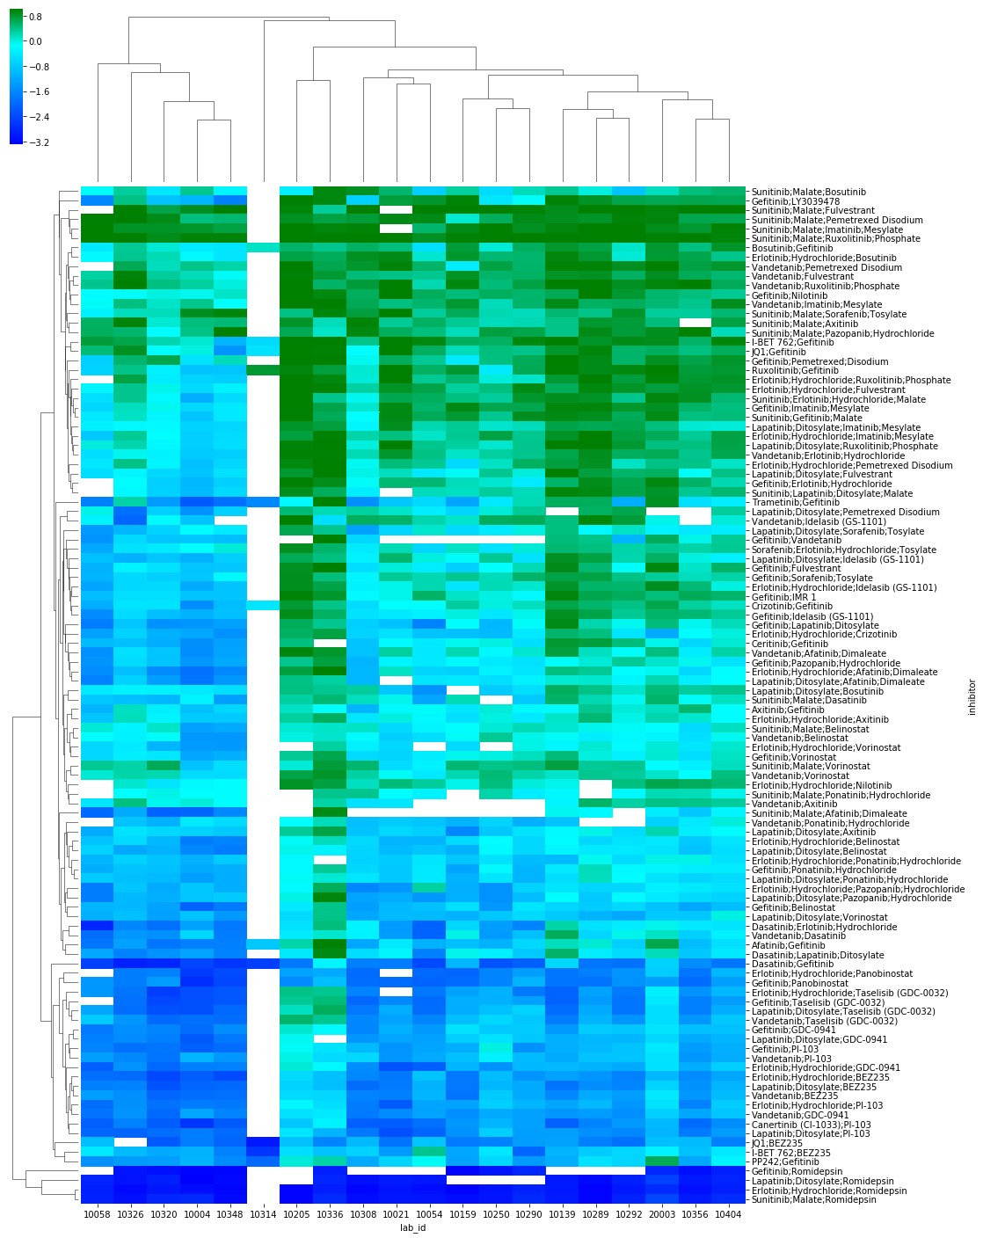
Single Agent
AUC calculated
across all inhibitors
Combination Agent

Slide 3
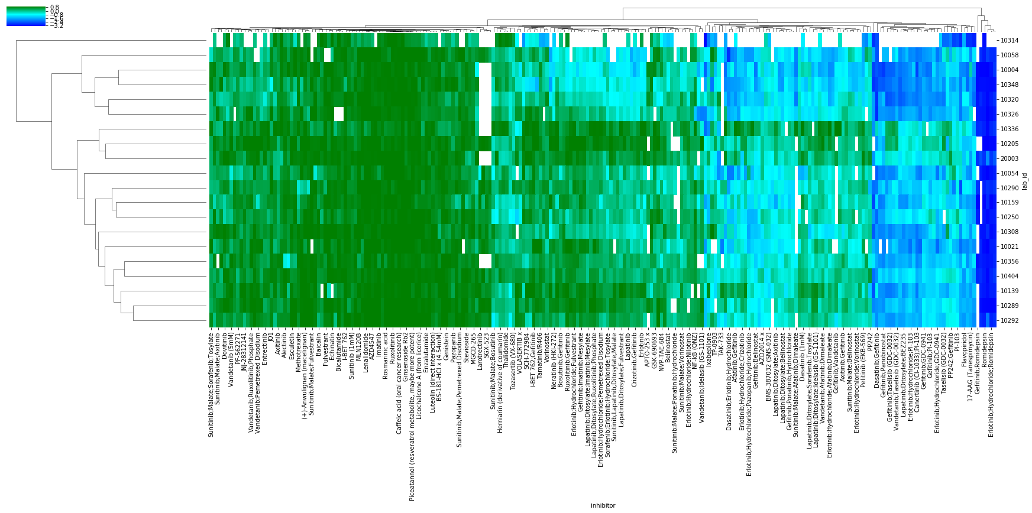
AUC zscores calculated across inhibitors – all agents

Slide 4
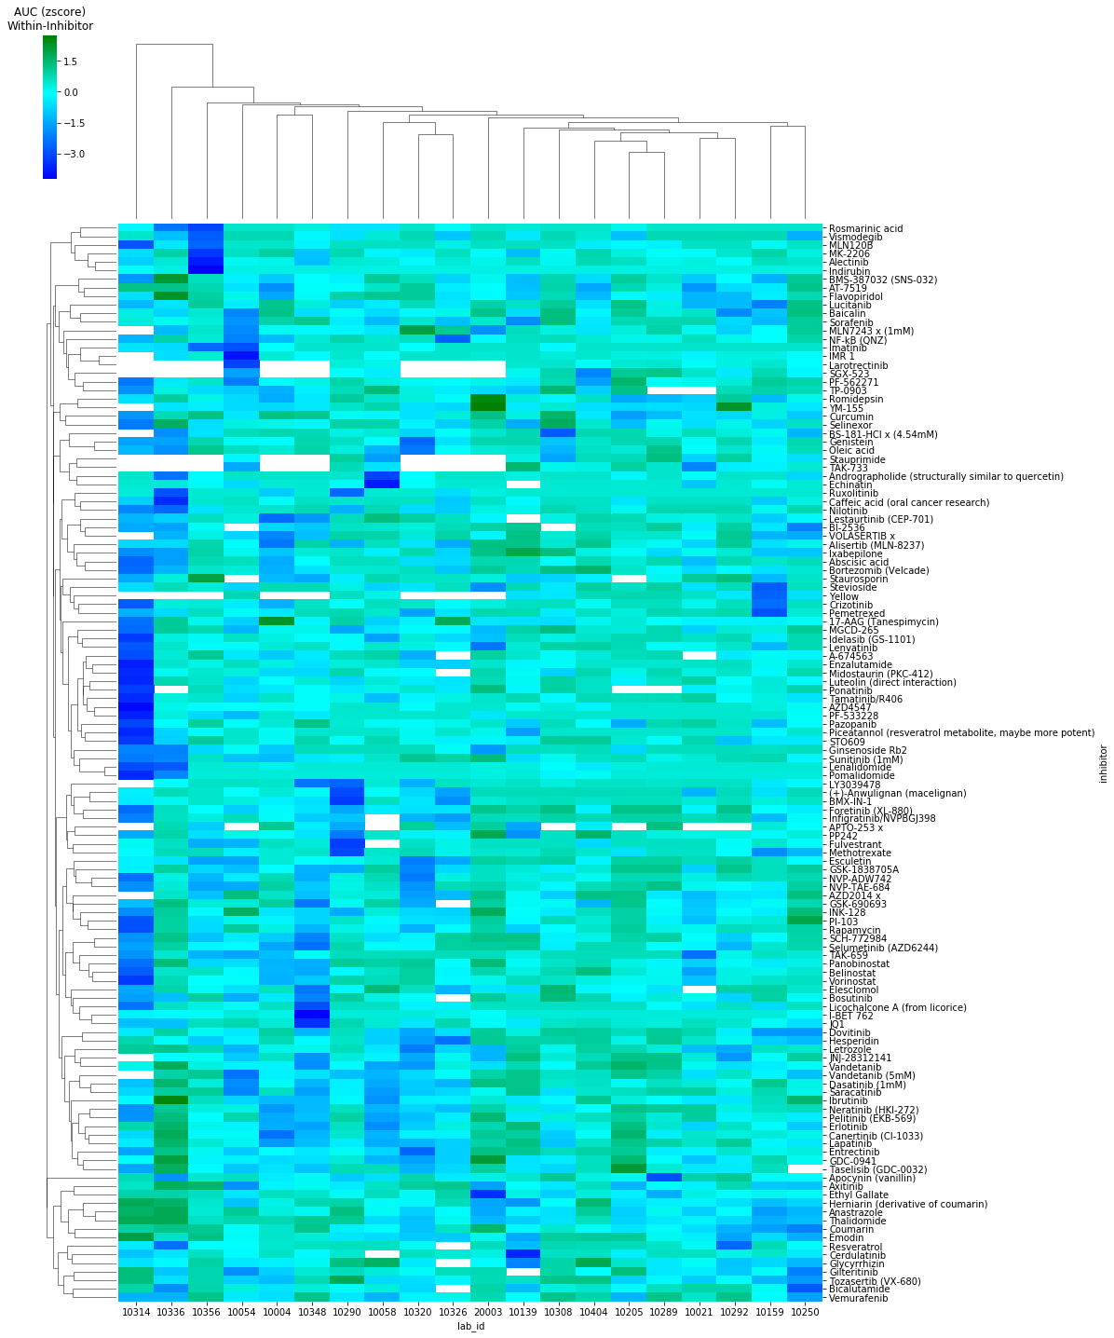
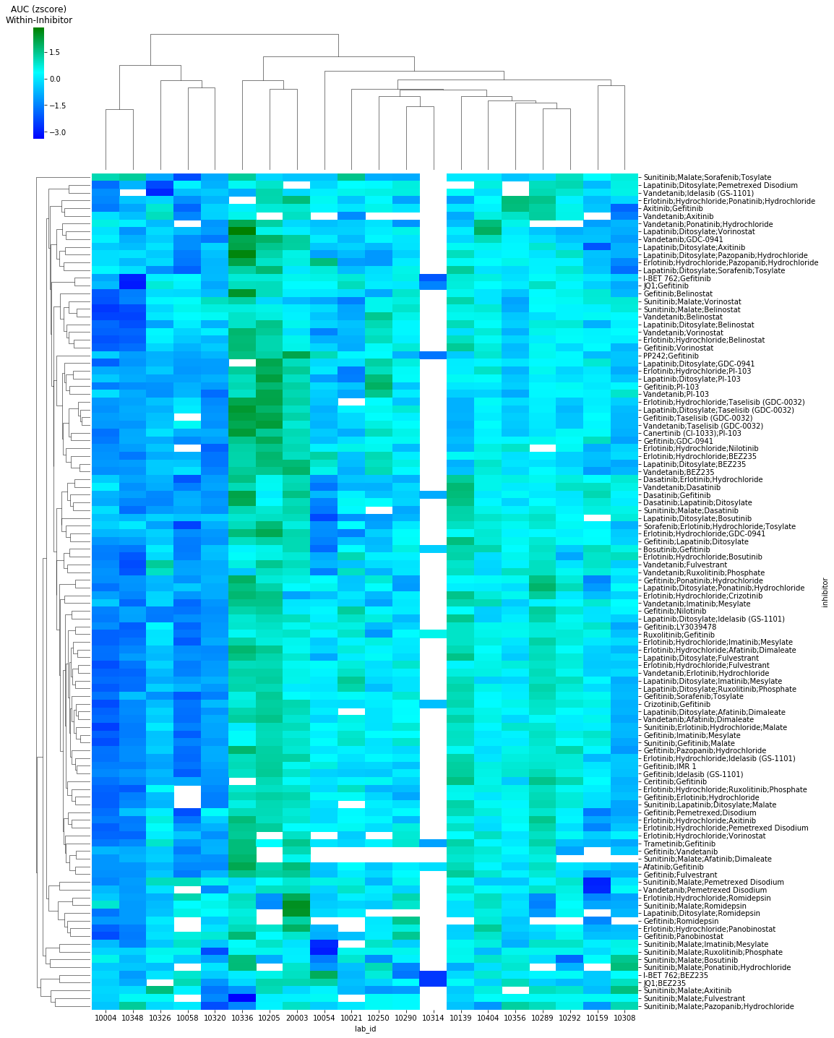
Single Agent
AUC calculated
within inhibitors
Combination Agents

Slide 5
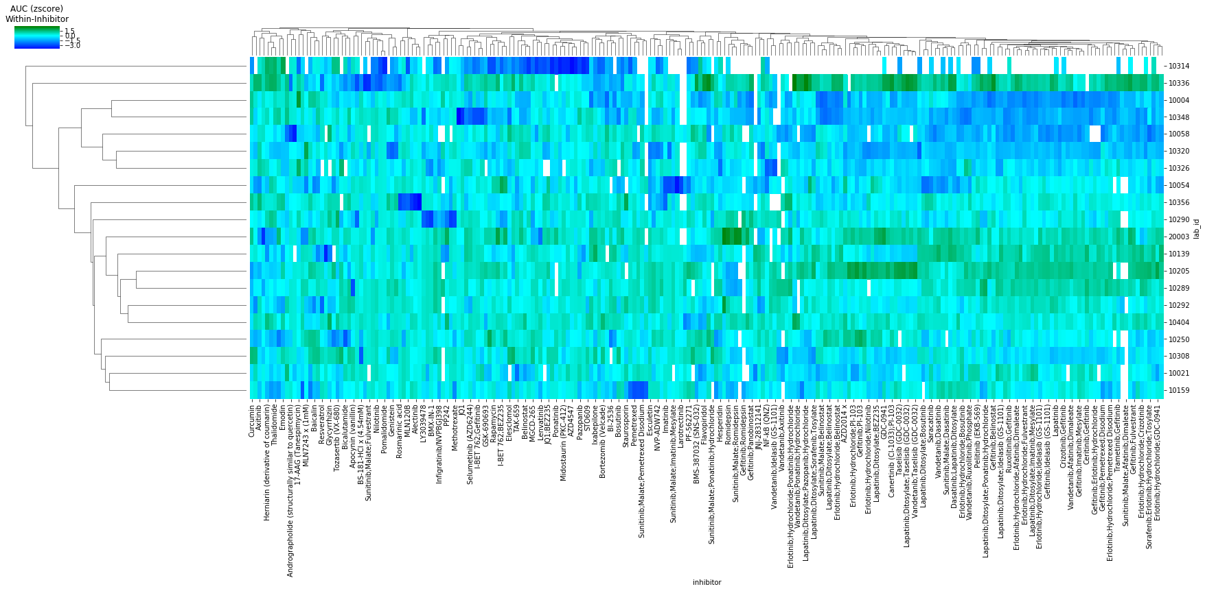
AUC zscores calculated within inhibitor – all agents

Slide 6
Issues
The combination agent names still aren’t correct – we’ll need to fix the plate maps and re-run the data
If we have clinical, mutation are pathway target data we can overlay it on the heatmap to see if they correspond with any of the clusters.

