Slide 1
Predicting Gene Dependency in the DepMap Achilles Dataset with TrojanArrow: a combined graph convolutional network and visible neural network model
Nathaniel Evans

Slide 2
Gene Dependency (Y)
A
B
For a given cell-line, what is the importance of each gene to cell proliferation?
Application in therapeutics:
Drug target identification
Drug response prediction
Other:
Pathway modeling
https://depmap.org/portal/
D
C
E
Death/Growth

Slide 3
Response Datatype: Pooled Gene Dependency
Cell Line
Gene KO +
unique barcode
Use CRISPR to Knock-out gene(s) + insert “barcode”
Let cells grow
~16 doublings
Time 0:
Cells(Y) = 1/5
Cells(B) = 1/5
Cells(G) = 1/5
Time 1:
Cells(Y) = 1/10
Cells(B) = 2/10
Cells(G) = 5/10
Log2 (fold change)
Dep(Y) = -1.0
Dep(B) = 0.0
Dep(G) = 1.3
Relative Abundance
Relative Abundance
Luo, B. et al. Highly parallel identification of essential genes in cancer cells. Proc. Natl. Acad. Sci. U.S.A. 105, 20380–20385 (2008).
Notes:
Produce ~5 shRNA per protein coding gene
In a given cell-line in-vitro:
Transfect shRNA(s) with multiplicity of ~0.3
Culture cells for period of time (~16 doublings)
Isolate the shRNA sequences by PCR amplification
Measure relative abundance of each shRNA
Output variable is log transformed relative abundance
If knocking out a gene is stimulatory to cell proliferation the relative abundance will increase and our output variable will be positive
If knocking out a gene is inhibitory to cell proliferation the relative abundance will decrease and our output variable will be negative

Slide 4
Graph Convolutional Network
Classical Convolutions
Graph Convolutions (spatial vs spectral)
F(B)
F(C)
A
B
F(B)
C
F(A)
F(B)
F(A)
F(C)
F(D)
F(D)
F(B)
F(A)
D
F(D)

Slide 5
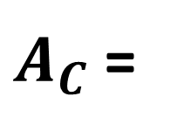


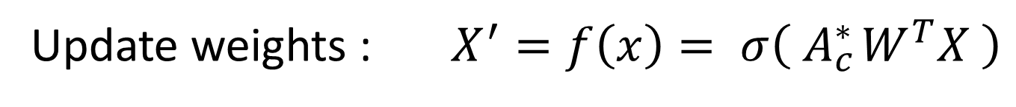



GCN: Encoding Knock Out (KO)
$A_{C}$ =
B
C
A B C ….
A
$$c_{ba}$$
$$c_{bc}$$
A
B
C
…
$$\begin{matrix}c_{AA} & c_{AB} & 0 \\ c_{AB} & c_{BB} & c_{BC} \\ 0 & c_{CB} & c_{CC}\end{matrix}$$
$$c_{ad}$$
$$c_{bd}$$
D
“renormalization” : ${A^{∗}= D}^{−0.5}AD^{−0.5} or D^{−1}A$
mask coupling matrix : ${ A}_{c}^{∗}={elementwise_mult(A}^{∗}, C)$
Update weights : $X^{′}=f\left(x\right)= σ\left( A_{c}^{∗ }W^{T}X \right)$

Slide 6
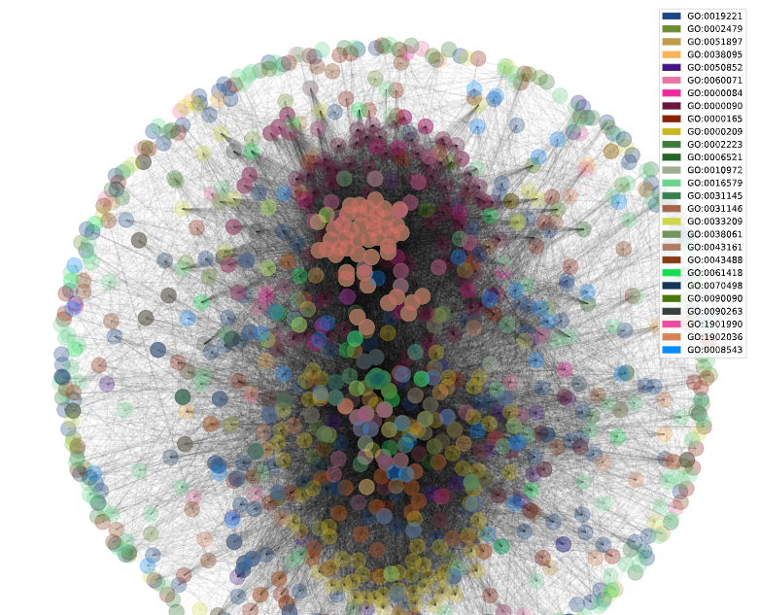
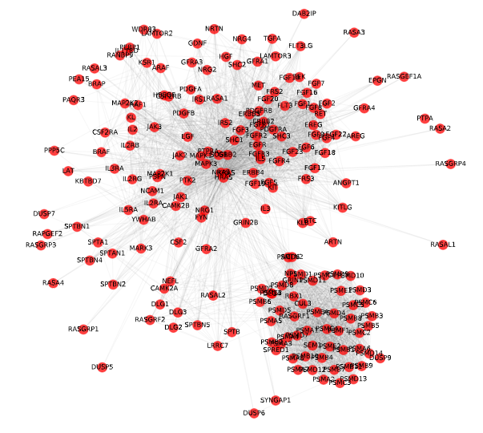
1027 Genes
Full Network
27 GO biological processes
MAPK cascade + major overlapping pathways
1027 Genes
MAPK Cascade
GO0000165
199 Genes
Notes:
Using Gene Ontology pathways:
GO:0000165 – MAPK cascade: 199 Genes involved (that overlapped in CCLE)
Using 199 genes:
find all other pathways that they’re involved in
Count number of MAPK cascade genes in each pathway
Filter to overlapping pathways with > 30 genes from MAPK cascade
Remove any excessively large pathways (> 600)
Leaves us with 27 GO biological processes (pathways) and 1076 Genes

Slide 7
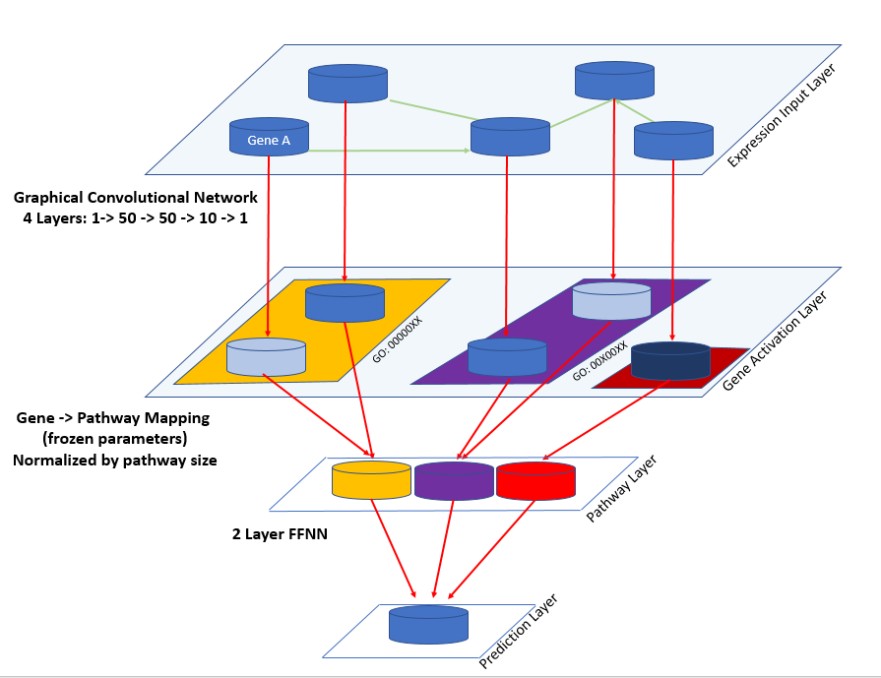
message passing

Slide 8
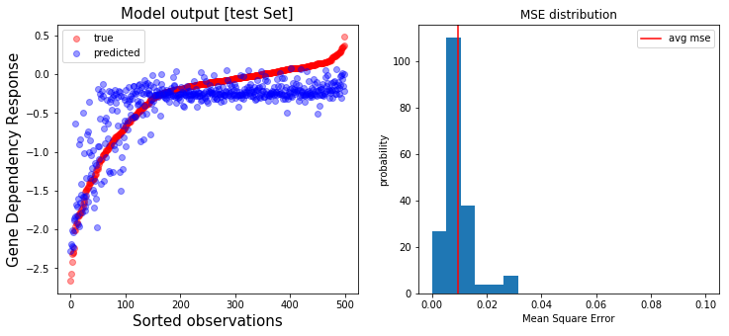
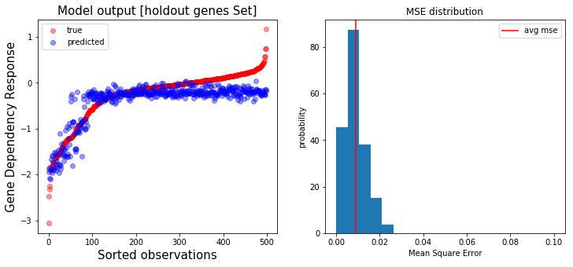
Performance on holdout cell lines
(novel expression features)
correlation: 0.848
average MSE: 9.66e-3
Performance on holdout gene knock outs
(novel graph structure)
correlation: 0.881
average MSE: 8.98e-3
Notes:
Trained for 100+ sub-epochs [100,000/500,000] on tesla P4000 [8GB mem] + 8 cores [64GB mem], which took 1-2 days. Training took approximately 4ms / observation, and to fit into memory I used batches of 10.
Used the Ranger Optimizer (combination of Lookahead [1] and RAdam [2]) along with the mish [3] activation function.
I was still seeing training improvement, however, since I was paying for compute time I decided to cut off training early. If I was to train longer I would like to implement a cosine annealing learning rate scheduler [4].
In retrospect, I regret training a regression rather than making this a classification problem. I think it would have trained better and been more interpretable.
1. Zhang MR, Lucas J, Hinton G, Ba J. Lookahead Optimizer: k steps forward, 1 step back. arXiv:190708610 [cs, stat] [Internet]. 2019 Dec 3 [cited 2020 Mar 14]; Available from: http://arxiv.org/abs/1907.08610
2. Liu L, Jiang H, He P, Chen W, Liu X, Gao J, et al. On the Variance of the Adaptive Learning Rate and Beyond. arXiv:190803265 [cs, stat] [Internet]. 2020 Mar 9 [cited 2020 Mar 14]; Available from: http://arxiv.org/abs/1908.03265
3. Misra D. Mish: A Self Regularized Non-Monotonic Neural Activation Function. arXiv:190808681 [cs, stat] [Internet]. 2019 Oct 2 [cited 2020 Mar 14]; Available from: http://arxiv.org/abs/1908.08681
4. Loshchilov I, Hutter F. SGDR: Stochastic Gradient Descent with Warm Restarts. arXiv:160803983 [cs, math] [Internet]. 2017 May 3 [cited 2020 Mar 14]; Available from: http://arxiv.org/abs/1608.03983

Slide 9
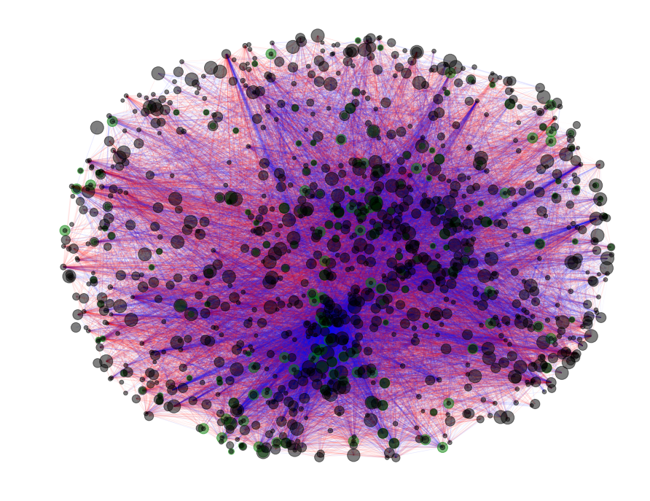
Model Interpretation: Learned Edge Weights
Node size ~ abs val self-edge weight
Edge color ~ positive / negative weight
Edge width ~ abs val edge weight
Green outline = MAPK cascade

Slide 10
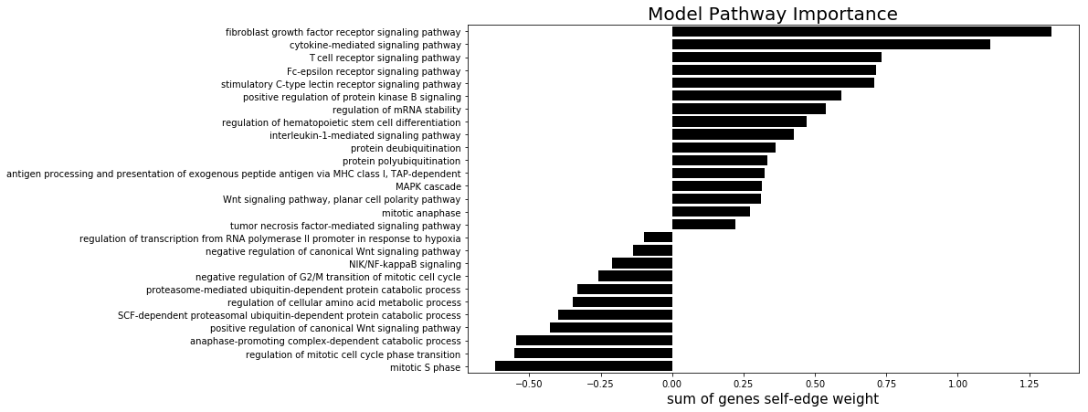
Model interpretation: Pathway Importance

Slide 11
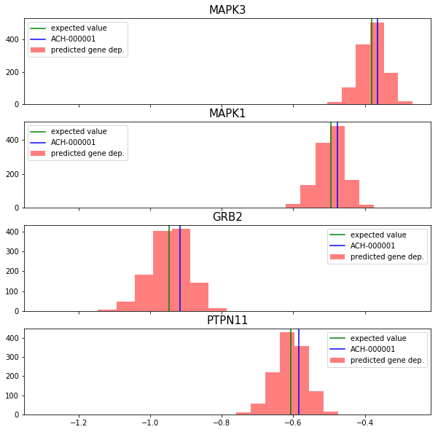
Wait! An issue…
- Cell lines seems to just be a bias

Slide 12
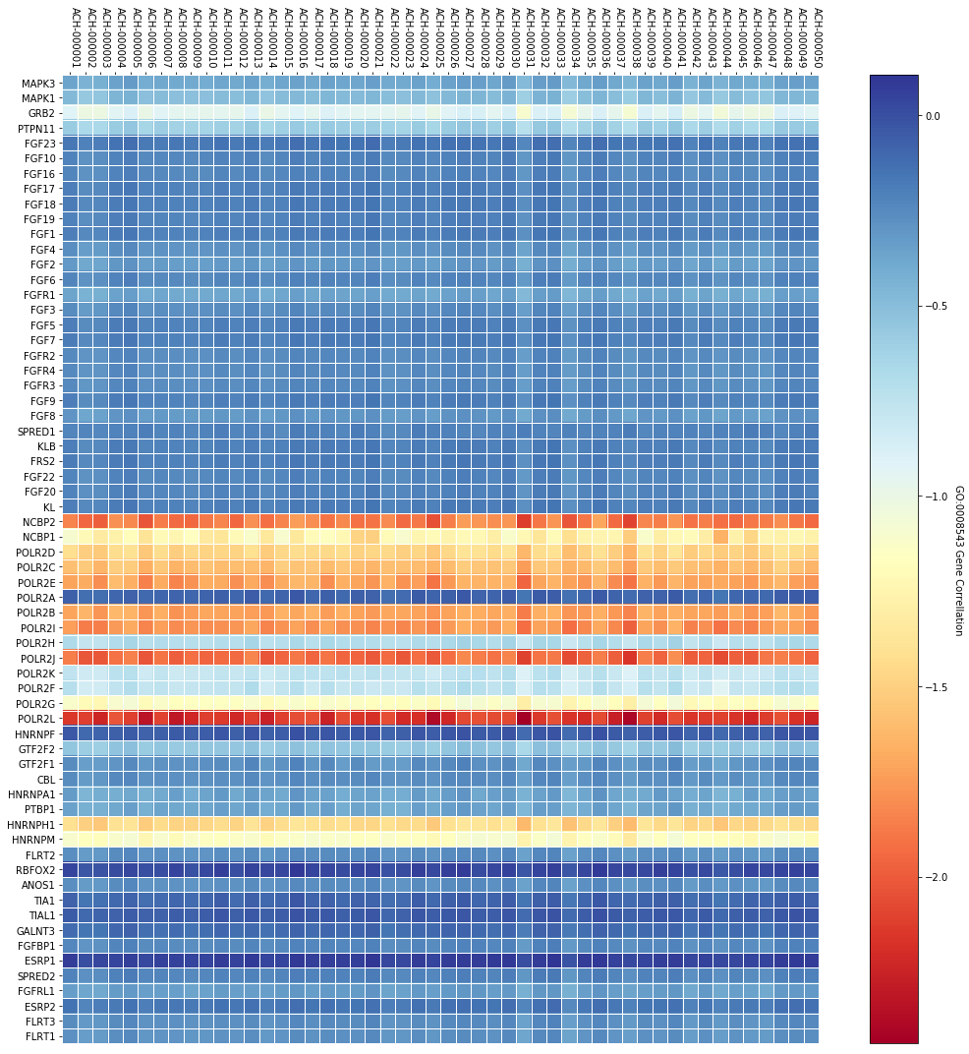
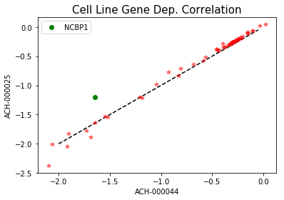
Majority of variance is explained by the KO (network topology)
Most questions relating to therapeutic are going to take advantage of the variance explained by genomic features (cell line)
Predicted Gene Dependency Score

Slide 13
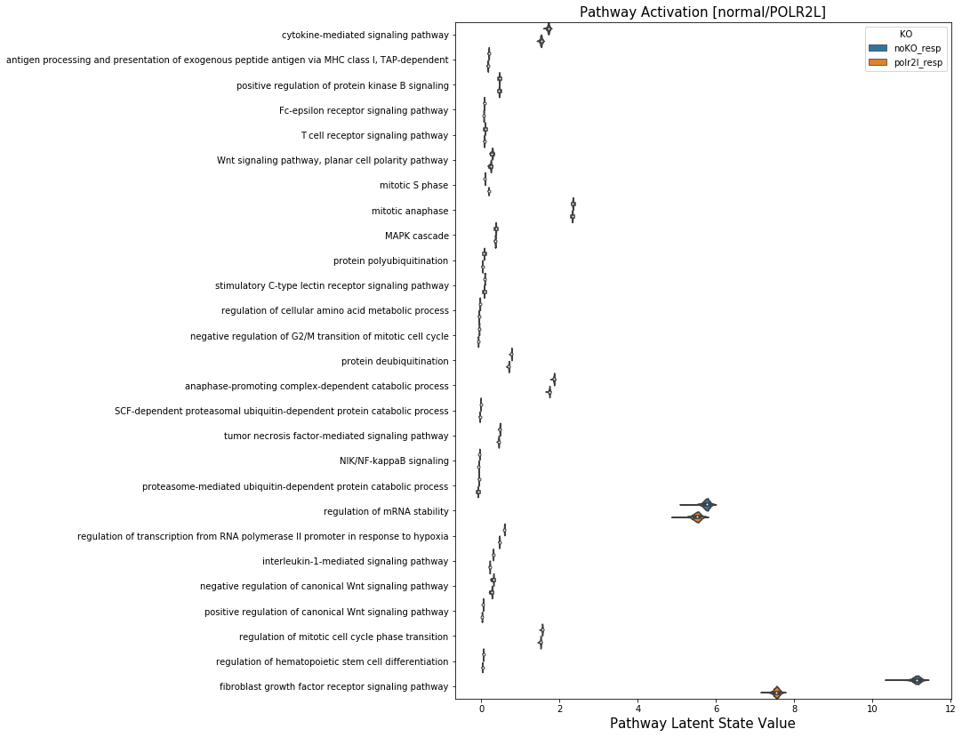
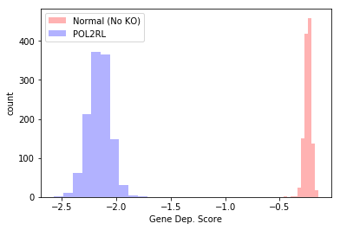

Slide 14
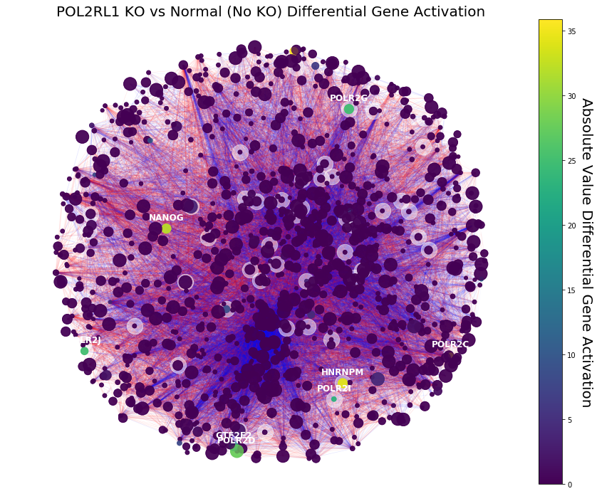
Comparing Gene Activations between Normal (No KO) and POL2RL1 KO.
- White outline: Fibroblast growth factor receptor signaling
- Color: Differential Gene Activation

Slide 15

https://github.com/nathanieljevans/TrojanArrow
Kuenzi BM, Park J, Fong S, Kreisberg J, Ideker T. Abstract C006: DrugCell: A visible neural network to guide precision medicine. Mol Cancer Ther. 2019 Dec 1;18(12 Supplement):C006–C006.
Ma J, Yu MK, Fong S, Ono K, Sage E, Demchak B, et al. Using deep learning to model the hierarchical structure and function of a cell. Nat Methods. 2018 Apr;15(4):290–8.
Title | Description | Link
A Comprehensive Survey on Graph Neural Networks (2019) | General overview of spatial and spectral graph convolution methods. | https://arxiv.org/pdf/1901.00596.pdf
SEMI-SUPERVISED CLASSIFICATION WITH GRAPH CONVOLUTIONAL NETWORKS (2017) | One of the early descriptions of GCNs. | https://openreview.net/pdf?id=SJU4ayYgl
Graph Attention Networks (2017) | An improvement on GCNs by adding attention parameters to learn edge ‘weights’. | https://arxiv.org/abs/1710.10903
Edge Attention-based Multi-Relational Graph Convolutional Networks (2018) | An improvement on GCNs to add support for different edge types, while incorporating attention – this is the method we will try to implement. | https://arxiv.org/abs/1802.04944
A machine learning approach predicts essential genes and pharmacological targets in cancer (2019) | Method that uses a random forest model to predict gene dependency scores. Baseline comparison for our models. | https://www.biorxiv.org/content/10.1101/692277v1.full

