Slide 1
Predicting Gene Dependency with Graph Convolutional Networks (GCN) and Visible Neural Network (VNN)
Nathaniel Evans

Slide 2
Question: Can we model Gene Dependency in the MAP3 Signal Cascade?
Sub-question: What other pathways overlap with MAP3 cascade genes?
Using Gene Ontology pathways:
GO:0000165 – MAPK cascade: 199 Genes involved (that overlapped in CCLE)
Using 199 genes:
find all other pathways that they’re involved in
Count number of MAPK cascade genes in each pathway
Filter to overlapping pathways with > 30 genes from MAPK cascade
Remove any excessively large pathways (> 600)
Leaves us with 27 GO biological processes (pathways) and 1076 Genes

Slide 3
Incorporating literature curated knowledge into our model using reactome Functional Interaction Network
Binned all edge types
Undirected

Slide 4
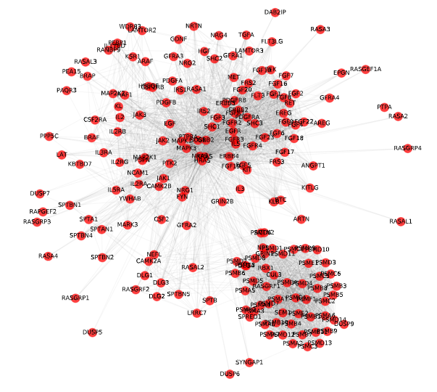
MAP3 Cascade
199 Genes

Slide 5
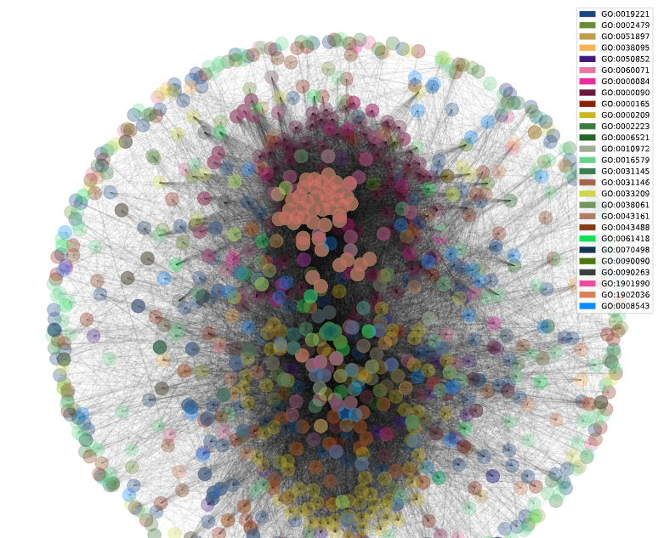
Full Network
27 GO biological processes
MAPK cascade + major overlapping pathways
1027 Genes
MAPK Cascade = GO0000165

Slide 6
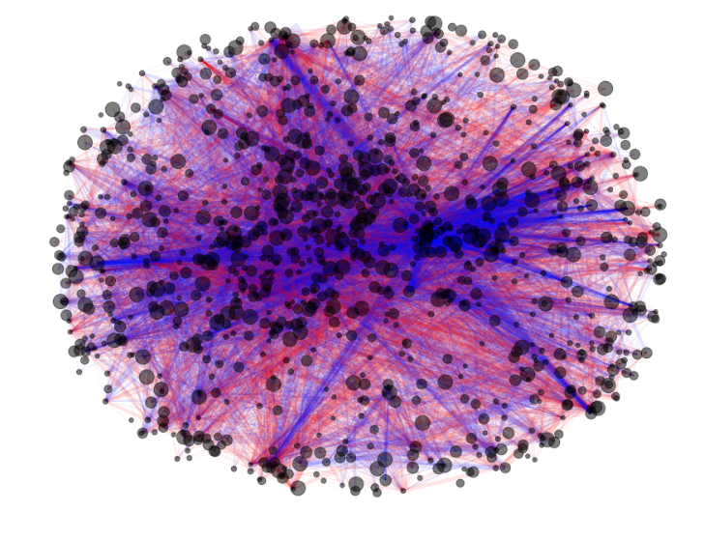
Learned Edge Weights
Node size ~ abs val self-edge weight
Edge color ~ positive / negative weight
Edge width ~ abs val edge weight

