Slide 1
Predicting Gene Dependency in the DepMap Achilles Dataset with TrojanArrow: a combined graph convolutional network and visible neural network model
Nathaniel Evans

Slide 2
Gene Dependency (Y)
A
B
For a given cell-line, what is the importance of each gene to cell proliferation?
Application in therapeutics:
Drug target identification
Drug response prediction
Other:
Pathway modeling
https://depmap.org/portal/
D
C
E
Death/Growth
Notes:
A cell line’s dependency on a given gene/protein to some function, in this case proliferation, can be conceptualized by multi-route pathways, and depending on the genomic landscape (mutatons, methylation, exression, protein activation) certain genes may be more or less critical.

Slide 3
Response Datatype: Pooled Gene Dependency
Cell Line
Gene KO +
unique barcode
Use CRISPR to Knock-out gene(s) + insert “barcode”
Let cells grow
~16 doublings
Time 0:
Cells(Y) = 1/5
Cells(B) = 1/5
Cells(G) = 1/5
Time 1:
Cells(Y) = 1/10
Cells(B) = 2/10
Cells(G) = 5/10
Log2 (fold change)
Dep(Y) = -1.0
Dep(B) = 0.0
Dep(G) = 1.3
Relative Abundance
Relative Abundance
Luo, B. et al. Highly parallel identification of essential genes in cancer cells. Proc. Natl. Acad. Sci. U.S.A. 105, 20380–20385 (2008).
Notes:
Produce ~5 shRNA per protein coding gene
In a given cell-line in-vitro:
Transfect shRNA(s) with multiplicity of ~0.3
Culture cells for period of time (~16 doublings)
Isolate the shRNA sequences by PCR amplification
Measure relative abundance of each shRNA
Output variable is log transformed relative abundance
If knocking out a gene is stimulatory to cell proliferation the relative abundance will increase and our output variable will be positive
If knocking out a gene is inhibitory to cell proliferation the relative abundance will decrease and our output variable will be negative

Slide 4
Graph Convolutional Network (GCN)
Classical Convolutions
Graph Convolutions (spatial vs spectral)
F(B)
F(C)
A
B
F(B)
C
F(A)
F(B)
F(A)
F(C)
F(D)
F(D)
F(B)
F(A)
D
F(D)
Notes:
GCNs were inspired by convolutional networks in image processing, which uses spatial structure in images (or other spatially organized data types) to learn feature extractions (analogous to our aggregation function), which can be applied over the entire matrix.
Similarly, GCNs are used to take advantage of the structural information encoded in a graph to extract relevant features. For instance, does a gene’s neighbors have low expression? A mutation? A distinct expression profile (classic GCN may not be able to measure this – but graph attention networks might)?
As in many PGMs and graph oriented algorithms, we’re implementing a message passing algorithm, however, the novelty comes from learning the aggregation function (or feature extraction function).
Spatial GCNs operate directly on the adjacency matrix and thus can be applied to novel graph structures and is considered inductive learning. Spectral GCNs operate on the eigenvectors of the graph Laplacian, and are relevant only to the graph structure it was trained on; The advantage of spectral methods are that once in the Fourier space, they can be implemented similarly to classical CNNs.

Slide 5

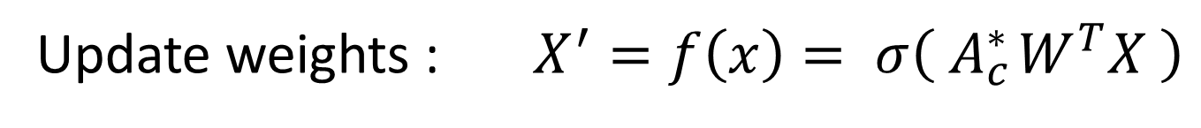




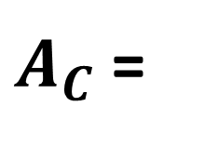
GCN: Encoding Knock Out (KO)
$A_{C}$ =
B
C
A B C ….
A
$$c_{ba}$$
$$c_{bc}$$
A
B
C
…
$$\begin{matrix}c_{AA} & c_{AB} & 0 \\ c_{AB} & c_{BB} & c_{BC} \\ 0 & c_{CB} & c_{CC}\end{matrix}$$
$$c_{ad}$$
$$c_{bd}$$
D
“renormalization” : ${A^{∗}= D}^{−0.5}AD^{−0.5} or D^{−1}A$
mask coupling matrix : ${ A}_{c}^{∗}={elementwise_mult(A}^{∗}, C)$
Update weights : $X^{′}=f\left(x\right)= σ\left( A_{c}^{∗ }W^{T}X \right)$
Notes:
Gene features are fairly straight forward to encode as a vector of features, organized in the same order as the adjacency matrix. The Gene Knockout is slightly more difficult. One naïve method would be to include a feature, perhaps a binary feature, on the gene itself; This would be an exceedingly sparse feature vector and unlikely to have good performance. Moreover, the biological relevance of a gene knockout lends itself to encoding as changes in graph topology. For instance, if Gene A is KO, then it cannot interact with it’s neighbors and can be encoded by removing the edges between A and it’s neighbors. Since we’re using a spatial GCN, novel graph topologies are all equally applicable.
To implement a GCN, especially on large graphs, requires a linear algebra framework. The learned aggregation function is pictured above. One key point here is, for good performance, we must normalize the adjacency matrix by it’s degree matrix. Since we’re summing over the aggregation function of all neighbors then genes with many neighbors will have much higher values. The original GCN paper (SEMI-SUPERVISED CLASSIFICATION WITH GRAPH CONVOLUTIONAL NETWORKS (2017)) presents this renormalization trick (see above), which has the advantage of not only normalizing by degree but also by the neighbors degree; Which can be thought of as something analogous to a centrality normalization.
Last, a novelty I’ve added is to learn a “coupling matrix”, that is, edge weights between nodes that limit how much information can pass along an edge. In drug response or signal transduction, the concept of coupling between genes is extremely important to cellular function, and similarly, learning these weights are an added source of interpretability and model flexibility. Implementation of this is done by element wise matrix multiplication of the adjacency matrix and the coupling matrix, or can be thought of as the coupling matrix masked by the adjacency matrix (since it’s 0/1).

Slide 6
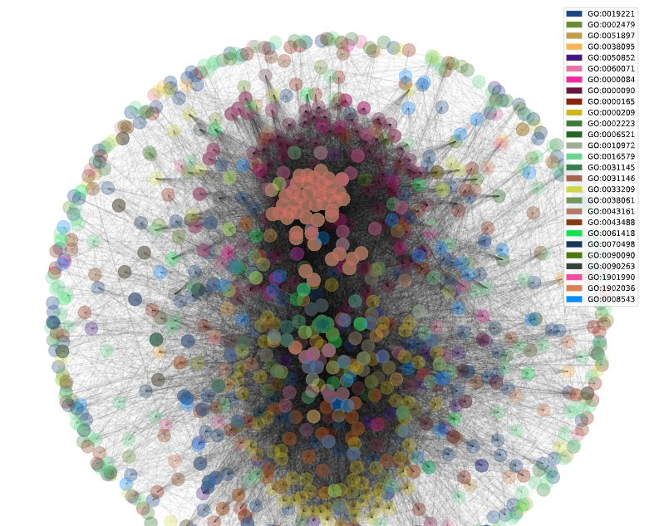
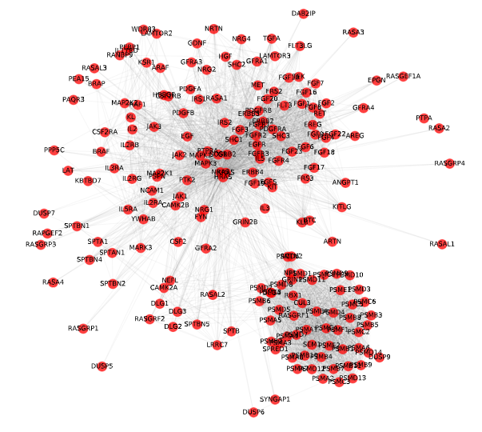
1027 Genes
Full Network
27 GO biological processes
MAPK cascade + major overlapping pathways
1027 Genes
MAPK Cascade
GO0000165
199 Genes
Notes:
To implement this model, I first attempted to use all available genes in the Reactome Functional Interaction network (~10k that overlapped with CCLE), however, this ran into memory issues when training (What do you mean I can’t allocate 250GB of memory?!). So to condense this I needed a smaller network, however, I wanted a set of genes that were locally connected, and functionally connected. To add a relevance to cancer biology, I chose to start with the MAPK cascade pathway (Gene Ontology pathway) which is involved in multiple cancer types and is targeted by drugs such as Trematinib (MAPK2/MAPK1). To make sure there was functional significance and pathway diversity (I’ll admit, part of this is so that I could implement the visible neural network) I searched for pathways that had a large number of genes from the MAPK cascade, then included those as well. The final network is approximately 1000 genes and made up of over 25 GO pathways.
To reduce scope for this project, I binned all edge types from the FI network and made them undirected. Only the largest component was kept.
Overview of process to generate network:
Using Gene Ontology pathways:
GO:0000165 – MAPK cascade: 199 Genes involved (that overlapped in CCLE)
Using 199 genes:
find all other pathways that they’re involved in
Count number of MAPK cascade genes in each pathway
Filter to overlapping pathways with > 30 genes from MAPK cascade
Remove any excessively large pathways (> 600)
Leaves us with 27 GO biological processes (pathways) and 1076 Genes

Slide 7
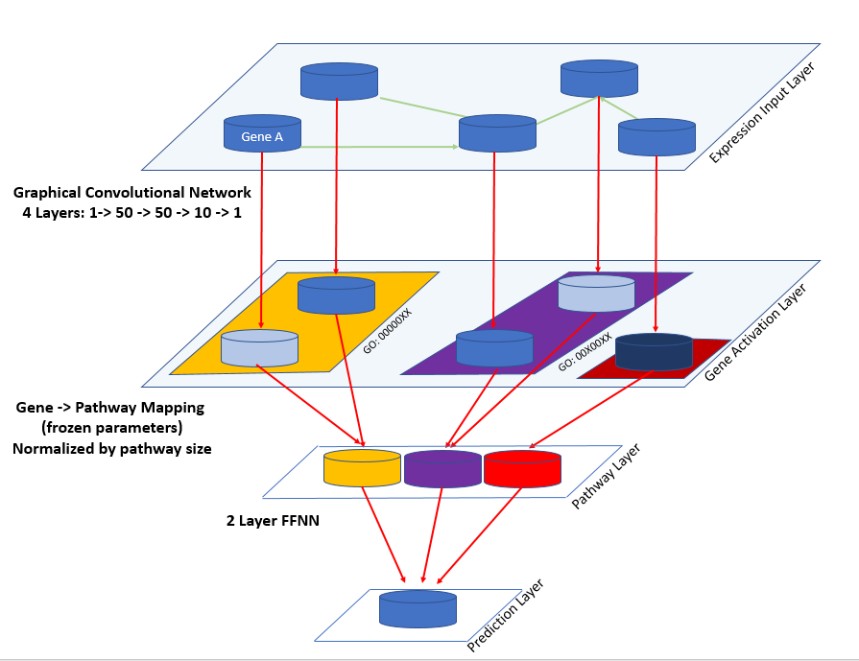
message passing
Notes:
The overall model architecture of TrojanArrow. The first four layers are a GCN, allowing information to pass between genes, and relevant features to be extracted. The gene activations are then mapped back to a single dimension to add interpretability (and simplicity) – this is the gene activation latent space that we will look at later on. Note, this does NOT indicate protein activation, rather, it’s activations relevant to the prediction task.
Next, using the GO pathway membership, gene activations are mapped to a pathway activation latent space, which is the sum of all gene activations for a given pathway (normalized by size of pathway). This is then followed by a two-layer feed forward neural network to predict Gene Dependency Score (continuous between roughly -2.5 and 1).

Slide 8
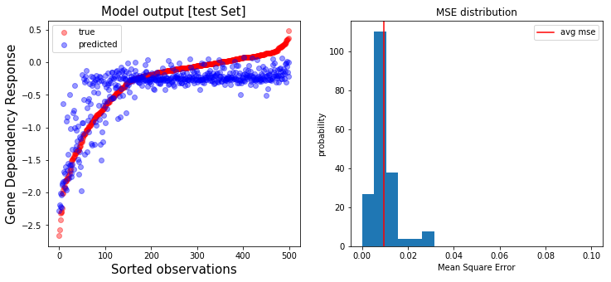
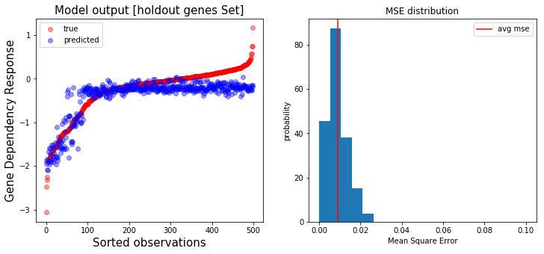
Performance on holdout cell lines
(novel expression features)
correlation: 0.848
average MSE: 9.66e-3
Performance on holdout gene knock outs
(novel graph structure)
correlation: 0.881
average MSE: 8.98e-3
Notes:
I tested on two holdout datasets, one (top) set was holdout cell-lines, therefore, novel genomes that the model has never seen. Second (bottom) was unique KO genes, thereby novel graph topologies. I’m happy to say that model performance is admirable on both datasets although the hold-out gene KOs seem slightly better. I find the results from the second dataset especially exciting since it indicates that our model does a good job learning the importance of network topology – and suggests that novel KOs or multi-gene KOs may be accurately modeled.
Trained for 100+ sub-epochs [100,000/500,000] on nvidia P4000 [8GB mem] + 8 cores [64GB mem], which took 1-2 days. Training took approximately 4ms / observation, and to fit into memory I used batches of 10.
Used the Ranger Optimizer (combination of Lookahead [1] and RAdam [2]) along with the mish [3] activation function.
I was still seeing training improvement, however, since I was paying for my compute time I decided to cut off training early. If I was to train longer I would like to implement a cosine annealing learning rate scheduler [4].
In retrospect, I regret training a regression rather than making this a classification problem. I think it would have trained better and been more interpretable.
1. Zhang MR, Lucas J, Hinton G, Ba J. Lookahead Optimizer: k steps forward, 1 step back. arXiv:190708610 [cs, stat] [Internet]. 2019 Dec 3 [cited 2020 Mar 14]; Available from: http://arxiv.org/abs/1907.08610
2. Liu L, Jiang H, He P, Chen W, Liu X, Gao J, et al. On the Variance of the Adaptive Learning Rate and Beyond. arXiv:190803265 [cs, stat] [Internet]. 2020 Mar 9 [cited 2020 Mar 14]; Available from: http://arxiv.org/abs/1908.03265
3. Misra D. Mish: A Self Regularized Non-Monotonic Neural Activation Function. arXiv:190808681 [cs, stat] [Internet]. 2019 Oct 2 [cited 2020 Mar 14]; Available from: http://arxiv.org/abs/1908.08681
4. Loshchilov I, Hutter F. SGDR: Stochastic Gradient Descent with Warm Restarts. arXiv:160803983 [cs, math] [Internet]. 2017 May 3 [cited 2020 Mar 14]; Available from: http://arxiv.org/abs/1608.03983

Slide 9
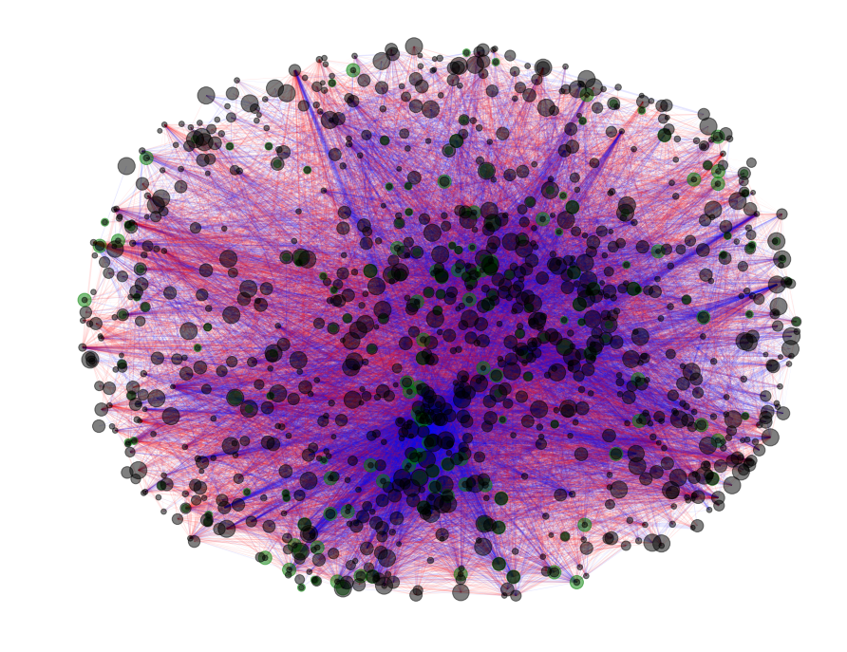
Model Interpretation: Learned Edge Weights
Node size ~ abs val self-edge weight
Edge color ~ positive / negative weight
Edge width ~ abs val edge weight
Green outline = MAPK cascade GO pathway
Notes:
Visualizing model learned edge weights.
Not actually sure how to interpret this, but it’s interesting that the lower cluster has so many negative edge weights. Also, that the MAPK cascade isn’t clustered at all, as I had expected it to be.

Slide 10
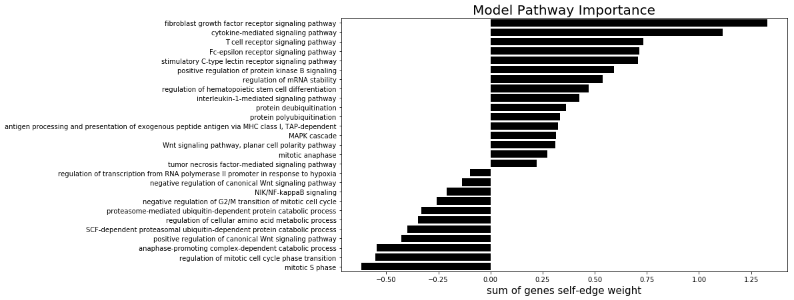
Model interpretation: Pathway Importance
Notes:
In a GCN, the only way to maintain self-information in a gene from layer to layer is by the self-edge connection. Since I’ve added this coupling component, I made the assumption that self-edge couplings are somewhat analogous to gene/node importance. Building on this assumption, I summed the self-edge weights within each pathway (normalized be pathway size), thereby providing a rough indicator of pathway relevance to the model.
I’m not sure how to interpret negative pathways; negative self-edge weights will invert the node values from GCN layer to layer. Future implementations of this should probably constrain these couplings to between 0 and 1. This would improve interpretability, and might be more robust as well…

Slide 11
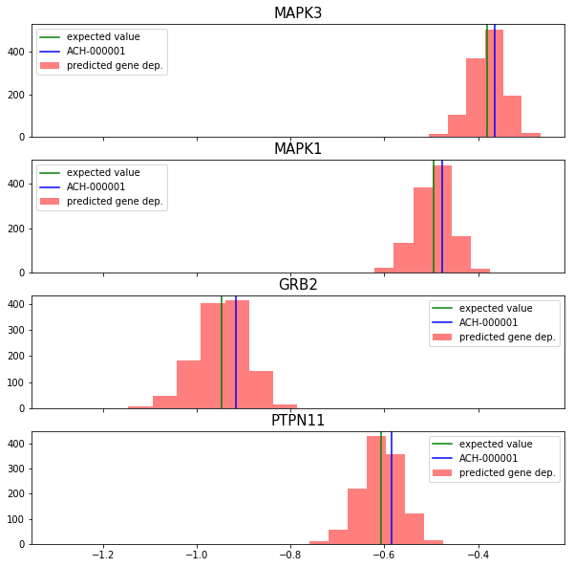
Wait! An issue…
Cell lines seems to just be a bias term
Is this accurate in the real data?
More EDA to know
Notes:
Almost all of the variance seems to be explained by gene KO, which at first worried me, however after more thought it makes sense. Almost all cell lines will share the majority of their genome and only on rare events diverge, even when they do, likely only slightly.

Slide 12
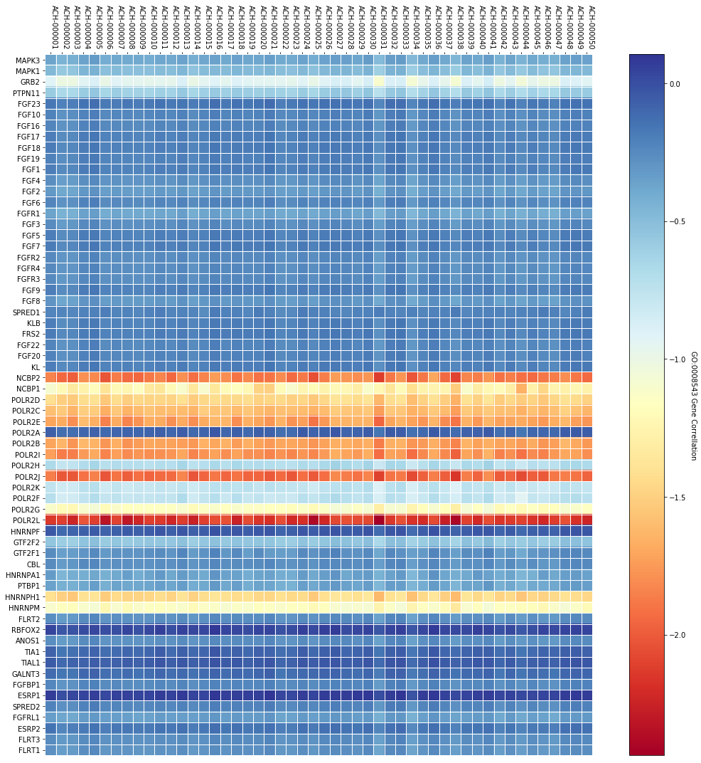
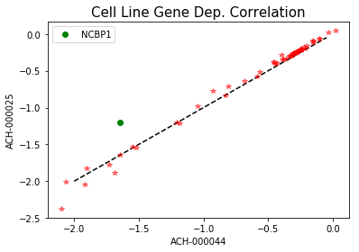
Majority of variance is explained by the KO (network topology)
Most questions relating to therapeutic are going to take advantage of the variance explained by genomic features (cell line)
Predicted Gene Dependency Score
Notes:
To further explore how KO vs genome importance to gene dependency, I plotted a subset of cell lines and gene KOs. As we see (left) almost all of the variance is explained by the gene knockout, although there is some slight impact by genomic features (vertical striations).
For the majority of therapeutic relevance, we need genome selectivity, thus we need to explore the genomic variance. In thinking through different ways to show this, I came up with the plot (right) showing two cell lines and the correlation of gene dependency between them. If all the values lie along the diagonal (or along any linear line) then there will be NO variation due to genome. However, gene dependency predictions that lie off that line will be indicative of cell line specific and differential response. In this plot between lines 34 & 44, gene KO of NCBP1 leads to much reduced proliferation in line 44 then it does it line 25. This may be a method of finding targetable gene with sensitivity in certain genomes.

Slide 13
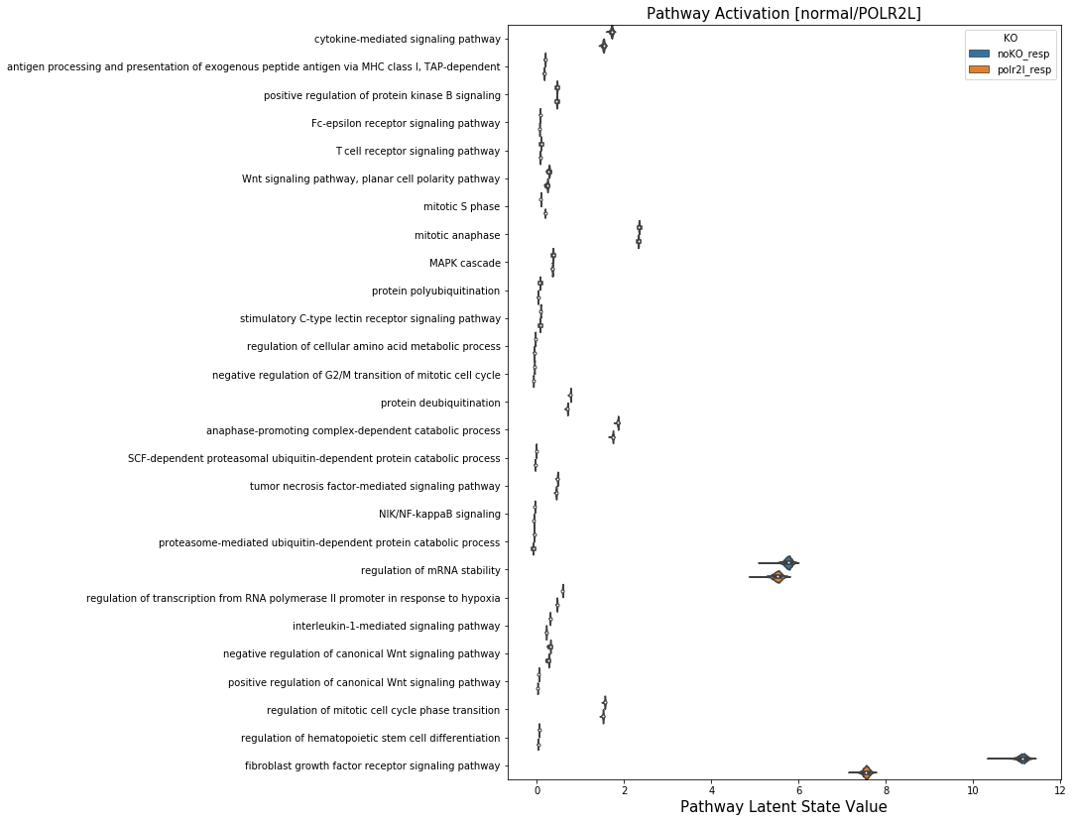
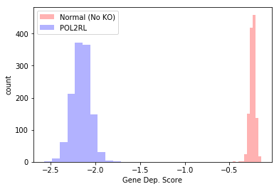
Notes:
To walk through how this model can be applied and interpreted…
We predict the gene dependency of POL2RL versus no KO. The plot (upper right) shows that POL2RL KO leads to significantly decreased proliferation (this distribution is for all 1200 CCLE cell lines we have access to).
We can then ask questions like, what does the model think the pathway activations for this look like? Extracting the pathway latent space for all 1200 ccle cell lines for either normal or POL2RL KO shows that most pathways are comparable, however, “fibroblast growth factor receptor signaling pathway” is significantly reduced in the POL2RL KO.
I recognize that this is likely not true pathway activation, rather, activation relevant to our prediction task. It would be interesting to think about validation techniques for KO -> pathway activation.

Slide 14
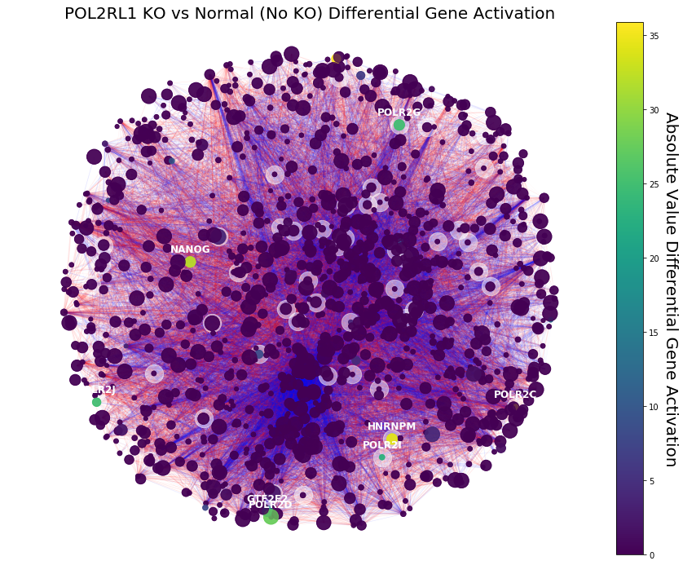
Comparing Gene Activations between Normal (No KO) and POL2RL1 KO.
- White outline: Fibroblast growth factor receptor signaling
- Color: Differential Gene Activation
Notes:
Other questions we can ask are, which genes are differentially activated (between POL2RL and normal)? Above is the same plot as before, where node size is mapped to self-edge weight, and edge color is edge weights, however, I’ve now overlaid the differential gene activation onto each node. For most genes, there is very little differential activation, however for a select few, there is significant difference. To explore the relevance to the “Fibroblast growth factor…” pathway, I’ve overlaid the pathway genes with a white circle. Many of our differentially activated genes are in the pathway, as we would expect from the last slide.

Slide 15

https://github.com/nathanieljevans/TrojanArrow
Kuenzi BM, Park J, Fong S, Kreisberg J, Ideker T. Abstract C006: DrugCell: A visible neural network to guide precision medicine. Mol Cancer Ther. 2019 Dec 1;18(12 Supplement):C006–C006.
Ma J, Yu MK, Fong S, Ono K, Sage E, Demchak B, et al. Using deep learning to model the hierarchical structure and function of a cell. Nat Methods. 2018 Apr;15(4):290–8.
Title | Description | Link
A Comprehensive Survey on Graph Neural Networks (2019) | General overview of spatial and spectral graph convolution methods. | https://arxiv.org/pdf/1901.00596.pdf
SEMI-SUPERVISED CLASSIFICATION WITH GRAPH CONVOLUTIONAL NETWORKS (2017) | One of the early descriptions of GCNs. | https://openreview.net/pdf?id=SJU4ayYgl
Graph Attention Networks (2017) | An improvement on GCNs by adding attention parameters to learn edge ‘weights’. | https://arxiv.org/abs/1710.10903
Edge Attention-based Multi-Relational Graph Convolutional Networks (2018) | An improvement on GCNs to add support for different edge types, while incorporating attention – this is the method we will try to implement. | https://arxiv.org/abs/1802.04944
A machine learning approach predicts essential genes and pharmacological targets in cancer (2019) | Method that uses a random forest model to predict gene dependency scores. Baseline comparison for our models. | https://www.biorxiv.org/content/10.1101/692277v1.full

