Slide 1
Library of Integrated Network-based Cellular Signatures (LINCS)

Slide 2
Overview
“The LINCS project is based on the premise that disrupting any one of the many steps of a given biological process will cause related changes in the molecular and cellular characteristics, behavior, and/or function of the cell”
There was a pilot phase that ended in 2013
Current phase 2 started in 2014
This synergizes with the NIH Big Data to Knowledge (BD2K) program
The goals of the program
establish a new understanding of health and disease through an integrative approach that identifies patterns of common networks and cellular responses (called cellular signatures) across different types of tissues and cells in response to a broad range of perturbations.
Disrupting any one of many steps will cause a change in the cellular phenotype
The definition of cellular signatures they use
the set of reduced dimensionality descriptors of the underlying data that provide insight into mechanism and serve as predictors

Slide 3
Overview cont.
They use 6 different Data and signature Generation centers
The Drug Toxicity signature generation center= monitor gene and protein expression as well as phenotype assays
The HMS LINCS Center = monitors cell responses using multiple biochemical, imaging and cell assays
The Lincs center for Transcriptomics = use the L1000 assay for gene-expression profiling
The Lincs Proteomic characterization center for signaling and epigenetics = performance of the P100 reduced representation phosphoprofiling and GCP global chromatin profiling
The MEP Lincs Center = imaging of cancer cell lines places into a microenviroment array
The NeuroLincs Center = Studying of the iPSCs derived from normal, familial and sporadic ALS patients
Each of these centers uses their own set of perturbations that are determined by the assay they use, in the same order as a above they are;
FDA -approved drugs applied individually or in combinations.
small-molecule protein kinase inhibitors and naturally occurring growth factors, cytokines and chemokines in various combinations.
Both the Lincs center for transcriptomics and the The Lincs Proteomic characterization center for signaling and epigenetics profile over 20,000 small molecules and 5,000 human genes
3,000 unique micro-environment conditions where an extracellular matrix protein is combined with an extracellular ligand to define a unique condition.
ALS motor neuron cells compared with cells from subjects that do not have the disease.

Slide 4
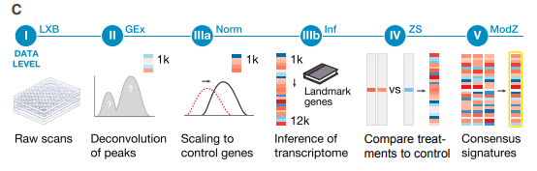
Workflow according to CLUE
The various levels correspond to various different steps in the data processing pipeline
Level 1 =Raw unprocessed flow cytometry data from Luminex
Level 2 = Gene expression values per 1000 genes after deconvolution
Level 3 = uantile-normalized gene expression profiles of landmark genes and imputed transcripts
A =Gene expression Normalized to invariant gene set curves and quantile normalized across each plate
B= Additional genes not directly measured in the L10000 assay are inferred based on normalized values for the landmark genes
Level 4 = Gene signatures computed using z-scores relative to the plate population as control or relative to the plate vehicle control
Level 5 = Differential gene expression signatures
This is the one we work off of

Slide 5
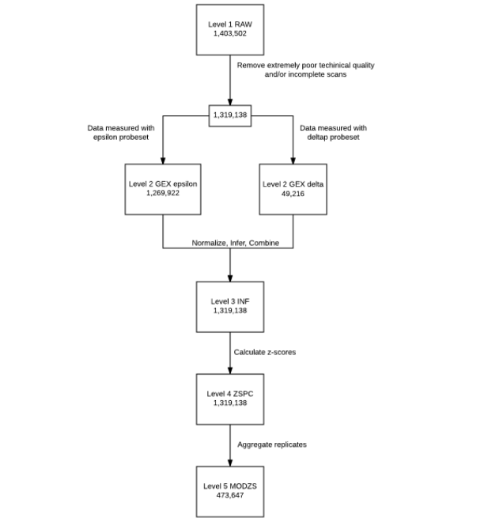
Weird things I found in the GRO CMAP LINCS User Guide v2.1
They seem to refer to multiple different data structures
They say this at one point
Q: What levels / types of data are available?
A: There are 5 levels of data available:
Level 1 - LXB - raw fluorescent count data generated by Luminex scanners. Fluorescent intensities measured for multiple beads of each of 500 different colors
Level 2 - GEX - Gene expression levels for the 978 landmark genes, deconvoluted from the measured fluorescent intensity values
Level 3 - INF_mlr12k - Gene expression (GEX, Level 2) levels that have been normalized to invariant gene set curves, and quantile normalized across each plate, and inferred values based on those normalized values
Level 4 - ZSVCINF_mlr12k - Z-scores for each gene based on INF_mlr12k / Level 3 with respect to the population of vehicle controls.
ZSPCINF_mlr12k - Z-scores for each gene based on INF_mlr12k / Level 3 with respect to the entire plate population
Level 5 - MODZ - replicate-collapsed z-score vectors based on Level 4.
But also show this graph→

Slide 6
Data can be downloaded from https://clue.io/releases/data-dashboard but a log in is required
You can calso download levels 1-4 from https://www.ncbi.nlm.nih.gov/geo/query/acc.cgi?acc=GSE70138
We will be using level 5 data from clue.io
We could attempt to use the controls or other treatments
Nut for now were just using the level 5 data for compounds
Most of the programs will also require a info file such as the GSE92742_Broad_LINCS_gene_info.txt.gz for dealing with level 5
They can also be downloaded from the clue link

Slide 7
Data Retrieval and interaction
Can be retrieved as a whole set from https://clue.io/releases/data-dashboard once a login is created can be retrieved with either, curl,wget or aws.
I tried curl took about 6 hrs then crashed
However direct download worked
Most packages require you download it that I found
Packages
These are the ones I got from Nate
Slinky – R this is the most promising
L1000 Viewer – this is a search engine and graphical interface I don’t think this exists any more or at least I cant access it
http://l1000viewer.bio-complexity.com/
DeepLINCS – python based off a deep learning approach.
Found elsewhere
Drug/ Cell-line browser
https://www.maayanlab.net/LINCS/DCB/
This may work as a quick way to grab just types of interest say, ovarian, bladder, kidney ect.
However doubt it will be good for large scale querying
signatureSearchData
allows to search with a query gene expression signature (GES) a database of treatment GESs to identify cellular states sharing similar expression responses (connections). This way one can identify drugs or gene knockouts that induce expression phenotypes similar to a sample of interest.
https://bioconductor.org/packages/release/data/experiment/vignettes/signatureSearchData/inst/doc/signatureSearchData.html#4_LINCS_Signature_Database
Links Data portal- this is just a search engine but could be useful.

Slide 8
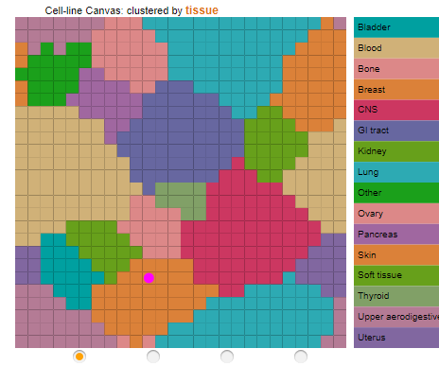
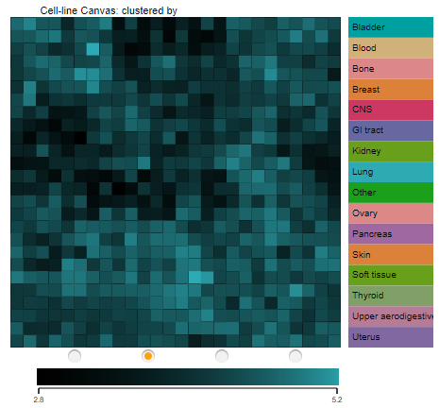
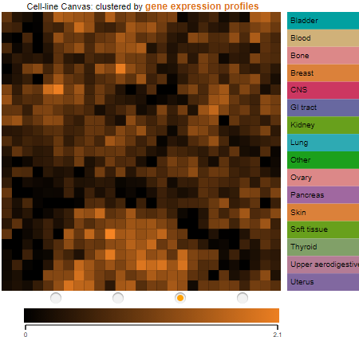
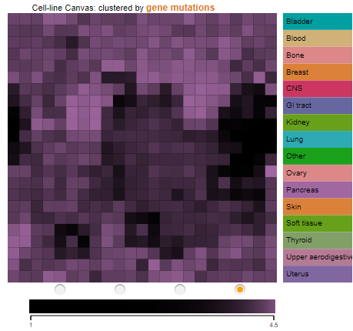
Drug/ Cell-line Browser
This is a HTML5 data visualization tool for interacting with cancer cell-line/drug-viability studies. It was created by Written by Qiaonan Duan and Avi Ma’ayan
can be found at https://www.maayanlab.net/LINCS/DCB/
The manual can be found at https://www.maayanlab.net/LINCS/DCB/DCB%20Manual.pdf
The cell-lines are clustered in four ways.
Default is category view, this is cell lines clustered by tissue type or subtype
Response to drug vector for each cell line
Basal gene expression within each cell line , clustered by gene expression profile vectors
Mutation status clustered by gene mutations status

Slide 9
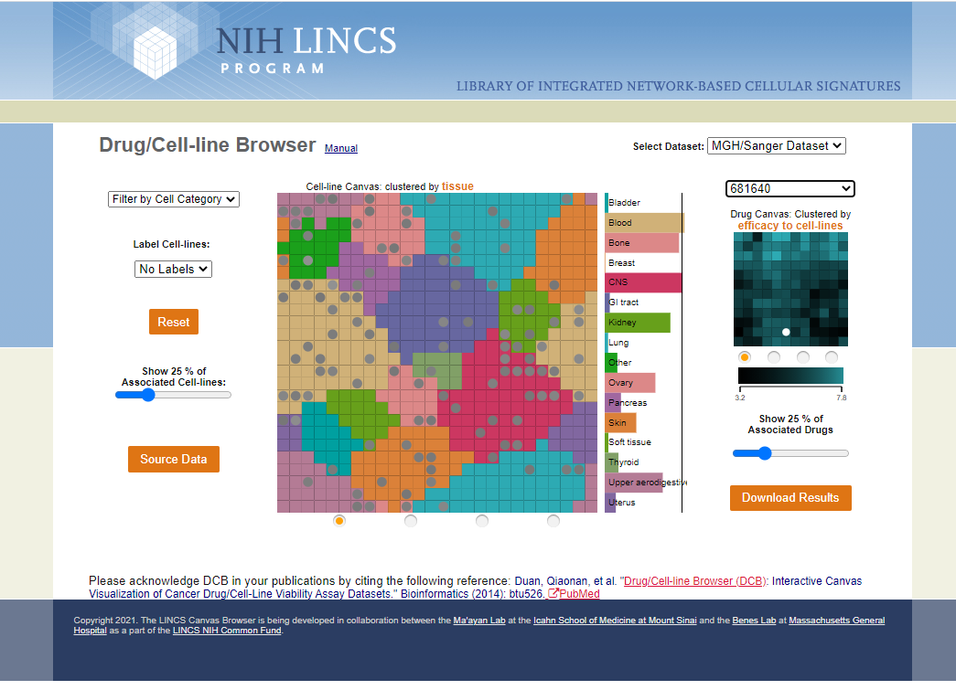
Drug/ Cell-line Browser
These views are manipulated by the buttons at the bottom
Using the drop down Select Drug menu will highlight the cell lines most sensitive to the drug this is by default the top 25%most sensitive but you can use the slider to change this threshold
This information can then be downloaded using the download results button. It comes out as a TXT file
Drug Select Dropdown
Download

Slide 10
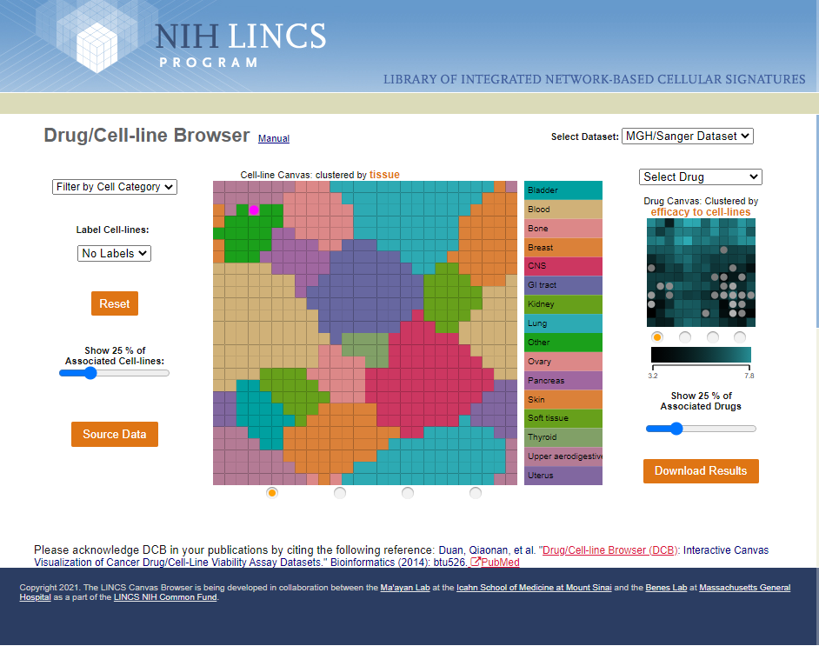
Drug/ Cell-line Browser
A tile can also be selected and this will show the most effective drug for inhibiting that cell line again this threshold is set at 25% and can be adjusted using the slider and exported.
Effective drugs for chosen cell
Selected cell

Slide 11
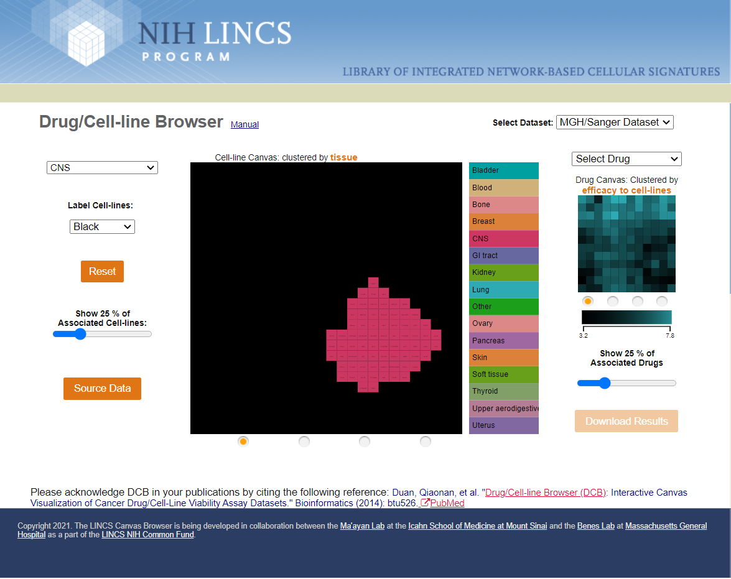
Drug/ Cell-line Browser
You can also filter the cell lines by using the cell line drop down
And you can add cell line names by using the cell line label drop down.
Note: The cell line lables are very small and hard to see
Cell Line Type
Cell Line lables

Slide 12
Drug/ Cell-line Browser
the dataset you are using by adjusting the select dataset dropdown menu.
Change Dataset

