Slide 1
Cyclic IF registration pipeline overview
Nate Evans

Slide 2
Problem Statement
TMA experiments consist of 10-15 x 10-15 “cores” spaced evenly across a slide
The axioscan microscope scans this slide and stitches the images into a large (20k+ x 20k+) image
Each experiment has 5-12 “rounds” which each have 5 “channels” or “colors” (c1-5). C1 is always a dapi stain. C2-c4 are protein fluorescence that vary.
Each round’s dapi image needs to be aligned or “registered” to the reference dapi image (Round 0, C1).
Due to axioscan errors when stitching images, cores are not always linearly stitched

Slide 3
Example pipeline script
# becacuse python calls are wrapped in run_registration...
cd $script_dir
# dedust the dapi images
python dedust_dapi_images.py --input $data_dir --output $dedust_out
# pre register TMAs
python slide_registration.py --input $dedust_out --output $prereg_out --slide $slide_name --scene $scene_name
# split cores and match across rounds
python segment_and_match_cores.py --input $data_dir --output $output_dir --slide $slide_name --scene $scene_name --config $myloc
# register each core
scene_dir=$output_dir/$slide_name/$scene_name
for core_dir in $scene_dir/*/
do
echo "registering $core_dir dir..."
python register_core.py --input $core_dir --config $config_path
python evaluate_core_registration.py --input $core_dir
#ls $core_dir | grep -P "unregistered_.*_round=R[1-9].*" | xargs -d"\n" rm # TODO - delete unregistered cores
done
# aggregate results
python aggregate_results.py --dir $output_dir
## restitch the cores
python restitch_cores.py --results_path $output_dir/aggregated_results.csv --output $output_dir/$slide_name/$scene_name/ --slide $slide_name --scene $scene_name --qc None --config $myloc

Slide 4
De-dust dapi images
Full Slide Registration
Segment, match, and separate cores
Register cores
Aggregate registration results
Generate QC file
Re-stitch images

Slide 5
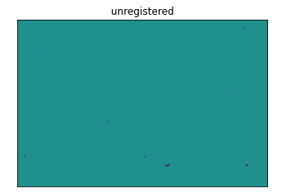
De-dust dapi images
Full Slide Registration
Segment, match, and separate cores
Register cores
Aggregate registration results
Generate QC file
Re-stitch images
Methods Overview:
1. Clip upper values – threshold of 150 [/255]
Rescale intensities
Usage + Location
(cycIF_reg) teddy@RWS01360:/mnt/c/Users/Public/cyclicIF_processing/cyclicIF_registration/workflow/scripts$ python dedust_dapi_images.py --help
usage: dedust_dapi_images.py [-h] [--input in] [--output out]
CyclicIF registration of a full slide
optional arguments:
-h, --help show this help message and exit
--input in directory of input files (.tif slide scenes)
--output out directory of output files (registered cores)
Dedusted - origional

Slide 6
De-dust dapi images
Full Slide Registration
Segment, match, and separate cores
Register cores
Aggregate registration results
Generate QC file
Re-stitch images
Usage + location
(cycIF_reg) teddy@RWS01360:/mnt/c/Users/Public/cyclicIF_processing/cyclicIF_registration/workflow/scripts$ python slide_registration.py --help
usage: slide_registration.py [-h] [--input in] [--output out] [--slide slide] [--scene scene]
CyclicIF registration of a full slide
optional arguments:
-h, --help show this help message and exit
--input in directory of input files (.tif slide scenes)
--output out directory of output files (registered cores)
--slide slide slide name (identifier)
--scene scene scene name (identifier)

Slide 7
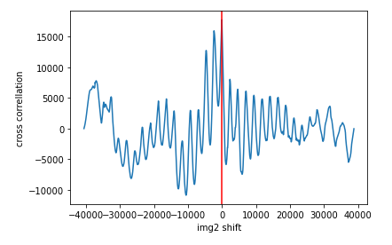
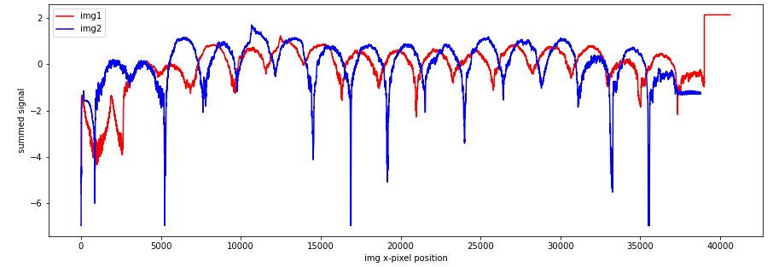
De-dust dapi images
Full Slide Registration
Segment, match, and separate cores
Register cores
Aggregate registration results
Generate QC file
Re-stitch images
Best 1-d shift
Methods Overview
Assume rigid registration and only x,y translation (no rotation)
Use cross-correlation to find best x,y shifts – this allows for global best fit
Note: gradient descent optimizers are liable to mis-align columns as local minimas

Slide 8
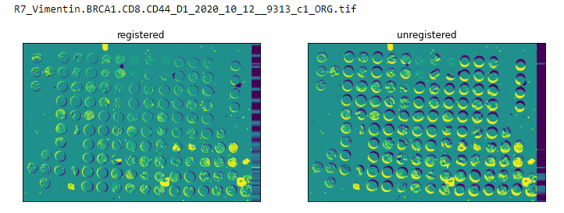
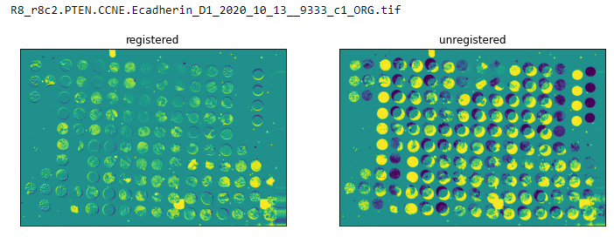
De-dust dapi images
Full Slide Registration
Segment, match, and separate cores
Register cores
Aggregate registration results
Generate QC file
Re-stitch images
Results
(From Dhivya-6, D1)

Slide 9
De-dust dapi images
Full Slide Registration
Segment, match, and separate cores
Register cores
Aggregate registration results
Generate QC file
Re-stitch images
Usage + Location
(cycIF_reg) teddy@RWS01360:/mnt/c/Users/Public/cyclicIF_processing/cyclicIF_registration/workflow/scripts$ python segment_and_match_cores.py --help
starting `segment_and_match_cores.py`...
usage: segment_and_match_cores.py [-h] [--input in] [--output out] [--slide slide] [--scene scene] [--config config]
CyclicIF registration pipeline. Segmentation of cores & matching across rounds.
optional arguments:
-h, --help show this help message and exit
--input in directory of input files (.tif slide scenes)
--output out directory of output files (registered cores)
--slide slide slide name (identifier)
--scene scene scene name (identifier)
--config config path to config file

Slide 10
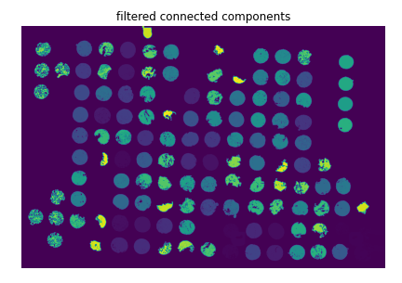
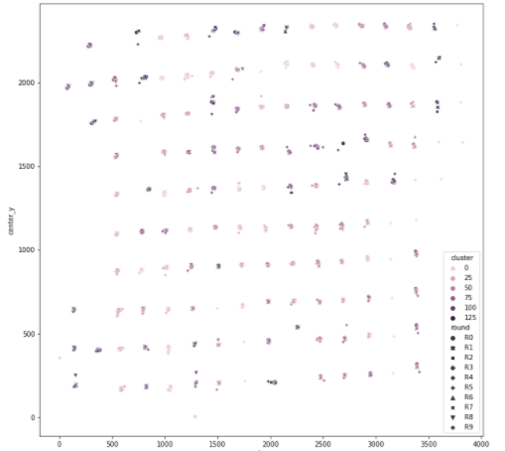
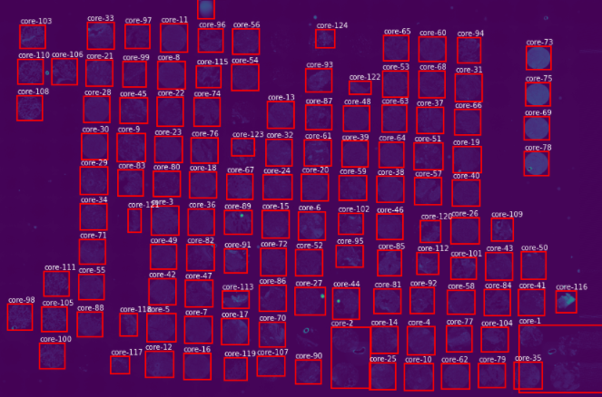
De-dust dapi images
Full Slide Registration
Segment, match, and separate cores
Register cores
Aggregate registration results
Generate QC file
Re-stitch images
Method Overview
Segment each core and assign a core id
Match core id’s across rounds using density based clustering and x,y pixel location as features
TODO: QC; remove any cores that have fewer than XX cores assigned.
Get shape statistics and location of each core
Isolate each core (in each round) and save to separate file

Slide 11
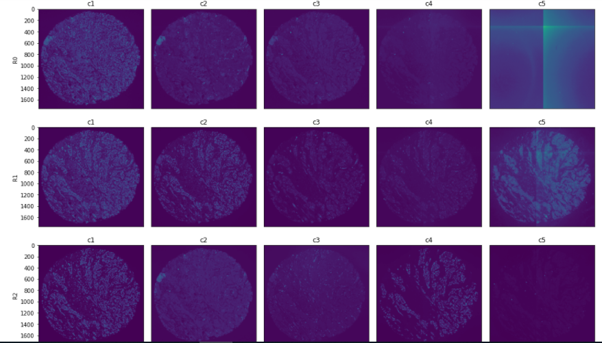
De-dust dapi images
Full Slide Registration
Segment, match, and separate cores
Register cores
Aggregate registration results
Generate QC file
Re-stitch images
Results

Slide 12
Full Slide Registration
De-dust dapi images
Segment, match, and separate cores
Register cores
Evaluate registration
Generate QC file
Re-stitch images
Usage + Location
(cycIF_reg) teddy@RWS01360:/mnt/c/Users/Public/cyclicIF_processing/cyclicIF_registration/workflow/scripts$ python register_core.py --help
starting `register_core.py`...
usage: register_core.py [-h] [--input input] [--config config]
CyclicIF registration pipeline. Registration of an individual core across rounds + channels.
optional arguments:
-h, --help show this help message and exit
--input input core directory (.tif core images)
--config config path to directory with config object

Slide 13
Full Slide Registration
De-dust dapi images
Segment, match, and separate cores
Register cores
Evaluate registration
Generate QC file
Re-stitch images
Methods Overview
Gradient Descent Optimizer using Mutual Information as the metric
< 20 iterations

Slide 14
Full Slide Registration
De-dust dapi images
Segment, match, and separate cores
Register cores
Evaluate registration
Generate QC file
Re-stitch images
Results

Slide 15
Full Slide Registration
De-dust dapi images
Segment, match, and separate cores
Register cores
Evaluate registration
Generate QC file
Re-stitch images
2 scripts
(cycIF_reg) teddy@RWS01360:/mnt/c/Users/Public/cyclicIF_processing/cyclicIF_registration/workflow/scripts$ python evaluate_core_registration.py --help
starting `evaluate_core_registration.py`...
usage: evaluate_core_registration.py [-h] [--input in]
CyclicIF registration pipeline. Evaluating a registration of an individual core across rounds + channels.
optional arguments:
-h, --help show this help message and exit
--input in core directory (.tif core images)
(cycIF_reg) teddy@RWS01360:/mnt/c/Users/Public/cyclicIF_processing/cyclicIF_registration/workflow/scripts$ python aggregate_results.py --help
starting `aggregate_results.py`...
usage: aggregate_results.py [-h] [--dir in]
CyclicIF registration pipeline. Aggregate all registration results for a given output directory.
optional arguments:
-h, --help show this help message and exit
--dir in output directory

Slide 16
Full Slide Registration
De-dust dapi images
Segment, match, and separate cores
Register cores
Evaluate registration
Generate QC file
Re-stitch images
Methods Overview

Slide 17
Full Slide Registration
De-dust dapi images
Segment, match, and separate cores
Register cores
Evaluate registration
Generate QC file
Re-stitch images
Results

Slide 18
Full Slide Registration
De-dust dapi images
Segment, match, and separate cores
Register cores
Evaluate registration
Generate QC file
Re-stitch images
Usage + Location

Slide 19
Full Slide Registration
De-dust dapi images
Segment, match, and separate cores
Register cores
Evaluate registration
Generate QC file
Re-stitch images
Methods Overview

Slide 20
Full Slide Registration
De-dust dapi images
Segment, match, and separate cores
Register cores
Evaluate registration
Generate QC file
Re-stitch images
Results

Slide 21
Full Slide Registration
De-dust dapi images
Segment, match, and separate cores
Register cores
Evaluate registration
Generate QC file
Re-stitch images
Usage + Location

Slide 22
Full Slide Registration
De-dust dapi images
Segment, match, and separate cores
Register cores
Evaluate registration
Generate QC file
Re-stitch images
Methods Overview

Slide 23
Full Slide Registration
De-dust dapi images
Segment, match, and separate cores
Register cores
Evaluate registration
Generate QC file
Re-stitch images
Results

