Slide 1
HER2 Project Analysis
Samuel Tsang, Aurora Blucher, Nate Evans

Slide 2
Agenda
Analysis Goal
Pipeline overview
Analysis details
Sensitivity analysis details
Analysis plan

Slide 3
Data Analysis Overview
Project Goal: Match HER2 mutations to effective targeted therapies.
Experiment Summary: For the SKBR3, EFM192A cell line:
(Test control cell lines (see below) with each mutant)
1) induce a specific HER2 mutation
2) The functional response to a Neratinib and Trastuzumab is measured by live cell reporter imaging
(pathway activity time series).
Controls:
WT SKB cells: These cells are sensitive to both Neratinib and Trastuzumab.
T798I cells: These cells are resistant to neratinib and has an unknown response to Trastuzumab
Nd611 cells: Resistant driver in-vivo – but may not show resistance in-vitro … maybe resistant to Trastuzumab.
The goal of this analysis is to explore how to assign mutant HER2 cell lines resistance/sensitivity calls.
(The data presented was done with ½ of the SKBR3 dataset)

Slide 4
cBioPotal
Identify Common HER2 mutations (breast)
Assign sensitivity based on similarity to controls
Induce Mutations
Live cell reporter imaging
SKBR8
Sensitive control
Validation
SKBR3 is HER2+
Resistant control
EFM192A
Sensitive control
Growth/Death Assays
Live cell reporter imaging (MCF10A, HER2-)
EFM192A is ER+/HER2+
Resistant control

Slide 5
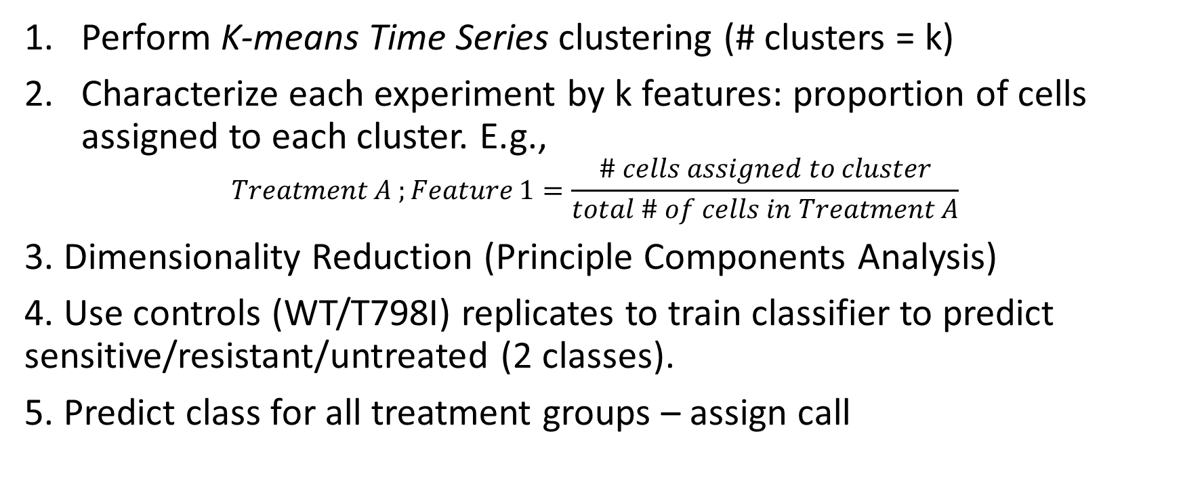
Data analysis overview
Perform K-means Time Series clustering (# clusters = k)
Characterize each experiment by k features: proportion of cells assigned to each cluster. E.g.,
$$Treatment A ;Feature 1=\frac{\# cells assigned to cluster}{total \# of cells in Treatment A}$$
3. Dimensionality Reduction (Principle Components Analysis)
4. Use controls (WT/T798I) replicates to train classifier to predict sensitive/resistant/untreated (2 classes).
5. Predict class for all treatment groups – assign call

Slide 6
Hyperparameters chosen by sensitivity analysis
Normalized vs raw
Resampling length
Number of clusters
Data
preprocessing
K-means clustering
Dimensionality Reduction
Within drug
+ cell line
Predict sens/res labels
Train Classifier
[on controls]
Sort by probability resistant

Slide 7
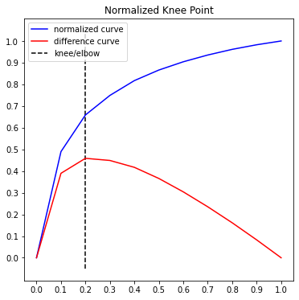
K-Means Time Series Clustering
Tslearn Package: https://tslearn.readthedocs.io/en/stable/index.html
Distance metric: Euclidean [options: DTW, DTW-soft, KernelKmeans]
Elbow plot suggests knee at around 4 – HOWEVER – experimentation shows better separation with greater # clusters:
Used K (# clusters) = 25

Slide 8
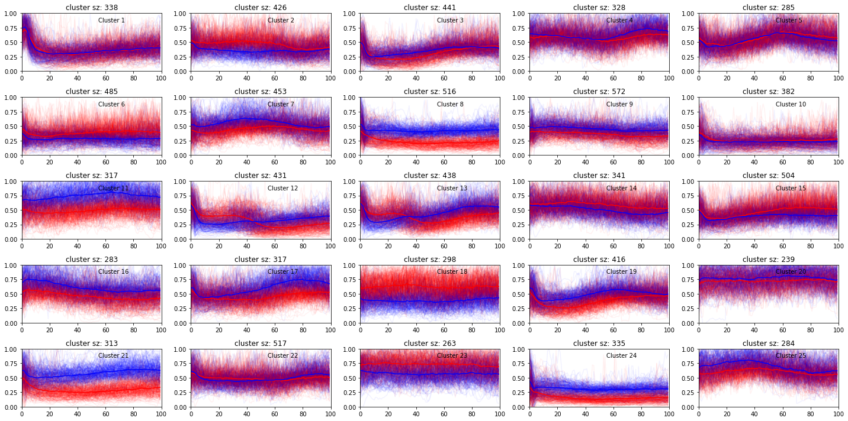

Slide 9
Experiment cluster proportion
2. Quantify cluster proportion within experiment
1. Assign clusters
Cluster 1
Cluster 1 = 0.67
Cluster 1
Cluster 2 = 0.33
Cluster 2

Slide 10
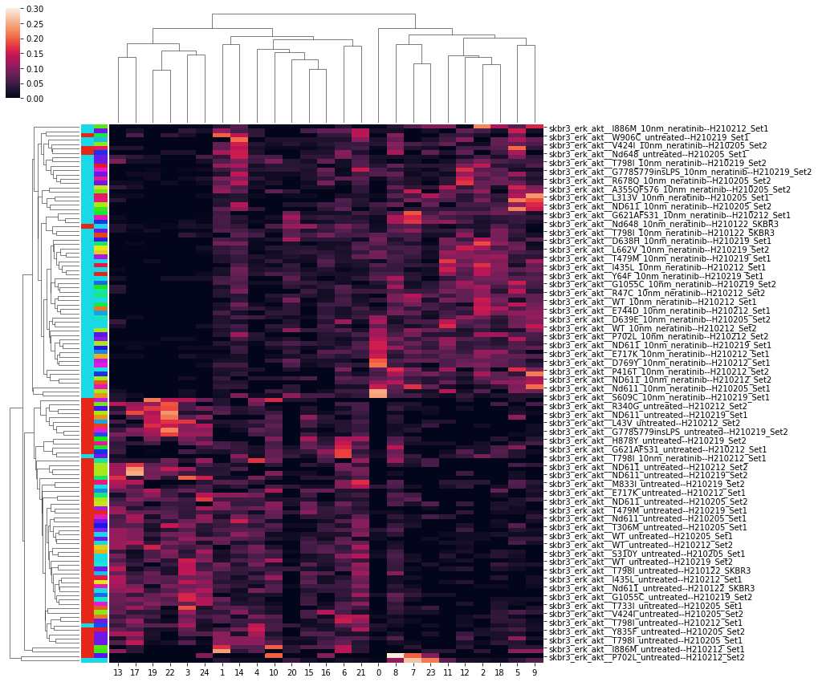
Cluster Proportion Heatmap
Treatment (Drug/untreated)
Mutant
Neratinib and untreated
All cell lines

Slide 11
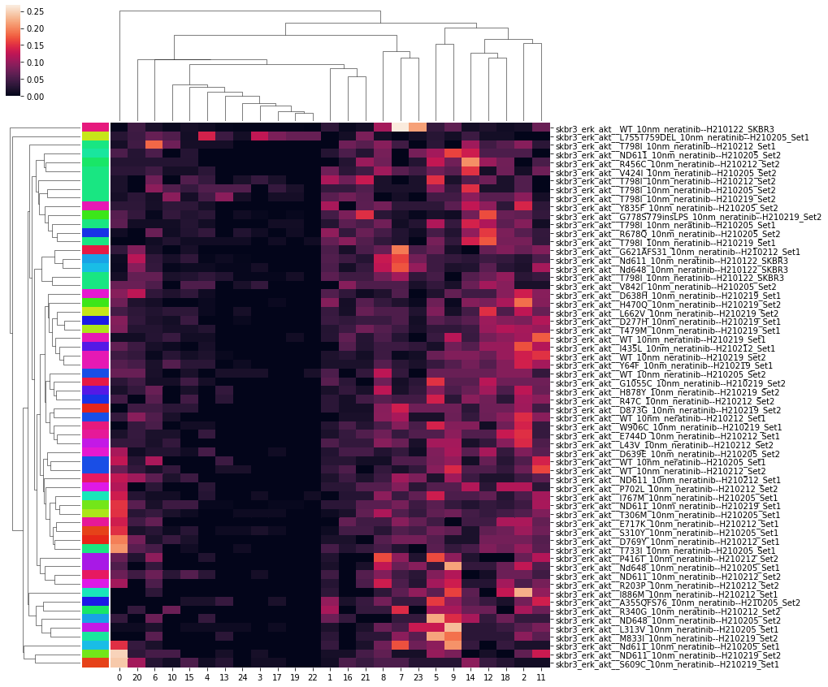
Cluster proportion heatmap (neratinib only)
Resistant cluster
Sensitive cluster

Slide 12
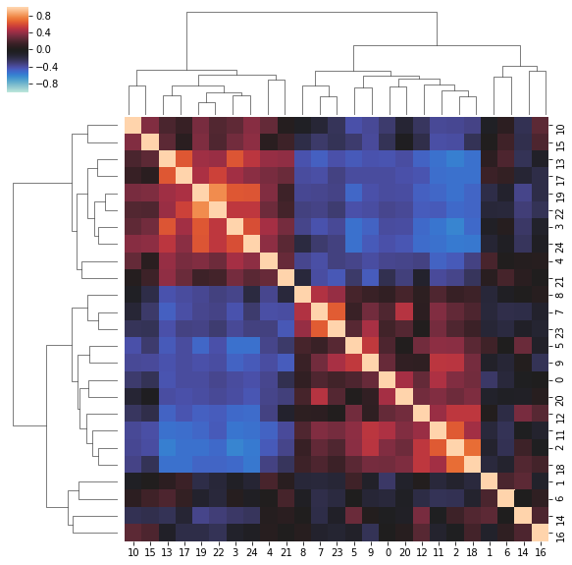
Feature Correlation
Pearson Corr.
Feature correlation suggests many of these clusters commonly co-occur within.
Could suggest that we’ve identified multiple clusters that are representative of smaller subset or dynamics (aka, too many clusters)
Cluster Label
Cluster Label

Slide 13
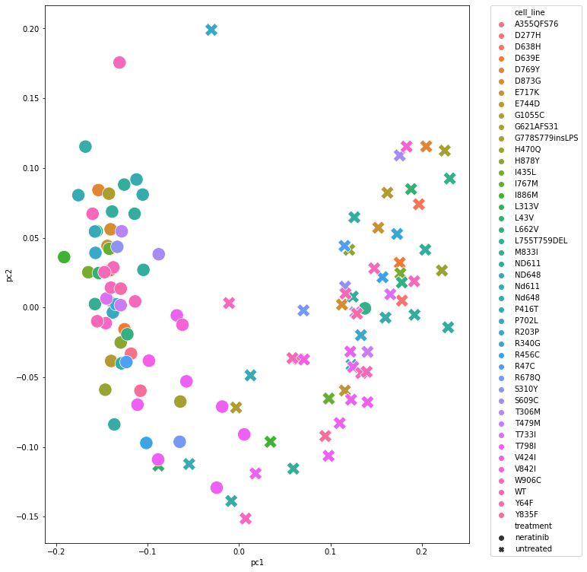
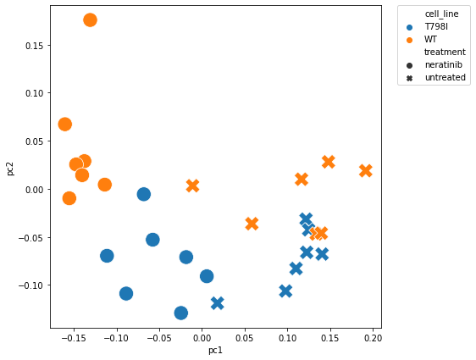
Dimensionality Reduction (PCA)
All Treatment Groups
explained variance ratio: [0.38 0.09]
Controls Only
Sensitive
Untreated
Resistant

Slide 14
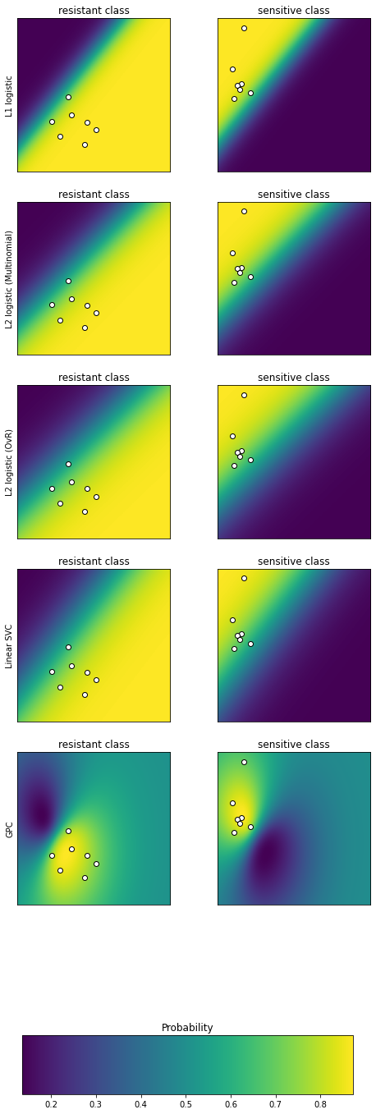
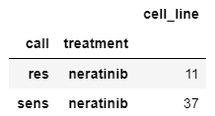
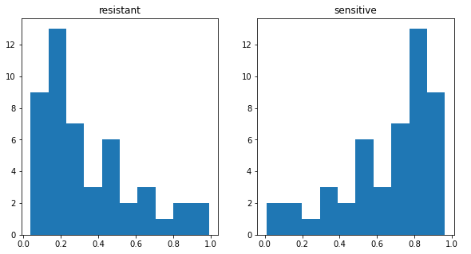
Sens/Res Classifier
Trained classifier on just neratinib (T798I=0 (res), WT=1 (sens))
Predicted classes on remaining neratinib samples (excluding WT, T798I)

Slide 15
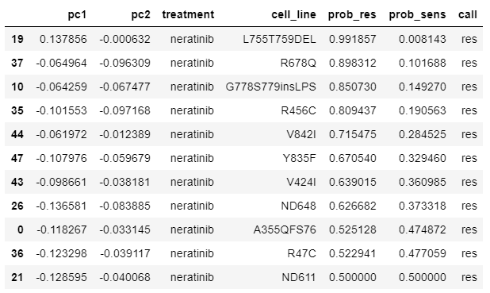
Resistant Calls
Sorted by probability (confidence)
From neratinib cluster proportion heatmap:

Slide 16
Sensitivity Experimental Setup
Grid Search
5 Replicates at each config. with random seeds
Config Params tested:
Clusters config: 2 3 5 10 15 25 35 45
Resampling size (time series length): 50 75 100 125 150
Data pre-processing: normalized or raw
Time < 8 hours. Overnight run.
For each experiment, random uuid assigned – output dir includes plots, classifier probability results and experiment results.

Slide 17
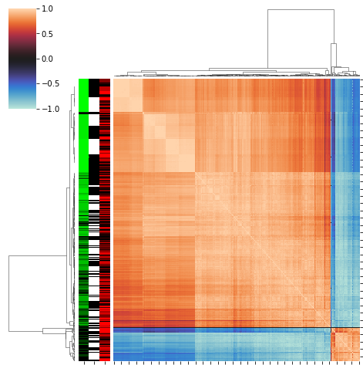
Probability Concordance
Pearson correlation between each experiment
Row label colors:
Green – nclusters (light green = few clusters)
White/balck – load (black = normalized)
Red – resample size (light red = shorter time series)

Slide 18
Model Variance
Setup:
Filter to within replicates
Calculate pairwise Pearson corr.
Calculate sufficient statistics
Low-variance (stable) models would have perfect positive correlation
High-variance (instable) models would have high correlation variance and 0 or negative correlation.

Slide 19
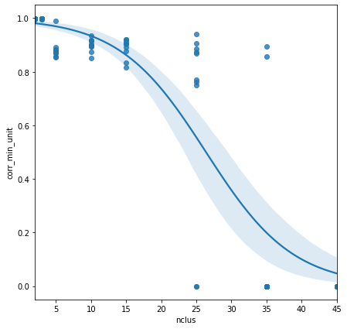
Model variance
Single-variate Logistic
1.0
$$corr_\min{\sim Logistic\left( nclus+load+resample sz\right)}$$
Min. Replicate Prob. Correlation
Variable | Coef. | CI (lower) | CI (upper) | Sig.
Intercept | 4.222236 | 1.429946 | 7.014527
load[T.raw] | -0.420407 | -1.919332 | 1.078518
nclus | -0.162454 | -0.229108 | -0.095800 | *
resample_sz | sz 0.002738 | -0.018269 | 0.023746
-1.0

Slide 20
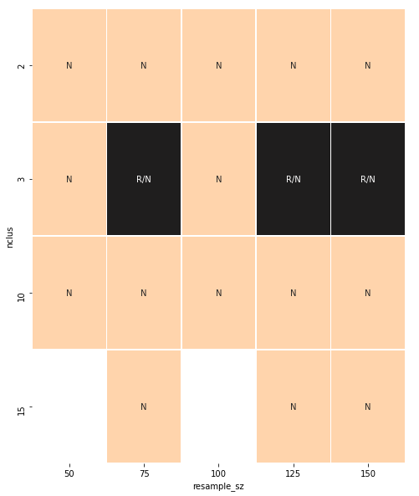
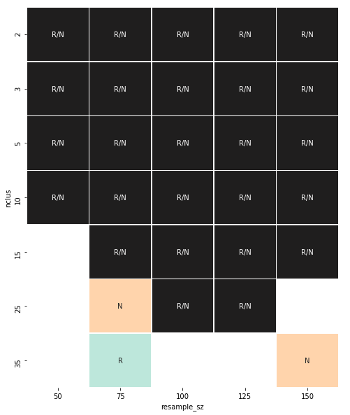
Configs with mean Accuracy == 1
Stable Configs

Slide 21
Recommended Config.
Resample size = 125
# clusters = 10
Pre-processing = ‘normalized’

Slide 22
Aim1 Timeline
Jan 2021
Now
JULY
SEPT
SKBR3 Imaging
SKBR3 processing
Validation
EFM192A Imaging
EFM192A processing

Slide 23
Data Analysis Plan
Dev:
Batch effects
Sensitivity analysis (add “burn in” pre-processing check)
Analysis:
SKBR8
Neratinib
Trastuzumab
Potentially weak resistant control; fall back plan?
EFM192A: still waiting on data

Slide 24
Other slides

Slide 25
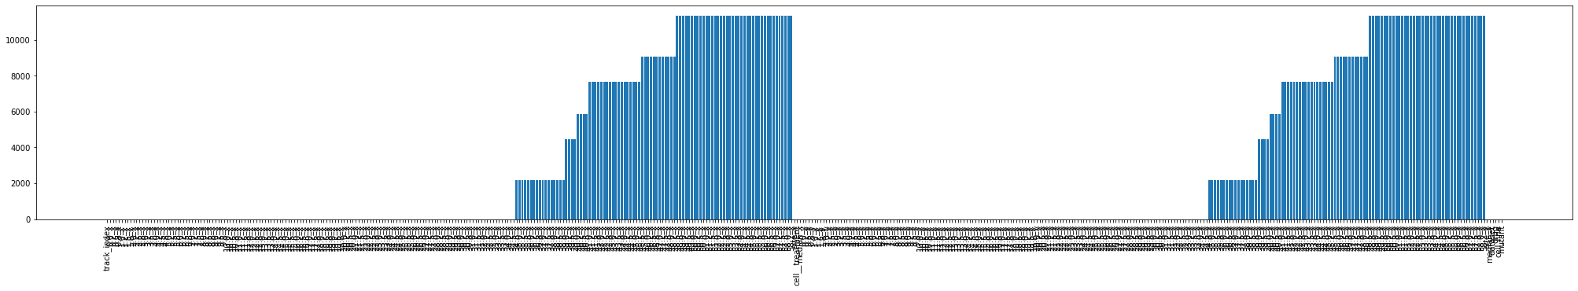
Data Pre-Processing, QC, Filtering
Using normalized data
Excluded time that has missing features across all treatment groups
Why is the data missing? Data is run for different lengths depending on when it is collected by Samuel – arbitrary differences
Resampled time-series to length = 100
Clover time series 0-58 hours
Mscarlet time series 0-58 hours
# NAs

Slide 26
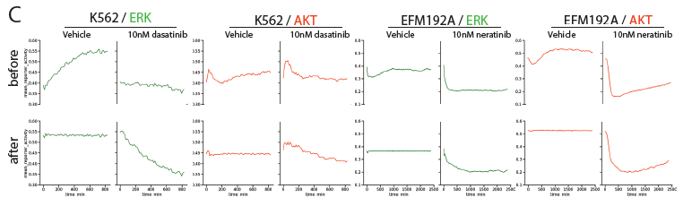
Data Normalization

Slide 27
Batch Effects [To-Do]
Use untreated controls, assume normal distribution- fit params and identify outliers by likelihood below some threshold
Untreated

Slide 28
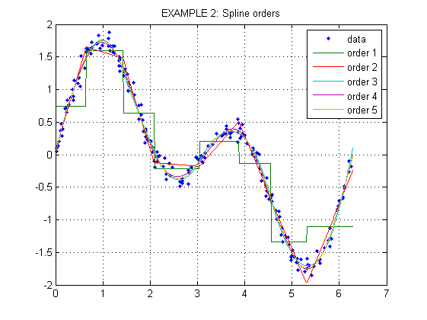
Tslearn TimeSeriesResampler
Uses scipy.interp1d
Type: “slinear” (spline of order 1)
Interpolation tutorial

Slide 29
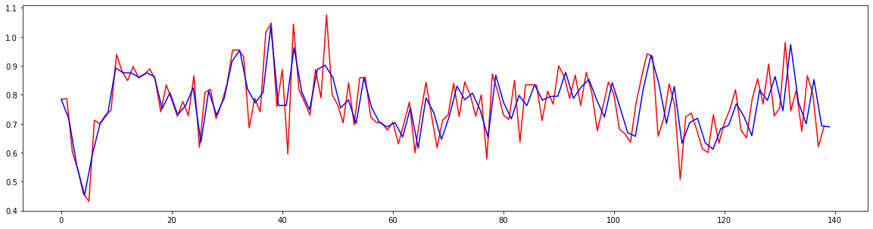
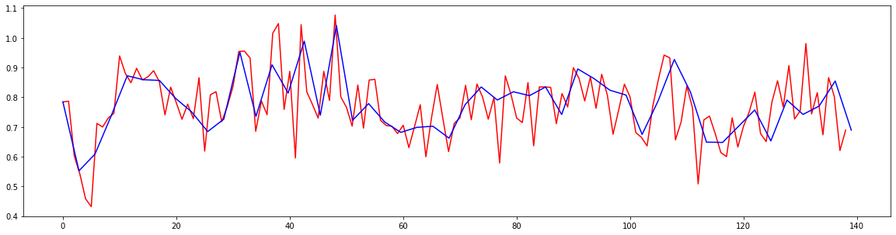
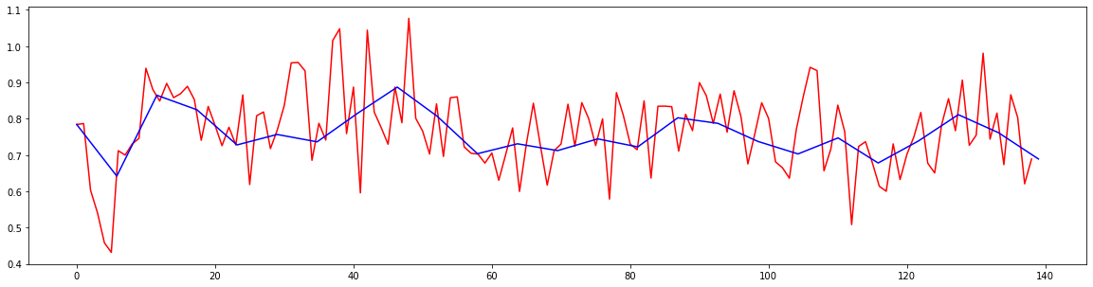
Resampling Example
Sz = 100
Sz = 50
Sz = 25

