Slide 1
HER2 Project Making Sensitive/Resistant Calls
Nate Evans, Aurora Blucher, Samuel Tsang
3/30/2021

Slide 2
Overview
Project Goal: Match HER2 mutations to effective targeted therapies.
Experiment Summary: For the SKBR8 cell line:
(Test control cell lines (see below) with each mutant)
1) induce a specific HER2 mutation
2) The functional response to a Neratinib and Trastuzumab is measured by live cell reporter imaging
(pathway activity time series).
Controls:
WT SKB cells: These cells are sensitive to both Neratinib and Trastuzumab.
T798I cells: These cells are resistant to neratinib and has an unknown response to Trastuzumab
Nd611 cells: Resistant driver in-vivo – but may not show resistance in-vitro … maybe resistant to Trastuzumab.
The goal of this analysis is to explore how to assign mutant HER2 cell lines resistance/sensitivity calls.

Slide 3
cBioPotal
Identify Common HER2 mutations (breast)
SKBR8
EFM192A

Slide 4
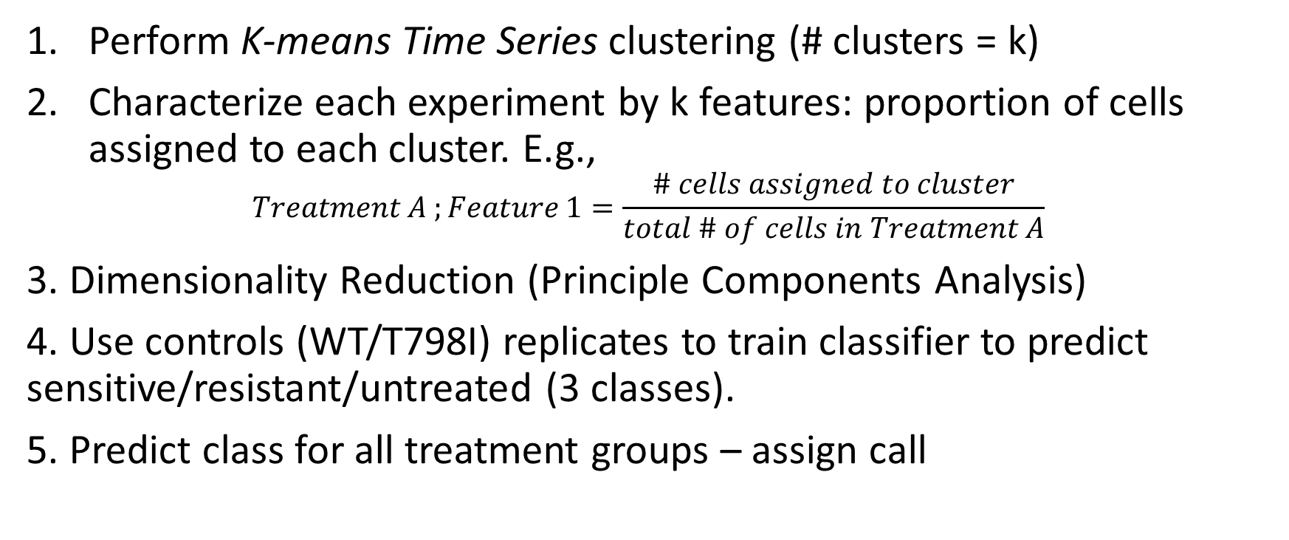
Data analysis overview
Perform K-means Time Series clustering (# clusters = k)
Characterize each experiment by k features: proportion of cells assigned to each cluster. E.g.,
$$Treatment A ;Feature 1=\frac{\# cells assigned to cluster}{total \# of cells in Treatment A}$$
3. Dimensionality Reduction (Principle Components Analysis)
4. Use controls (WT/T798I) replicates to train classifier to predict sensitive/resistant/untreated (3 classes).
5. Predict class for all treatment groups – assign call

Slide 5
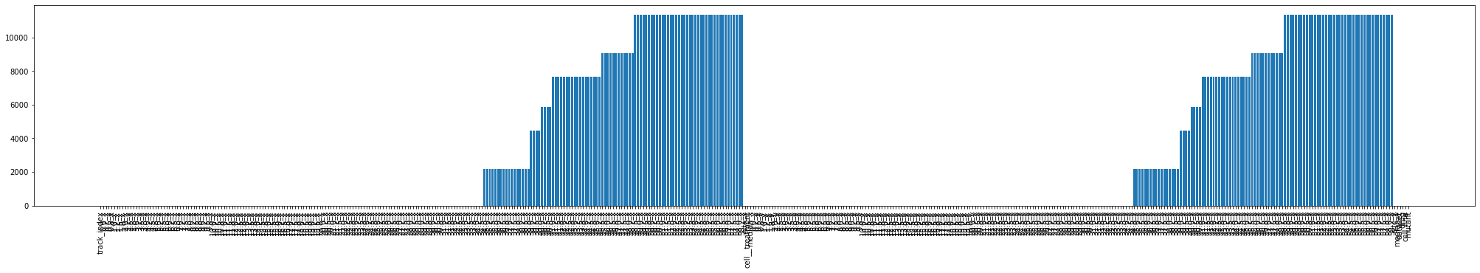
Data Pre-Processing, QC, Filtering
Using normalized data
Excluded time that has missing features across all treatment groups
Why is the data missing? Data is run for different lengths depending on when it is collected by the technician – arbitrary differences
Resampled time-series to length = 100
Clover time series 0-58 hours
Mscarlet time series 0-58 hours
# NAs

Slide 6
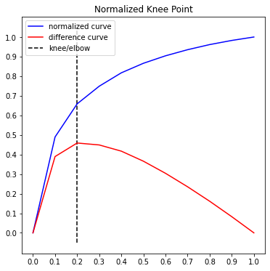
K-Means Time Series Clustering
Tslearn Package: https://tslearn.readthedocs.io/en/stable/index.html
Distance metric: Euclidean [options: DTW, DTW-soft, KernelKmeans]
Elbow plot suggests knee at around 4 – HOWEVER – experimentation shows better separation with greater # clusters:
Used K (# clusters) = 25

Slide 7
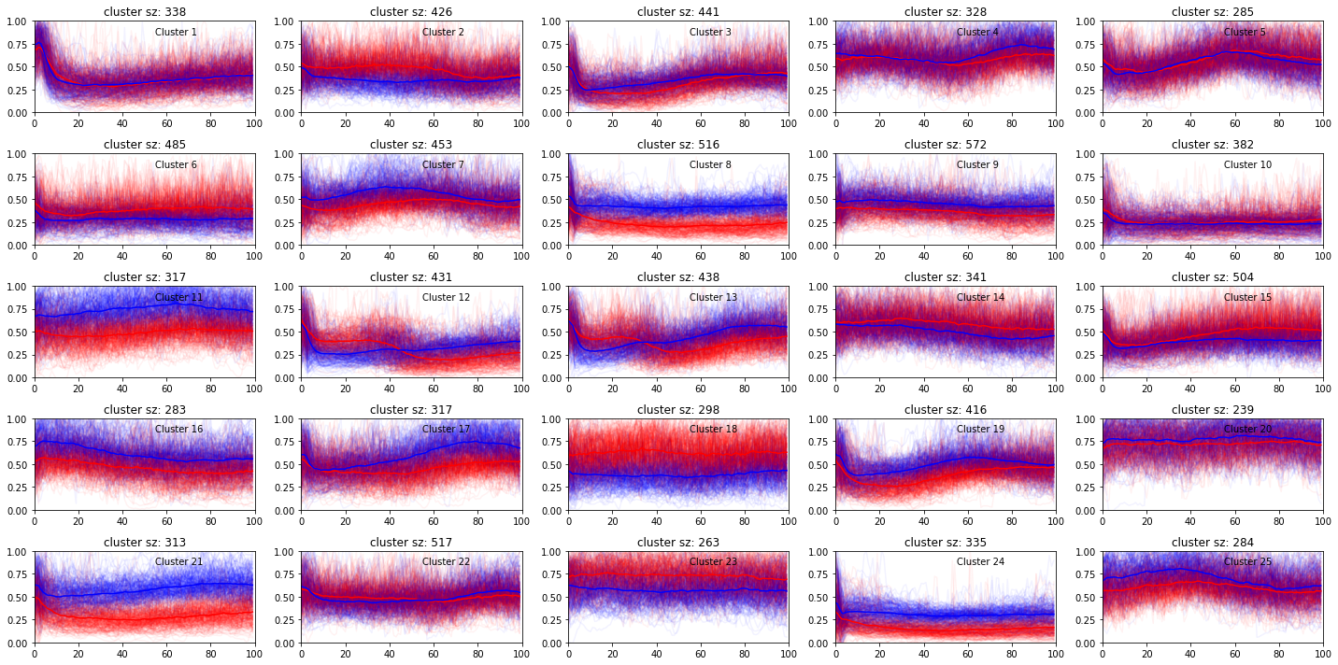

Slide 8
Experiment cluster proportion
Cluster 1
2. Quantify cluster proportion within experiment
Cluster 1 = 0.67
1. Assign clusters
Cluster 1
Cluster 2 = 0.33
Cluster 2

Slide 9
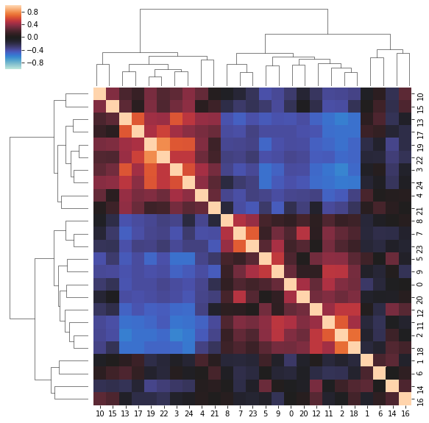
Feature Correlation
Pearson Corr.
Feature correlation suggests many of these clusters commonly co-occur within.
Could suggest that we’ve identified multiple clusters that are representative of smaller subset or dynamics (aka, too many clusters)
Cluster Label
Cluster Label

Slide 10
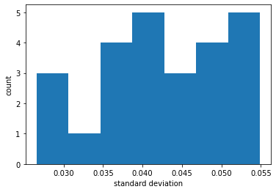
Feature Variance
Cluster variance is relatively similar across clusters
Potentially, could use this to select a subset of custers to use as down stream analysis
Not implemented

Slide 11
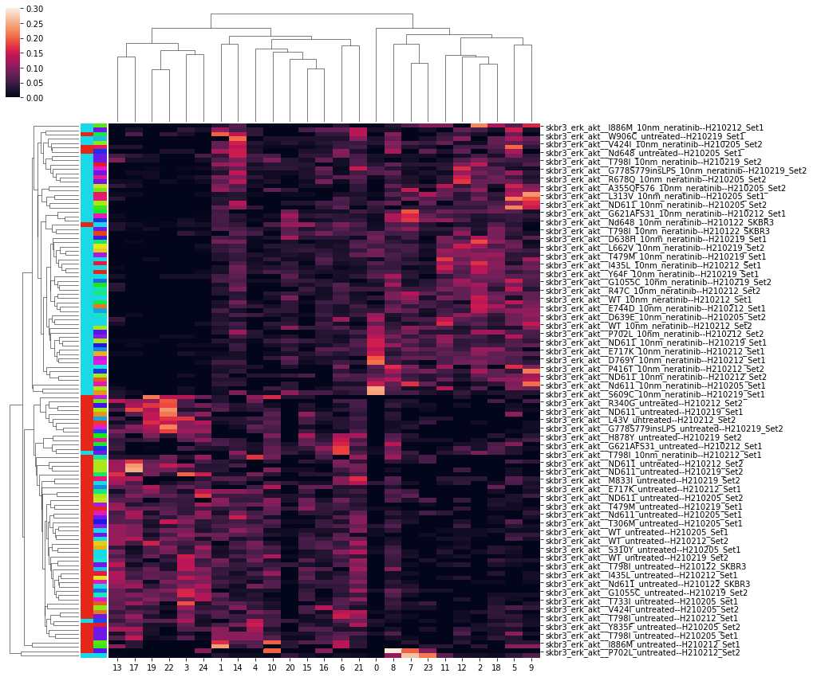
Cluster Proportion Heatmap
Treatment (Drug/untreated)
Mutant
Neratinib and untreated
All cell lines

Slide 12
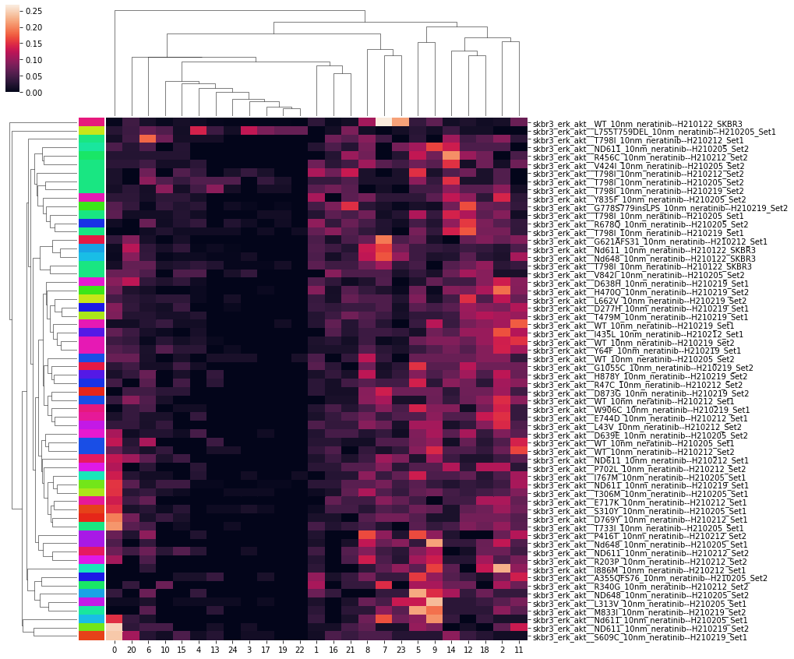
Cluster proportion heatmap (neratinib only)

Slide 13
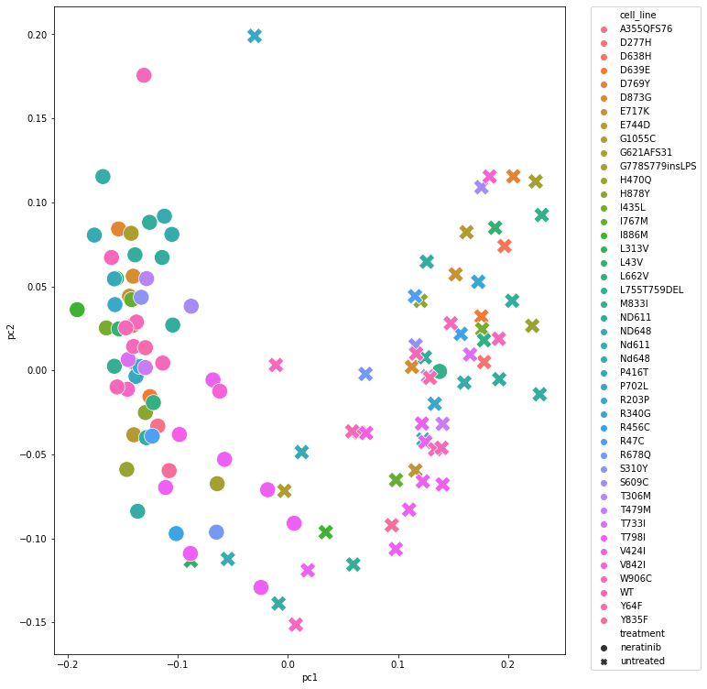
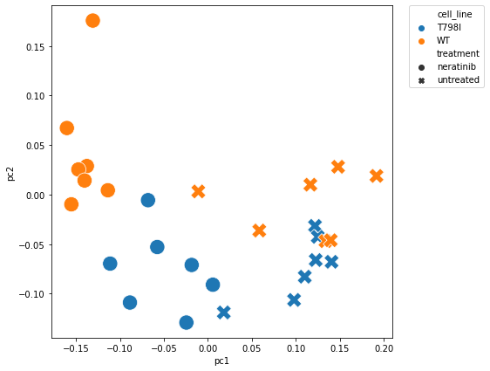
Dimensionality Reduction (PCA)
All Treatment Groups
explained variance ratio: [0.38 0.09]
Controls Only
Sensitive
Untreated
Resistant

Slide 14
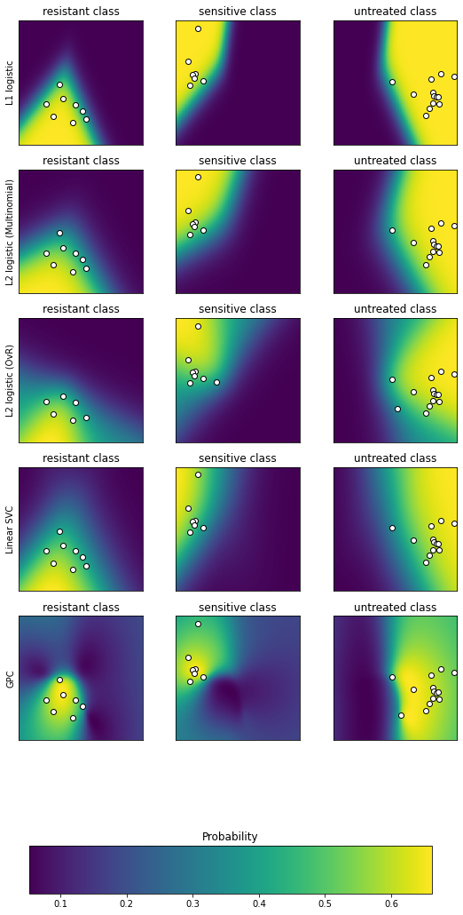
Classifier
Used 2 PC’s
Tried 5 Different classifiers
Chose Linear SVC to assign probs/calls

Slide 15
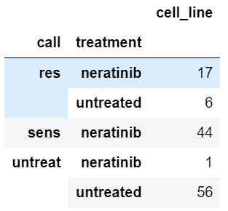
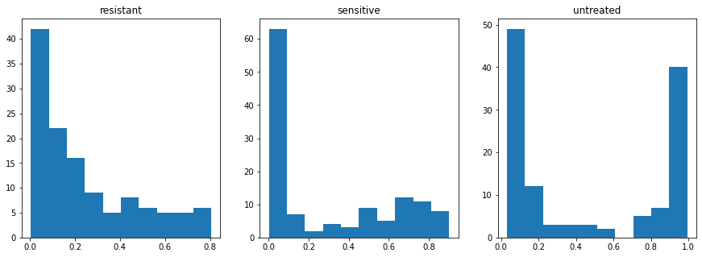
Sensitivity/Resistance Calls for all Treatment
Probability Predictions for All Treatment Groups

Slide 16
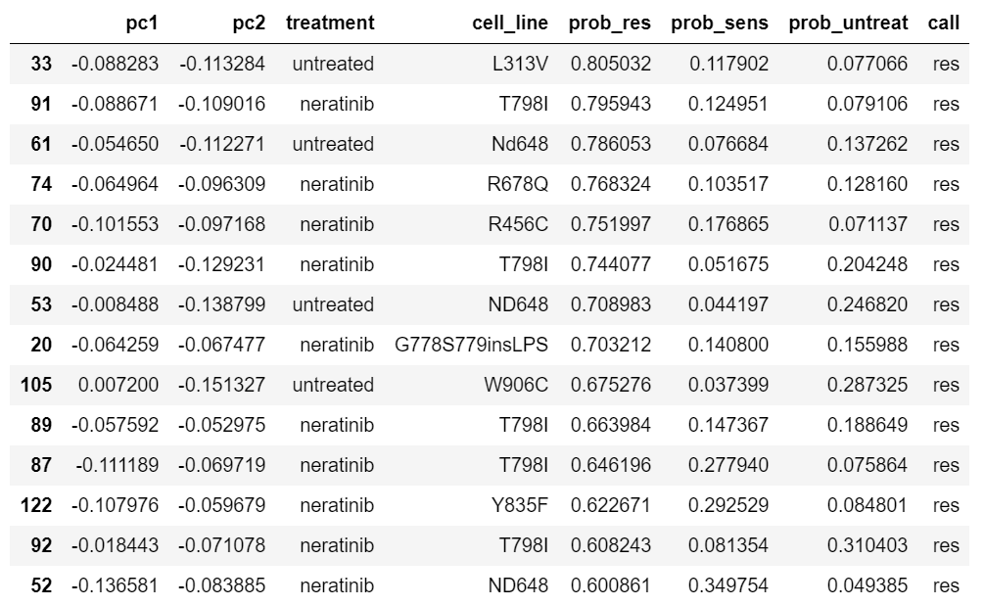
Resistant Calls (Sorted by prob. resistant)

Slide 17
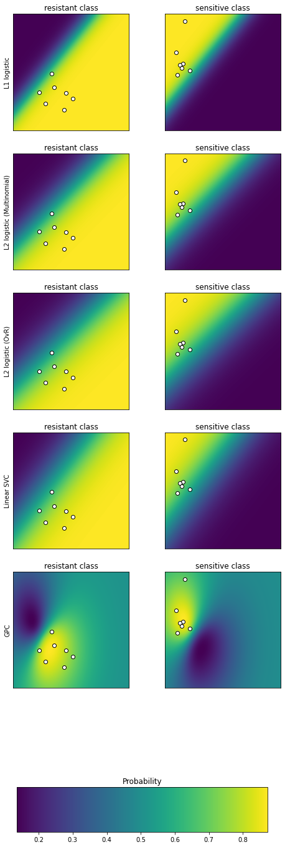
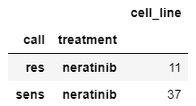
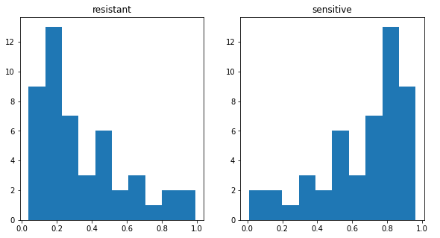
Sens/Res Classifier
Trained classifier on just neratinib (T798I=0 (res), WT=1 (sens))
Predicted classes on remaining neratinib samples (excluding WT, T798I)

Slide 18
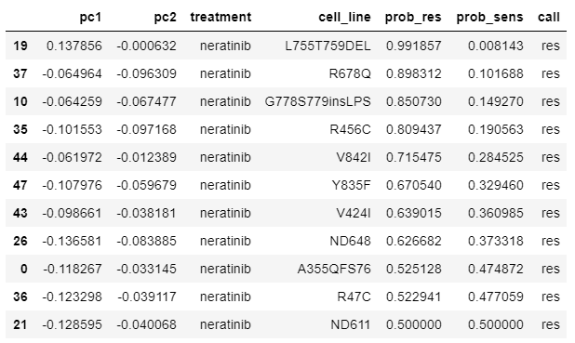
Resistant Calls
Sorted by probability (confidence)
From neratinib cluster proportion heatmap:

Slide 19
QC & Next steps
Sensitivity analysis: re-run this pipeline with various hyperparameters and compare how the calls change.
We can mitigate the issue of choosing the right number of clusters, etc, if we can show that the results are robust to a range of hyperparameters
Raw vs normalized
QC: are we seeing batch effects in these cluster-derived features?
Explore alternative feature extractions?
Shapelets
DTW metric in Kmeans
Kernel Kmeans
Viability data comparison.

Slide 20
Trastuzumab
We don’t have a positive control (resistant cell line) so we use the same supervised approach – we can! nd611.
Fall back: hierarchical clustering ?

