Slide 1
HER2 Project Making Sensitive/Resistant Calls Sensitivity analysis
Nate Evans, Aurora Blucher, Samuel Tsang
4/25/2021

Slide 2
Agenda
Resample example / overview
Sensitivity experimental setup
Results
Accuracy
PC explained variance
K-means inertia
Probability concordance
Call concordance
Model variance
Stable config parameters
Results of stable config parameters

Slide 3
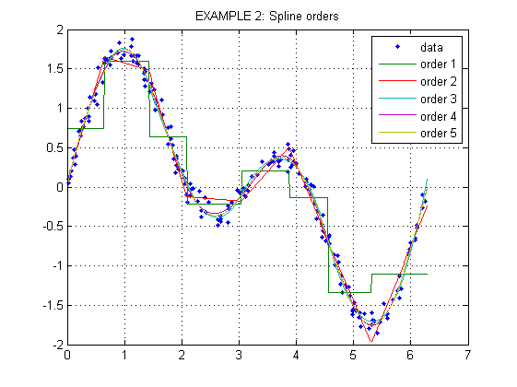
Tslearn TimeSeriesResampler
Uses scipy.interp1d
Type: “slinear” (spline of order 1)
Interpolation tutorial

Slide 4
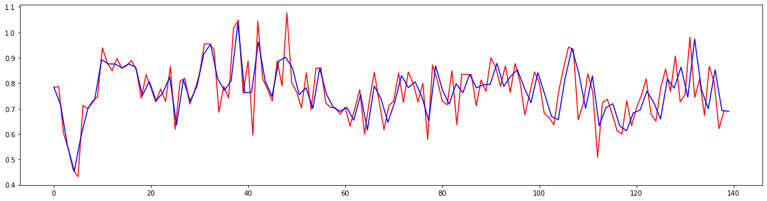
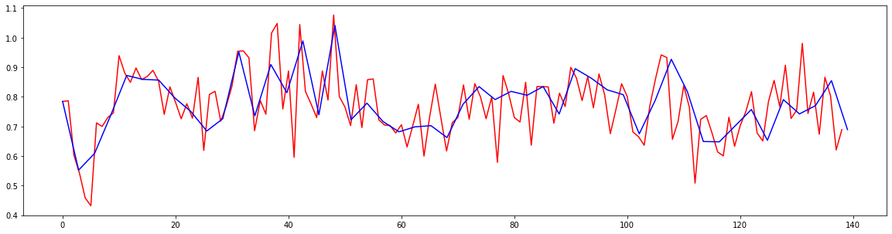
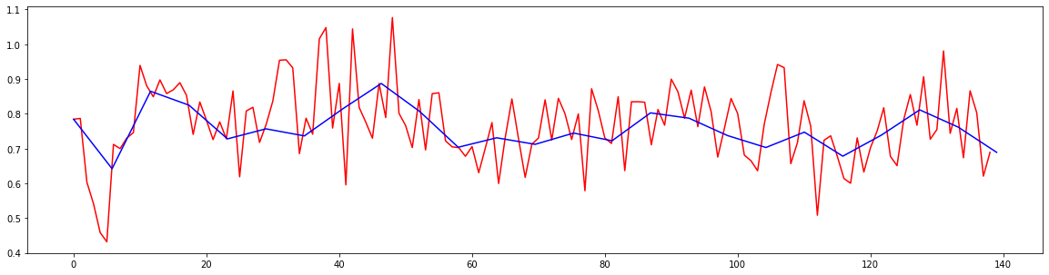
Resampling Example
Sz = 100
Sz = 50
Sz = 25

Slide 5
Sensitivity Experimental Setup
Grid Search
5 Replicates at each config. with random seeds
Config Params tested:
Clusters config: 2 3 5 10 15 25 35 45
Resampling size (time series length): 50 75 100 125 150
Data pre-processing: normalized or raw
Time to run ~ 8 hours.
For each experiment, random uuid assigned – output dir includes plots, classifier probability results and experiment results.

Slide 6
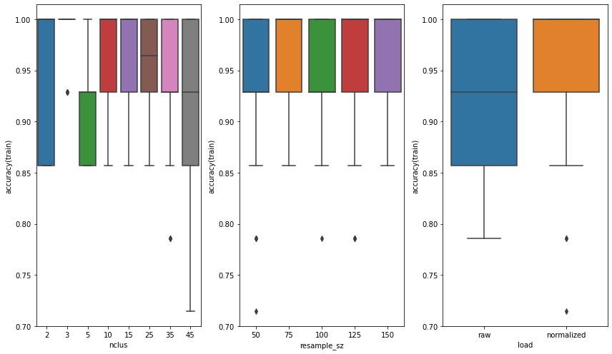
Sensitive/Resistant separability Training Accuracy

Slide 7
Sensitive/Resistant separability Training Accuracy
$$accuracy\left(train\right) \sim load+nclus+resample_sz$$
`normalized` had better accuracy
Higher number of clusters has better accuracy
Longer resample sizes have better accuracy
Variable | Coeficient | P-Value | Variable range
Intercept | 0.974441
load[T.raw] | -0.053883 | 1.289361e-26 | 0,1
nclus | 0.000462 | 4.042845e-03 | 2,45
resample_sz | 0.000098 | 1.416664e-01 | 50,150

Slide 8
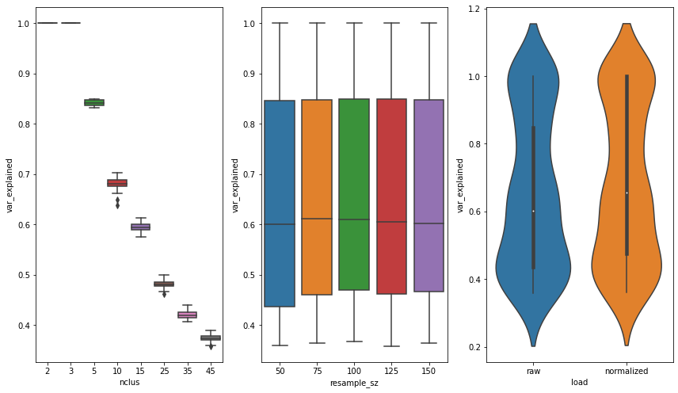
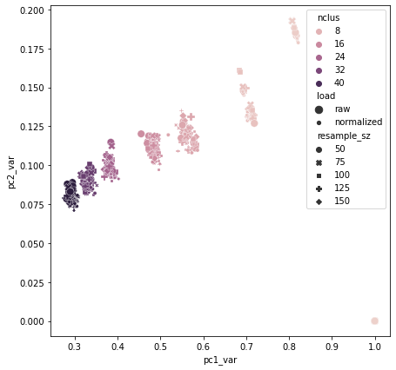
Dimensionality Reduction Explained variance

Slide 9
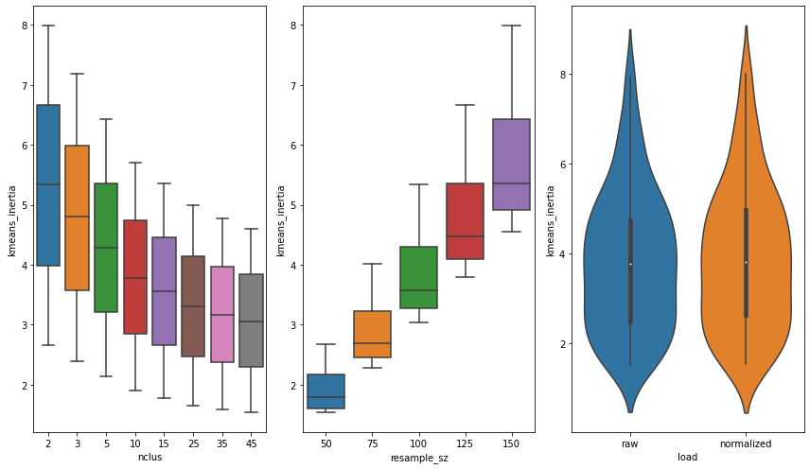
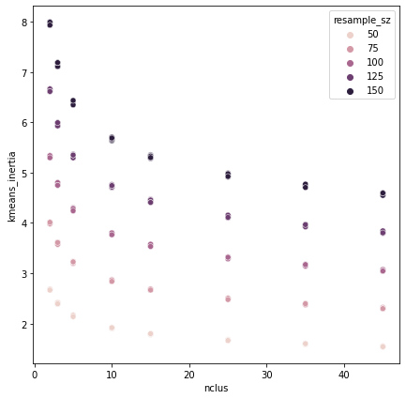
K-means Sum-of-squares (inertia)

Slide 10
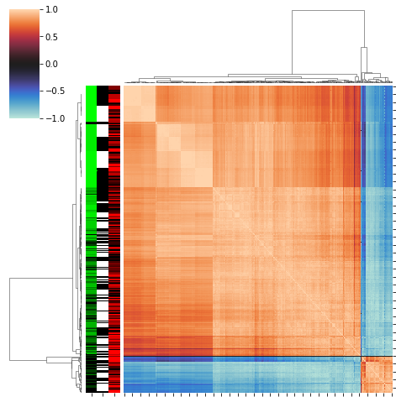
Probability Concordance
Pearson correlation between each experiment
Row label colors:
Green – nclusters (light green = few clusters)
White/balck – load (black = normalized)
Red – resample size (light red = shorter time series)

Slide 11
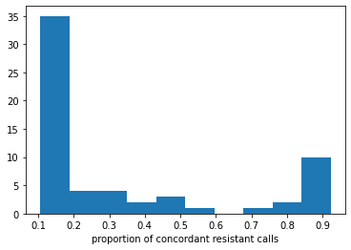
Call Concordance
7 cell lines have > 75% concordance of being called “resistant” (across ALL experiments)

Slide 12
Model Variance
Setup:
Filter to within replicates
Calculate pairwise Pearson corr.
Calculate sufficient statistics
Low-variance (stable) models would have perfect positive correlation
High-variance (instable) models would have high correlation variance and 0 or negative correlation.

Slide 13
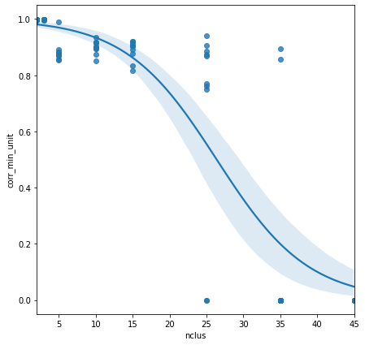
Model variance
Single-variate Logistic
$$corr_\min{\sim Logistic\left( nclus+load+resample sz\right)}$$
Variable | Coef. | CI (lower) | CI (upper) | Sig.
Intercept | 4.222236 | 1.429946 | 7.014527
load[T.raw] | -0.420407 | -1.919332 | 1.078518
nclus | -0.162454 | -0.229108 | -0.095800 | *
resample_sz | sz 0.002738 | -0.018269 | 0.023746

Slide 14
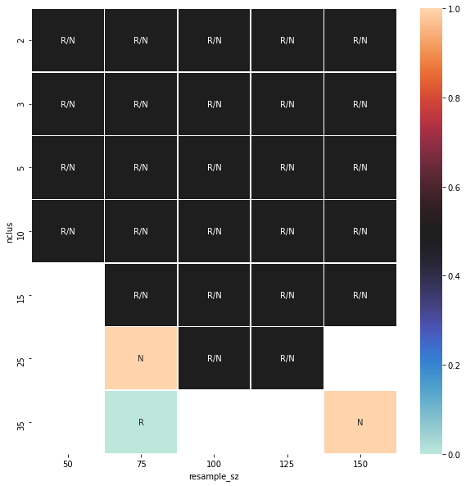
Stable Config. Parameters
config parameters with min_corr > 0.85
High number of clusters become unstable
‘raw’ seems to be slightly more stable

Slide 15
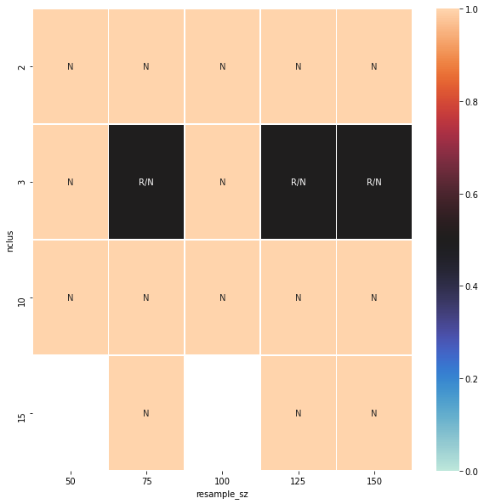
Configs with mean Accuracy == 1
Stable Configs

Slide 16
Recommended Config.
Resample size = 125
# clusters = 10
Pre-processing = ‘normalized’

Slide 17
Recommended config results
 | pc1 | pc2 | treatment | cell_line | prob_res | prob_sens | call
19 | 0.192402 | 0.028282 | neratinib | L755T759DEL | 0.992113 | 0.007887 | res
47 | -0.132126 | -0.104849 | neratinib | Y835F | 0.821855 | 0.178145 | res
10 | -0.097308 | -0.050594 | neratinib | G778S779insLPS | 0.809228 | 0.190772 | res
37 | -0.108749 | -0.060189 | neratinib | R678Q | 0.799327 | 0.200673 | res
35 | -0.146444 | -0.096237 | neratinib | R456C | 0.772686 | 0.227314 | res
0 | -0.177870 | -0.134597 | neratinib | A355QFS76 | 0.765428 | 0.234572 | res
44 | -0.104982 | -0.009760 | neratinib | V842I | 0.707474 | 0.292526 | res
43 | -0.120236 | -0.023194 | neratinib | V424I | 0.691320 | 0.308680 | res
25 | -0.206359 | -0.108004 | neratinib | ND611 | 0.614643 | 0.385357 | res
11 | -0.217978 | -0.111577 | neratinib | H470Q | 0.583697 | 0.416303 | res
26 | -0.177202 | -0.056971 | neratinib | ND648 | 0.583665 | 0.416335 | res

