Slide 1
CME Challenge
Nathaniel Laurent
August 13, 2024

Slide 2
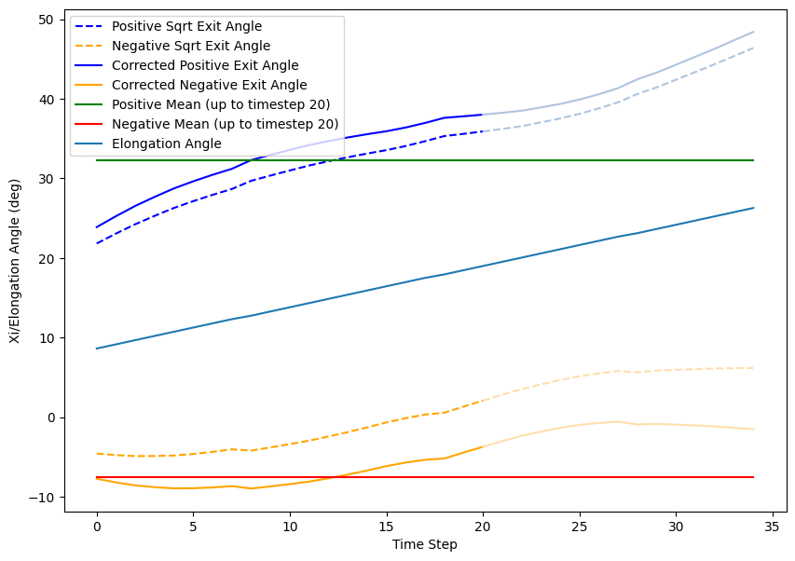
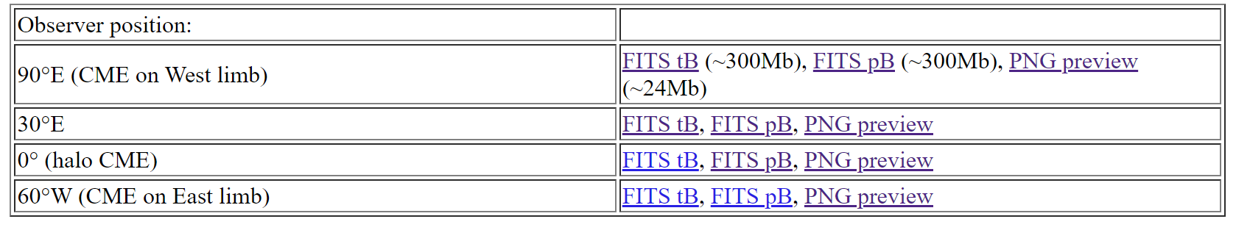
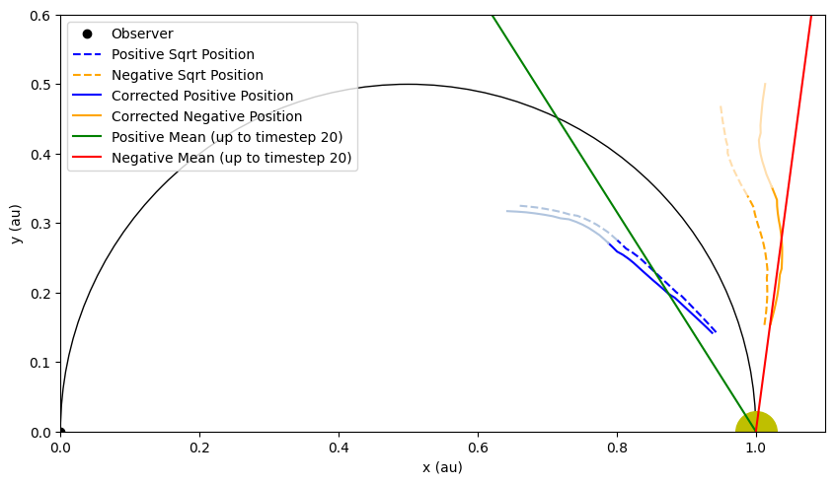
CME 0 (90°E)
Stats (from timestep 0 to 20):
Positive sqrt (blue):
slope = 0.70°/timestep
mean = 32.3°
Negative sqrt (orange):
slope = 0.20°/ timestep
mean = -7.6°

Slide 3
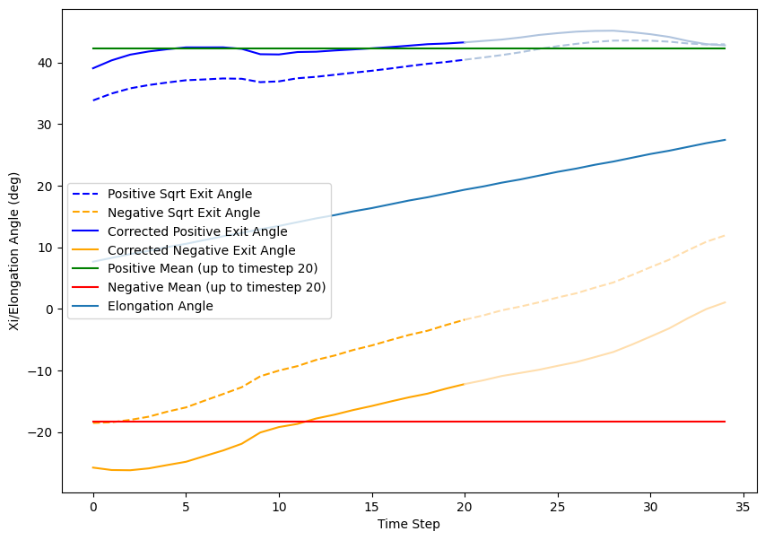
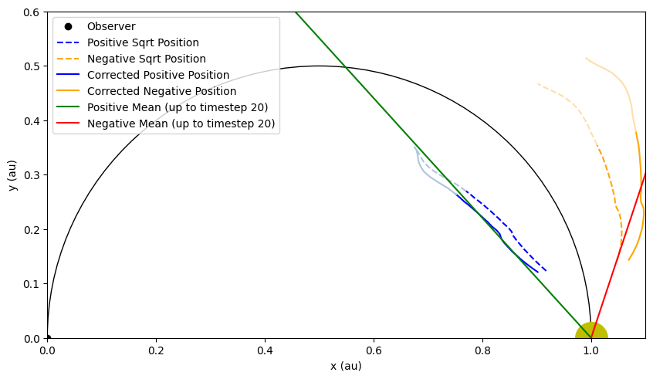
CME 0 (30°E)
Stats (from timestep 0 to 20):
Positive sqrt (blue):
slope = 0.05°/ timestep
mean = 42.2°
Negative sqrt (orange):
slope = 0.84°/ timestep
mean = -18.3°

Slide 4
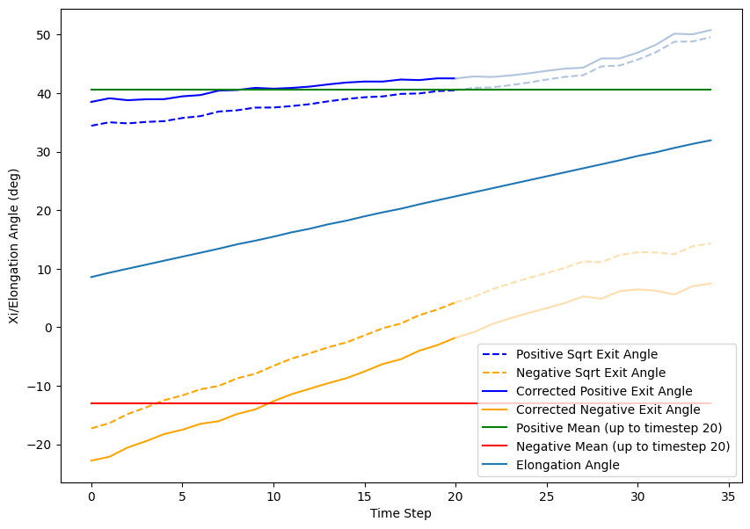
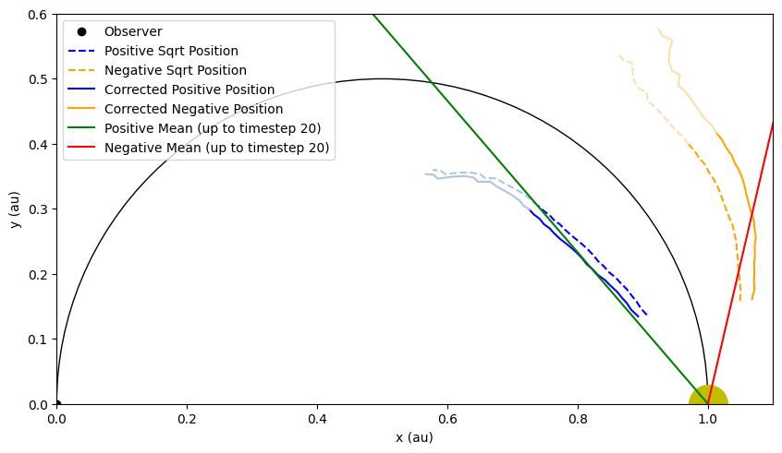
CME 2 (30°E)
Stats (from timestep 0 to 20):
Positive sqrt (blue):
slope = 0.22°/ timestep
mean = 40.6°
Negative sqrt (orange):
slope = 1.03°/ timestep
mean = -13.1°

Slide 5
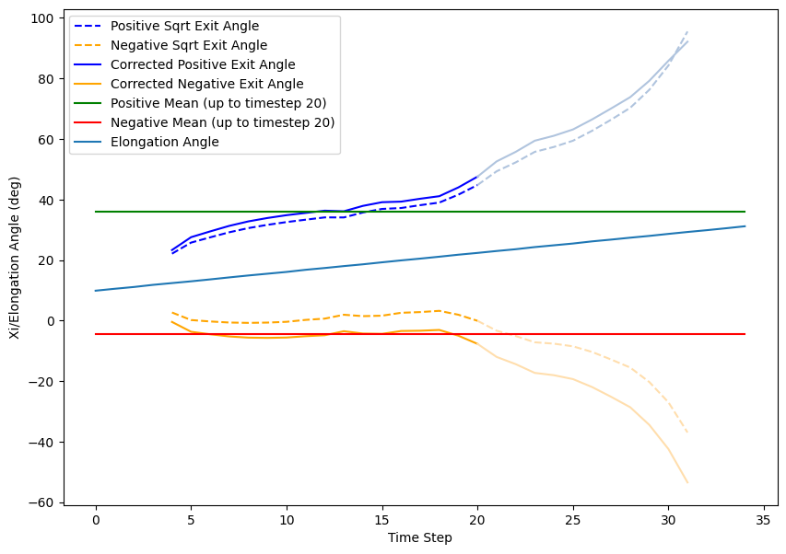
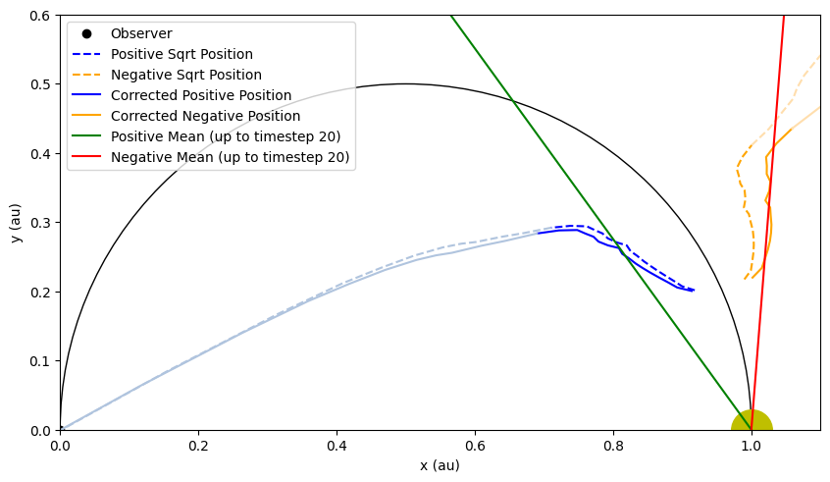
CME 3 (90°E)
Stats (from timestep 0 to 20):
Positive sqrt (blue):
slope = 1.00 °/ timestep
mean = 36.0°
Negative sqrt (orange):
slope = 0.09°/ timestep
mean = -4.5°

