Slide 1


“BHHAI: An Online Payment Portal System and Profiling for Brooklyn Heights Subdivision, Guiguinto,Bulacan”

Slide 2






TEAM STARTECHNOLOGIES
CLYDE T. CANAS
JOSELITO M. JUCAY JR
NATHANIEL A. MORAL
ROSECHELL R. SAN DIEGO
MIKE KEVIN A. UBAL
BSIT4H-G1

Slide 3
Overview
This project focuses on developing an online payment portal system for a homeowners association (HOA) to improve financial transactions and enhance community communication. The user-friendly platform will feature a Transparency Report that provides homeowners with detailed financial insights, including payment history and outstanding balances, promoting trust in the HOA. User Profiling will allow homeowners to maintain accurate profiles, while a secure Payment System will facilitate various payment methods for efficient processing. The system will also send reminders to encourage timely payments and track overdue amounts.

Slide 4
GENERAL OBJECTIVE
01
The study aims to create an online payment portal for a homeowners association (HOA) that makes financial transactions easier and improves communication within the community. The goal is to offer features like transparency reports, so homeowners can see where their money is going, as well as user profiles for better account management. It will also have a secure payment system, reminders to help people pay on time. Overall, the study seeks to build trust among homeowners and encourage more active participation in community life.

Slide 5
SPECIFIC OBJECTIVE
01
To implement user authentication and profile management to ensure secure access for homeowners
To develop a reliable payment system that enables residents to pay HOA fees conveniently and securely
To create a profiling system that organizes and manages homeowner information effectively
To provide a notification feature for delivering timely announcements and updates about HOA activities and agendas

Slide 6
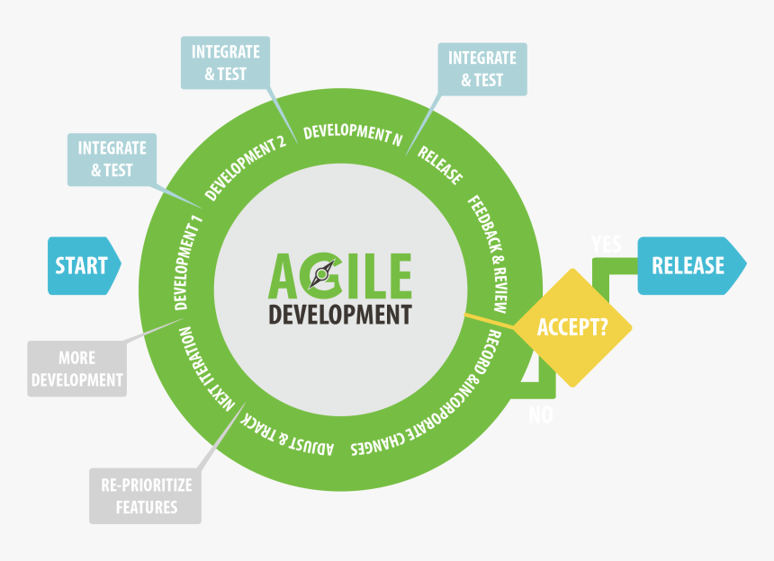
METHODOLOGY
01

Slide 7




01
Software Development tools used:
Visual Studio
is Microsoft’s software for coding and debugging applications. It supports many programming languages, has tools to make coding easier
XAMPP
It acts as a local server and a real time server in the system. Its main use is it acts as a database with the use of phpMyAdmin.
Laravel
Laravel is a PHP framework for building web applications. It offers tools and libraries to simplify tasks like routing, authentication, and database management, making development faster and more efficient.
React.js
React.js is a JavaScript library for building fast, interactive user interfaces using reusable components

Slide 8




Results
01
Respondents of the evaluation
IT Expert: 31.03%
IT Students: 17.24%
Students: 27.59%
Homeowners: 24.14%

Slide 9

Results and discussion
01
5.0
Functionality
4.8
Reliability
4.6
4.4
Usability
4.2
4
Maintainability
3.8
Portability
3.6
3.4
Training and Documentation
Mean Distribution of Expert Respondent Rating

Slide 10
Thank You

