Slide 1

NumberLand Tutoring System
Presentation by Nathaniel Raley 2nd year graduate student – Dept. of Ed. Psych
“Supplying students with their own automated tutor, capable of finely tailoring learning experiences to students' needs, has long been the holy grail of teaching technology”
-McArthur and Lewis, 1998
Notes:
<number>

Slide 2
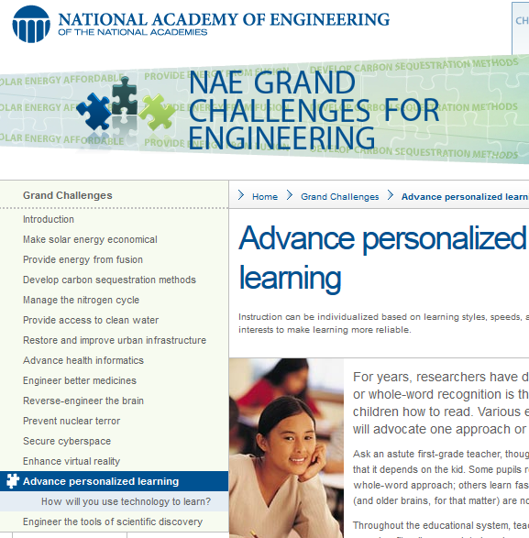
Personalized learning is one of the
National Academy of Engineering's 14 “Grand Challenges”
http://www.engineeringchallenges.org/cms/8996/9127.aspx
Notes:
<number>

Slide 3
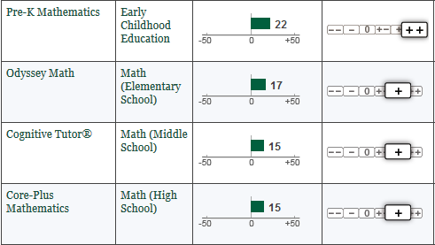
What Works Clearinghouse
An ITS (Cognitive Tutor) comes in at 5th most effective out of all 37 math interventions,
easily meeting the WWC standards of evidence.
That's an average increase of 15 percentiles compared to control, with no contrary evidence!
http://ies.ed.gov/ncee/wwc/findwhatworks.aspx
Notes:
<number>

Slide 4
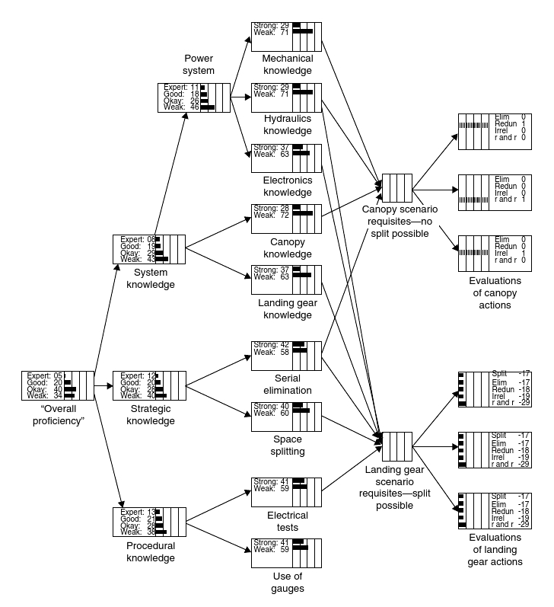
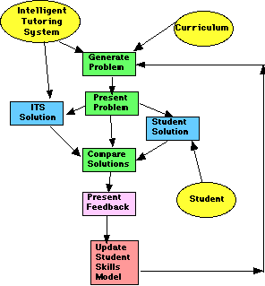
Simple Diagram
Complex Diagram
Notes:
<number>

Slide 5
Active Learning & Problem Solving
Problem solving domains are where ITSs really shine!
Reduce cognitive load, taking problems step-by-step and emphasizing important points
“Guidance fading effect” (help provided at first, then gradually reduced)
“Expertise reversal effect” (differential outcomes for low- vs. high-ability students)
- e.g., examples before vs. after the problem
Effective Feedback
Provides crucial information for correcting misconceptions or inappropriate strategies
-immediate feedback increases rate of learning by 3x over delayed feedback
Computerized feedback can be more effective than non-computerized feedback
(Baumeister et al., 1990)
Can modify a learner's goal orientation, topic self-concept, and view of intelligence
-reinforce the idea that ability/skill is developed through practice, effort, and mistakes
(Narciss, 2004)
Notes:
<number>

Slide 6

MathLand (my c++ proj.)
Influenced by Mathnasium techniques & Common Core guidelines
Students read brief explanation of a given technique
Then, math problems randomly generated to practice technique
Students can request hints and view their progress
Mastery criteria to advance: - 95% correct overall
- average time/question < 5s
- at least 15 question attempts
Final quiz → Unlocks advanced play (rand()%100)!

Slide 7
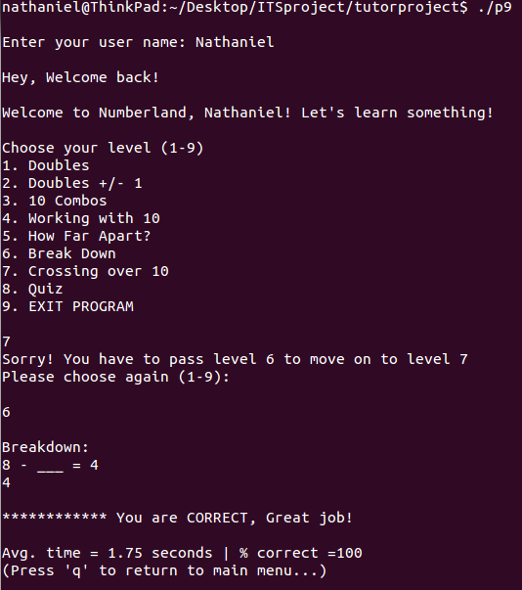
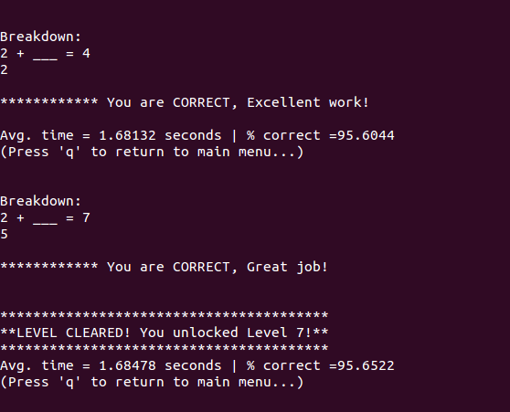

Slide 8
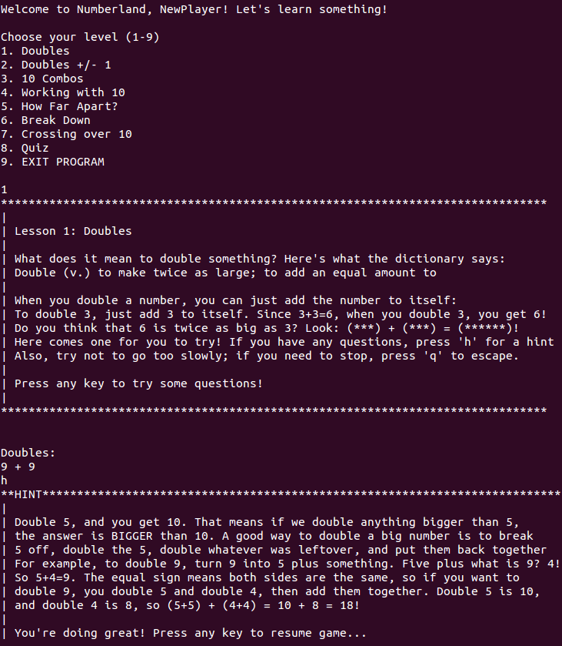

Slide 9
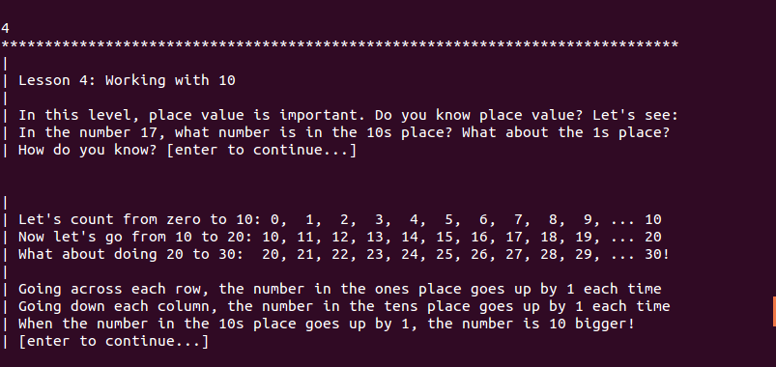
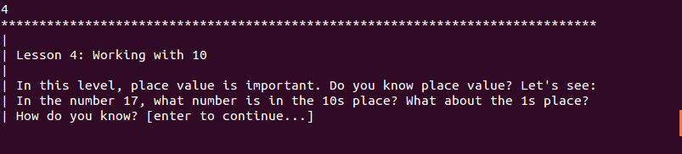
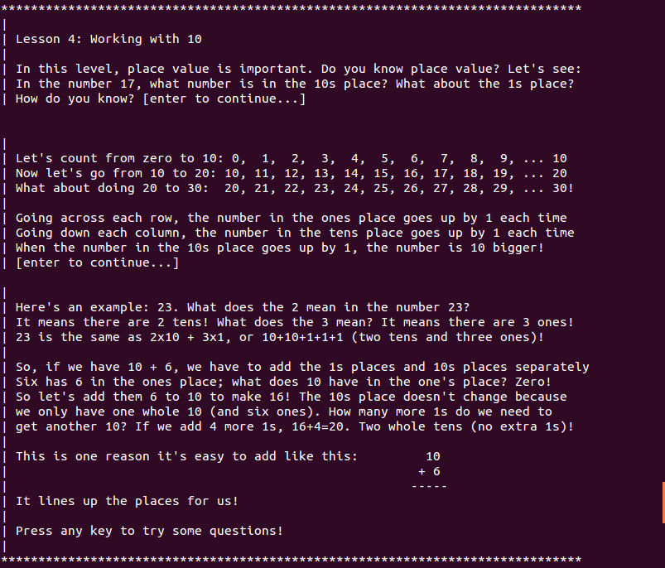

Slide 10
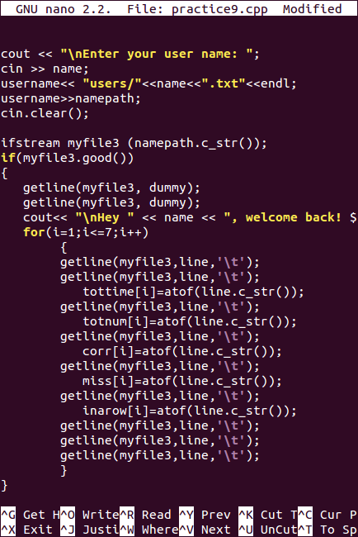
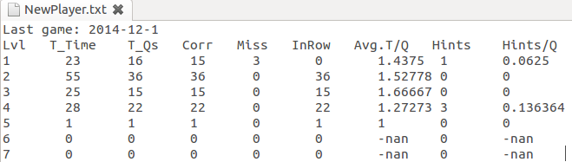
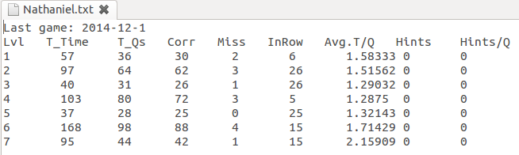
Examples of output files:

Slide 11
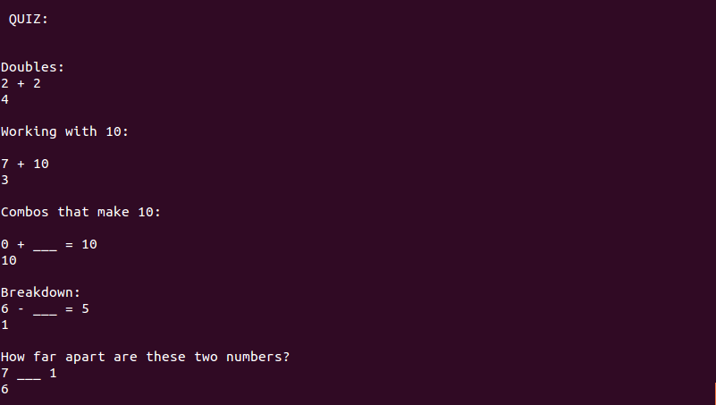

Quiz:
Quiz pass criteria: two of every question type correct without any errors...

Slide 12
MathLand
Students log in with a username; creates personal user file
Data is collected for each level of the game: ...# of questions attempted, # correct, # of hints, time/question
All data written to student's file; past data loaded at login
Data piped to gnuplot within the game to view personal stats
Tried really hard to build a gui using gtkmm (gkt+ for c++)
...wasted a lot of time; hard to do anything beyond basic widgets
Here's a demo: http://youtu.be/LXJsV_mMI7g

