Slide 1
Configuration files for each network device

Slide 2
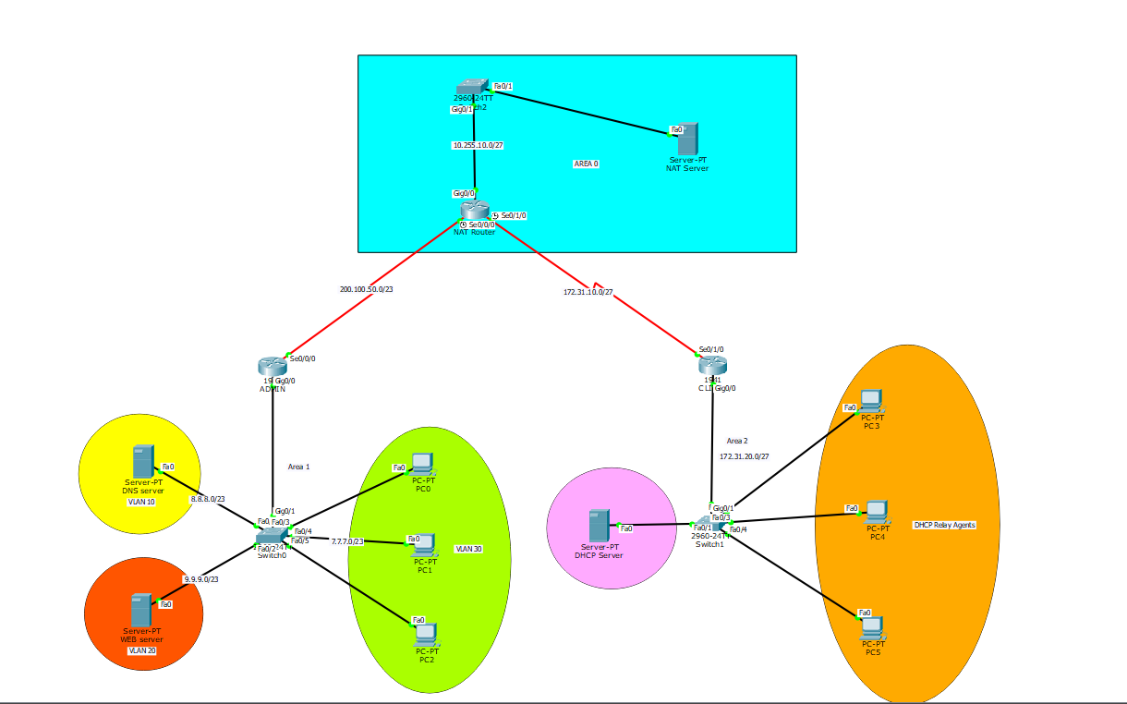
Star Topology Overview

Slide 3
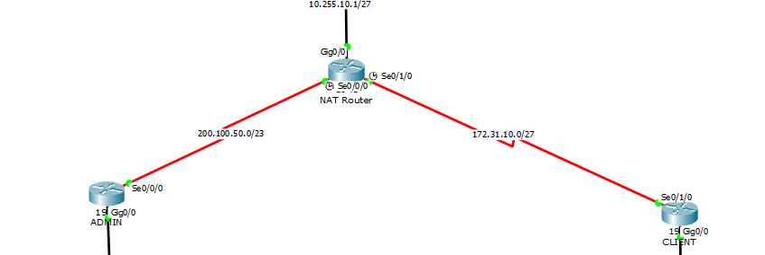
Connect Every Router and Network Using OSPF Protocol

Slide 4
Security
Secures remote access to the NAT Router by using SSH with strong encryption, and it also implements Access Control Lists (ACLs) to limit who can access the device.
Line con 0 controls local access through the console port, securing physical interaction with the device.
Line vty controls remote access, ensuring that only authorized users can manage the device over the network and with secure protocols like SSH.
NAT also hides internal IP addresses from the public network, providing an extra layer of security.

Slide 5
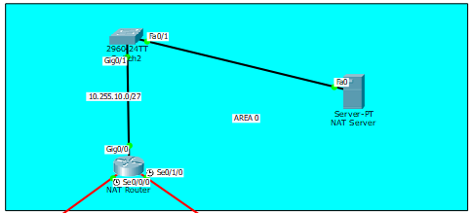
Enabling SSH with ACL to ensures that only authorized users from specified networks can access the NAT Router
10.255.10.0/27 is the only allowed network to configure NAT Router

Slide 6
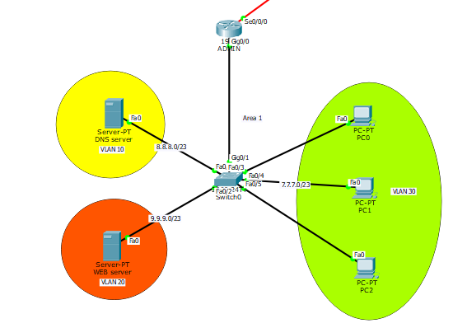
Handle inter-VLAN traffic using Router on stick inter-VLAN routing
DNS Server: VLAN 10
WEB Server: VLAN 20
Multiple PC: VLAN 30

Slide 7
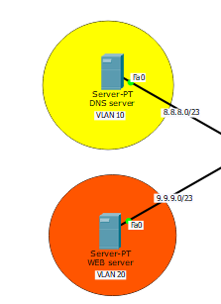
Enable DNS to associate the web server services with a domain name instead of using the IP address.
Enable DNS to associate the web server services with a domain name instead of using the IP address.
Enable the ability to ping web.com or search for it in a web browser from any PC device who have dns server ip address

Slide 8
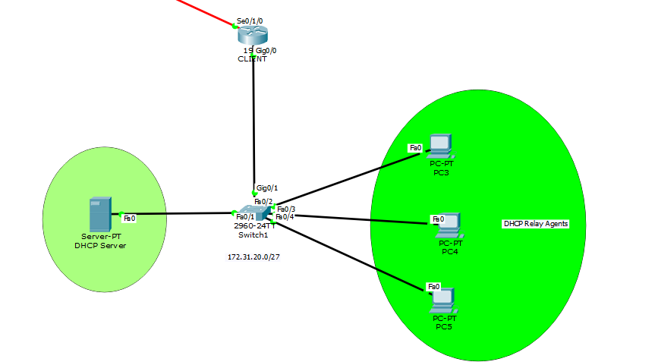
Implement DHCP server pool with relay Agents

Slide 9
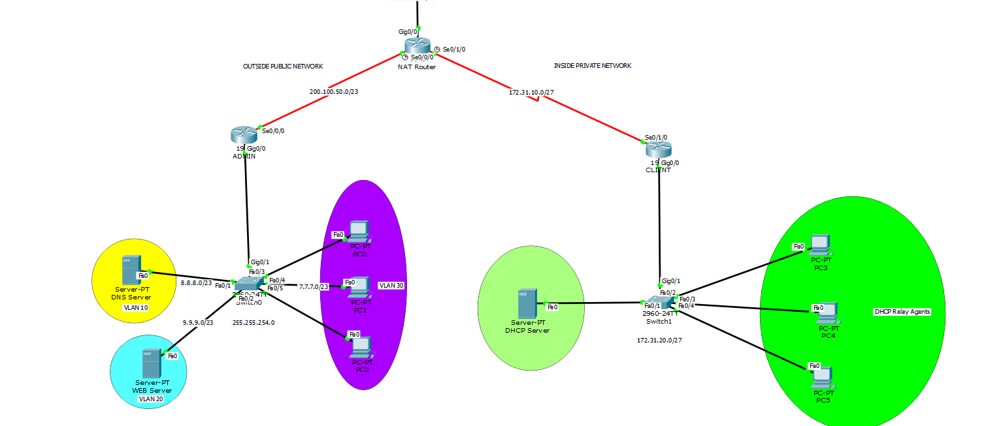
Translate Private network to Public Network using NAT Configuration

