Slide 1
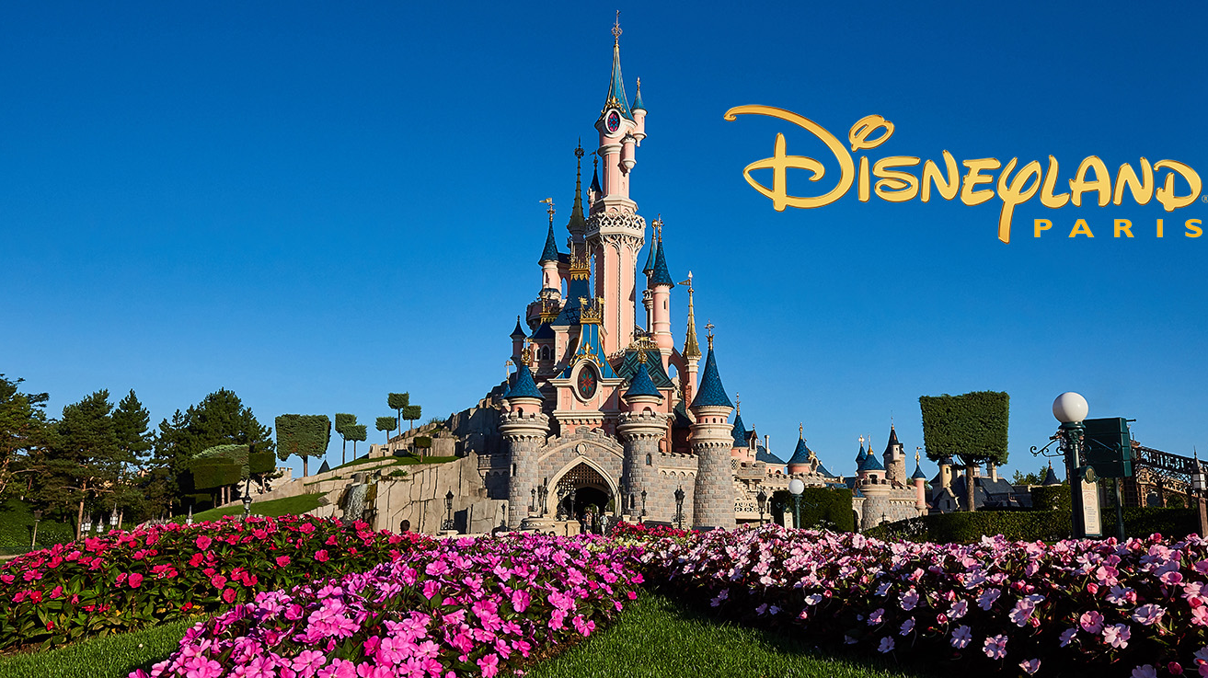
Facebook reviews of disneyland, paris
BAN 675 - Text Mining Project
Sona Nathani
Dated : 11/30/2018

Slide 2
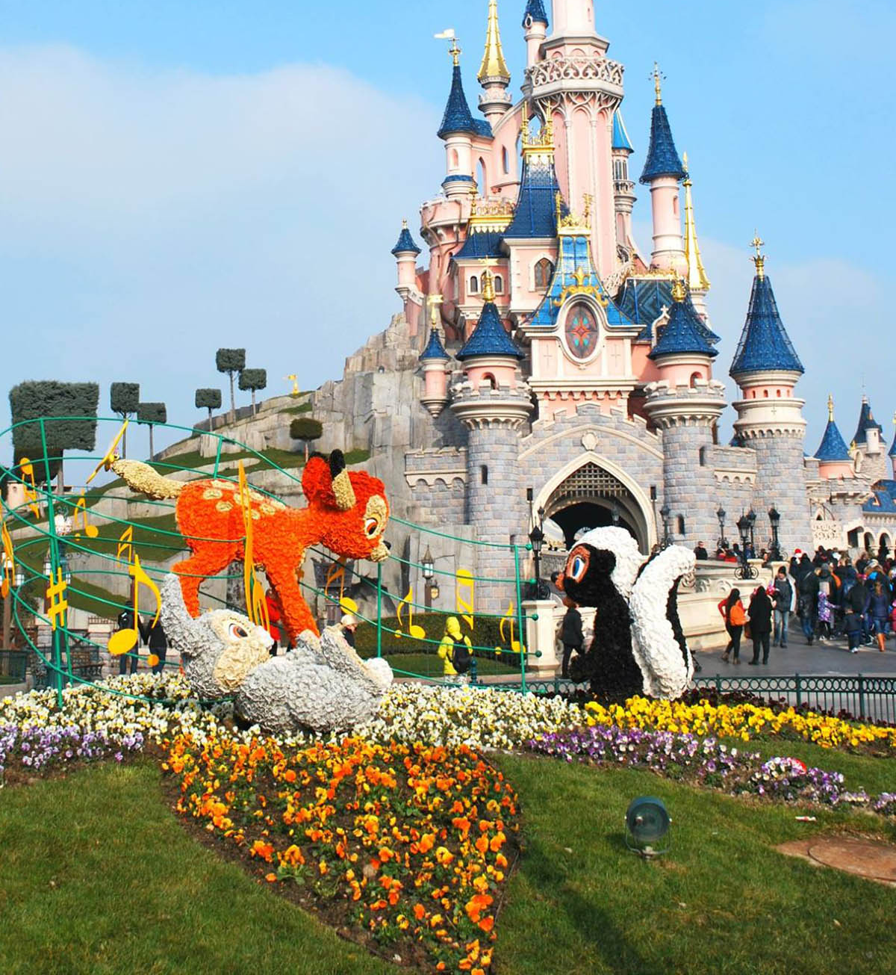
INTRODUCTION
What is the Project?
We are analyzing Disneyland Paris’s Facebook reviews.
The reviews are provided in different languages, but we are analyzing only English Language reviews.
Why?
Analyze the actions based on positive reviews.
Introspect all the negative reviews.
How?
We are using Text Mining methods like sentiment analysis to review its ratings, classification, visualization of positive and negative reviews.
We are producing word cloud to determine the frequency of words used in the reviews and to measure the positivity and negativity of the reviews.

Slide 3

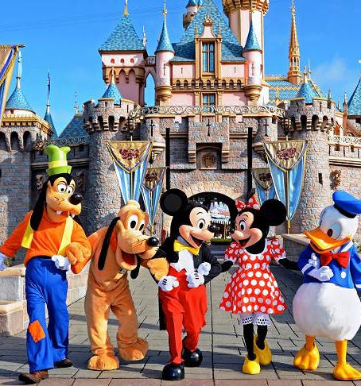
ABOUT DATA
Data from Disneyland Facebook Page by Kaggle.
UserID, Review, Stars, Date_format, Time_of_day, Hour_of_day, Day_of_week, Review_format, Review_lang, Month_year, Review_len, Review_nb_words.
Used ‘review_lang’, 'stars','review_format’, 'review_len’, 'review_nb_words’ for analysis of reviews.
Total number of English Reviews: 2394.

Slide 4
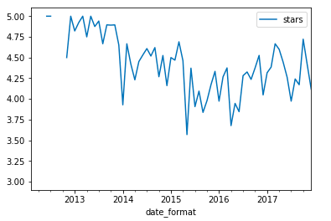
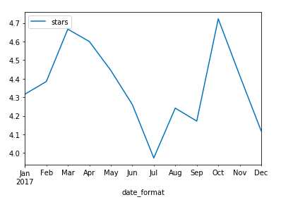
DATA VISUALIZATION
Fig 3 – Number of reviews for the last 5 years
Fig 1 – Star Rating
Star Ratings (1-5)
Fig 2 - Average number of words in review comments vs star rating
Fig 4 – Number of reviews for the last year

Slide 5

Research Methodology
Method 1: Sentiment Analysis
Method 2: Text Classification
Method 3: Topic Modelling

Slide 6
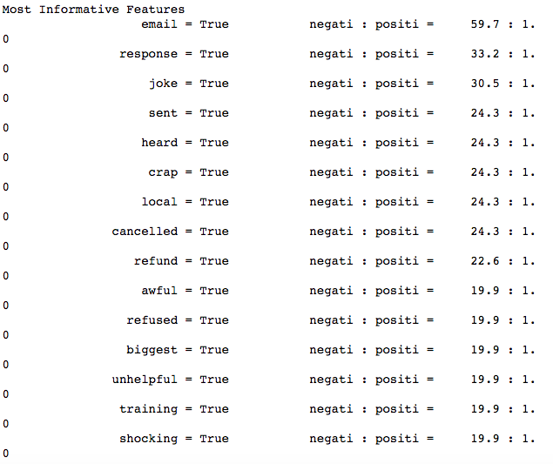
SENTIMENT ANALYSIS
TEXT CLASSIFICATION
Positive reviews(stars>=3)
Negative reviews(stars<=2)
Accuracy of positive reviews: 87.72%
Accuracy of negative reviews: 60.46%
Accuracy: 86.43%

Slide 7
Most liked things about Disneyland
TOPIC MODELLING AND CONCLUSION
Visitor's found Disney’s hotel stay amazing.
Christmas Day Parade and show were liked by many.
Disney characters and rides were great.
Fun experience for kids as well as for adults.
Fig 5 - Clusters from LDA model

Slide 8

Problems faced by Visitors
Long waiting time in the queue.
People have issues with co-visitors smoking within the park premises.
Rude staff.
Complaints about Food.
Fig 6 - Clusters from LDA model

Slide 9
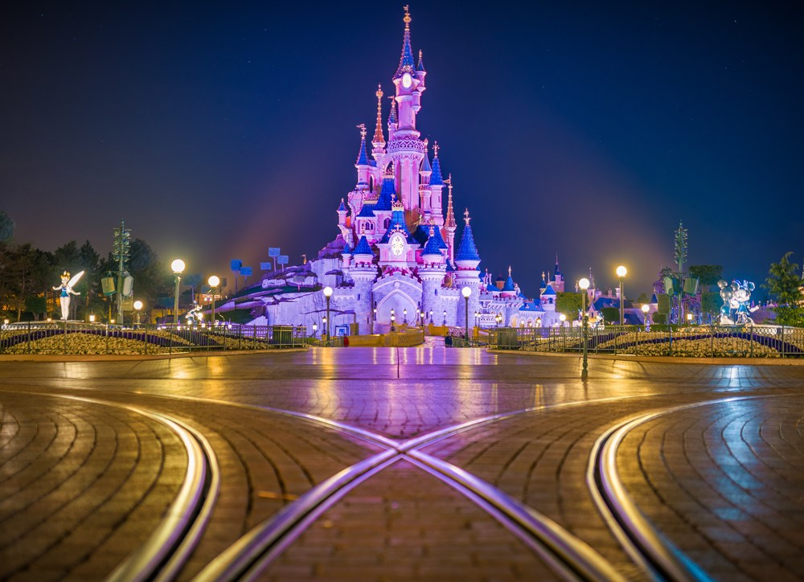
THANK YOU!

