Slide 1
School orchestra data base
SEOUNGYOON LIM

Slide 2
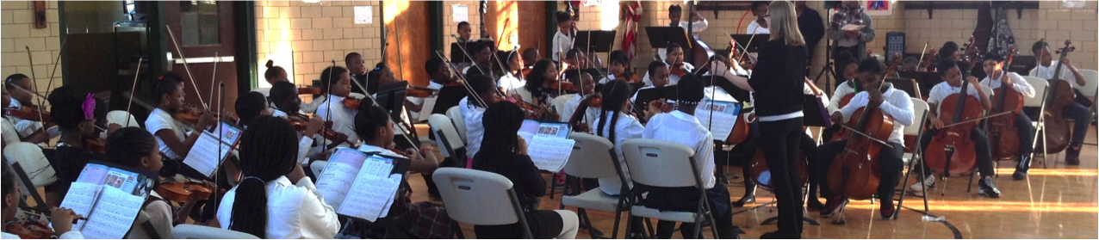
background
An orchestra program has just started at an elementary school in Bronx
To encourage students’ practice, the teacher adapted level-belt system
When students pass a certain level test, they will get a belt(colored yarn) to tie proudly on their instruments’ case.
There are ten kinds of belts(white, yellow….gold), each belt shows their level of playing instrument

Slide 3
The teacher wants
To retrieve the instrument distribution and report periodically the levels of the students to the principal
To make diverse classrooms to participate into the orchestra
To stack database of songs fitting to each level
To figure out students who need extra help or practice

Slide 4
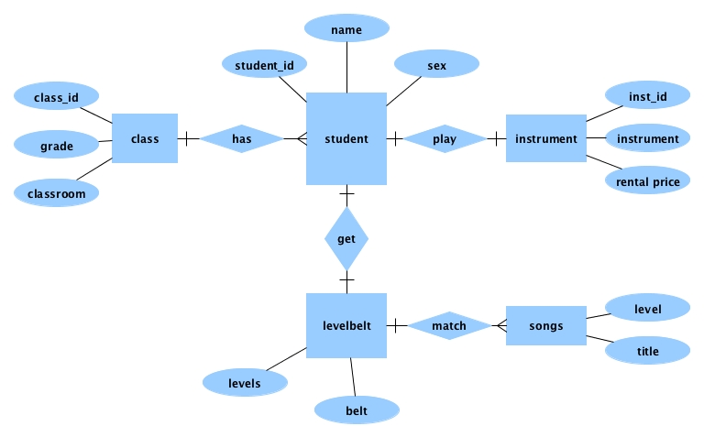
Entity relationship diagram

Slide 5
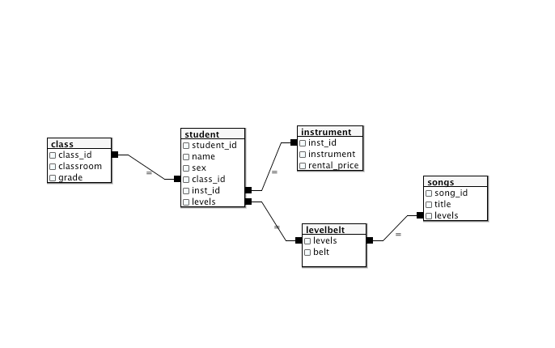
Entity relationship diagram2

Slide 6
Possible extension
We can add the below to the database,
Student Attendance Data, so that the teacher can check the rate of the students’ attendance
Students’ family income Data, so that the teacher can see whether the rental prices of instrument are affordable. This might be the reason that other student can not join the orchestra
Songs for music competition Data, and connect to “Songs table”, so that students can get the level belt and also prepare a competition

Slide 7
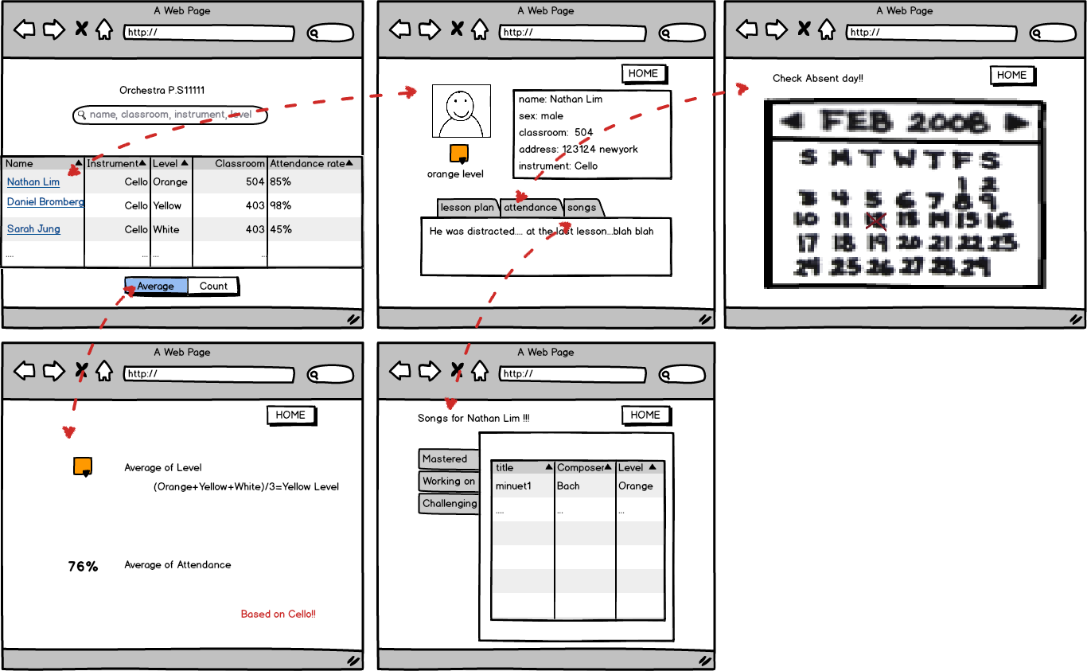
User Interface

