Slide 1

FREDY MACK LOGO
Rollover
buttons
Home
About Us
Gallery
Contact Us
Heading 2 (25 px, Black, Verdana)
HEADING 1 (32 px, Black, Bold, Verdana)
Heading 3 (20px, Black, Verdana)
Paragraph (18px, Black, Verdana)
Picture (of van)
Boarder size = 4px
Boarder colour = #CC0000
Border background colour - #FFFFFF
Background - #FFFFFF

Slide 2
Rollover
buttons
Home
About Us
Gallery
Contact Us
FREDY MACK LOGO
Heading 2 (25 px, Black, Arial)
HEADING 1 (32 px, Black, Bold, Arial)
Heading 3 (20px, Black, Arial)
Paragraph (18px, Black, Arial)
Boarder size = 4px
Boarder colour = #CC0000
Border background colour - #FFFFFF
Background - # #FF0000

Slide 3
FREDY MACK LOGO
HEADING 1 (32 px, Red, Bold
Heading 2 (25 px, Black, Times New Roman)
Heading 3 (20px, Black, Times New Roman)
Home
About Us
Picture (of van)
Gallery
Paragraph (18px, Black, Times New Roman)
Contact Us
Rollover
buttons
Background - #FFFFFF
Boarder size = 4px
Boarder colour = #CC0000
Border background colour - #FFFFFF

Slide 4
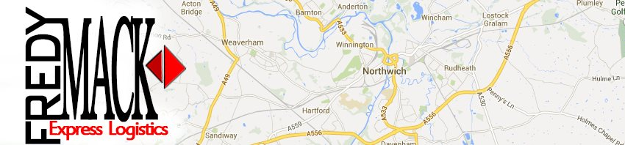
Home
About Us
Gallery
Contact Us
Home
FREDY MACK!
Small enough to cope, Small enough to care.
We are a dedicated delivery company that totally doesn’t suck, sure I may just be one guy who says we to make it sound like the company is actually bigger than it is, but everyone does it! It’s called business. Anyway this will be a short description of the company.
Picture (of van)
Google Chrome map to show where the business it located??

Slide 5
Home
About Us
Gallery
Contact Us
About Us
FREDY MACK!
On Time. Every Time.
We are a dedicated delivery company that totally doesn’t suck, sure I may just be one guy who says we to make it sound like the company is actually bigger than it is, but everyone does it! It’s called business. Anyway this will be a short description of the company.
More words about starting up, talking bout the company, the history, etc…
Picture (of van)

Slide 6
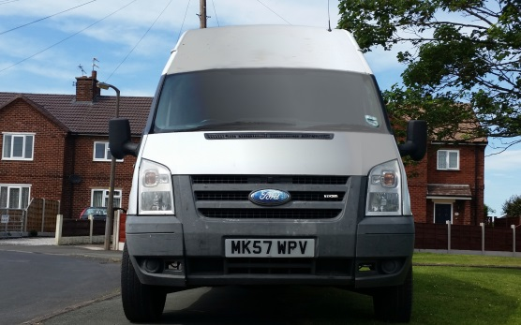
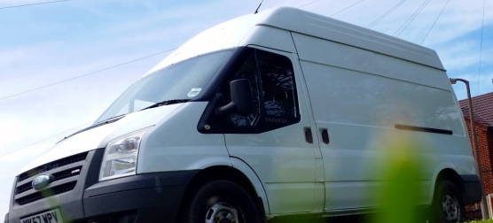
Home
About Us
Gallery
Contact Us
Gallery
FREDY MACK!
Small enough to cope, Small enough to care.
Words describing the vans
Picture (of van)
Words describing the vans

Slide 7
Home
About Us
Gallery
Contact Us
Contact Us
FREDY MACK!
We Care.
If you wish to contact us about any matters involving deliveries, jobs or problems, please contact us in any of the following ways…
Google Chrome map to show where the business it located??
Picture (of van)
Name: Fedy Mack
Home: 01606 ### ###
Phone: 07#########

